Slide 1
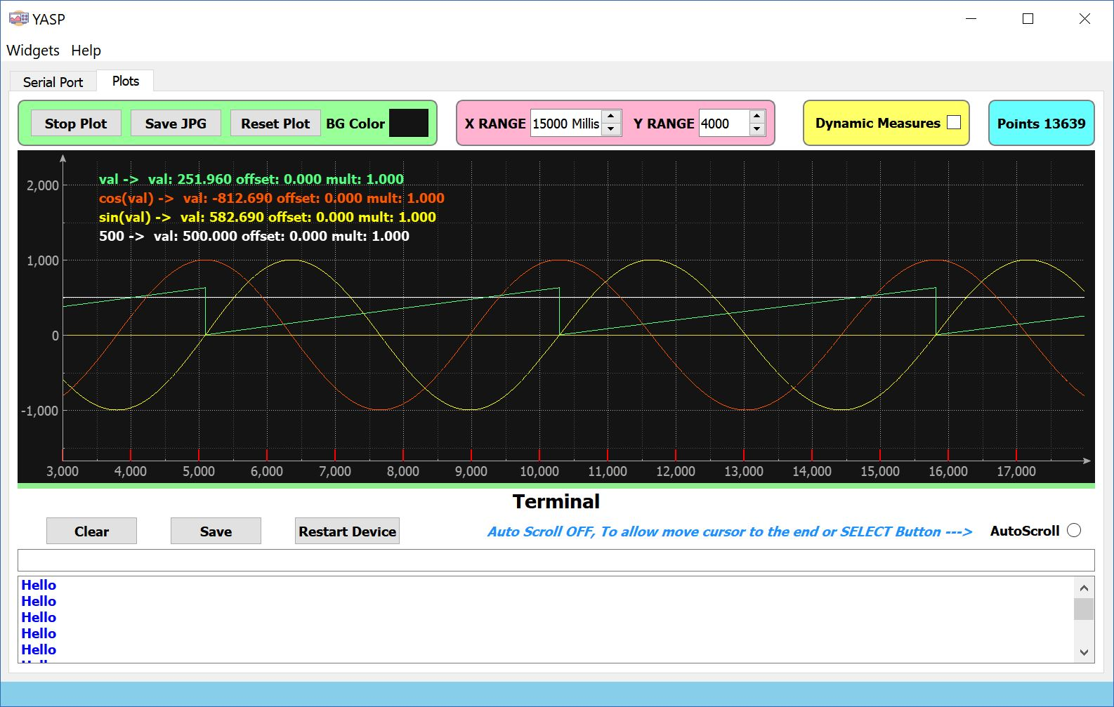
The Plot Area
The Terminal Area

Slide 2
Actions Buttons
Ranges Buttons

Slide 3
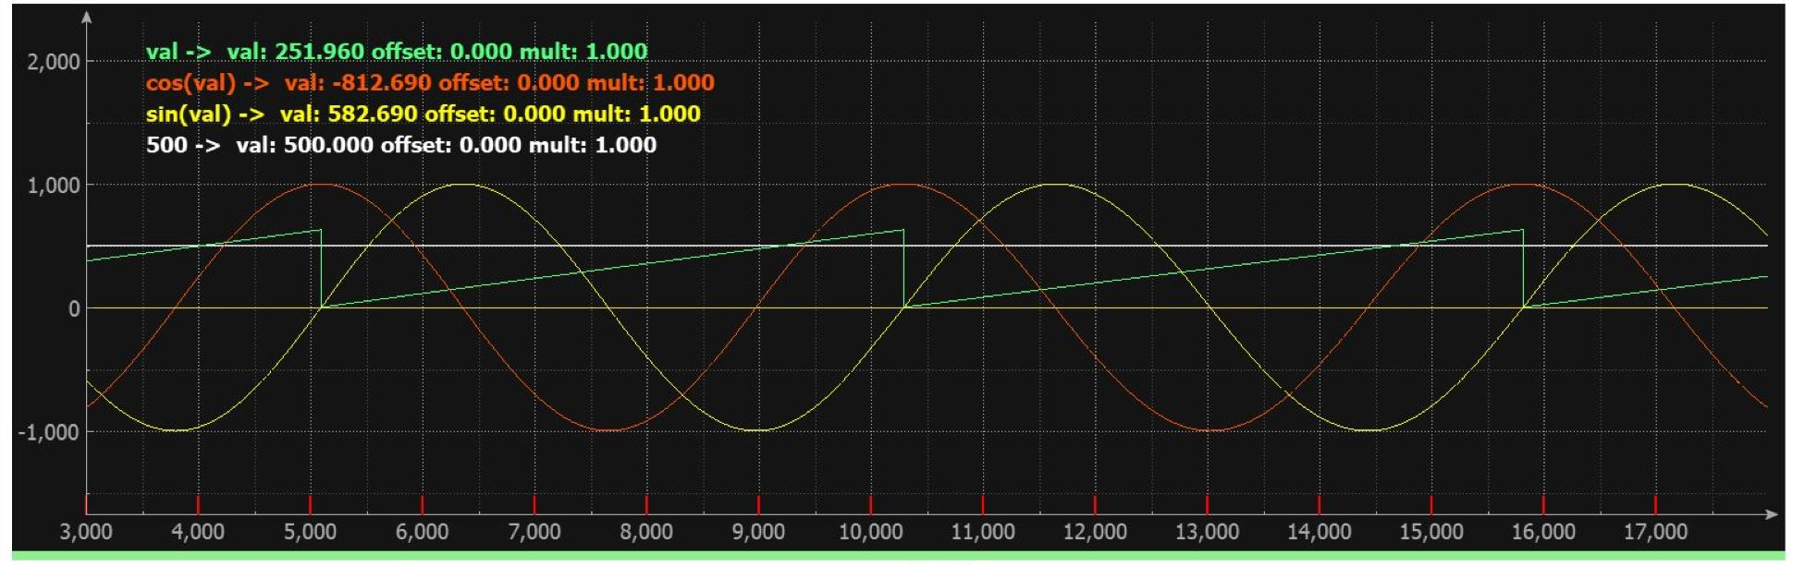
Plots
Information
Selection
Plots

Slide 4
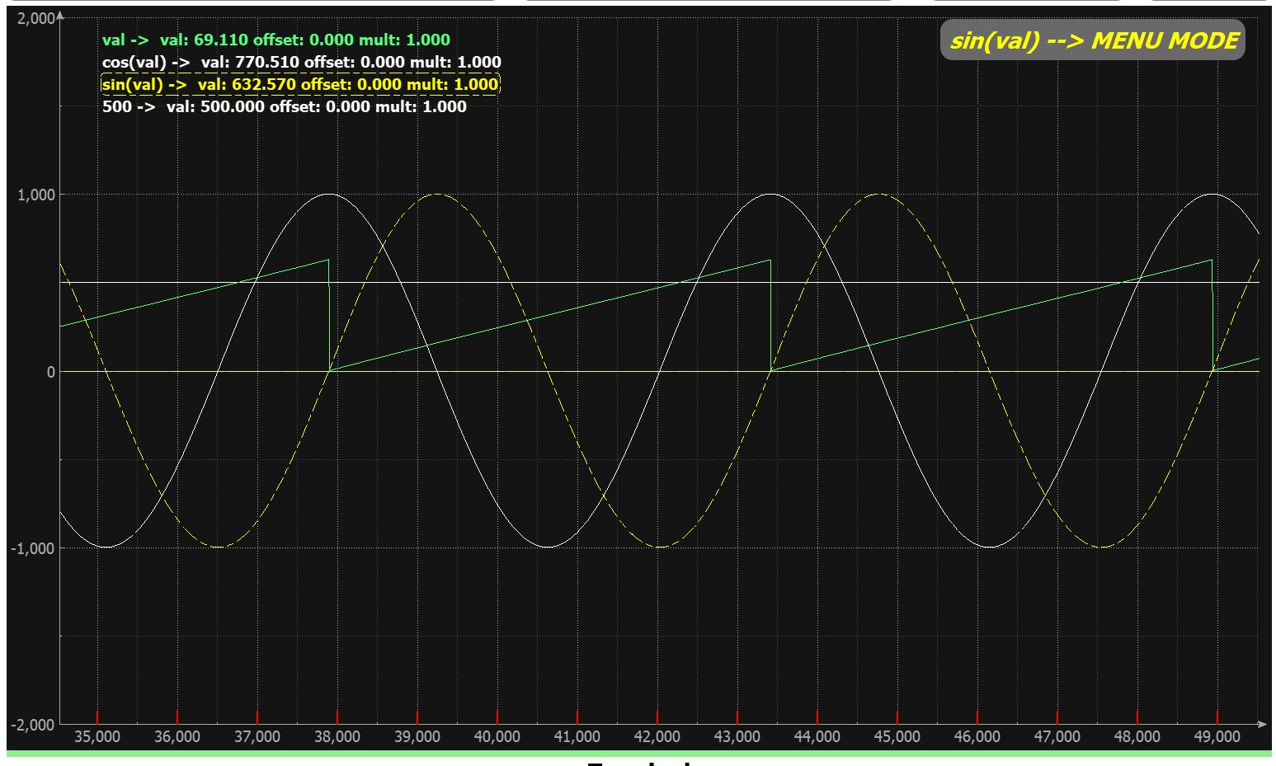
Click Here to UnSelect Plot
Or
Click Here to Select Another Plot
Operation Mode
Plot information border box marked as selected.
Plot marked as selected

Slide 5
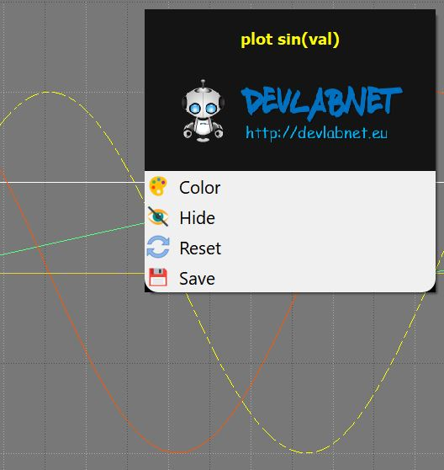
Change plot color
Show/Hide plot
Reset plot
Save Plot data

Slide 6
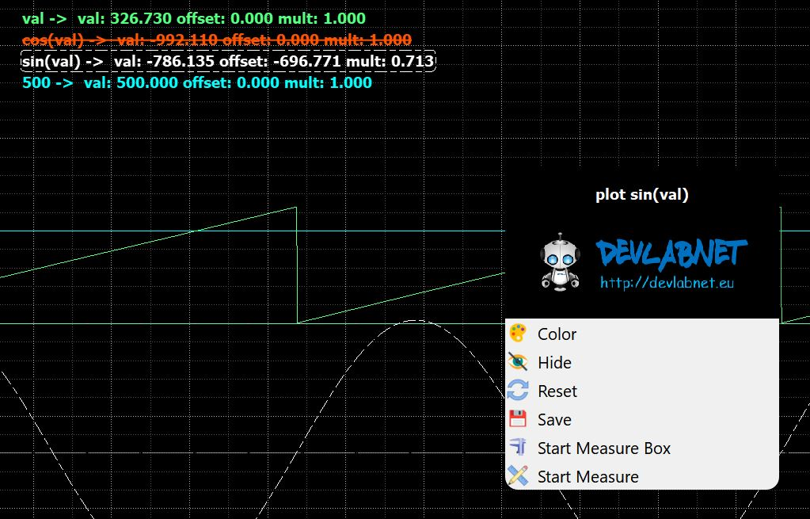
Red plot is Hidden
White Plot is Selected
BOX Measure
Simple Measure

Slide 7
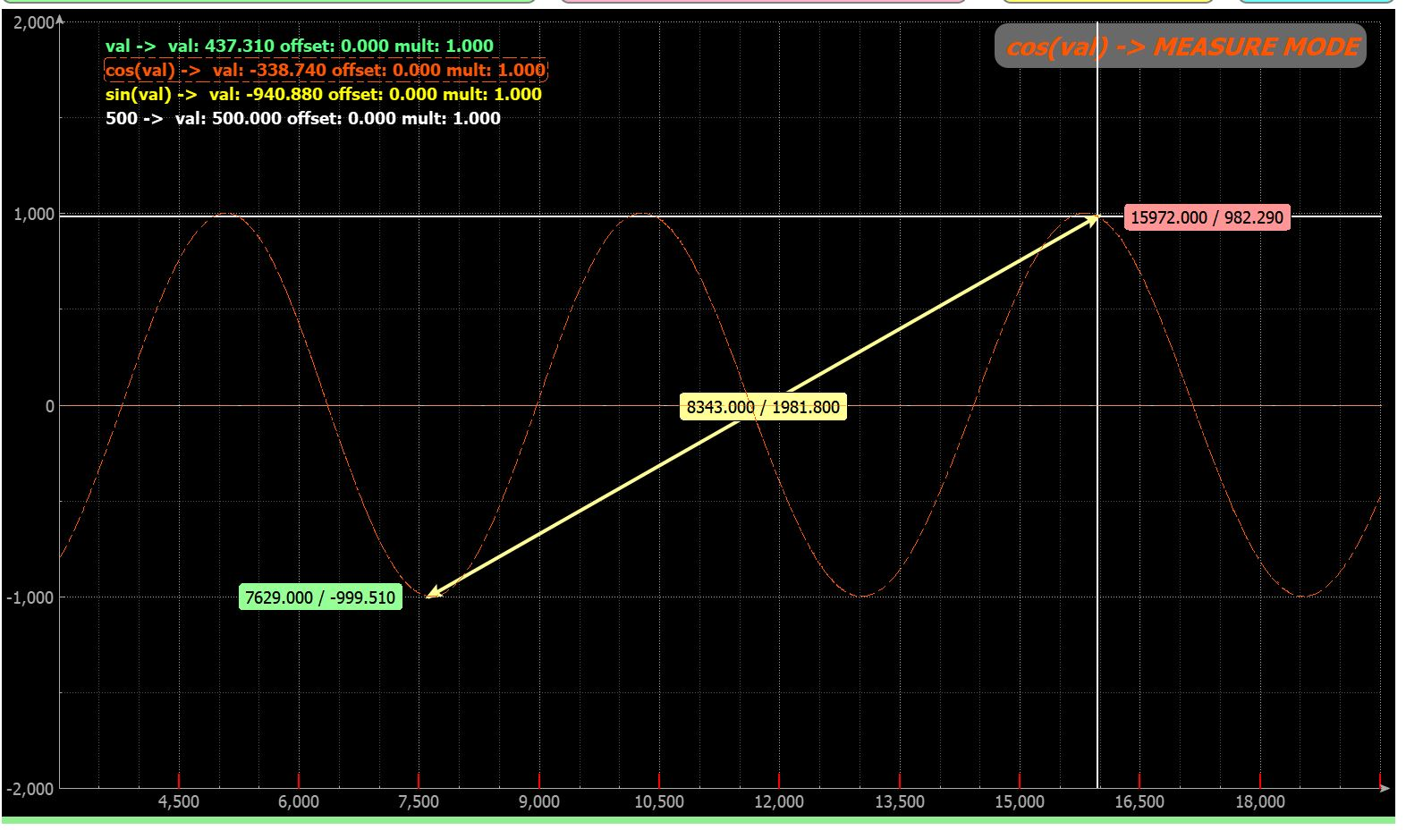
Measure End
Ctrl Key to Start a new measure
Shift Key to erase measure
Tracer
(Follow the Plot)
Measure
Measure
Measure Start

Slide 8
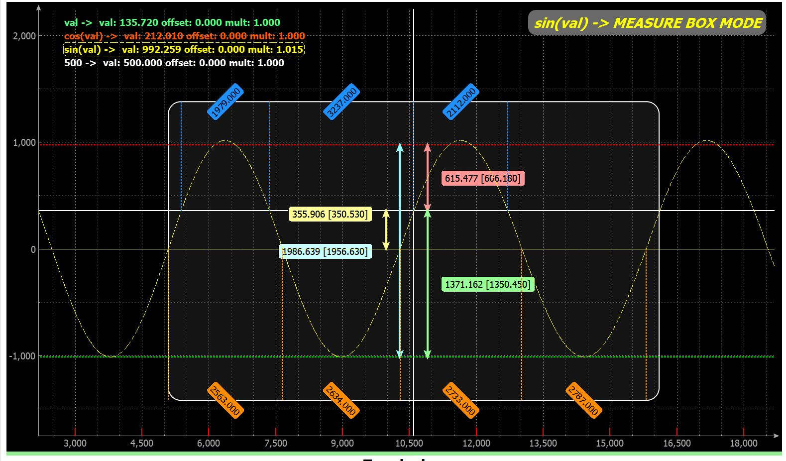
Tracer
(Follow the Plot)

