Slide 1
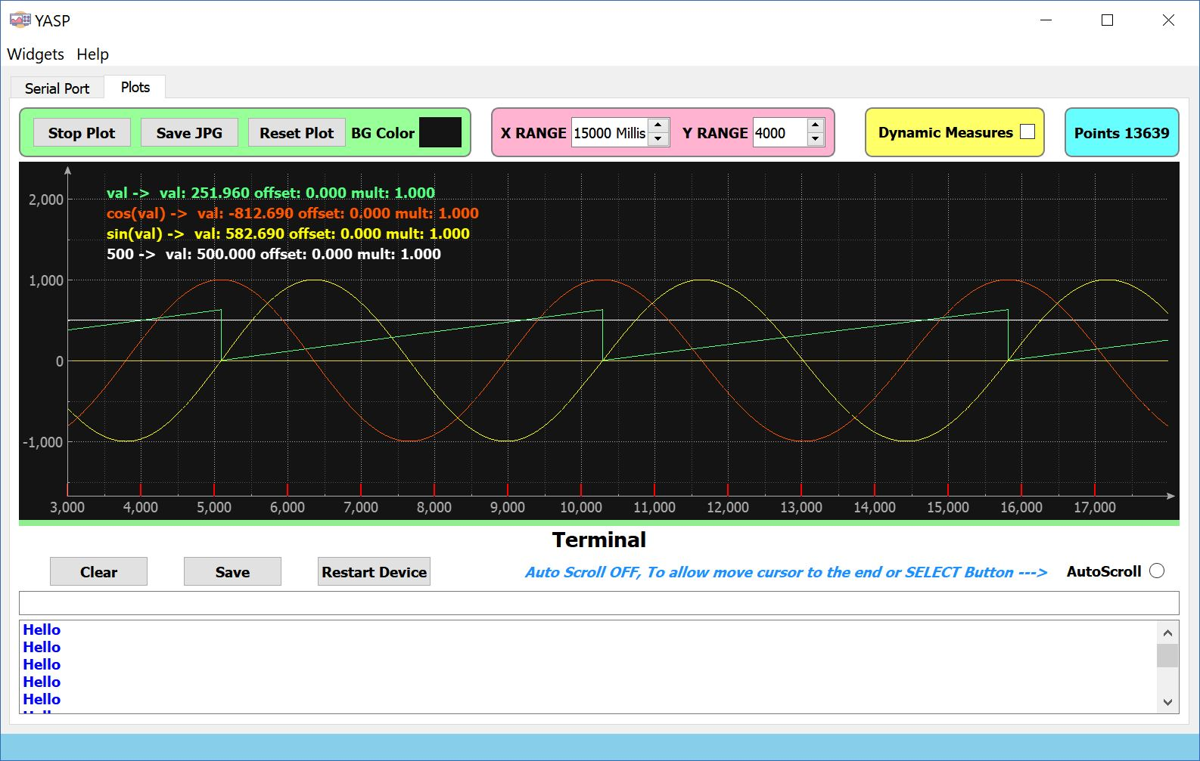
The Plot Area
Splitter
Line
The Terminal Area

Slide 2
Actions Buttons
Ranges Buttons
Logged Data Counter

Slide 3
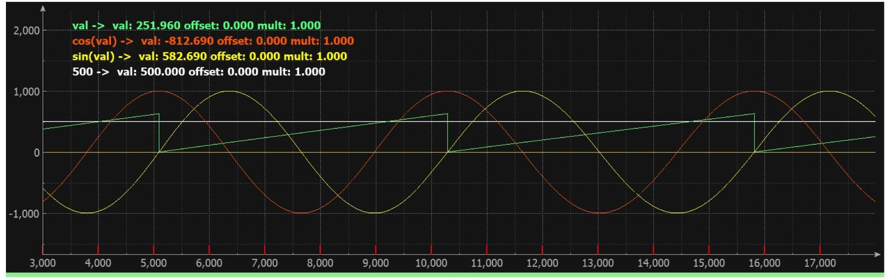
Plots
Information
Selection
Plots

Slide 4
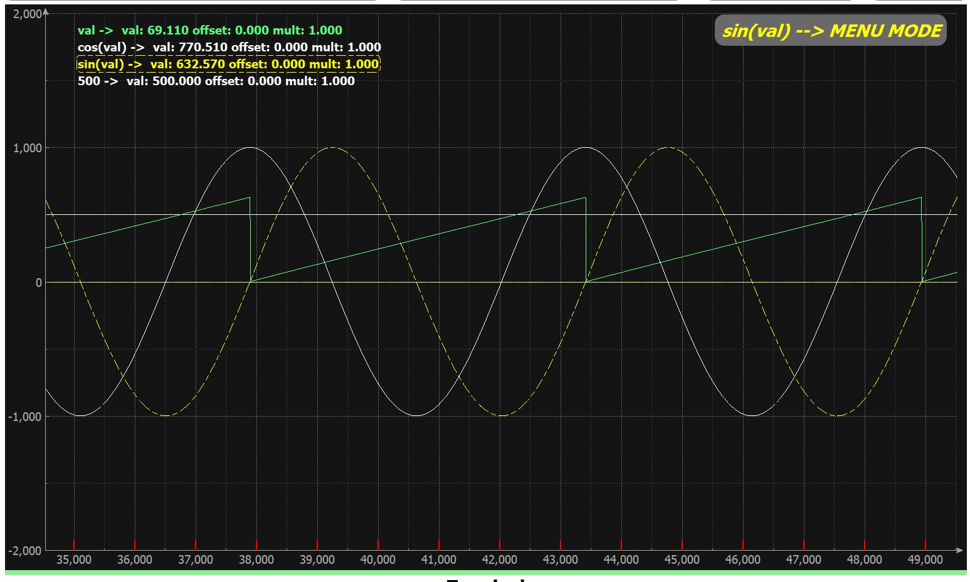
Click Here to Unselect Plot
Or
Click Here to Select Another Plot
Operation Mode
Plot information border box marked as selected.
Plot marked as selected

Slide 5
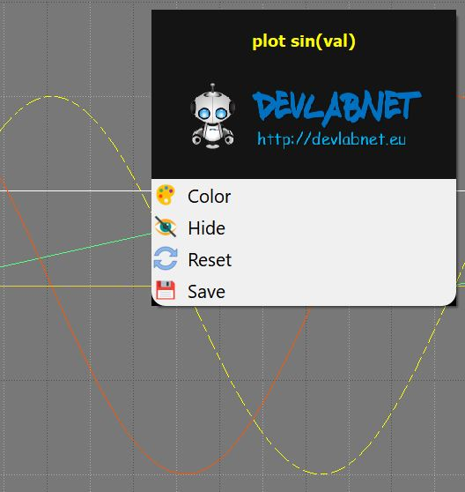
Change plot color
Show/Hide plot
Reset plot
Save Plot data

Slide 6
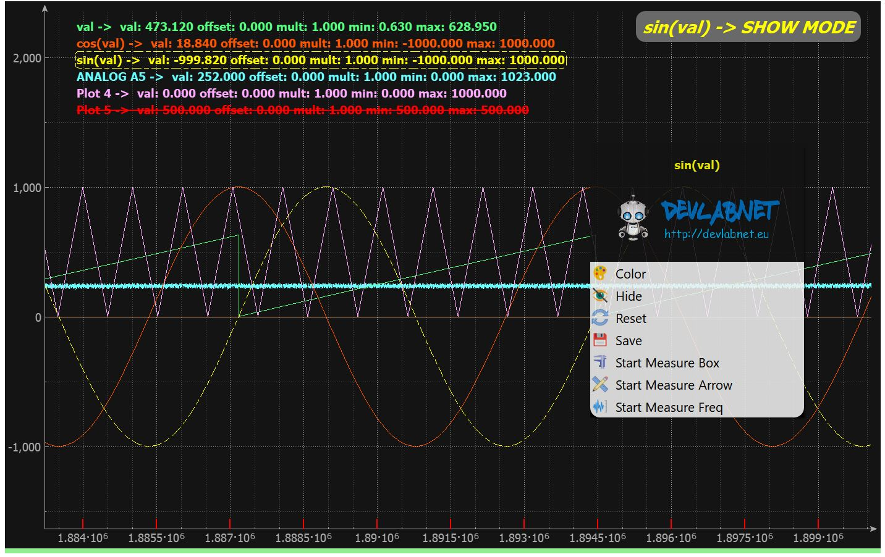
Yellow Plot is Selected
Red plot is Hidden
BOX Measure
ARROW Measure
FREQ Measure

Slide 7
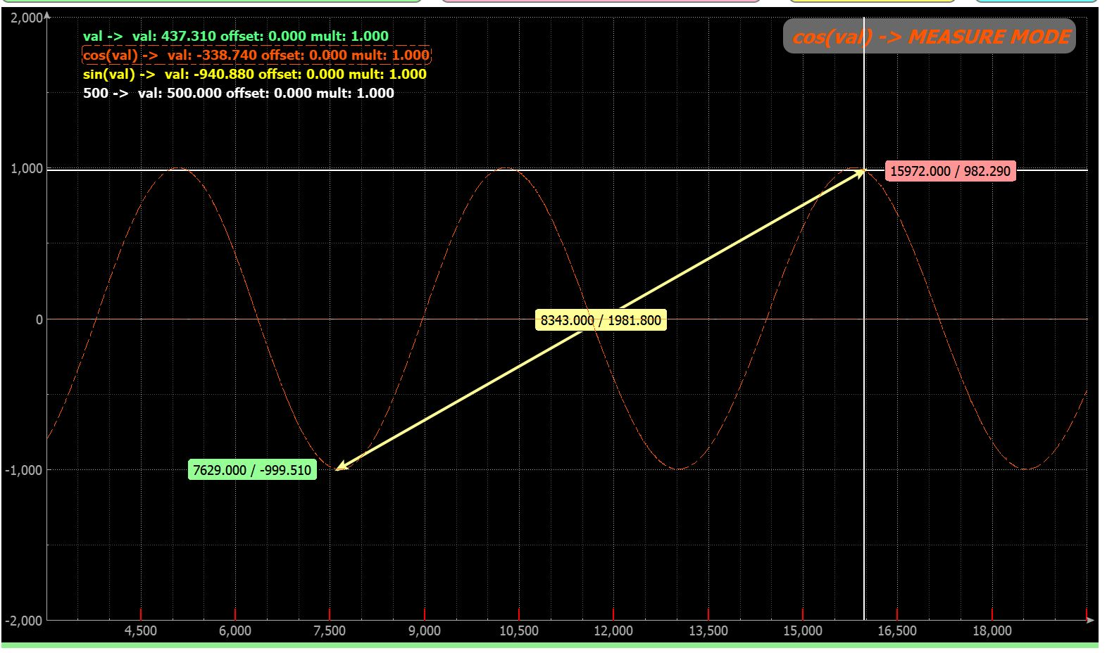
Measure End
Ctrl Key to Start a new Arrow
Shift Key to erase Arrow
Tracer
(Follow the Plot)
Measure
Measure
Measure Start

Slide 8
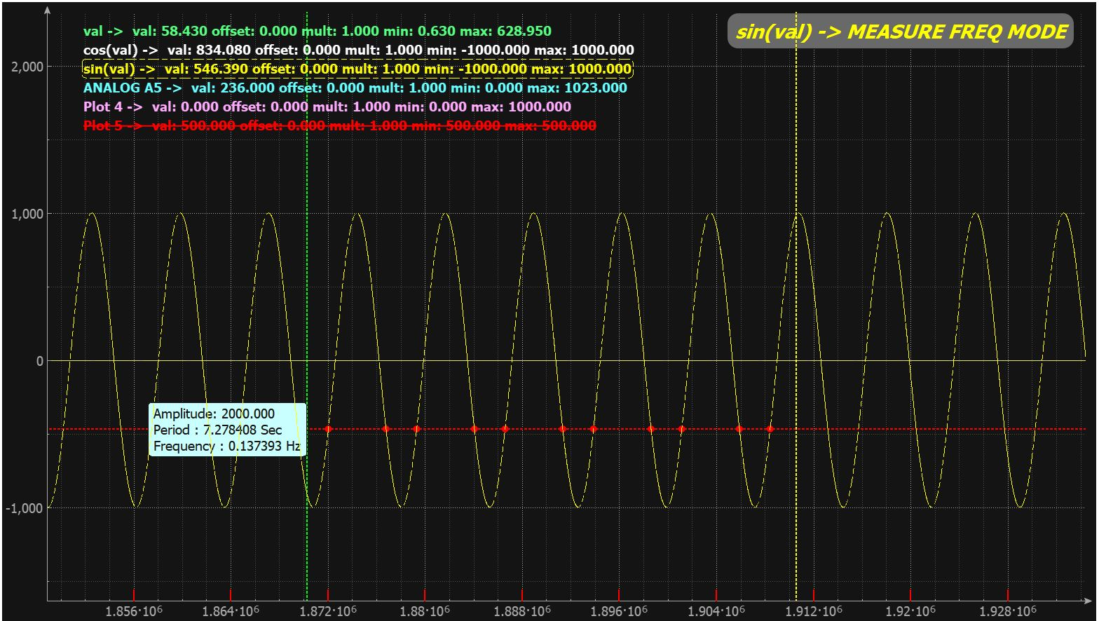
First “Ctrl Key” SET the Start Line, Second “Ctrl Key” set the End Line.
“Shift Key” erase the lines.
Measure Box
The “Frequency” value is the average value computed from all the measure points.
Measure Points
Start Line
End Line

Slide 9
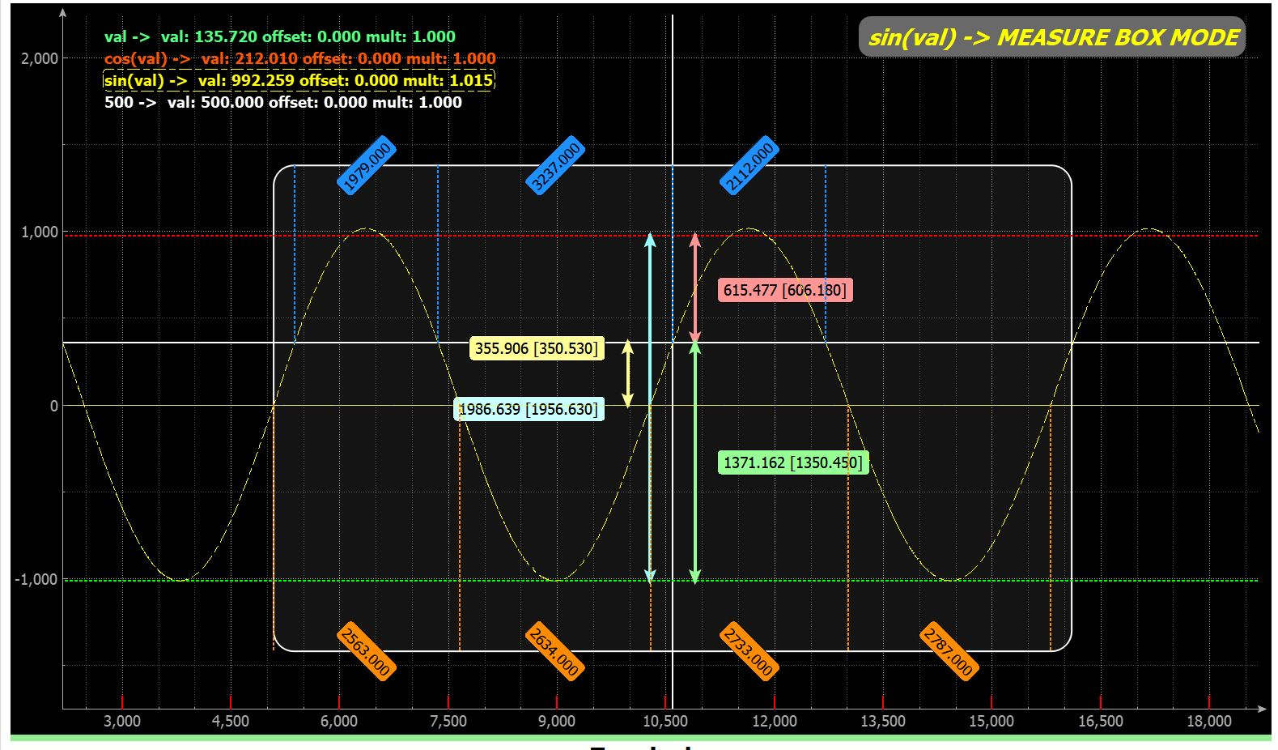
Tracer
(Follow the Plot)

Slide 10
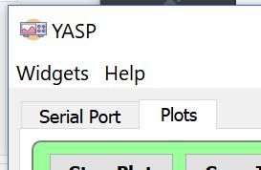
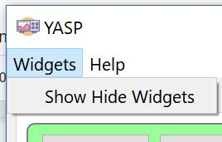


Slide 11
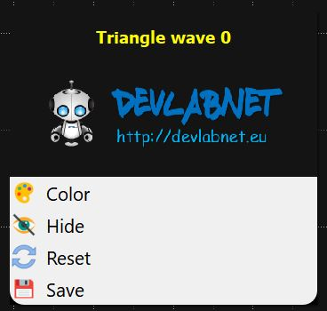
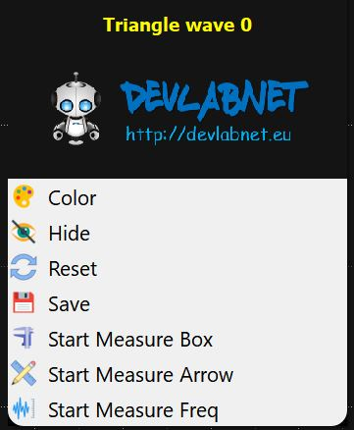
NO
Plotting Stopped
YES
No Plot Selected - Plot Running
No Context Menu
No Plot Selected – Plot Stopped
No Context Menu
Click on a Plot Info Line
Click on a Plot Info Line
Plot Selected - Plot Running
Plot Selected - Plot Stopped
Plot Selected - Plot Stopped
Select a Measure
Measure Mode
ESC Key
ESC Key
Click on Operation Mode
Click on Operation Mode
ESC Key
Click on another Plot Info Line
Click on another Plot Info Line
Click on Operation Mode
Start Plot
Stop Plot
Click on another Plot Info Line
Start Plot

Slide 12
