Slide 1
Authentication
Presented by:
Naing, Ye Htet, Liang Fang, Shihao Dong

Slide 2
What is Authentication?
According to Microsoft: Authentication is the process by which the system validates a user's logon information.

Slide 3
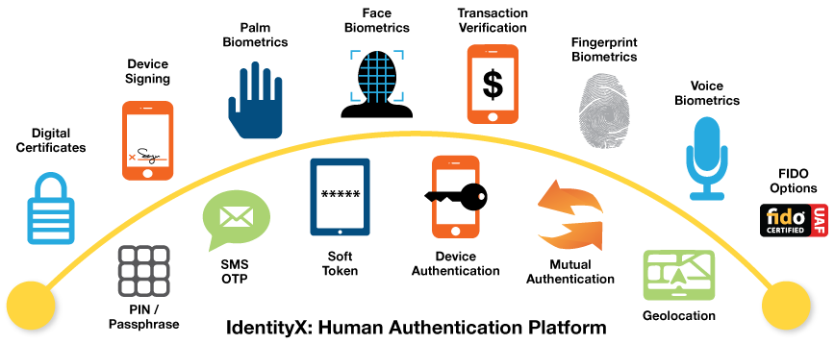
Types of Authentication

Slide 4
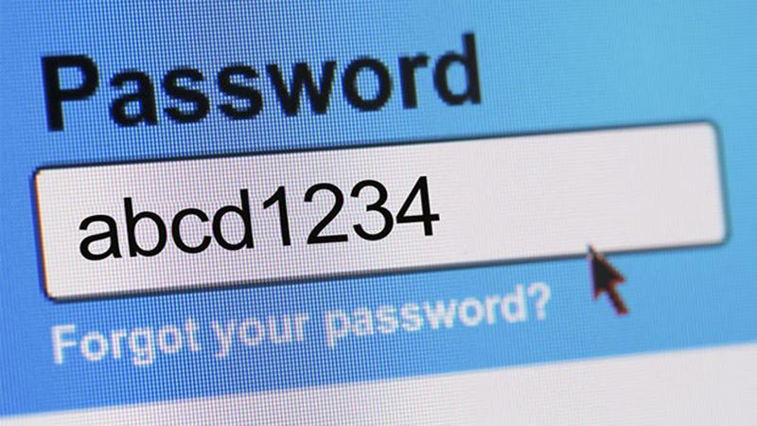
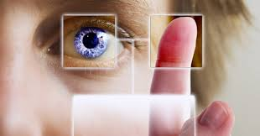
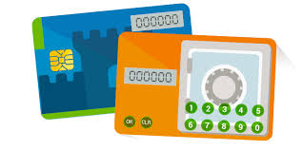
Types of Authentication
Password
Biometric
Token/Chip

Slide 5
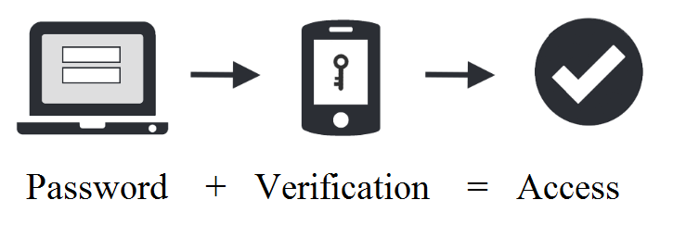
Password

Slide 6
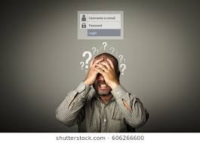
Password
Advantage
Most commonly used.
User friendly.
Convenient.
Easy to use.
Disadvantage
Once computer get virus, password will be compromised immediately
Too lengthy
User defined too weak password

Slide 7
Biometric Video
https://www.youtube.com/watch?v=rGnnNj8l7pI

Slide 8
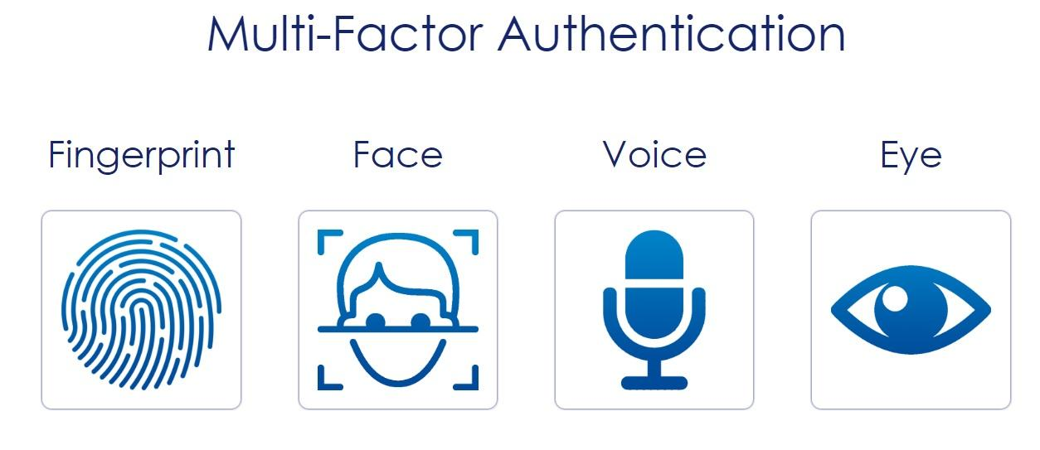
Biometric

Slide 9
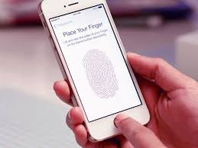
Biometric
Advantages
Unique from person to person.
No more long password.
Can not be lost or forgotten.
Disadvantages
Can be expensive
Not 100% accurate
Maybe not work if biometric features are altered.

Slide 10
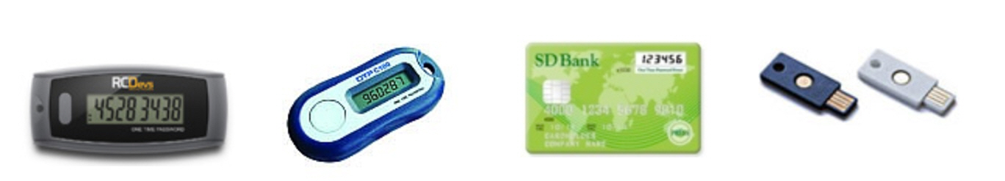
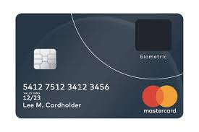
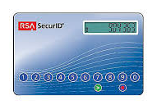
Chip/Token Hardwares

Slide 11

Chip/Token
Advantages
Physical device.
Passcode is saved in the chip/token.
Disadvantages
Can be easily:
Misplaced
Damaged
Hacked

Slide 12
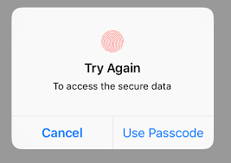
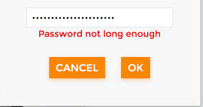

Problem
Notes:
http://www.speedypassword.com/articles/username-ideas/

Slide 13
Solution

Slide 14

Coding

Slide 15
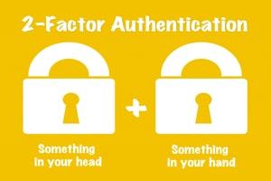
Conclusion
Advantages:
Additional layer of security
Hard to hack
Better security
New Technology
Disadvantages:
If mobile virus hijack Authenticator apps. Hackers can crack the app and clone your 2FA codes indefinitely.
You need to have a smartphone.

Slide 16


Slide 17
Project Contribution
Naing, Ye Htet:
Created the codes: String conversions
Drafted up the research paper: Introduction, Biometric
Created powerpoint: Biometric.
Liang Fang:
Created the codes: Test file, Secret key algorithm.
Drafted up the research paper: Conclusion, Password
Created powerpoint: Password
Shihao Dong:
Created the codes: Linked compiler to file.
Drafted up the research paper: Body
Created powerpoint: Chip/Token

Slide 18
Resources
“Authentication.” About Processes and Threads (Windows), msdn.microsoft.com/en-us/library/windows/desktop/aa374735(v=vs.85).aspx. Accessed 28 May, 2018.
Birken, Emily Guy. “Topics.” Money Crashers, www.moneycrashers.com/create-password-prevent-hacking-phishing/. Accessed 28 May, 2018.
Dragonette, Laura. “Security Token.” Investopedia, Investopedia, 25 May 2016, www.investopedia.com/terms/s/security-token.asp. Accessed 28 May, 2018.
Hoffman, Chris. “The Different Forms of Two-Factor Authentication: SMS, Autheticator Apps, and More.” How-To Geek, How-To Geek, 8 June 2017, www.howtogeek.com/232598/5-different-two-step-authentication-methods-to-secure-your-online-accounts/. Accessed 28 May, 2018.

Slide 19
Resources
“Password-Based Authentication (Sun Directory Server Enterprise Edition 7.0 Reference).” Lesson: All About Sockets (The Java™ Tutorials > Custom Networking), https://docs.oracle.com/cd/E19424-01/820-4811/gdzeq/index.html. Accessed 28 May, 2018.
Shinder, Deb. “Understanding and Selecting Authentication Methods.” TechRepublic, www.techrepublic.com/article/understanding-and-selecting-authentication-methods/
Accessed 28 May, 2018.
TOASTguy2. “National Security Emergency.” YouTube, YouTube, 15 Nov. 2008, www.youtube.com/watch?v=rGnnNj8l7pI. Accessed 28 May, 2018.
“Token Based Authentication | Learn SEO Blog.” Engineering Blog, www.loginradius.com/cIAM-basics/token-based-authentication/. Accessed 28 May, 2018.
“What Is Biometric Authentication? - Definition from Techopedia.” Techopedia.com, www.techopedia.com/definition/29824/biometric-authentication. Accessed 28 May, 2018.

Slide 20
Resources
“Why Use 2FA?” What Is Two Factor Authentication? | SecurEnvoy, www.securenvoy.com/two-factor-authentication/why-use-two-factor-authentication.shtm.
Accessed 28 May, 2018.
Wodehouse, Carey. “Why You Should Use Two-Factor Authentication For Better Mobile Security.” Hiring | Upwork, 23 May 2018, www.upwork.com/hiring/development/two-factor-authentication/. Accessed 28 May, 2018.

