Slide 1
5 AI Agent Terms You Need to Know
@DevlinDuldulao
Senior consultant at SoftwareOne Norway
Notes:
What is an agent? Everything is new so it can still be a bit confusing. One developer is thinking about a chatbot, and another developer is thinking about a script with a while-loop in it, and another developer is thinking about fine-tuning.
So today we are going to talk about 5 official terms in ai. AGENTS.md. Agent skills. MCP. A2A. And subagents.
But I am not going to start there. So, we are going to spend the first five minutes on how we got here.
Let's go back to 2023.

Slide 2


Slide 3
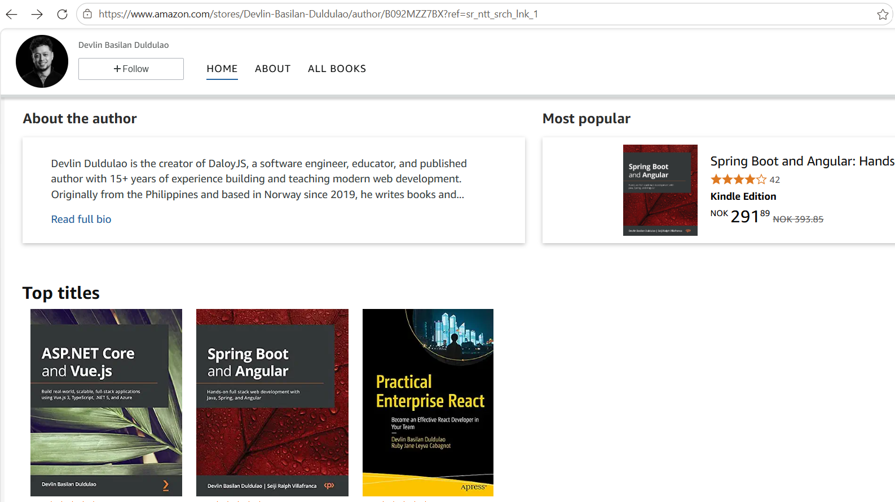
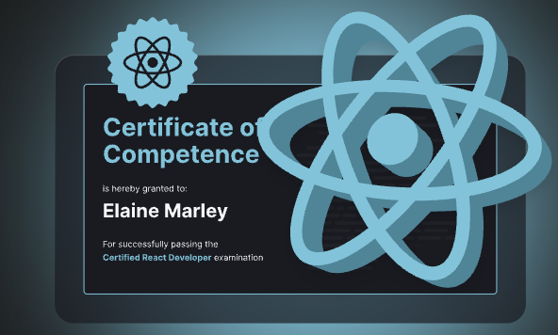

Slide 4
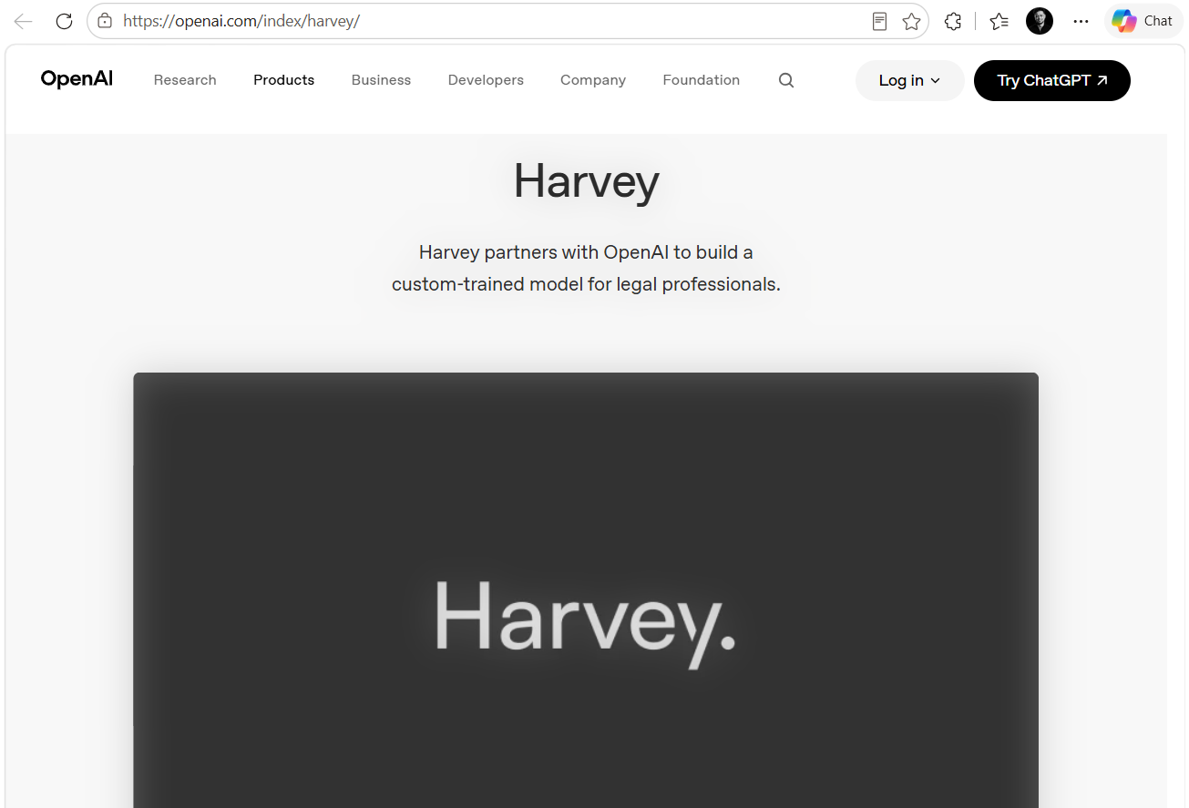
Notes:
In 2023, a well-known legal tech start-up, Harvey, decided that a general-purpose model was not good enough for legal work.
So, they partnered with OpenAI, and they built their own. They fine-tuned a custom model on legal data.

Slide 5
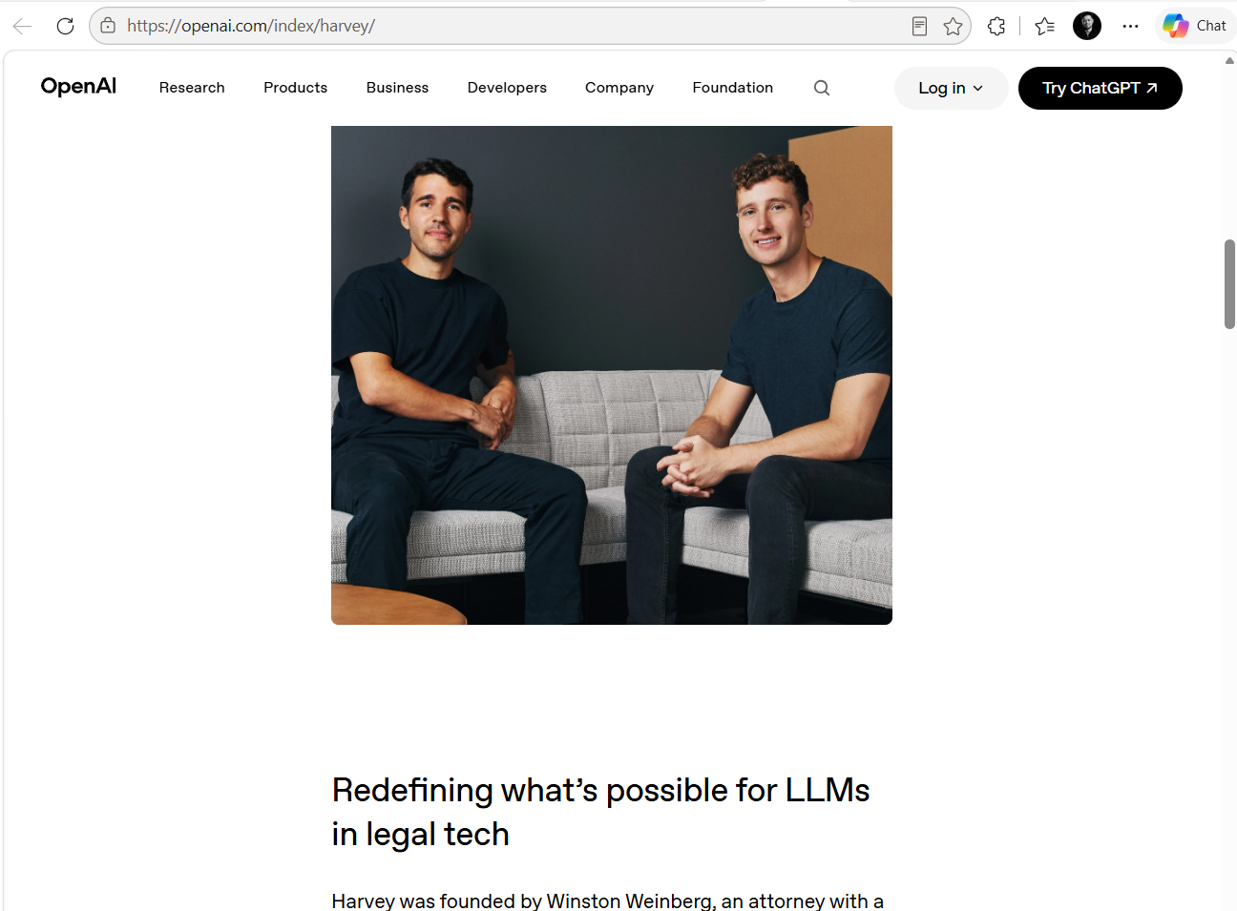
Notes:
Then they ran blind tests. Real attorneys or lawyers. Given output from the custom model, and output from “GPT-4”, which at the time was the best model on earth..
Guess what. The attorneys preferred the custom model. Ninety-seven percent of the time.

Slide 6
The answer was: train your own.
97%
of blind comparisons preferred a fine-tuned legal model over GPT-4
Notes:
Ninety-seven means almost all.
And the lesson looked completely obvious. If the general model is not quite right for your domain, train your own. That was correct advice in 2023.
The thing is, models are getting better every 3 months.

Slide 7
Two years later, seven models beat it.
7
none of the general-purpose models were trained on a single contract
Notes:
Two years later, the same company did something genuinely admirable. They built and published their own legal benchmark. A real measurement of how well a model does actual legal work.
And then they ran their own custom model against the current frontier models.
Seven of the general-purpose models beat it.
Those were not trained or fine-tuned. The models are really good even without domain data, cases, or contracts injected in the context.

Slide 8
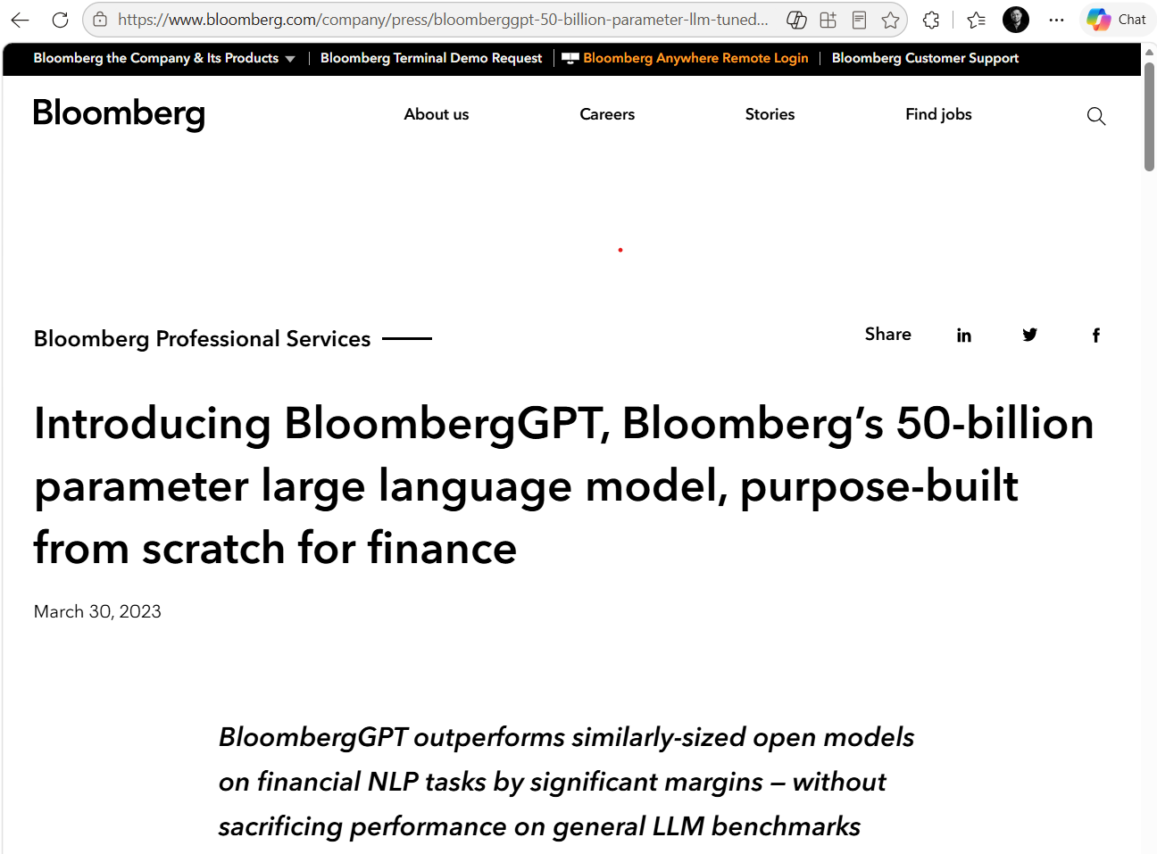
Notes:
The same thing happened to Bloomberg. They trained BloombergGPT from scratch on financial data. Serious, expensive, well-executed engineering. And later evaluations found GPT-4 beating it on many financial benchmarks.
Now, neither of those teams made a bad decision. I want to be clear about that. In 2023 they were right.
So, the question is: why?

Slide 9
CONTEXT WINDOW
2k → 1M+
read it, don't bake it
Notes:
Three things happened at the same time.
Context windows exploded. GPT-3 held two thousand tokens. Today a frontier model reads a million. Think about what that changes. If the model can read five hundred pages of contracts directly in the prompt, why would you ever bake those documents into the weights?
A weight is a learned numerical value in an LLM that determines how strongly one piece of information influences the model's output. Without weights being adjusted, the model wouldn't actually learn from the training data.

Slide 10
CONTEXT WINDOW
REASONING
2k → 1M+
At question time
read it, don't bake it
extended thinking
Notes:
Second, reasoning moved to inference time. The model now thinks when you ask the question. Reasoning models will just work on your question step-by-step before answering. It does it’s own loop inside.

Slide 11
CONTEXT WINDOW
REASONING
COST
2k → 1M+
At question time
Falls every quarter
read it, don't bake it
extended thinking
getting efficient and smarter
Notes:
And third, cost fell. And it keeps falling.
The baseline you are trying to beat gets better every few months while the model you fine-tuned is stuck in that knowledge you used to customize it..

Slide 12
CONTEXT WINDOW
REASONING
COST
2k → 1M+
At question time
Falls every quarter
read it, don't bake it
extended thinking
getting efficient and smarter
A fine-tune is a snapshot. The frontier is a video.
Notes:
A quick analogy here:
A fine-tune model is a snapshot. A frontier model is a video.

Slide 13
Customization moved off the weights.
how we got here
Notes:
So, if you are not adjusting weights anymore, how do you make a general model behave like a specialist of a domain you are working on? Like the best lawyer or doctor?
It turns out there is a whole stack for that.

Slide 14
MISSING FACTS
Retrieval
Fresh, traceable, governed
Notes:
If what is missing is facts, you retrieve them. You go and fetch the right documents at the moment of the question and put them in the prompt. That is RAG short for Retrieval-Augmented Generation. It is fresh, you can cite the source, and it still respects who is allowed to see what.

Slide 15
MISSING FACTS
MISSING FRAMING
Retrieval
Context
Fresh, traceable, governed
assembled in code, not typed
Notes:
If what is missing is framing, that is context engineering. Deciding, in code, exactly what the model sees when it is called.

Slide 16
MISSING FACTS
MISSING FRAMING
MISSING KNOW-HOW
Retrieval
Context
Skills
Fresh, traceable, governed
assembled in code, not typed
written in plain English
Notes:
Skill.md file if what is missing is know-how, how we do this here, the actual procedure.

Slide 17
MISSING FACTS
MISSING FRAMING
MISSING KNOW-HOW
Retrieval
Context
Skills
Fresh, traceable, governed
assembled in code, not typed
written in plain English
These problems don’t need training.
Notes:
They don’t need training.

Slide 18
5 AI Agent Terms
Notes:
I have an annoying personality. I love telling movie or sports spoilers to my friends and families.
Here are the spoilers, so you don’t have to spend a lot of time figuring out where do they live or what are them.

Slide 19
MCP and A2A are open protocols and specifications.
  MCP is agent to tool, A2A is agent to agent
AGENTS.md is a config file. Always loaded, so keep it short
SKILL.md is a plugin format file. Schema plus folder, loaded on demand
Subagents is an architectural design pattern. No spec, so every vendor does it differently
Notes:
It is more like a TL;DR.
MCP and A2A are external workflows. Let’s imagine each one of us has a software company….
I will show 2 slides after this for the AGENTS.md and SKILL.md then I will go to my VS Code to show you a real-world sample.
Subagents is just for your own solution. It is an internal workflow. You own it, you control it.

Slide 20
Repo rules the agent always reads
01
AGENTS.md
A markdown file in your repo
Read every session before any work starts
It can be nested
Notes:
1st term: AGENTS dot md.
It is just a markdown file. You don’t need to install anything. You create a file called AGENTS.md into your repository.
What’s you write there? The things you would tell a new developer on their first day. This is how you build the project. These are the commands that run the tests. We use this naming convention. Do not touch the generated folder. Pull requests look like this. Etc.
This will always be loaded in your ai context.
You can still add more AGENTS.md files if you have other applications in your repository.

Slide 21
Demo
01
AGENTS.md

Slide 22
Skills load expertise on demand
02
Agent skills
A folder: SKILL.md, plus scripts and template
Name, trigger (description), instructions
Procedural knowledge and how we do it here
Notes:
2nd term: agent skills. I think this what matters most right now for engineers or developers or data scientists who deal with repositories.
A skill is a folder. Inside that folder is a file called SKILL dot md file, and that file has three things or parts: a name, a trigger also known as the description, and instructions.
The trigger is the important one.

Slide 23
Your AI agent loads this file in 3 stages
LEVEL 1
LEVEL 2
LEVEL 3
Front matter
The body
Linked files
name + when to use, always loaded
the instructions, loaded on a match
./scripts, ./references,
on demand
Notes:
Level one is the front matter. This loads to the context window right away. The name and the trigger.
Level two is the body. This gets loaded on demand or when only it is needed or get triggered. The actual instructions.
Level three is optional: linked files, scripts or commands, and a references folder for the extra detail linked from the body.
So, the AI builds itself a little internal registry in itself. Whenever you prompt, the model looks at its registry.

Slide 24
The description will trigger your AI agent
VAGUE
SPECIFIC
PUSHY
generates reports
what + when
Oversell and be verbose
the agent will skip it
the job, and the phrases that mean it
models under-trigger
The skill will not run if the description is vague
Notes:
There is a tendency in agents that they will ignore your skills especially if they are vague. Not unless you specifically include the path of your skills and tell it to use it.
So the best practice is include what and when and you have to oversell like verbose sentences to use the skills.

Slide 25
Demo
02
Agent skills

Slide 26
Treat a skill like a dependency
Notes:
A skill file can run code into your machine and can go to your file system and environment variables.

Slide 27
Treat a skill like a dependency
35%
Less than 4000 public skills had a security flaw
Notes:
Almost four thousand public skills and 35% of it had a security flaw thru prompt injection. So it make sense to know or read a third-party skills or skills written by someone and sharing it to the internet and framing it as a skill for writing python codes with best practice in mind.

Slide 28
Update AGENTS, Delete some of your skills
DELETE
USE
RE-ADD
Every six months
Run it bare
Only proven needs
AGENTS.md and the whole skills folder
watch where the new model really fails
repeatedly, not once
Boris Cherny, who built Claude Code, said this at YC Startup School and he did not hedge it: delete your skills. 27 Jul 2026
Notes:
Update AGENTS, delete some of your skills.
The models today might already have reflex or knowledge of the instructions you wrote 6 months ago. Models today might already know them.
daloyjs.dev/docs/odm/ottoman.md

Slide 29
MCP gives every tool one interface
03
MCP
Notes:
3rd terminology: MCP. Model Context Protocol.

Slide 30
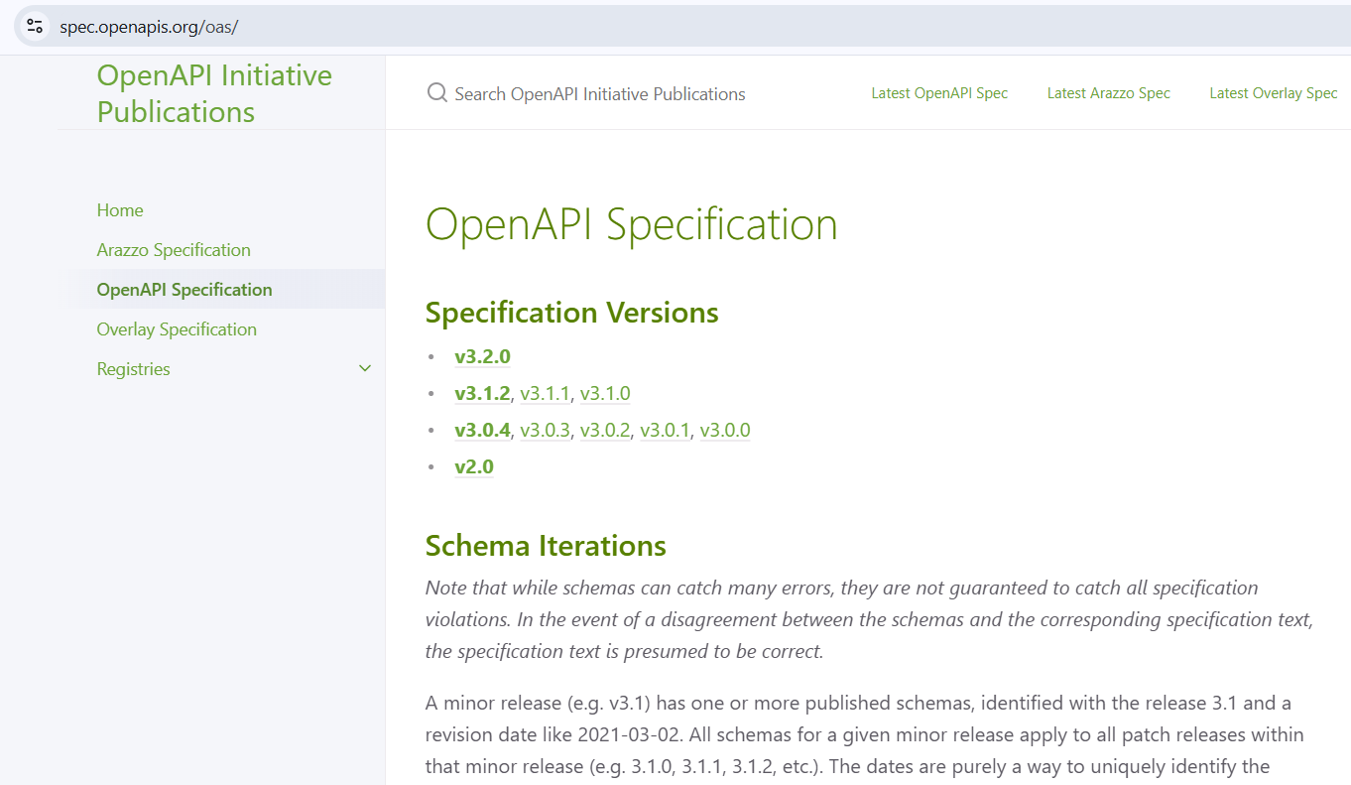
Notes:
In web development, developers use Swagger or OpenApi spec. It’s a list of operations you can do in the backend server.
This is the same in the MCP. You create a list of operations of what an AI agent can request from the backend server.

Slide 31
MCP gives every tool one interface
03
MCP
Notes:
MCP replaces all of that with one shape. Three parts.

Slide 32
MCP gives every tool one interface
03
MCP
Client asks what tools exist, before calling one
Notes:
MCP client is a module that calls the tools of MCP server. Cursor, Claude Code, VS Code, Slack, and Microsoft Teams have this MCP client built-in. These groups of software who have built-in MCP clients are called MCP hosts.

Slide 33
MCP gives every tool one interface
03
MCP
Client asks what tools exist before sending requests
Protocol is JSON-RPC 2.0
Notes:
Model Context Protocol (MCP) uses JSON-RPC 2.0 as its underlying message format.

Slide 34
MCP gives every tool one interface
03
MCP
Client asks what tools exist before sending requests
Protocol is JSON-RPC 2.0
Server listens for requests from the client
Notes:
A running server. This could be just an additional API endpoint in your existing service. You don’t have to create another web service just for this.

Slide 35
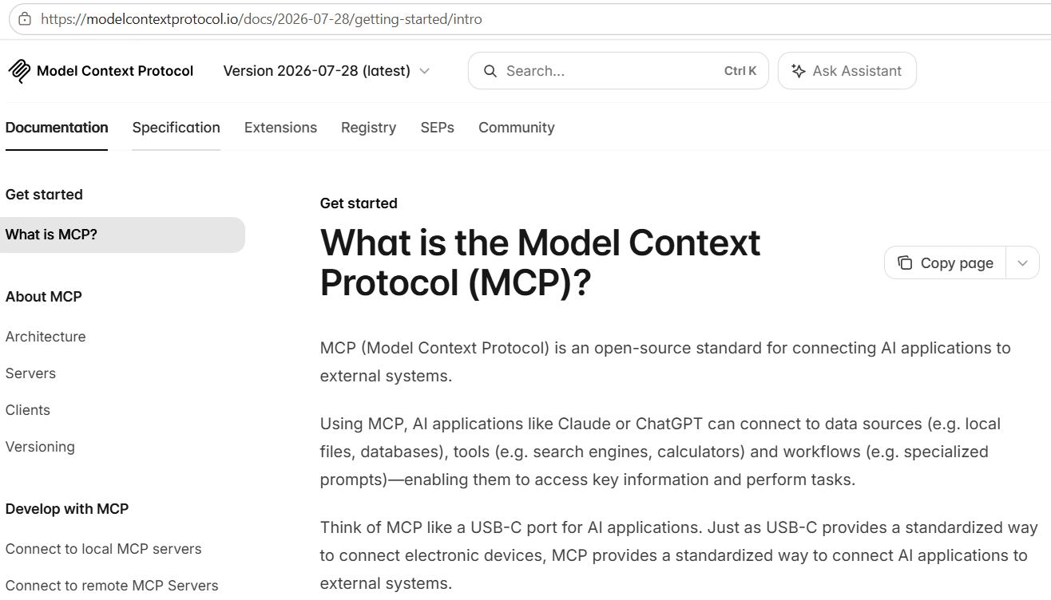
Notes:
Anthropic published MCP in late 2024. It now sits under the Agentic AI Foundation, and this July they shipped the fifth spec.

Slide 36
Demo
03
MCP
Notes:
mcp in vs code

Slide 37
MCP spec 2026-07-28
Security improvements
Cacheable
Stateless
Notes:
July twenty-eighth this year. Spec 2026-07-28.
They dropped the required handshake.
They dropped the session id. Every request now travels on its own.
They also made the catalog cacheable.

Slide 38
A2A lets agents discover and delegate
04
A2A
Each agent publishes a card at a well-known URL
The card says what it does and where to send work
No shared library or hard wiring or coupling
Notes:
4th term: A2A. Agent to agent.
A2A is how an agent reaches another agent. One that a different team, in a different language, on a different stack, built without ever talking to you.
99.99% you are not going to use this, unless you are building a platform with integrations to Azure AI Foundry, Copilot Studio, Amazon Bedrock, AgentCore Runtime, Vertex AI.

Slide 39
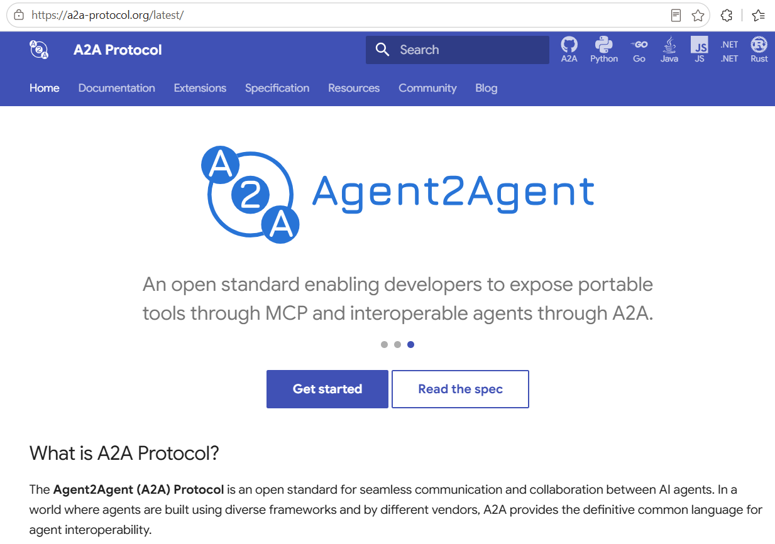
Notes:
It is an open protocol and has specifications so every software company can expect their agents can easily talk to another software company’s agent in a secured way without extra custom implementations.

Slide 40
Subagents keep the parent clean
05
Subagents
parent
child 1
child 2
child 3
child 4
Notes:
5th term: subagents.
This is an architectural design pattern. The parent orchestrate works to different little agents and re-billed 40K tokens per turn. The latency between the parent and the child when they communicate with each other. You would want this if a context of a work will be too big for one agent so you are basically dividing it and if you want to do parallelism like querying from 5 different vector database at the same time.

Slide 41
AGENTS.md
project behaviour
Agent skills
task expertise
MCP
tools and data
A2A
peer agents
Subagents
work scale
linuxfoundation.org · aaif.io · agentskills.io · modelcontextprotocol.io · a2aproject/A2A
MCP 2026-07-28 · IBM Technology: fine-tuning + skill practices · ycombinator.com (Boris Cherny)
Notes:
So the checklist.
AGENTS.md, when the boundary is project behaviour.
Agent skills, when the boundary is task expertise.
MCP, when the boundary is tools and data.
A2A, when the boundary is other agents.
Subagents, when the boundary is scale.
Three sentences and I am done.
Name the boundary before you pick the mechanism. Almost every bad architecture decision in this space is somebody reaching for a protocol when they needed a paragraph of markdown.
Prefer files before weights. We spent the first ten minutes earning that one. You can change a file this afternoon. A training run you live with, and maintain, for months.
And every few model generations, delete whatever no longer earns its tokens.

Slide 42
MCP and A2A are open protocols and specifications.
  MCP is agent to tool, A2A is agent to agent
AGENTS.md is config. Always loaded, so keep it short
SKILL.md is a plugin format. Schema plus folder, loaded on demand
Subagents is an architectural design pattern. No spec, so every vendor does it differently
Notes:
Again, a simple key takeaways.
An agent harness is the runtime scaffolding that turns a language model into an agent that can perform work. It drives model and tool calls, manages conversation state and context, applies approval policies, and can keep the agent progressing through a multi-step task.

Slide 43
06
Agentic Harness

Slide 44
An agentic harness is the runtime and control layer around an AI model that gives it tools, context, execution, feedback, and guardrails so it can autonomously complete multi-step tasks.

Slide 45
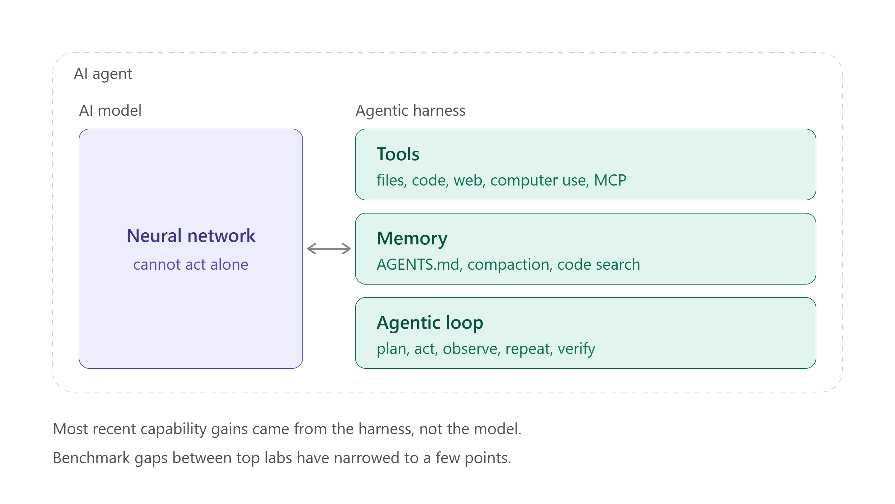
Notes:
The diagram splits an AI agent into its two constituent parts: the model and the harness wrapped around it.
The model is just the neural network — capable, but unable to open a file, execute code, or reach the web by itself, which is the brain-in-a-jar framing.
The harness supplies three things:
tools (file access, code execution in a sandbox, browsing, computer use, and MCP for services that don't live on the machine),
memory (instruction files like AGENTS.md, context compaction as the window fills, and search so only relevant code gets pulled in),
and the agentic loop where the model plans, the harness acts, results come back, and the cycle repeats for seconds or hours. Verification runs throughout that loop rather than at the end — tests as it goes, screenshots, sometimes a separate model acting as reviewer — which is what lets a run go long without drifting off course. The reason this distinction matters is in the caption: benchmark gaps between the top labs have narrowed to a few points, so when one product clearly outperforms another on the same model, the harness is usually the explanation.
The boundary is also fluid, since long-horizon planning and self-verification are increasingly trained into the models themselves, while consistency across a long task is increasingly shaped by harness conventions and project files.

Slide 46
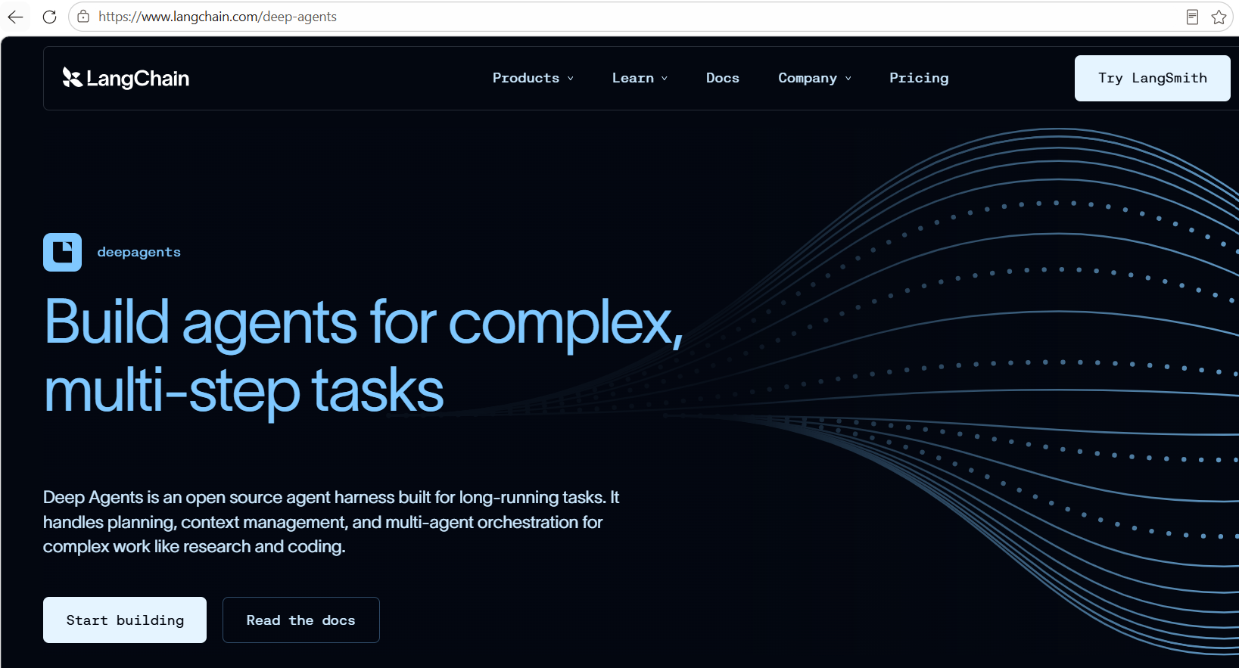

Slide 47
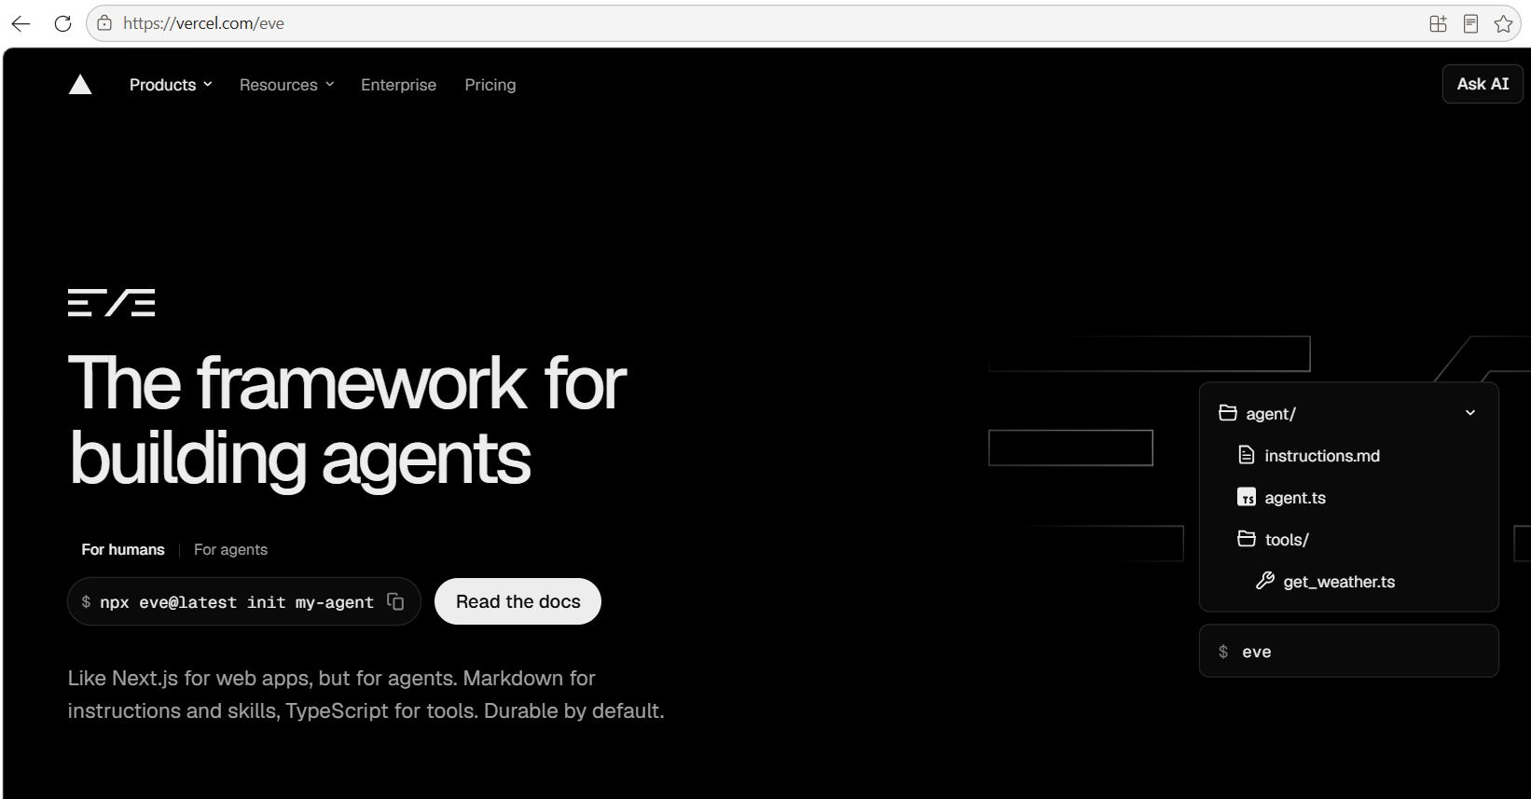

Slide 48
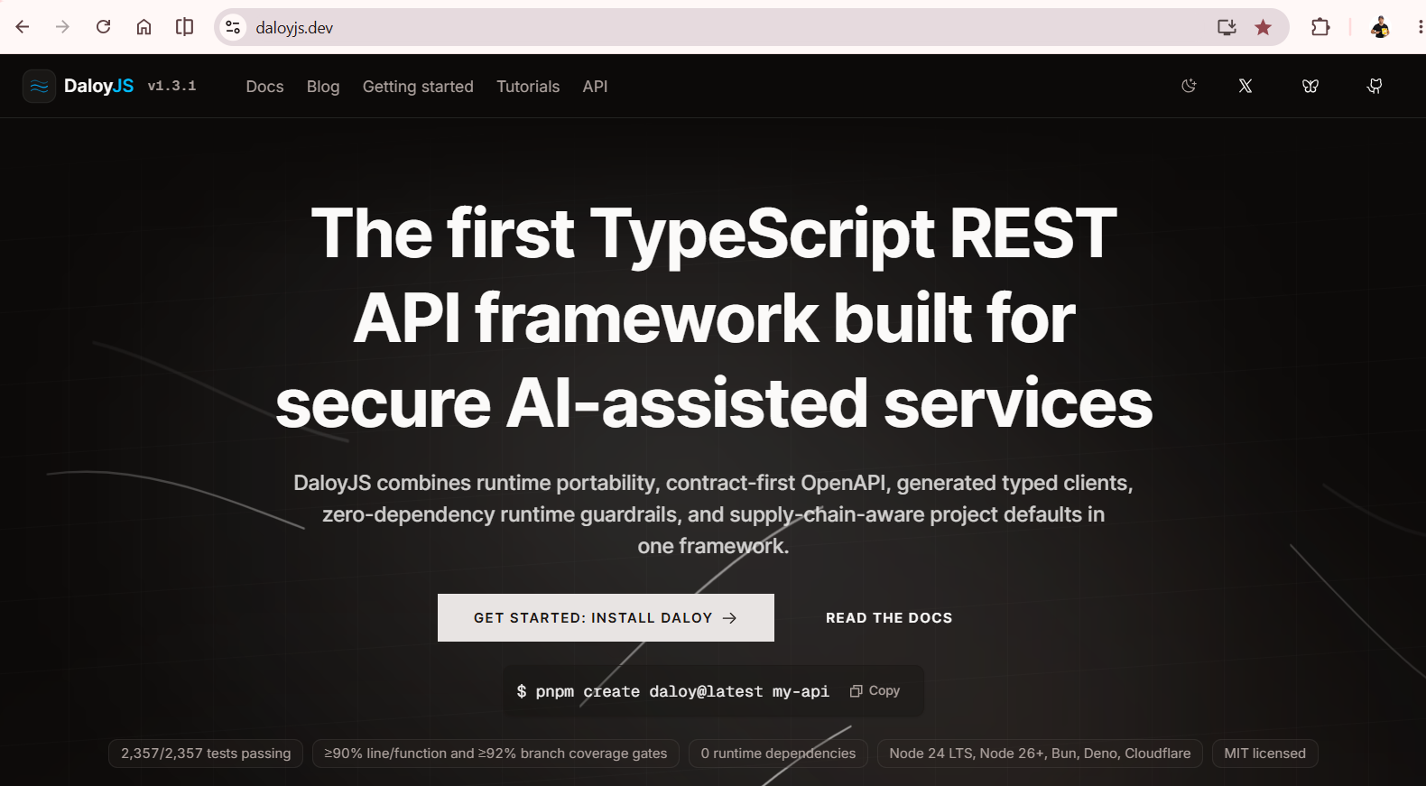
Notes:
bodyLimitBytes, jsonMaxKeys, jsonMaxDepth, requestTimeoutMs, secureHeaders + maxHeaderCount, RFC 9457 problem+json which is reduction or auto strip detail from 5xx.
Server will refuse to run on
wildcard CORS with credentials and anywhere
a session secret under 32 bytes or a default placeholder
sessions, a mutating route, and no CSRF hook
proxy trust left unconfigured in production
a symmetric algorithm handed to a JWKS verifier
auth declared with no auth hook behind it

Slide 49
Knowledge atrophy is the gradual weakening of human thinking and problem-solving skills through overreliance on AI to do our mental work.
Notes:
Knowledge atrophy, or cognitive atrophy, is the gradual decline of memory, critical thinking, and problem-solving skills caused by overreliance on AI tools like LLMs for mental work.
Keep learning the technical details of things that you are building. This will help you in the future in guiding agents to the right directions. It will save money because of lesser prompting. And lastly it will improve your skills

Slide 50

Thank you!
@DevlinDuldulao
Social Links

