Slide 1
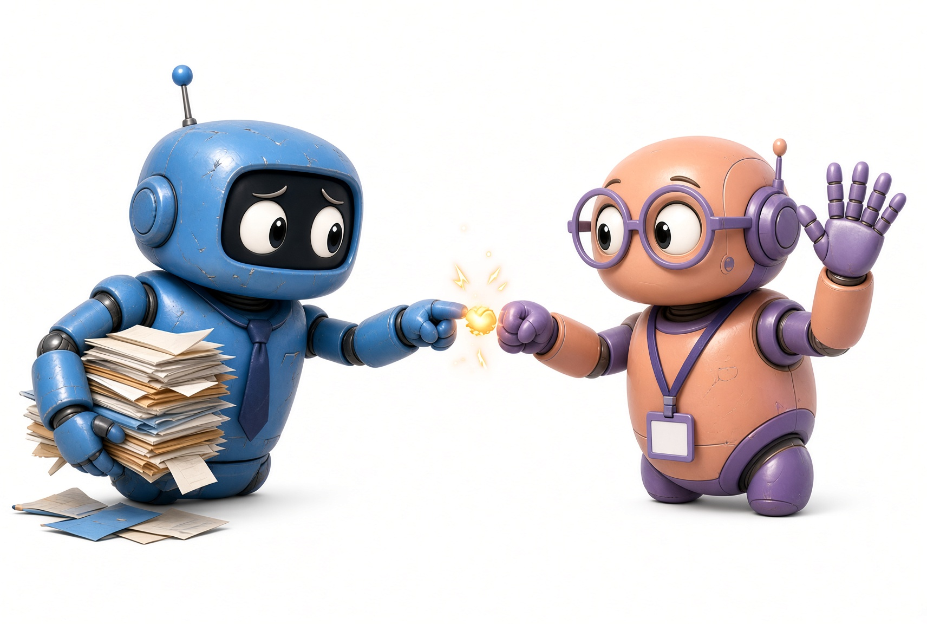
a2a-protocol.org

Slide 2
Agent to Agent Protocol
A shared way for AI agents to find each other, send a job, and share the result. Even when different companies built them.
Find
Log in
Send job
Work
Result
Notes:
Hello everyone. Thank you for coming. Today we will learn the Agent-to-Agent protocol. People also say A2A. It is not a product you buy from one vendor. It is a shared set of rules so one AI agent can work with another AI agent.
Look at the five boxes at the bottom. That is the whole story of a call. Find the other agent. Log in. Send the job. Let it work. Take the result. We will come back to this path many times.
Why does this matter now? Many teams already have an agent. The next problem is not one more model. The next problem is: how does my agent ask your agent for help when I cannot see your code, your tools, or your data? A2A is the answer we will study.
I will speak in simple words. If a word on the slide is new, I will explain it when we get there. Please save questions for the end of each part, or write them down.

Slide 3
MCP and A2A are open protocols and specifications.
  MCP is agent to tool, A2A is agent to agent.
AGENTS.md is a config file. Always loaded, so keep it short.
SKILL.md is a plugin format file. Schema plus folder, loaded on demand.
Subagents is an architectural design pattern. No spec, so every vendor does it differently.
Agentic harness is a wrapper for a model that must have tools, memory, and agentic loop. Use a framework. Don’t implement this yourself.
Notes:
It is more like a TL;DR of my talk in a university in Halden. Some important terminologies here, but we will focus on A2A… So.
MCP and A2A are external workflows. Let’s imagine each one of us has a software company….
a lot of us are already familiar with AGENTS.md and agent skills md files.
Subagents is just for your own solution. It is an internal workflow. You own it, you control it. You have a parent model here who decides where to delegate a task to its subagent.
Agentic harness is the term for the app that you are using where you can select a model you prefer.

Slide 4
What we will talk about
1. What A2A is, and what it is not
2. The problem: agents that cannot talk
3. Benefits, and when to use it
4. The main pieces and the call path
5. A2A next to MCP
6. Login and permission across companies
7. How your team can start
Notes:
Here is the map of the short presentation. First I will say what A2A is, and I will also say what it is not, because people mix it with tools and with chat products.
Second, the problem. I will use a trip example. A user asks one assistant to plan a trip. That job needs other agents that the assistant does not own.
Third, benefits and when to use it. A2A is not for every job. If you only need your own database, you do not need A2A.
Fourth, the pieces: Agent Card, task, message, result. Then the five step path.
Fifth, MCP. MCP is for tools inside your company. A2A is for agents you do not run.
Sixth, login and permission. This part matters because the other agent often belongs to another company.
Seventh, what you can. A card, a trusted list, one sample call.
If we run short on time, we will not skip the path slide or the login slide.

Slide 5
What A2A is
An open standard. Google started it. Many partners joined. It now lives with the Linux Foundation.
1 Find
2 Talk
3 Do the job
4 Stay private
Read the Agent Card. Learn skills and the web address.
Use normal web calls. HTTP, JSON-RPC, live updates.
A task can be short or long. Status can change.
Share the result. Do not share inner tools.
Works with LangGraph, CrewAI, ADK, and custom code. You do not need the same stack.
A2A is not a model, not a chatbot app, and not MCP. It is the shared language between agents.
Notes:
Agent to Agent. A2A.
It is an open standard. Google published it last year. Many companies joined. The work now sits with the Linux Foundation, so it is not only a Google tool.
Look at the four boxes. One, find. You read a small public file called an Agent Card. That file says who the agent is, what it can do, where to send work, and how to log in.
Two, talk. The talk uses normal web technology. HTTP. JSON-RPC. Live updates if the job is long. Your team already knows these.
Three, do the job. The unit of work is a task. A task has an id and a status. It can finish in one second or run for hours.
Four, stay private. The other agent is a black box. You get the result. You do not get their prompts, their tool list, or their customer database.
What A2A is not: it is not ChatGPT. It is not a model. It is not MCP. MCP is how a model uses tools. A2A is how one agent talks to another agent.
You can build the agent with LangGraph, Dotnet Agent Framework, Eve in Vercel, Google ADK, or your own code but I would not recommend that.

Slide 6
The public file is the Agent Card. It is how other agents find yours.
What it is
A small public description of the agent. Who it is, what skills it has, where to send work, and how to log in. It is not the agent code. It is not the customer data. Think of it as a name tag plus a shop sign.
File name and place
File name: agent-card.json
Usual public URL: https://your-agent.example.com/.well-known/agent-card.json
Older clients may also look for /.well-known/agent.json
HTTP GET. Response type is JSON (application/json, some stacks say application/a2a+json)

Slide 7
Format
JSON. Not YAML. Not XML. Not .env.
Do not put secrets in it. List the login method only. Tokens go in HTTP headers later.
Here is a sample you could serve at /.well-known/agent-card.json:

Slide 8
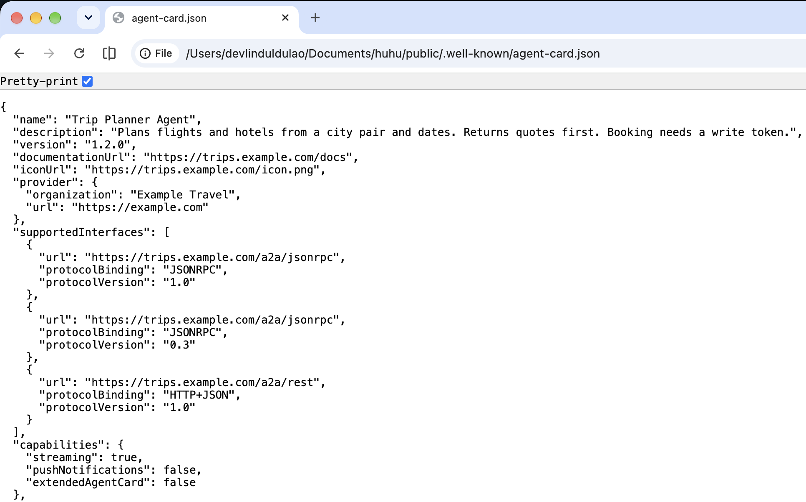

Slide 9
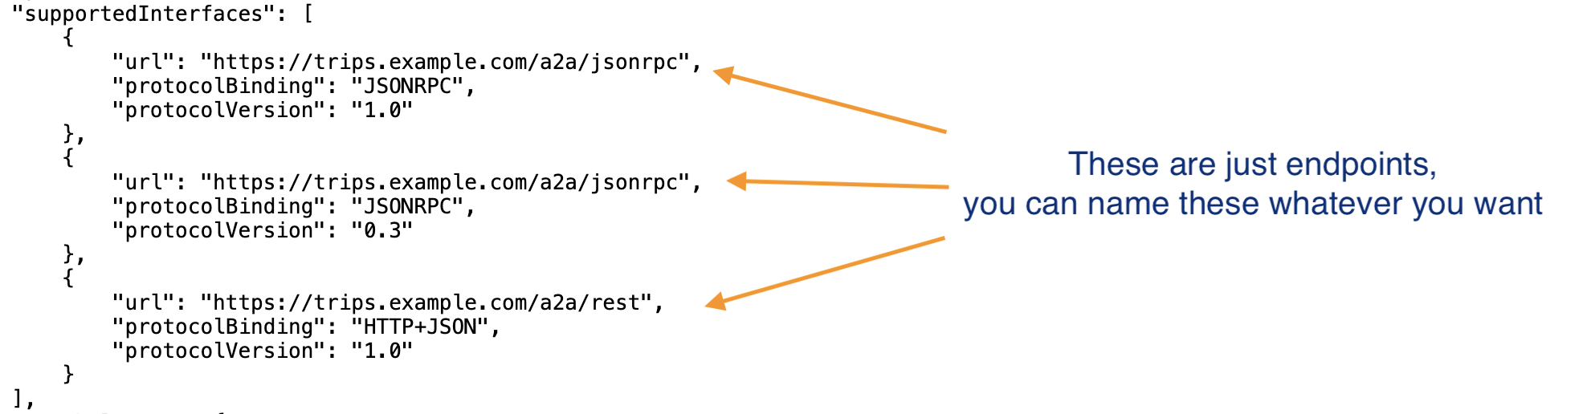

Slide 10
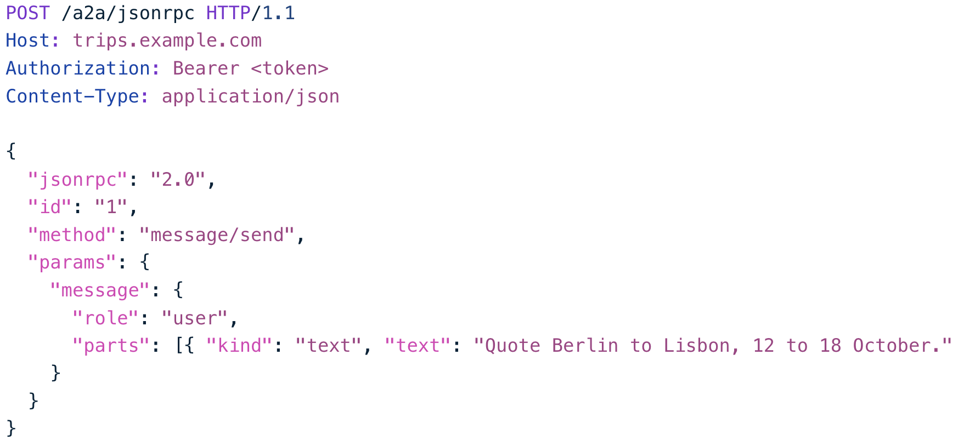
Notes:
A call to your “work URL” looks like this shape.
Your server answers with a task or a result. That reply is also JSON.

Slide 11
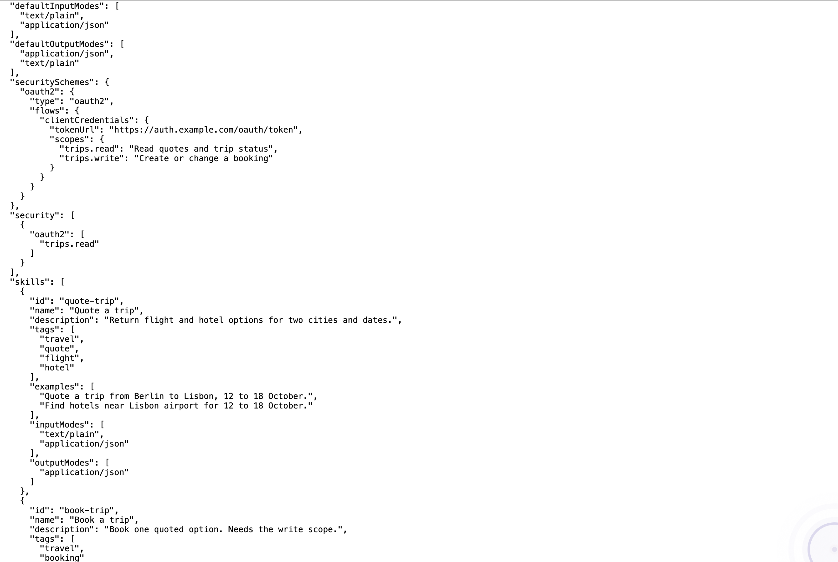

Slide 12
The problem without A2A
A user says: plan my trip. One assistant cannot do it alone.
Your assistant
Has the user goal. Needs help.
No shared path. Each pair needs a custom link. That is slow, costly, and often unsafe.
Flight
Hotel
Money
Local
Other vendor
Other vendor
Other vendor
Other vendor
Notes:
This picture is the problem. The yellow box is your assistant. The user asked it to plan a trip. The assistant is good at talk, but it does not own flights, hotels, currency, or local tickets.
Those four specialists live in other companies. They use other software. They have other rules. Today, with no shared standard, your team would build four private connections. Next year a fifth vendor appears, and you build again.
Three extra problems hide here.
First, people wrap an agent as a simple tool. A tool returns a number and stops. A real agent may need to ask: which dates? what budget? A tool cannot do that well.
Second, custom links often skip login, or they put a password inside the message body. That is how leaks start.
Third, there is no common job ticket. When something fails, your log and their log do not share an id. Nobody can find the same call.
A2A exists to give those four boxes one shared path up to the assistant.

Slide 13
Why A2A helps
Work across teams
Less glue code
Agents from different vendors can join one job without a shared runtime.
You write the agent once. Partners speak the same rules.
Long jobs are normal
Many kinds of content
A task can run a long time and send status while it works.
Text, forms, files. Later also sound or video.
Inner work stays home
Same safety steps
You send the job. You get the result. Tools stay inside.
Every partner uses the same login pattern and the same job id.
Notes:
Six benefits. I will give one sentence for each.
Work across teams. Your flight agent and their hotel agent do not need the same programming language.
Less glue code. Without A2A, every new partner is a new project. With A2A, the partner publishes a card and you already know how to call it.
Long jobs are normal. Booking a trip is not one click. A2A can stream status: still searching, need your passport number, done.
Many kinds of content. Not only chat text. A form. A PDF. A table.
Inner work stays home. This is a business benefit and a safety benefit. You do not hand over your secret process.
Same safety steps. Your security team learns one pattern. They do not review a new private API every month.
So again, A2A lets us work with agents we do not own, without opening our system.

Slide 14
When and where to use A2A
Use A2A when
Do not use A2A when
The other agent is outside your process. Another team, another company, or another tool. You need a job done, not a copy of their system.
You only need your model to read your own database or files. That is a local tool job. Use MCP there.
Good places
Who builds with it
An order across pricing and shipping. Travel across vendors. Health records between providers. A locked specialist inside your own company.
Teams on LangGraph, CrewAI, Google ADK, or custom code. SDKs exist for Python, JavaScript, Java, Go, and more.
Notes:
When and where to use A2A.
Use A2A when the other agent does not live in your process. That includes another team in your company if they refuse to share their runtime. It also includes a vendor.
Do not use A2A when you only need Postgres, a file folder, or a calculator you already run. That is MCP. MCP is closer, simpler, and should stay inside your network.
Good places: an order that needs pricing, legal, and shipping. A trip. Two hospitals that must pass one record. Or an inside specialist that must stay locked, for example a tax engine that may not leave a secure room.
You can use MCP and A2A together. MCP under your agent. A2A between agents.
A common mistake: wrapping a foreign agent as a local MCP tool. That hides login and pulls too much context across the company line. Do not do that.

Slide 15
A2A and MCP do different jobs
Your company
Their company
A2A agent
A2A agent
Asks the other agent for help.
Does the work and sends the result.
MCP tools
MCP tools
Your database, files, local tools.
Their database, files, local tools.
Your data
Their data
Stays inside your wall.
Stays inside their wall.
Notes:
I created color-coded boxes here to separate things.
Yellow is data. It never crosses by default.
Green is MCP. That is how an agent uses tools next to its own data. Each company has its own MCP layer. There is no arrow between the green boxes.
Purple is A2A. That is the only layer that crosses the company line. Your agent sends a job. Their agent sends a result.
If someone says we already have MCP so we do not need A2A, show this slide. MCP does not solve the crossing. A2A does not replace MCP. They stack.
The crossing is also why login belongs in A2A. You are leaving your wall.

Slide 16
The main pieces
Agent Card
Task
Message
Result
Who they are, what they can do, where to call, how to log in.
One job with an id. You can follow it over time.
One turn. A question, an answer, a file, a form.
The finished output. This is what you take home.
Status of a task
Submitted
Working
Needs input
Done
Failed
Notes:
Four pieces on the top row.
Agent Card. A JSON file, often at slash dot well-known slash agent-card.json. It is a name tag and a shop sign. It lists skills and the login method. Do not put passwords in this file.
Task. One unit of work. It has an id both companies can write in their logs. That id is how you debug later.
Message. One turn. Role is user or agent. Inside a message you can put text, a file, or structured data.
Result. The docs also say artifact. I will say result. It is the thing you wanted: a booked plan, a report, a table.
Bottom row: life of a task. Submitted means they accepted the job. Working means they are busy. Needs input is important. That is how the other agent asks a question instead of guessing. Done means you can take the result. Failed means stop and read the error. There is also canceled, if someone stops the job.
A very short answer can be only a message, with no task. A long job should always be a task so you can follow it.

Slide 17
How a call works
1
2
3
4
5
Find
Log in
Check rights
Send work
Get result
Get the Agent Card.
Get a token if the card asks.
May you start this skill?
Send a message. A task may start.
Take the finished output.
Three ways to wait: one reply, live updates, or a later notice. Three roles: user, your agent, their agent.
Notes:
This is the path. I will walk it slowly.
Step one, find. Your agent loads the Agent Card from a known web path, or from a private list your company keeps.
Step two, log in. The card says how. Maybe OpenID. Maybe a bearer token. Maybe an API key. You get that proof from a login server, not from the card file. You send the proof in the HTTP header, not inside the job text.
Step three, check rights. A valid login is not a free pass. Their server asks: may this caller start this skill? Read a price is not the same as pay a bill. If the answer is no, you get 401 or 403. Stop. Do not send the job.
Step four, send work. You send a message. If the work is long, they create a task and you follow the task id.
Step five, get the result. Status becomes done. You take the output. You do not take their inner steps.
You can wait in three ways. One reply if the job is fast. Live updates if you keep a connection open. A later notice to a web address you give them, if you cannot stay connected.
Three roles. The user sets the goal. Your agent is the client. Their agent is the server. Tomorrow the roles can flip. Then you must check their token the same way.

Slide 18
Typical order in login and permission stage of A2A:
Their agent GETs your Agent Card.
Their agent talks to the IdP (token endpoint, or token exchange).
IdP returns a token.
Their agent POSTs to your work URL with Authorization: Bearer ....
Your gateway or middleware checks TLS, then the token (signature, issuer, audience, expiry).
Your auth layer maps token → user + agent + scopes.
Your permission layer asks: may this caller run this skill on this user’s rows?
Only then does the A2A handler open the JSON and start a task.
Notes:
If 5–7 fail, the handler should not run. Return 401 or 403.
You can put 5–7 in an API gateway so the work URL handler never sees a bad call. Same pattern as a locked REST API. A2A just adds the card and the task envelope around that.

Slide 19
How a call works
1
2
3
4
5
Find
Log in
Check rights
Send work
Get result
Get the Agent Card.
Get a token if the card asks.
May you start this skill?
Send a message. A task may start.
Take the finished output.
Three ways to wait: one reply, live updates, or a later notice. Three roles: user, your agent, their agent.
Notes:
This is the path. I will walk it slowly.
Step one, find. Your agent loads the Agent Card from a known web path, or from a private list your company keeps.
Step two, log in. The card says how. Maybe OpenID. Maybe a bearer token. Maybe an API key. You get that proof from a login server, not from the card file. You send the proof in the HTTP header, not inside the job text.
Step three, check rights. A valid login is not a free pass. Their server asks: may this caller start this skill? Read a price is not the same as pay a bill. If the answer is no, you get 401 or 403. Stop. Do not send the job.
Step four, send work. You send a message. If the work is long, they create a task and you follow the task id.
Step five, get the result. Status becomes done. You take the output. You do not take their inner steps.
You can wait in three ways. One reply if the job is fast. Live updates if you keep a connection open. A later notice to a web address you give them, if you cannot stay connected.
There are three roles in this process. The user sets the goal. Your agent is the client. Their agent is the server.

Slide 20
When the other agent is not yours
Your company
Their company
Your agent, your tools, your data. The other side should not see these.
Their agent, their tools, their data. You should not see these.
A2A path
Job and result only
You will not get their code. That is why login, permission, and this narrow path sit in the shared rules.
Notes:
Blue is you. Peach is them. Purple in the middle is A2A.
This is the hard case, and it is the case A2A was built for. You cannot review their source. You cannot join their user directory. You should not copy their tools into your agent.
So the protocol must do three things that a random private API often forgets.
One, a standard way to prove who is calling.
Two, a standard way for the owner to say this caller may start this skill, but not that skill.
Three, a narrow path. Only the job and the result cross. Your agent’s template prompts and tool lists and customer data will not be exposed to the other agents sending requests.
If your partner cannot meet those three, do not connect. A2A does not replace your login system. It tells both agents how to use the login system you already have.

Slide 21
How to start a POC
1. Publish an Agent Card with a real login method. Not open access.
2. Keep a private list of partners you trust.
3. Use the login system you already have. A2A does not replace it.
4. Run one sample server. Send one message. Then try live updates.
5. Start with one simple read skill. Add write or pay later.
6. Read a2a-protocol.org, agent2agent.info and the enterprise ready page.
Notes:
Six actions you can take for a proof-of-concept.
One. Publish a card. Put a real login method on it. A sample card that allows anyone is fine on a laptop. It is not fine in production.
Two. Make a private list of partners. That list is your allow list.
Three. Keep Entra-ID or whatever you use. A2A only says how to present the token.
Four. Run your agent. Fetch the card with a simple GET. Send one message. Then turn on live updates so you feel a long job.
Five. First skill should be read only. A quote. A search. Not a payment. Add write skills after the path is proven.
Six. Read the official docs a2a-protocol.org and community maintained learning website agent2agent.info.

Slide 22
Takk for meg!

