Slide 1
Why it feels that CSS is like dating?
( wait for it… )
Notes:
Hello everyone. I want to start with a question.
How many CSS developers does it take to change a lightbulb?

Slide 2
You think you've finally found the right one, then !important shows up.
Notes:
None. They change everything around it and hope it cascades.

Slide 3
Why LLMs & JS frameworks
love Tailwind CSS
…and why you should too
@DevlinDuldulao
Senior consultant at SoftwareOne Norway

Slide 4





















































Titanium Sponsors
Platinum
Sponsors
Gold
Sponsors
Friends of KCDC
Other Awesome Organizations

Slide 5


Slide 6
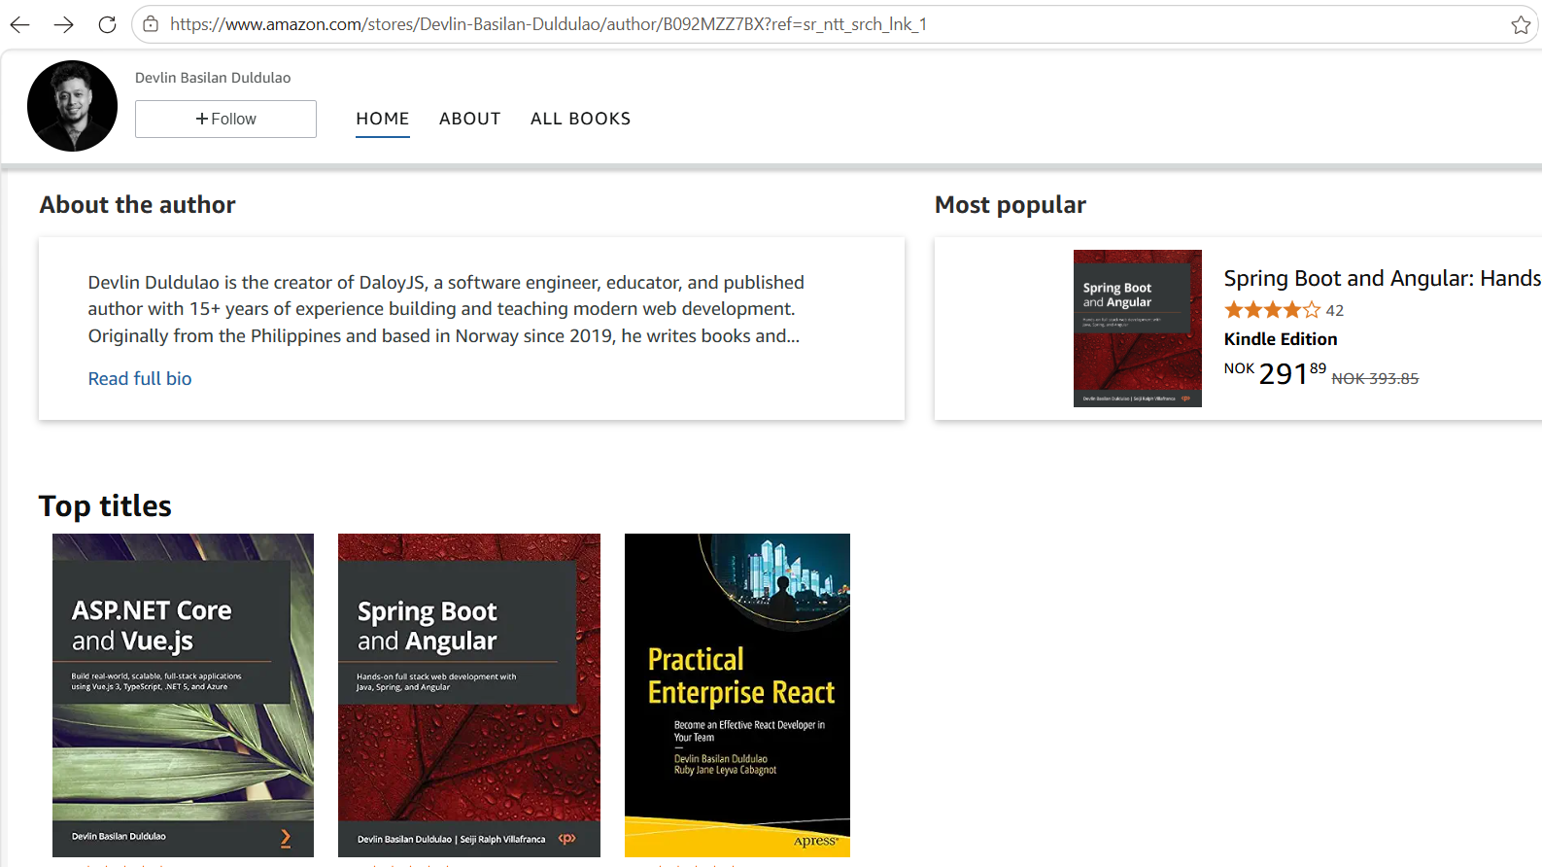


Slide 7
15 years of methodology wars
Vanilla
OOCSS
BEM
SMACSS
Atomic
CSS Modules
CSS-in-JS
Tailwind
2005
2009
2010
2011
2013
2015
2016
2017→
Notes:
For fifteen years, frontend developers fought methodology wars.
Vanilla CSS in 2005.
Then OOCSS in 2009, object-oriented CSS, which said reuse objects, not pages.
BEM in 2010, block element modifier, which tried to make naming systematic.
SMACSS in 2011, scalable and modular architecture.
Atomic CSS in 2013.
CSS Modules in 2015, which scoped names to a file.
CSS in JS in 2016, which put styles back into JavaScript.
Then Tailwind, from 2017 on.
Every one of these tried to answer the same two questions. Where do styles live? And what do we name them? That is the whole war. Location, and naming.
Most of these methodologies answered those questions with more rules. More naming conventions. More files. More process.
Tailwind is interesting because it mostly deletes those questions instead of answering them better. You stop inventing names. You stop splitting the look into another file.

Slide 8
The machines have voted.
v0
bolt.new
Lovable
Vercel
StackBlitz
full-app gen
Claude Artifacts
shadcn/ui
Cursor, Copilot
Anthropic
default for AI tools
lean Tailwind
Notes:
This what happened in the past two years. The machines have voted.
v0 from Vercel generates UI in Tailwind.
bolt.new from StackBlitz does the same.
Lovable generates full apps in Tailwind.
Claude Artifacts from Anthropic.
shadcn is the default component system the AI tools reach for.
Cursor and Copilot lean Tailwind every time you ask for a component.
Every major AI UI generator defaults to Tailwind. Not because Tailwind won a popularity contest with humans. Because the way Tailwind is shaped matches the way a language model, and a teammate, actually understand code. And for the news flash, Tailwindcss is joining Shopify. The reason is they have a new hydrogen framework that is using React Server Component.

Slide 9
Naming things
“There are only two hard things in computer science: cache invalidation and naming things.”
Every element needs an invented, project-specific name
Names drift: card / Card / cardWrapper / card-box
Humans AND ai agents invent inconsistently across a session
styles.css
.card__header--featured {
border-color: #75dfbc;
}
.card__cta { … }
.card__badge { … }
Notes:
Problem number one. Naming things.
Semantic CSS makes you invent a name for every element, and those names are project-specific.
Then they drift. card. Card. cardWrapper. card-box. Four names for the same idea, invented by four people, or by one person on four different days.
Humans invent inconsistently. Models invent inconsistently.
This styling here for example. card header featured. What does featured even mean in this file? Is it a thicker border? A badge? A different button color? You cannot know until you read the CSS.
Tailwind deletes the naming decision. You do not name the thing. You describe the look with a closed vocabulary.

Slide 10
Separation of concerns
Component.tsx
styles.css
<div className="card--featured">
🔗
.card--featured { … }
Notes:
Separation of concerns.
We were taught to keep markup in one file and styles in another. That sounded clean. In practice, the component file has a class name, the stylesheet has the rule, and they are joined only by a magic string. card featured on one side. The same string on the other. A pointer. Not a spec.

Slide 11
Tailwind = co-location
Everything about the component, in one place.
PricingCard.tsx (the whole component)
// no CSS file. no class names. no cascade.
<button className={cn(
"rounded-lg px-4 py-3 font-bold",
featured && "bg-mint text-ink hover:bg-mint/80"
)}>
Choose plan
</button>
Notes:
The fix is co-location. Tailwind puts markup and style in one place.
Look at this button. There is no CSS file. There are no invented class names. There is no cascade to reason about. rounded-lg, px-4, py-3, font-bold. And if it is featured, a background, a text color, and a hover state. Everything about how this button looks is sitting on the button.
An LLM sees the entire spec in one span of tokens. A teammate sees the same thing. You do not open a second tab. You do not search for a class name. You read the component and you are done.
That is the whole trick. Markup and style live in one place.
Before vibecoding days, you can say that this is ugly, but using shadcn ui I saw how to write best practice tailwindcss code in components. You will see later how in my demo.

Slide 12
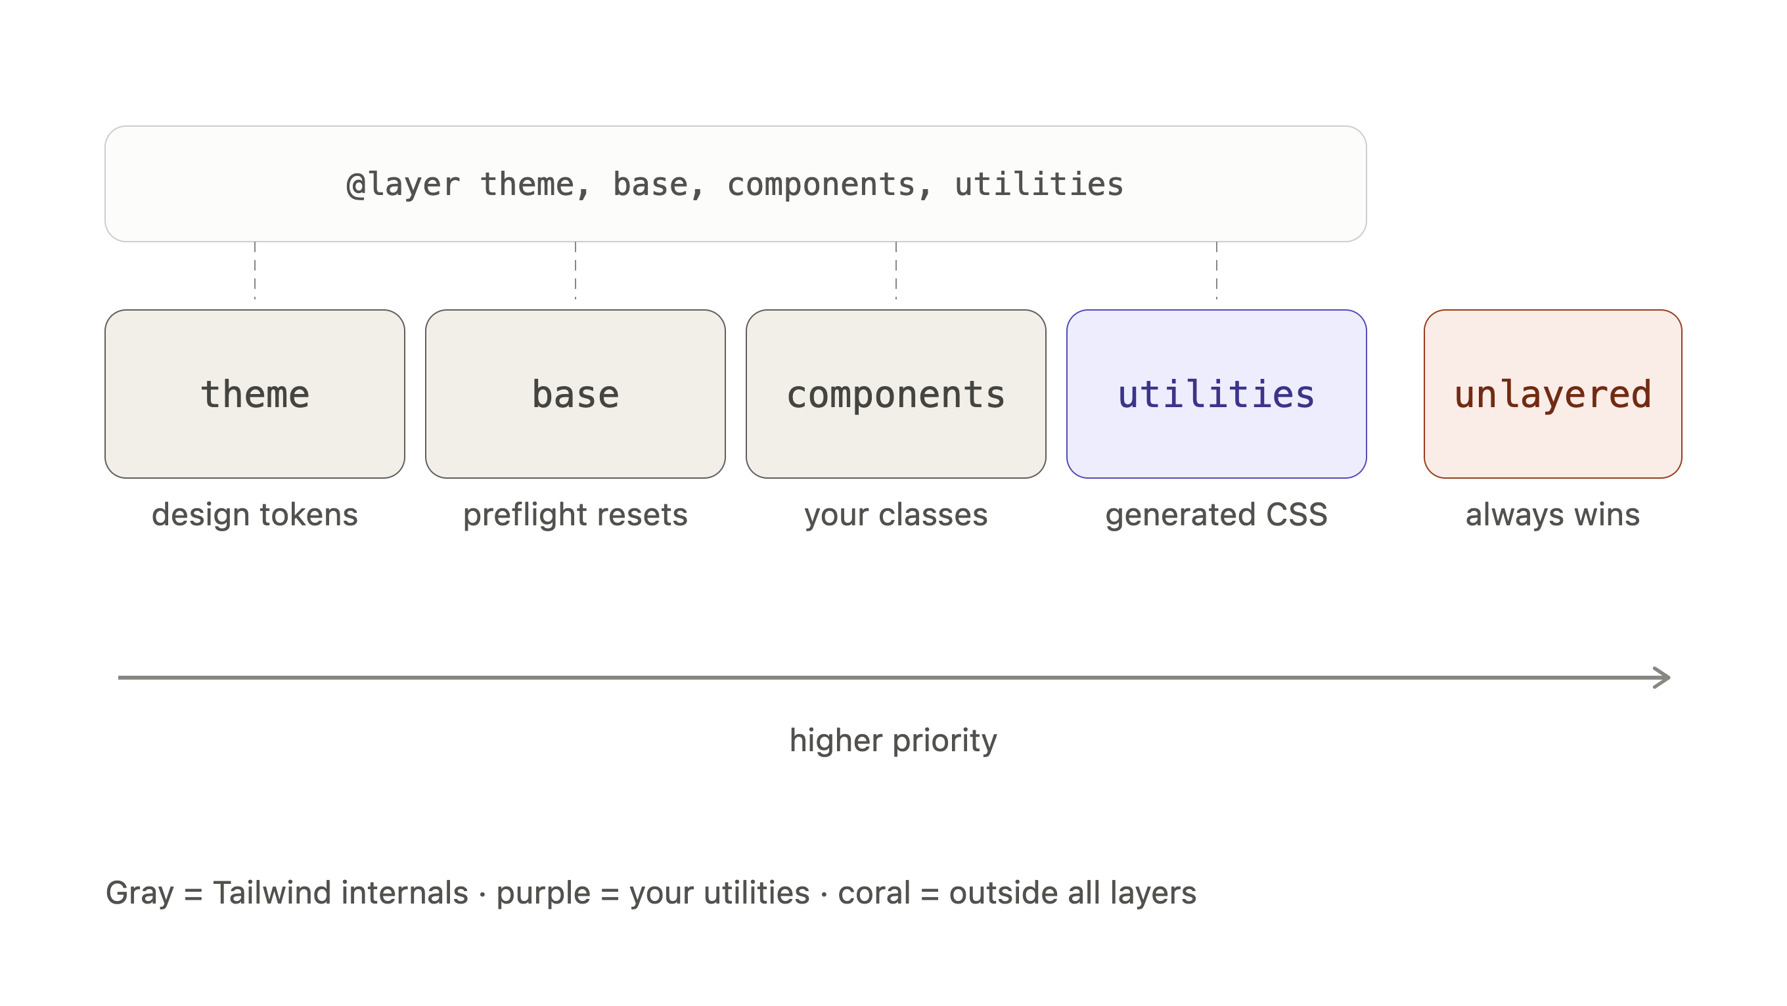
Notes:
Tailwindcss rules in priorities looks like this.
Each box is a place a CSS rule can live, and the arrow tells you which one wins a conflict in styling.
The four named layers come from @import "tailwindcss", which declares their order up front. The coral or redish box isn't a layer or unlayered styles means styles are CSS rules written outside of any explicit @layer block, meaning they always take absolute precedence over Tailwind's built-in utility and theme layers

Slide 13
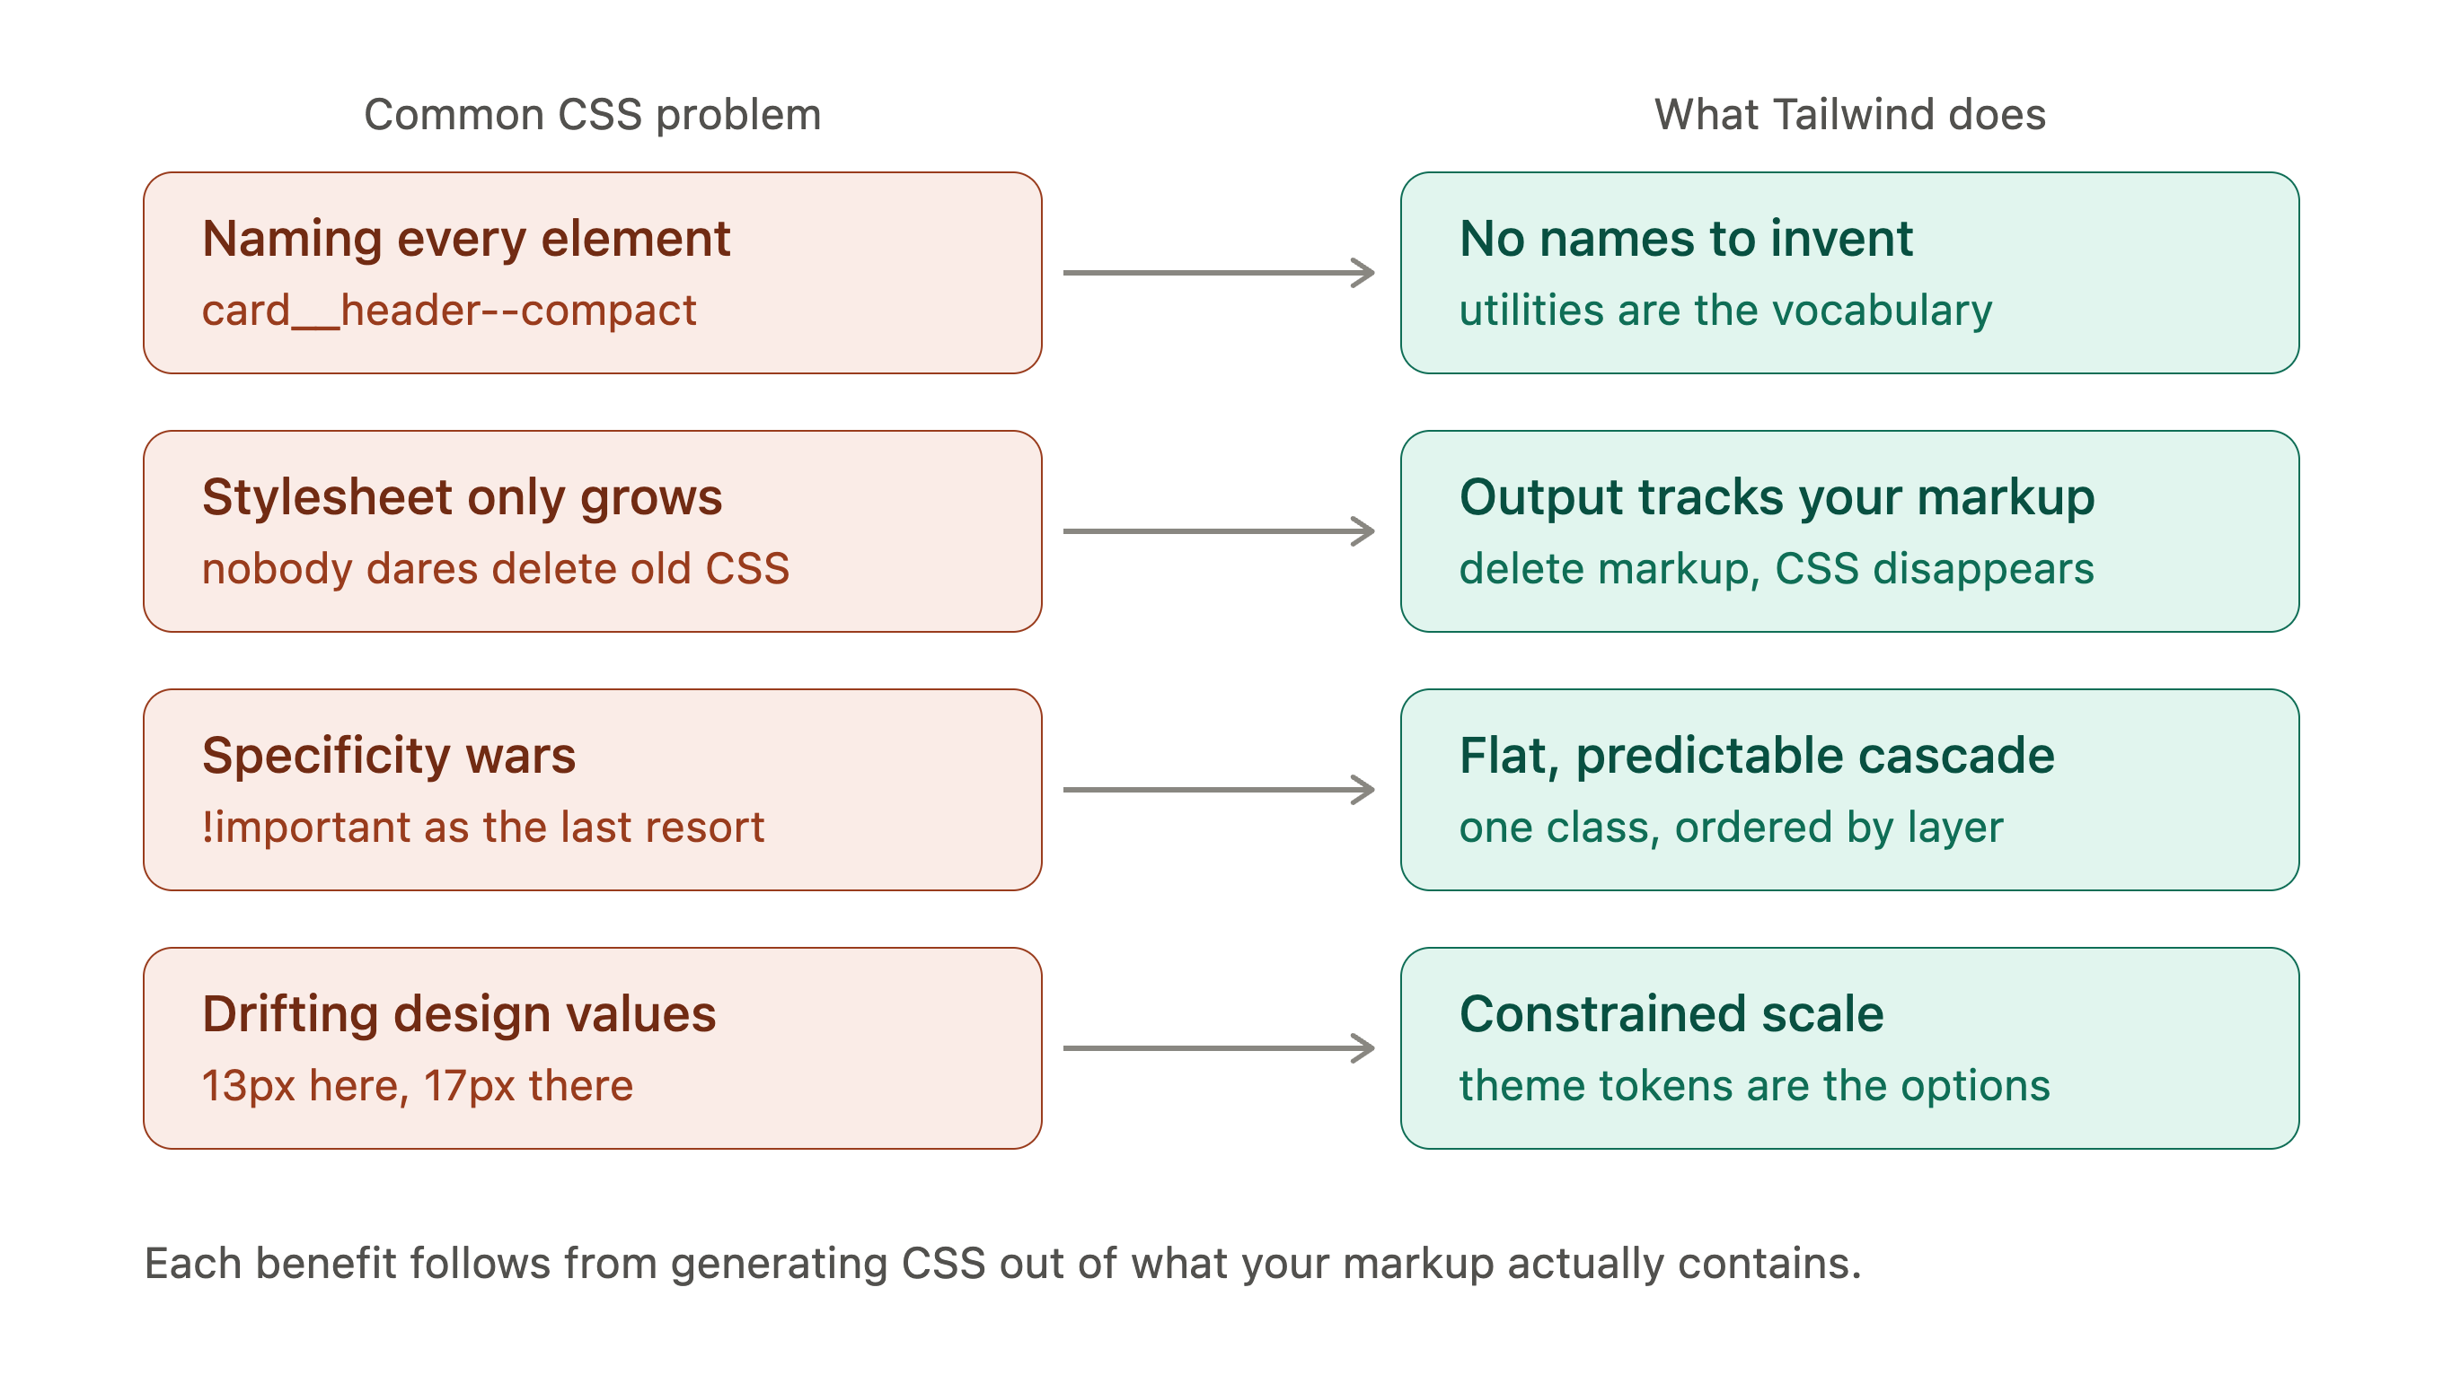
Notes:
And tailwindcss gives you some solutions to your common css problems.

Slide 14


Slide 15
Vibecoding without design system

Slide 16
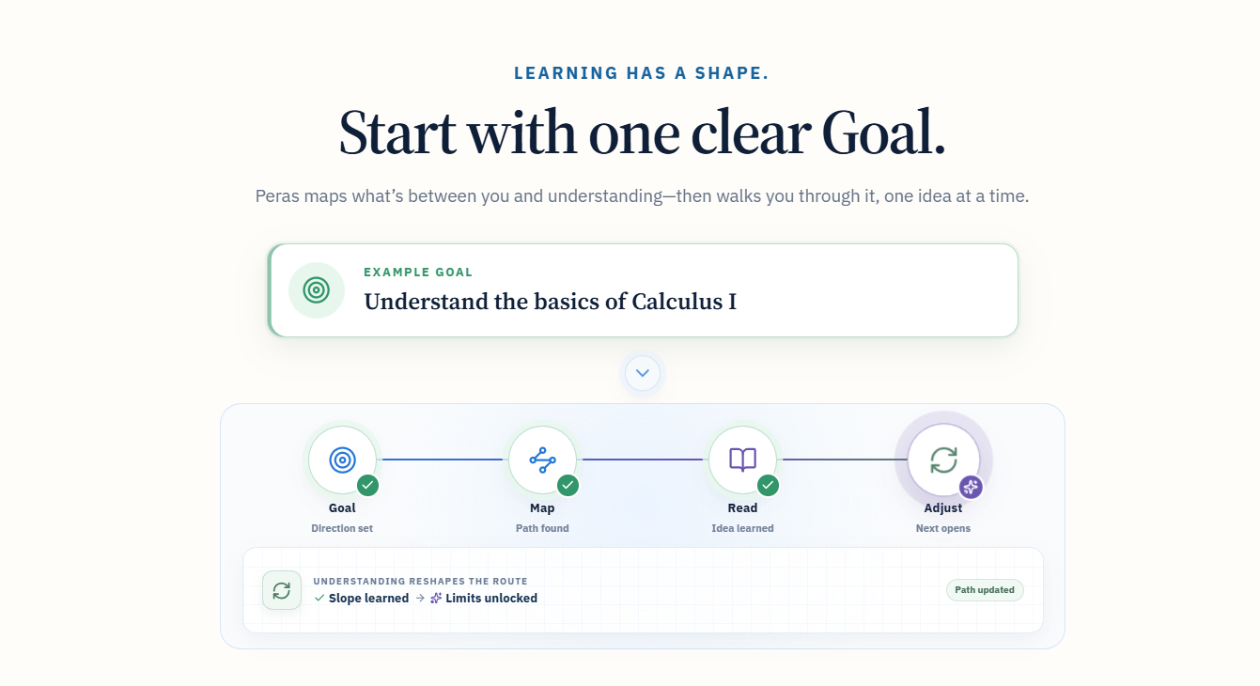

Slide 17
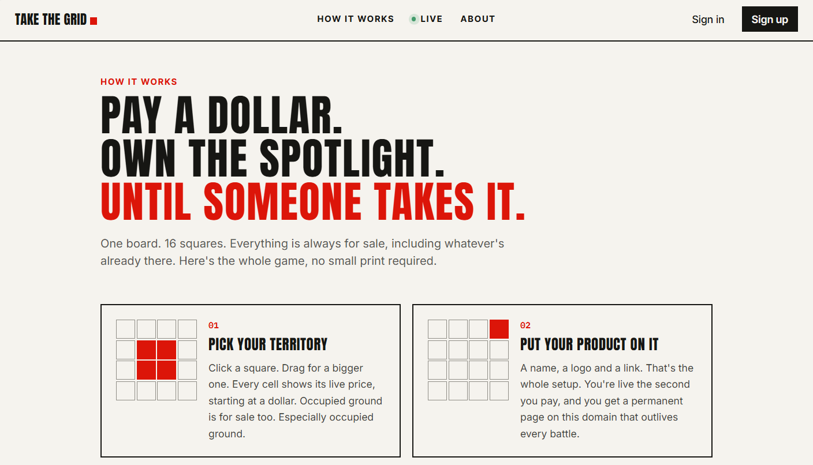

Slide 18
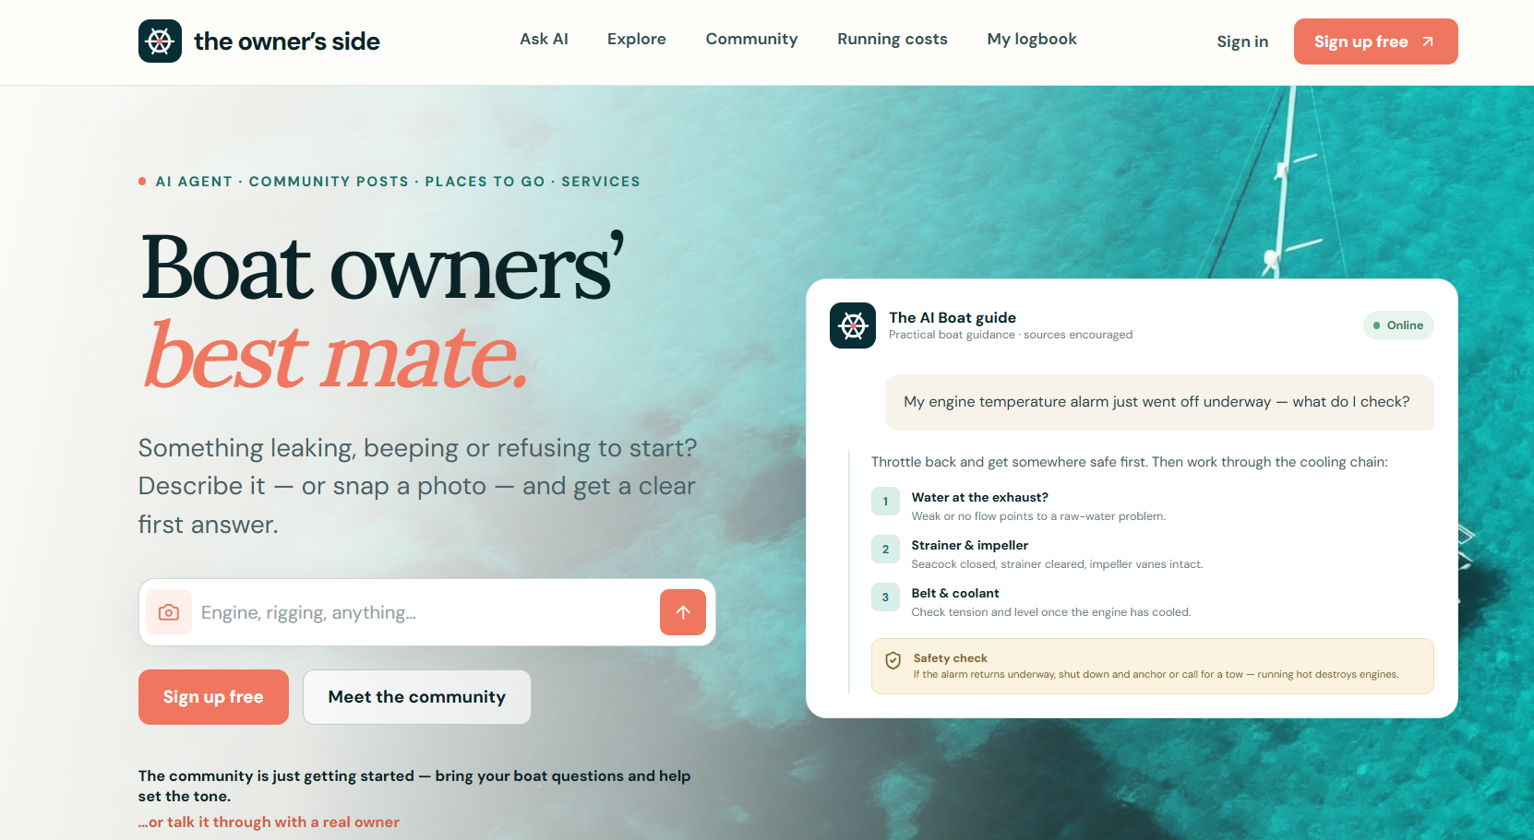

Slide 19


Slide 20


Slide 21
Demo
ui.shadcn.com/create
and a real-world project

Slide 22
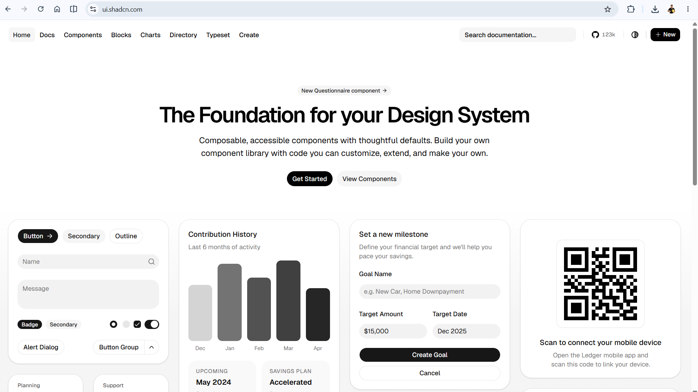
Notes:
shadcn/ui is not a finished design system; it's a foundation for building your own design system.

Slide 23
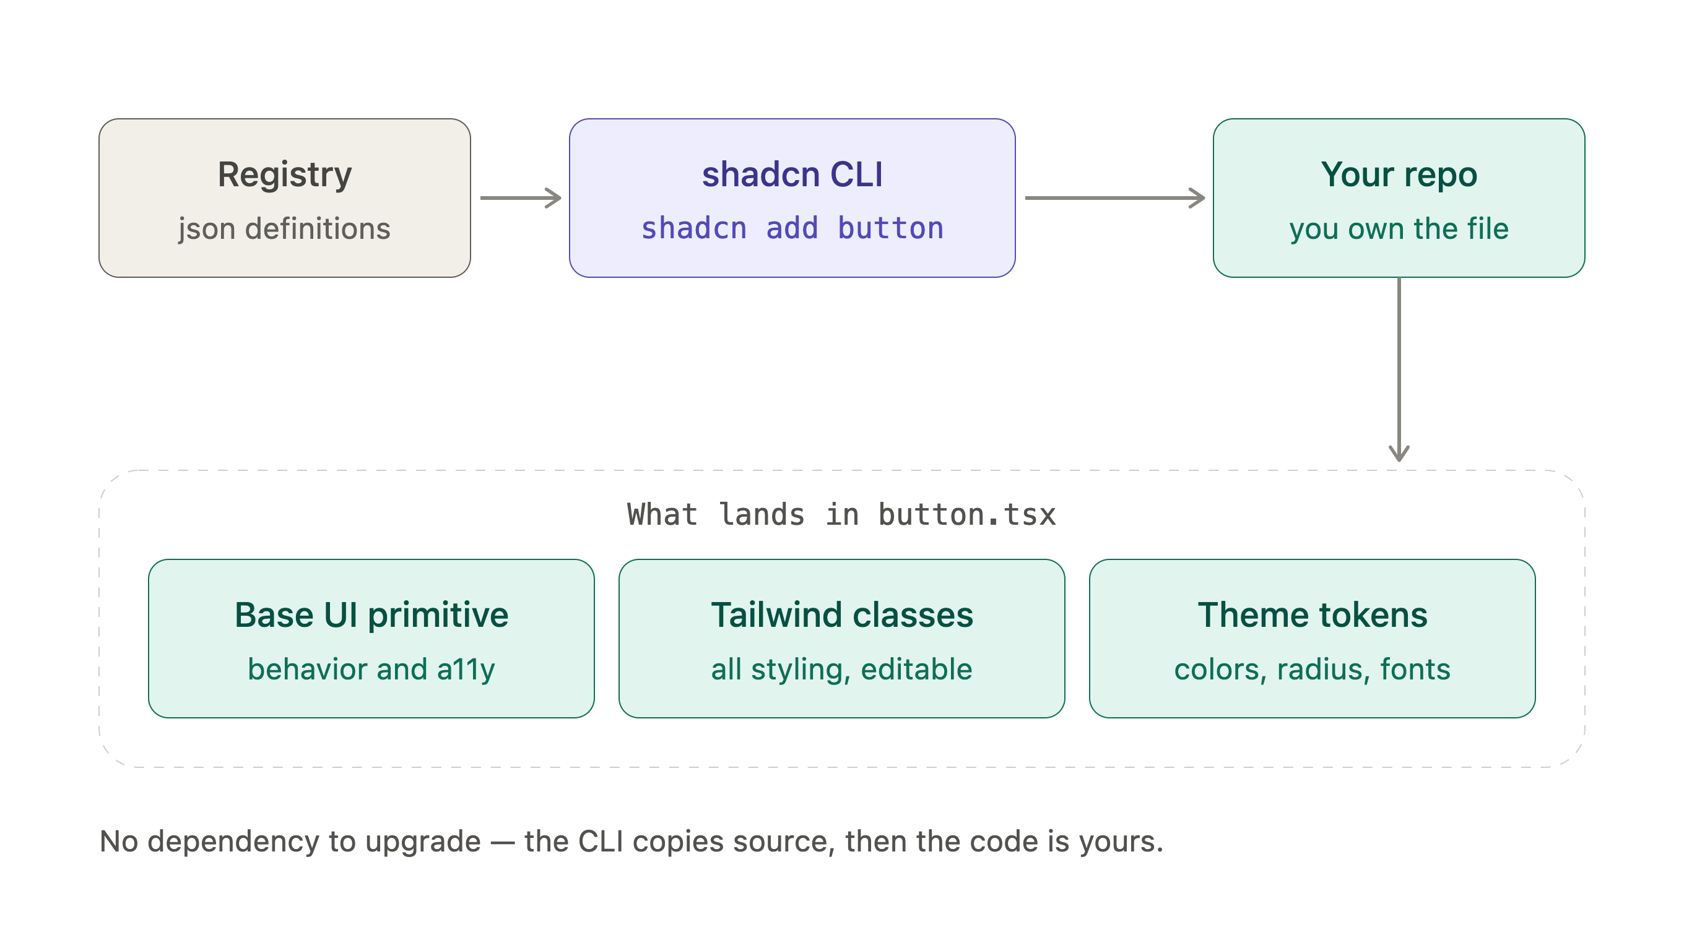
Notes:
shadcn distributes code rather than a package:
the registry serves JSON definitions,
the CLI writes real .tsx files into your repo,
and nothing links back afterward since the component never lands in node_modules.
The three boxes at the bottom are the layers inside each file.
Base UI handles keyboard, focus, and ARIA,
Tailwind carries every visual decision as editable classes,
and your theme tokens supply the values. That's why customizing means opening the file instead of overriding from outside.
The trade-off is that you own the maintenance, though add --diff will show you what changed upstream so you can merge deliberately.

Slide 24
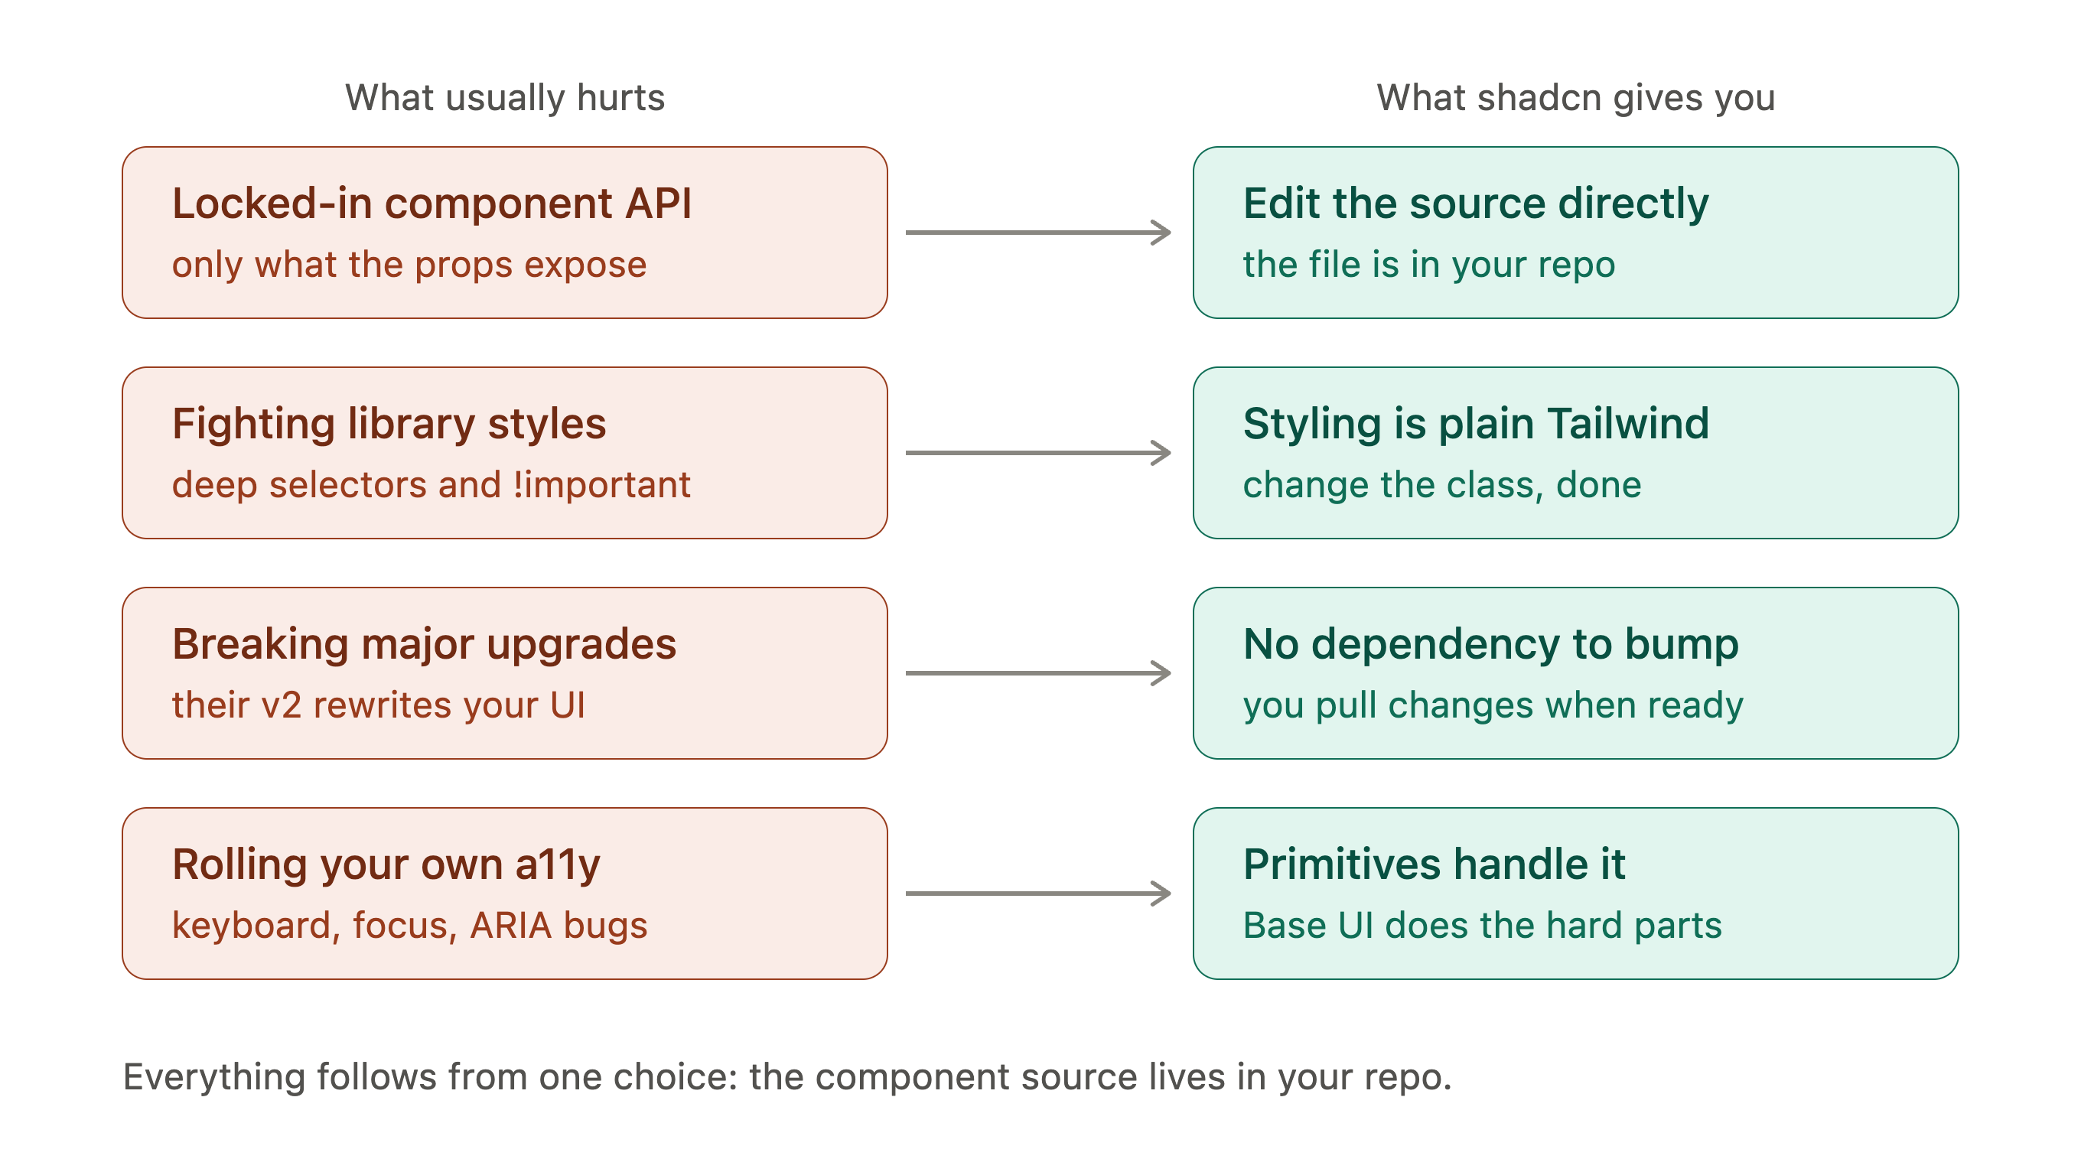
Notes:
Rows 1 through 3 all trace back to the same decision — the source lives in your repo, so there's no props API to work around, no foreign CSS to override, and no version to bump.
Row 4 is the separate win: Base UI supplies the keyboard, focus, and ARIA behavior that's genuinely hard to get right by hand.
Being compliant in accessibility is a headache if you will write them manually. Especially in Europe, any public facing app should be accessible by default.

Slide 25
Why coding models love tailwind css and shadcn-ui?

Slide 26
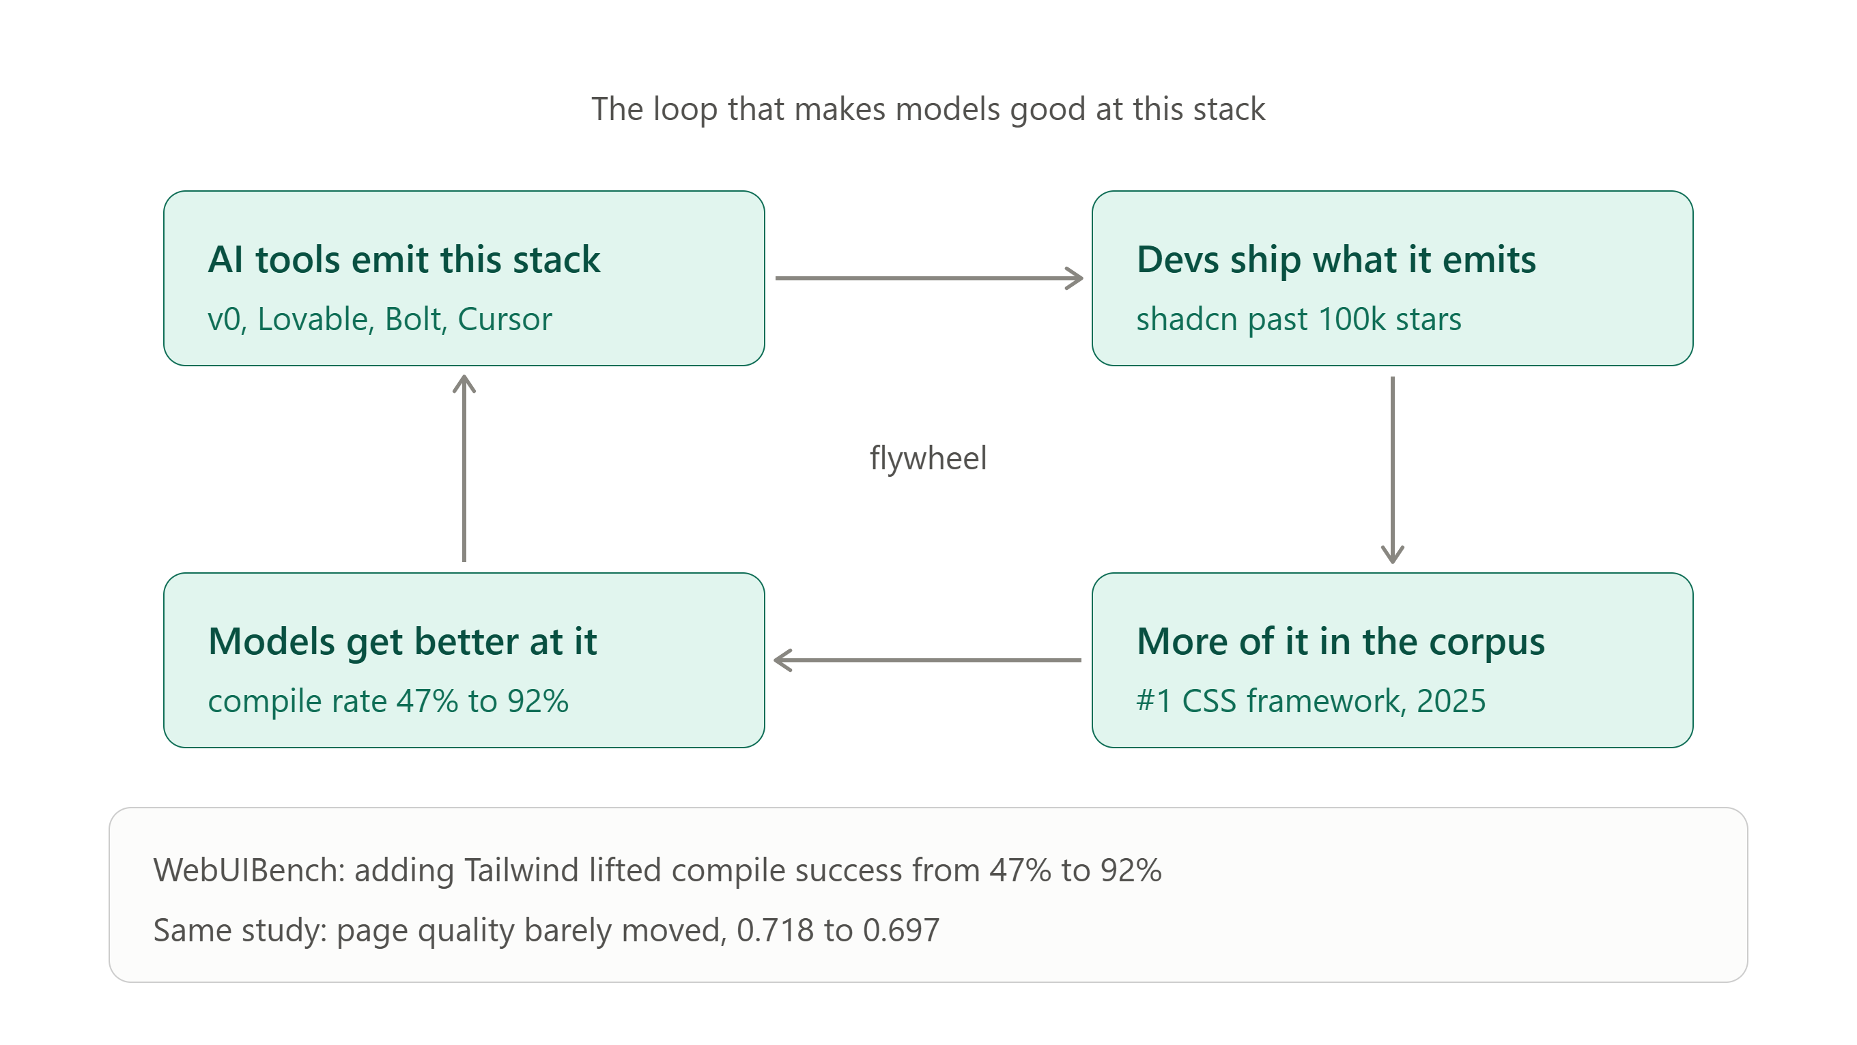
Notes:
The hardest evidence is WebUIBench: generating the same 100 UI images with and without a Tailwind instruction moved compilation success from 47% to 92%.
Adoption backs it up — Bolt, Lovable, v0, and Cursor emit shadcn/ui by default, with v0 restricted to React plus Tailwind plus shadcn, and the reason given is architectural, since visible owned source is easier for a model to read and modify than an opaque library abstraction.
shadcn passed 109,000 GitHub stars by March 2026,
Tailwind ranked first in State of CSS 2025 and shadcn now ships official AI skills for agents.

Slide 27
Why coding models love JavaScript and TypeScript libraries and frameworks?

Slide 28
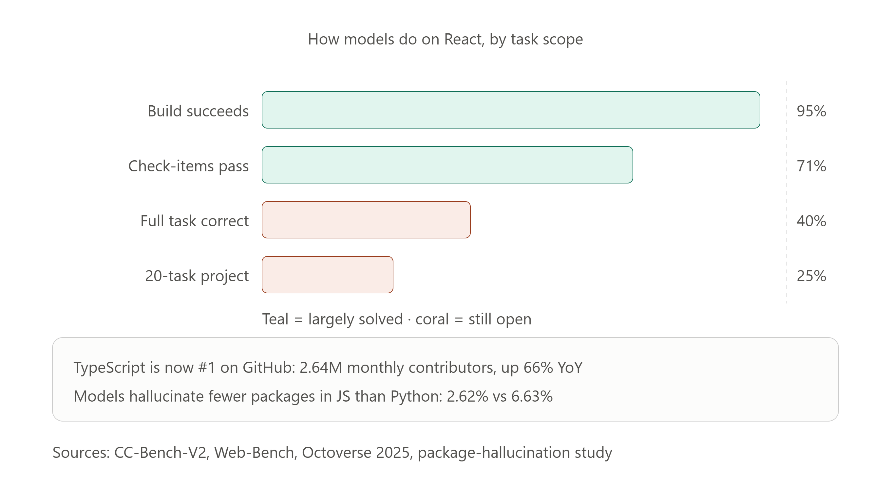
Notes:
On CC-Bench-V2's frontend suite, generated React projects built successfully 95% of the time for Claude Opus 4.5 and 100% for GLM-5, with check-item pass rates near 71%.
TypeScript became GitHub's most-used language in August 2025 at 2,636,006 monthly contributors, up about 1.05 million year over year, which GitHub credits to typed languages being more reliable for agent-assisted coding and frameworks scaffolding TypeScript by default.
and package hallucination rates across the 2026 frontier cohort were consistently lower for JavaScript than Python, 2.62% versus 6.63% for Claude Sonnet 4.6.

Slide 29
What to do if you want to use a newly release framework?

Slide 30
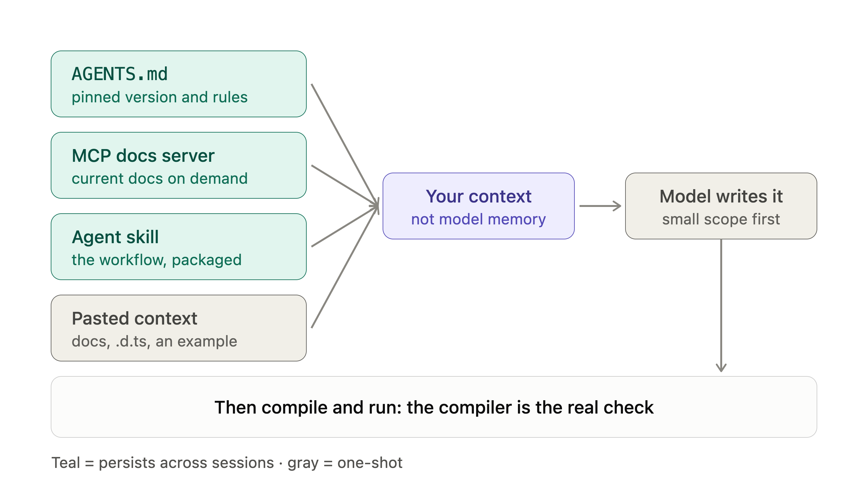
Notes:
AGENTS.md holds facts that don't change — the pinned version, the import styles.
An MCP docs server fetching current docs on demand instead of a snapshot that goes stale.
A skill packages the procedures: which command, which flags, what to check.
Copying and pasting prompt context is gray because it dies with the chat, though it's still the fastest way to try something once.

Slide 31
Knowledge atrophy is the gradual weakening of human thinking and problem-solving skills through overreliance on AI to do our mental work.
Notes:
Knowledge atrophy, or cognitive atrophy, is the gradual decline of memory, critical thinking, and problem-solving skills caused by overreliance on AI tools like LLMs for mental work.
Keep learning the technical details of things that you are building. This will help you in the future in guiding agents to the right directions. It will save money because of lesser prompting. And lastly it will improve your skills

Slide 32
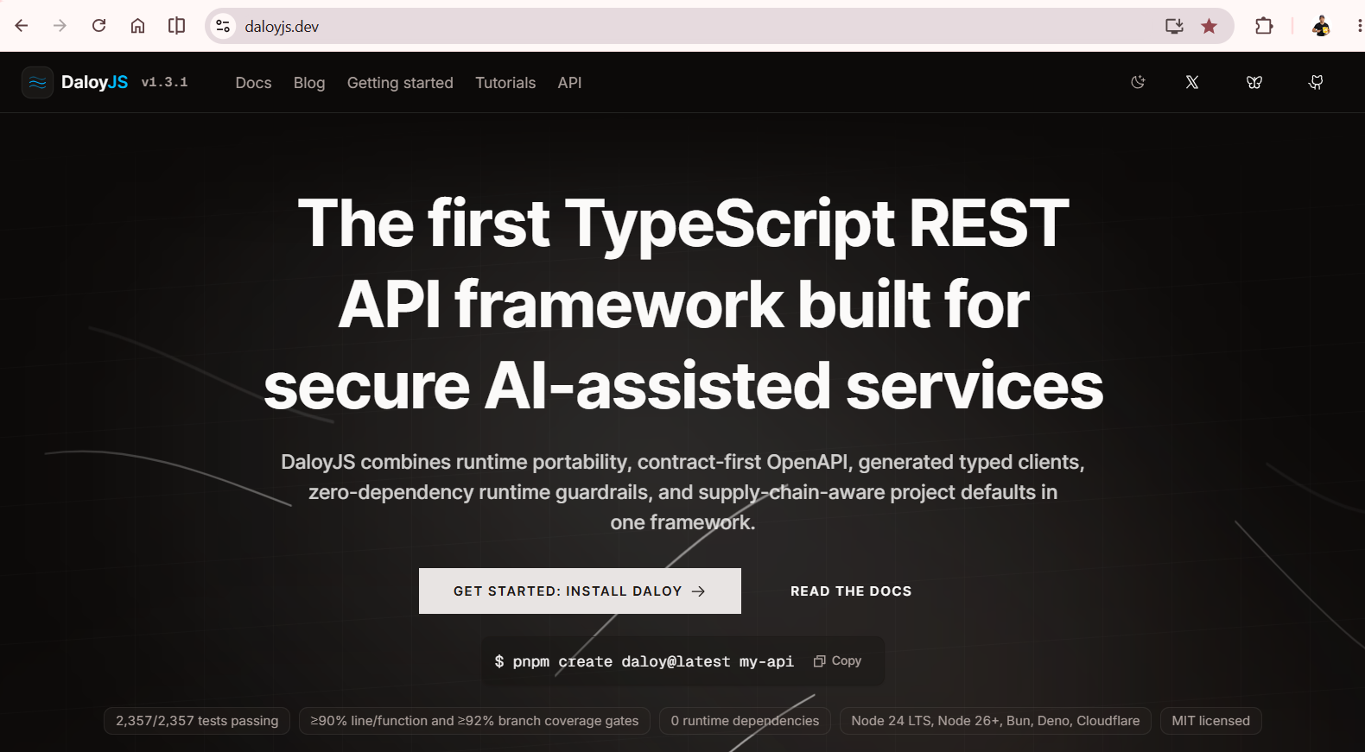
Notes:
bodyLimitBytes, jsonMaxKeys, jsonMaxDepth, requestTimeoutMs, secureHeaders + maxHeaderCount, RFC 9457 problem+json which is reduction or auto strip detail from 5xx.
Server will refuse to run on
wildcard CORS with credentials and anywhere
a session secret under 32 bytes or a default placeholder
sessions, a mutating route, and no CSRF hook
proxy trust left unconfigured in production
a symmetric algorithm handed to a JWKS verifier
auth declared with no auth hook behind it

Slide 33

Thank you!
@DevlinDuldulao
Social Links

