Slide 1
React 19 Suspense Meets Module Federation
@DevlinDuldulao
Senior consultant at SoftwareOne Norway

Slide 2


Slide 3
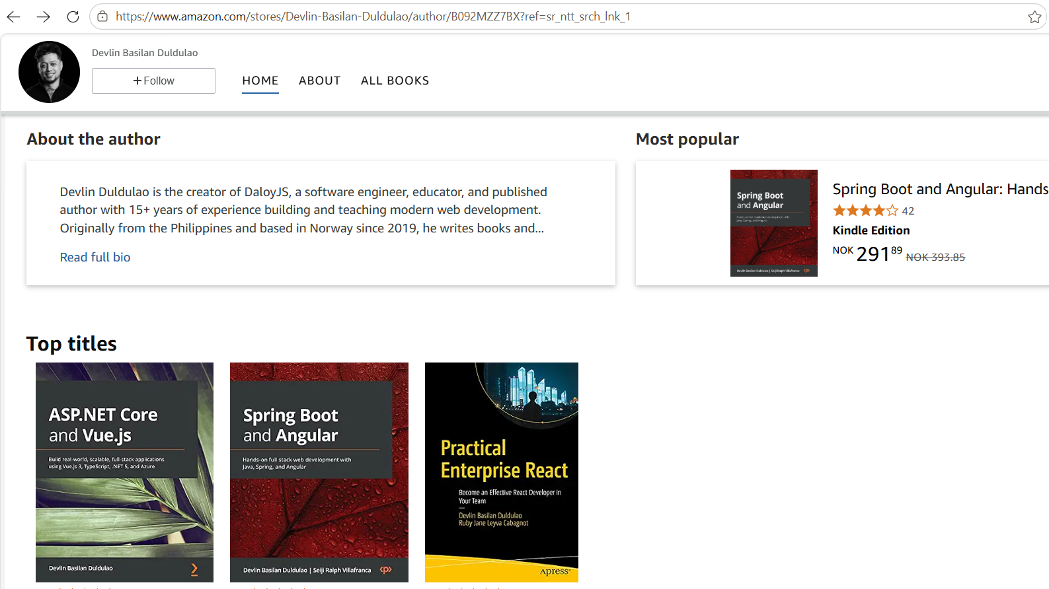


Slide 4
What are we solving here in microfrontends?
Notes:
What are we solving here in microfrontends?

Slide 5
Independent deploys, and a smaller blast radius
Notes:
Here's the first.
Independent deploys, and a smaller blast radius

Slide 6
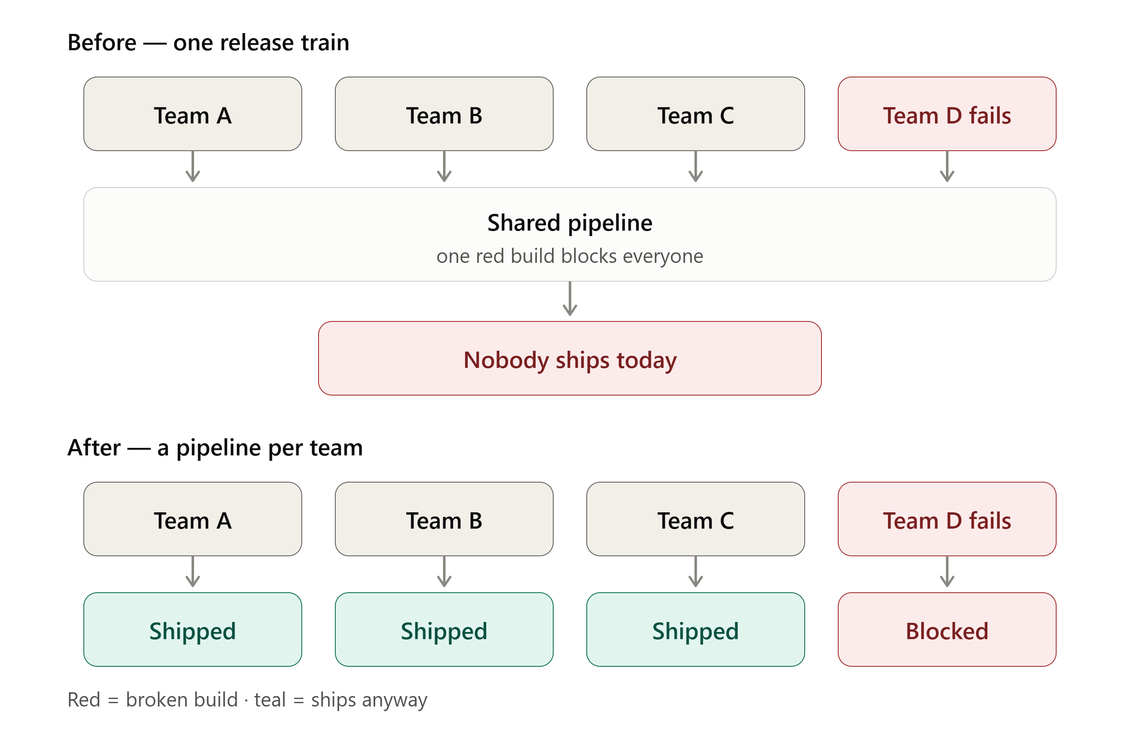
Notes:
The distinction that matters is between build coupling and deploy coupling. Teams can share a repo happily, but sharing a release pipeline means one failing build becomes everyone's problem.
Team D maybe have a failing build and that’s a blocker in the upper half.
While the lower half lets you own your build and problems stay where they are.

Slide 7
Ownership becomes structural, not cultural
Notes:
Second reason.
Ownership becomes structural, not cultural

Slide 8
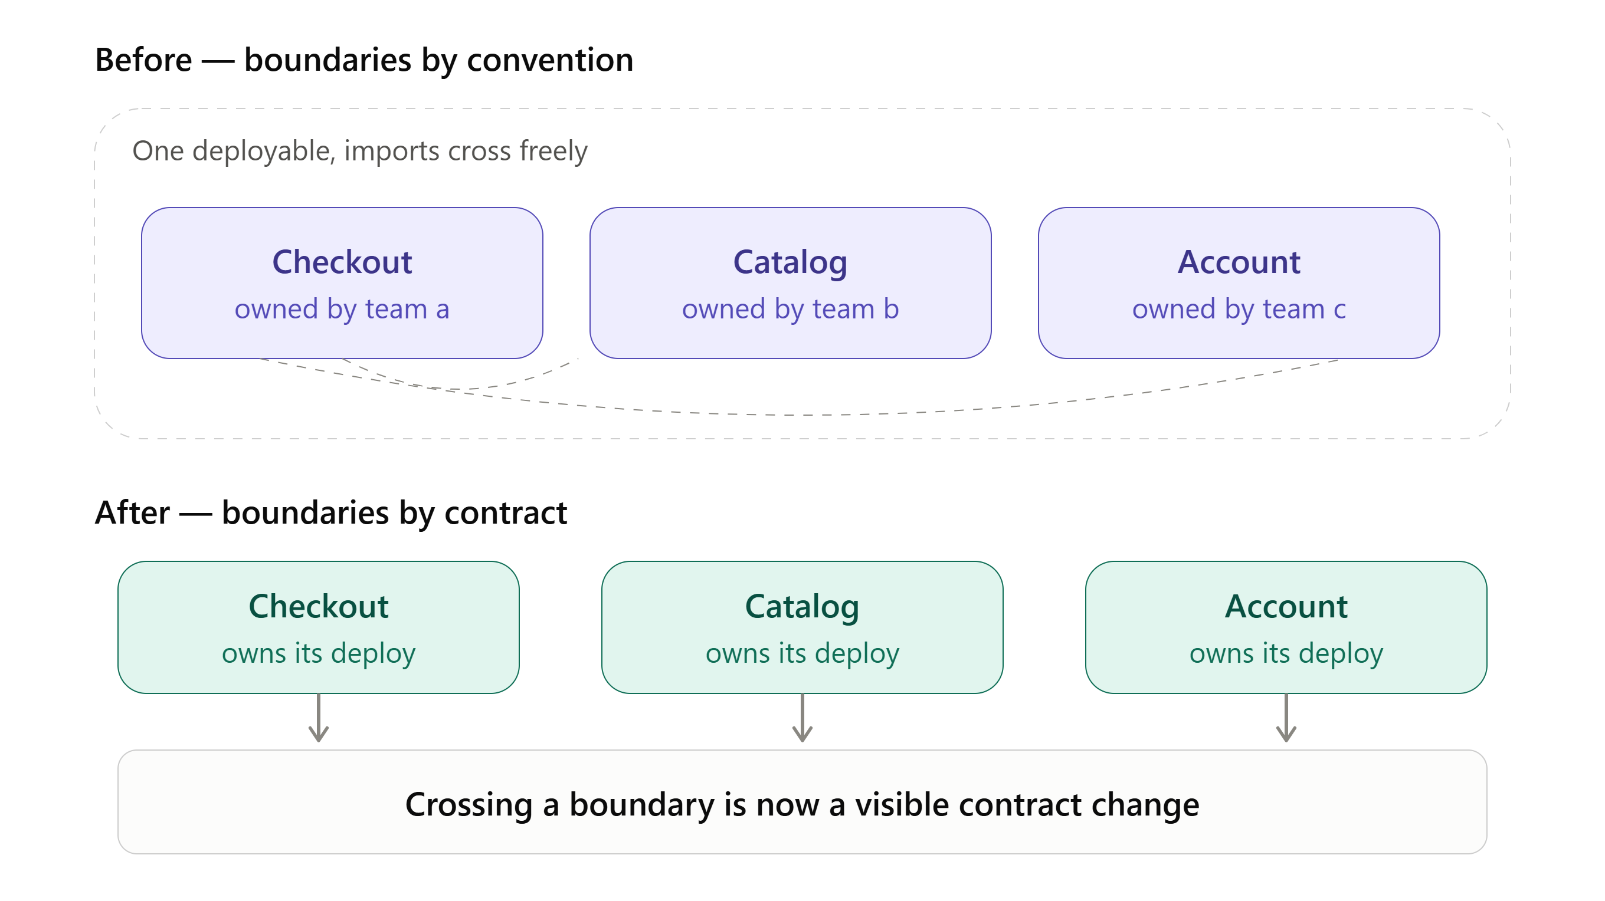
Notes:
Up top, Checkout, Catalog, and Account are one app, so any team can import from any other part. The dashed lines are those reaches — they look like normal imports, so nobody notices them in review.
Down below, each part ships separately, so using Catalog's code means adding a dependency or calling an API. That is a real change in a real file, and a reviewer will see it.
Before, crossing a boundary was invisible.
After, it is visible.
What you can do here is a shared library.

Slide 9
Bounded cognitive load as headcount grows
Notes:
Third reason.
Bounded cognitive load as headcount grows.

Slide 10
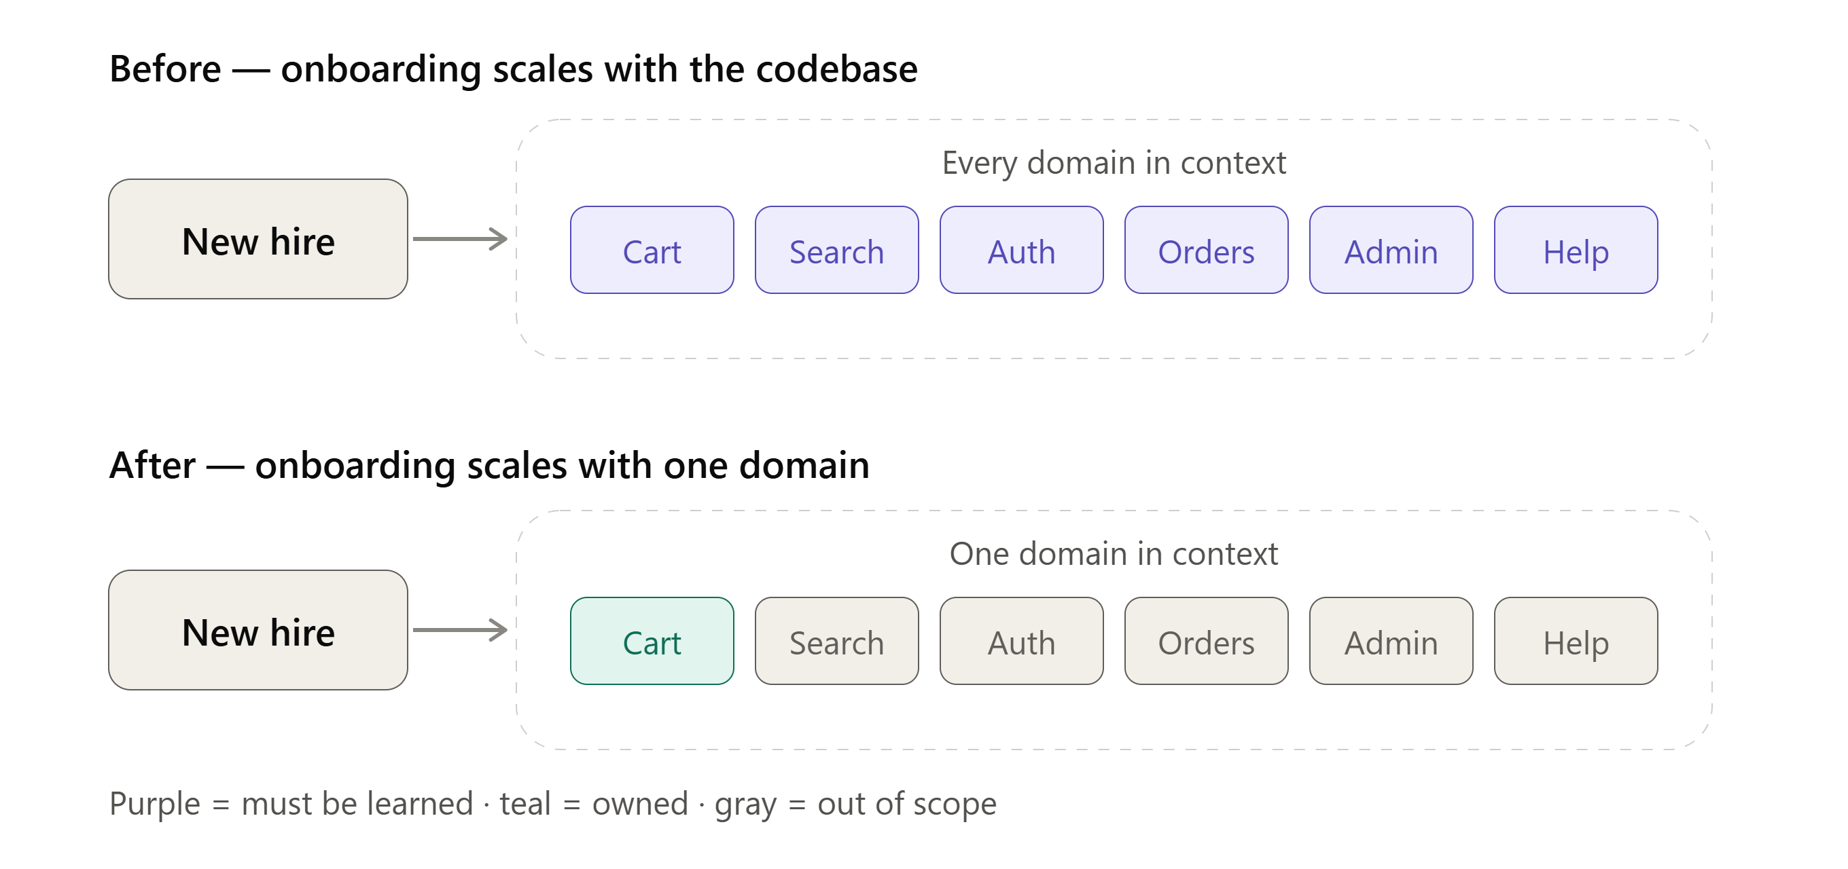
Notes:
This is the one people underrate. It isn't about total lines of code — it's about how much of the system a person must hold in their head before they can safely change one line in a codebase.
When onboarding a new frontend developer?

Slide 11
Incremental migration instead of a rewrite
Notes:
Last, but not the least. This is actually my first experience in micro-frontend when we were removing little pieces of Angular version 1, which is plain JavaScript, to the latest version of Angular.
Incremental migration instead of a rewrite

Slide 12
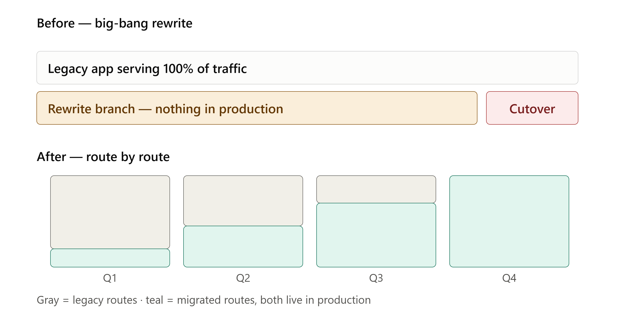
Notes:
This is the one that stands on its own even when the others don't apply.
The key detail is that both stacks serve real traffic the entire time, which is what makes it reversible.

Slide 13
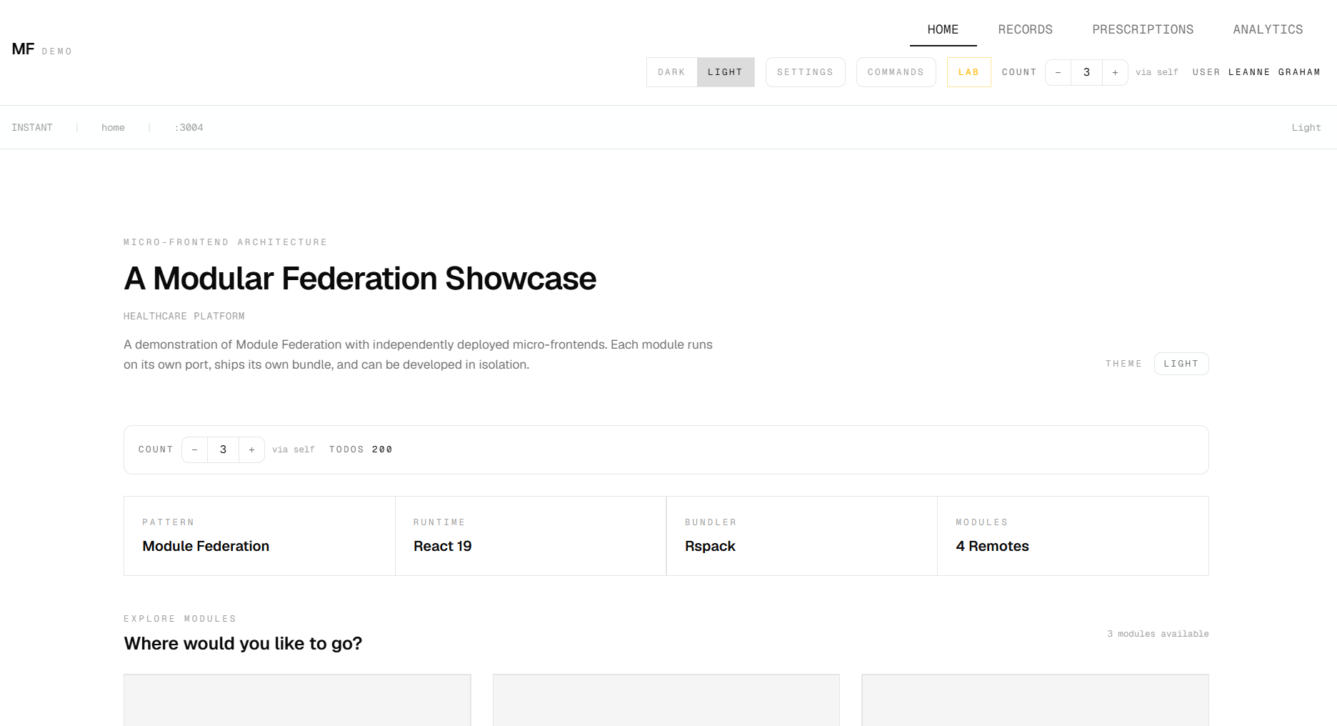
Notes:
So demo app is this. This is a healthcare app. With some patient records, prescriptions, analytics.

Slide 14
Shell (host) :3000
├── Home :3004 INSTANT
├── Records :3001 EAGER
├── Prescriptions :3002 SUSPENSE
└── Analytics :3003 SUSPENSE
Notes:
This is a diagram of the demo app. It is a running healthcare shell.
The host is on port 3000.
Home is on 3004 and loads instantly.
Records is on 3001 and is eagerly preloaded.
Prescriptions is on 3002 and suspense on demand.
Analytics is on 3003 and does the same.
Five independent React apps. Each has its own bundler config, its own dev server, and its own test suite. They compose at runtime through Module Federation. React 19. Rspack 2.1.
This module federation gives your teams better developer experience. And suspense fallbacks gives your visitors better user experience. We are going to prove both, live, in the same architecture.

Slide 15
Demo
Code base (bootstrap.tsx, Routes, Rspack config & plugin)

Slide 16
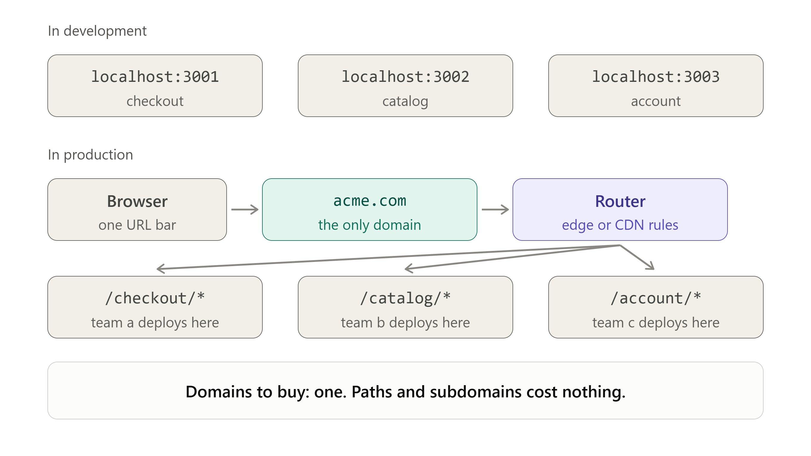
Notes:
The different ports are just a local dev artifact — three dev servers can't all bind port 3000 on one laptop — and they vanish on deploy.
In production the browser only ever sees acme.com, with a router at the edge (a Vercel rewrite, a CloudFront behavior, an nginx proxy_pass, a Cloudflare Worker) mapping each path to the host where that team deploys, so users stay on one origin while each team still ships on its own schedule.
Those deploy targets are free: every platform hands you a hostname, and subdomains of a domain you already own are just DNS records, not purchases. One domain, three paths, nothing extra to buy.

Slide 17
Module Federation for teams, Suspense for load UX
CONCERN | WHO BENEFITS | WHAT IT SOLVES
Module Federation | Developers & teams | Independent builds, deploys, onboarding at scale, slow rewrite
Suspense + skeletons | End users & visitors | Instant perceived load, no blank screens at runtime
Notes:
Module Federation is for developers and teams. It gives you independent builds and independent deploys. Onboarding improvements.
Suspense and skeletons are for end users. They experience perceived instant load and no blank screens at runtime.

Slide 18
Module Federation for teams, Suspense for load UX
Without Suspense: click tab → blank screen → spinner → content
(slow UX even when team ownership is solid)
With Suspense: click tab → skeleton instantly → content resolves
(each remote owns its loading choreography)
Notes:
You can have one without the other. Plenty of teams do. You can federate four remotes and still show a blank screen and a spinner every time someone clicks a tab. That is slow user experience even when team ownership is solid.
With Suspense, the user clicks a tab, a skeleton appears immediately, and the content resolves when it is ready. Each remote owns its own loading choreography.

Slide 19
One shell, four remotes, three loading strategies
┌───────────────────────── SHELL :3000 ─────────────────────────┐
│ Nav · Router · Theme · Status strip (INSTANT|EAGER|STREAMING)│
│ │
│ <ErrorBoundary> │
│ <Suspense fallback={<Skeleton />}> │
│ <RemoteModule /> │
│ </Suspense> │
│ </ErrorBoundary> │
└───────┬───────────┬────────────────┬──────────────┬───────────┘
Home :3004 Records :3001 Prescriptions :3002 Analytics :3003
INSTANT EAGER STREAMED STREAMED
Notes:
This is the shape of the app. One shell on port 3000. The shell owns navigation, the router, the theme, the counter, and the logged user.
Every remote is wrapped the same way. An error boundary. Then Suspense with a skeleton fallback. Then the remote module itself.
Four remotes hang off that shell. Not every module should load the same way if you want something like this. The strategy will depend on which content you will prioritize.

Slide 20
Demo
Preloading and prefetching (network tab devtools)

Slide 21
Three strategies, three layers of resilience
Layer 1: lazy() + .catch() if remote is unreachable
Layer 2: <Suspense> skeleton while loading
Layer 3: <ErrorBoundary> for runtime errors
Notes:
Prescriptions and Analytics are streamed. They load on demand, behind per-module skeletons.
Every strategy still gets three layers of resilience. A catch on lazy, so an unreachable remote becomes a fallback instead of a white screen. Suspense, so a loading remote shows its own skeleton. An error boundary, so a runtime crash in one remote does not take down the app.

Slide 22
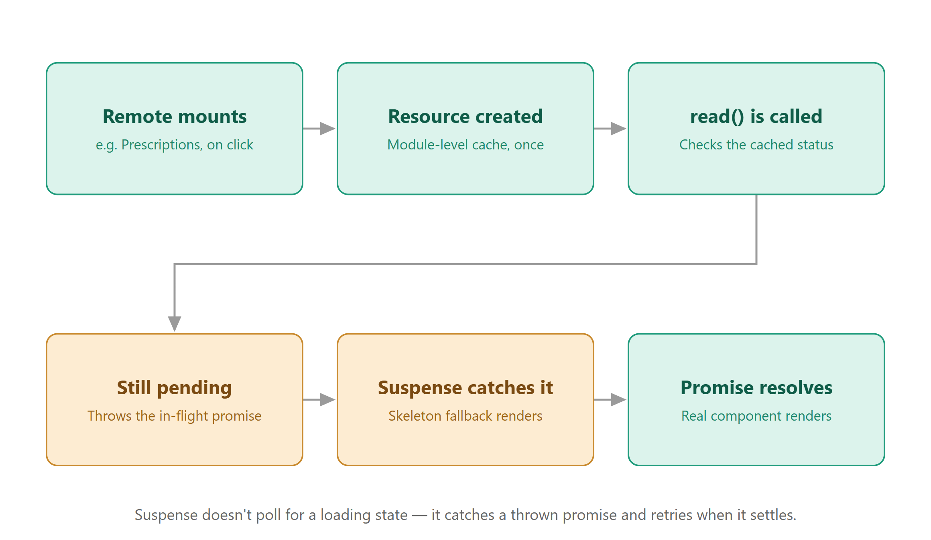
Notes:
So, this is the flow if I click the Prescriptions menu which will navigate to the Prescriptions app.

Slide 23
Question
Why lazy() for eager modules?
Remotes are separate builds resolved at runtime.
Eager import() warms the cache; lazy() resolves from it.
Notes:
People ask why we wrap eager modules in lazy(). It's because the dynamic import in index.tsx already resolved the shared scope and that a static import makes the remote block first paint, and leaves nowhere to catch a failed remote.
So, we fire import() at shell init to warm it, and lazy() resolves from the module registry instantly — while keeping the Suspense and ErrorBoundary per module.

Slide 24
Settings, Commands, Federation Lab menus
Health Monitor: polls each remoteEntry.js every 5s, shows latency
Kill Switches: simulate remote failure; the rest keeps running
Theme: CSS variables + localStorage + themeChange event, zero shared imports
Notes:
Before I do another demo, here are the functionalities of the other buttons on the menu header.
A health monitor that polls remoteEntry.js every five seconds.
Kill switches.
That panel is for the demo. I can take a module down in front of you and show you that the rest of the app keeps running. Basically, we are going to simulate module-level crashes, network failures, and bad deploys are isolated at the boundary.
Theming.

Slide 25
Demo
Admin panel for module federation

Slide 26
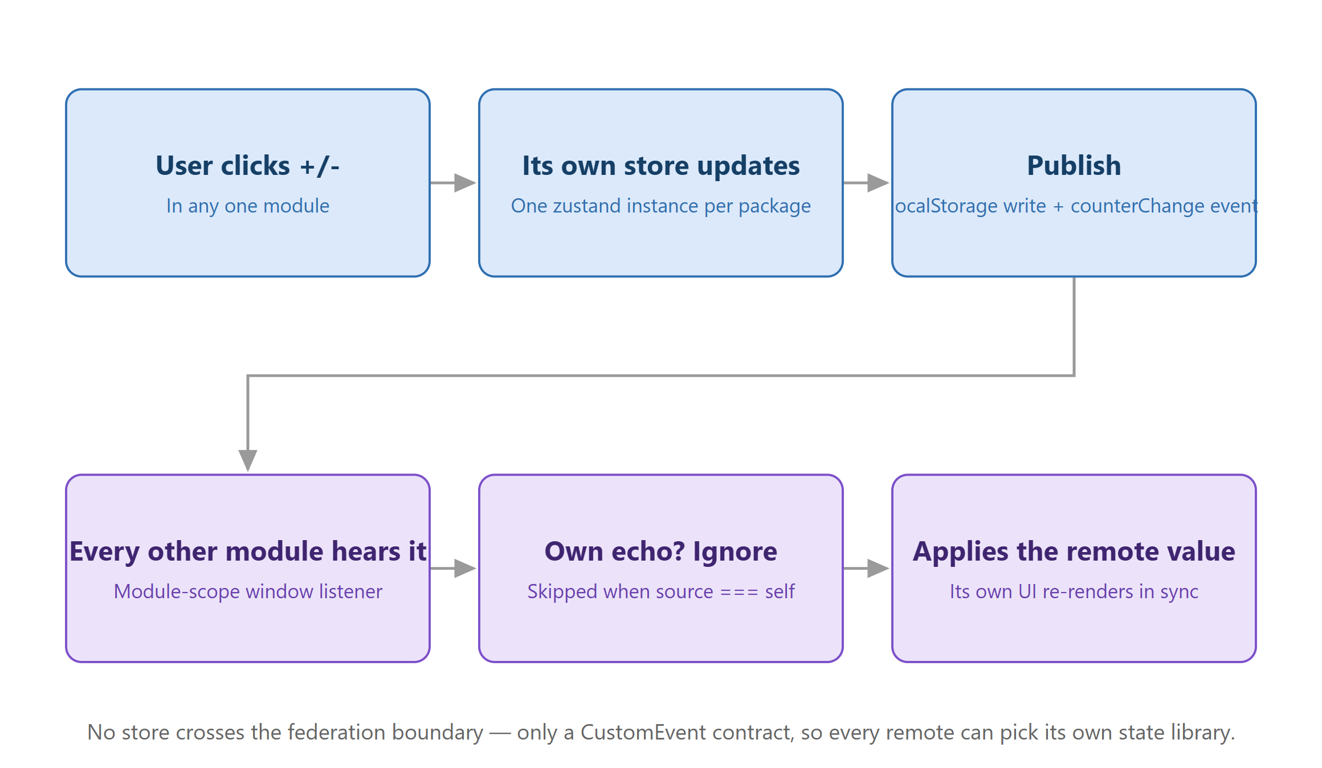
Notes:
This is how you deal with client state management. I will show you more later and also something about server state management like TanStack Query.

Slide 27
Prefer events over shared state
No direct cross-module imports
Shell stays the only router owner
Works across deployments when the event contract stays compatible
Framework-agnostic (React, Vue, Svelte)
Typed via WindowEventMap augmentation
Notes:
Why use the browser api events instead of a shared store? A shared store is a shared dependency.
There will be version coupling between teams if shared stores, while the events will survive in independent deploys.
They even survive framework diversity. For example, a Vue remote and a React remote can talk through the same window contract.
The payload is still a versioned contract. Keep it backward compatible. Each remote defines the same event shapes in its own types file by augmenting WindowEventMap. No shared package is required. addEventListener is fully typed.

Slide 28
The ownership rule
Event | Who broadcasts | Why
themeChange | shell only | The shell owns the theme
moduleChange | shell only | The shell owns the router
addPrescription | records | Records owns "a prescription was requested"
showNotification | any module | Anyone can have something to say; the shell owns the <Toaster />
counterChange | any module | Nobody owns the counter — it's genuinely peer state
Notes:
Each app owns its own store and its own query client — nothing is shared. For client state they agree on a typed event contract, and whoever owns the state is the one who broadcasts:
the shell owns theme and routing, so it broadcasts those;
addPrescription.
showNotification.
the counter belongs to nobody, so any module can.
For server state, like TanStack Query, there's no syncing at all — every app just fetches, because the REST API is already the shared state.

Slide 29
Demo
Counter value in different pages

Slide 30
Shell-owned theming across the federation
Shell (owns theme)
├── Persists to localStorage ("mf-demo-theme")
├── Applies CSS variables to document.documentElement
├── Exposes window.__MF_THEME__ bridge
└── Broadcasts "themeChange" event
├── Records → useActiveTheme()
├── Prescriptions → useActiveTheme()
└── Analytics → useActiveTheme()
Notes:
Theming is a cross-cutting concern, and the shell owns it.
The shell persists the choice to local storage. It applies CSS variables to the document element. It exposes a small bridge on window so a remote can read or set the theme without importing host code. And it broadcasts a theme-change event.

Slide 31
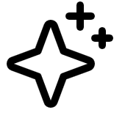
AI
Notes:
And before I end this presentation, I have two things here I want to share. This is important because of our work has changed from writing code to vibecoding using AI agents making us 20x engineers now.

Slide 32
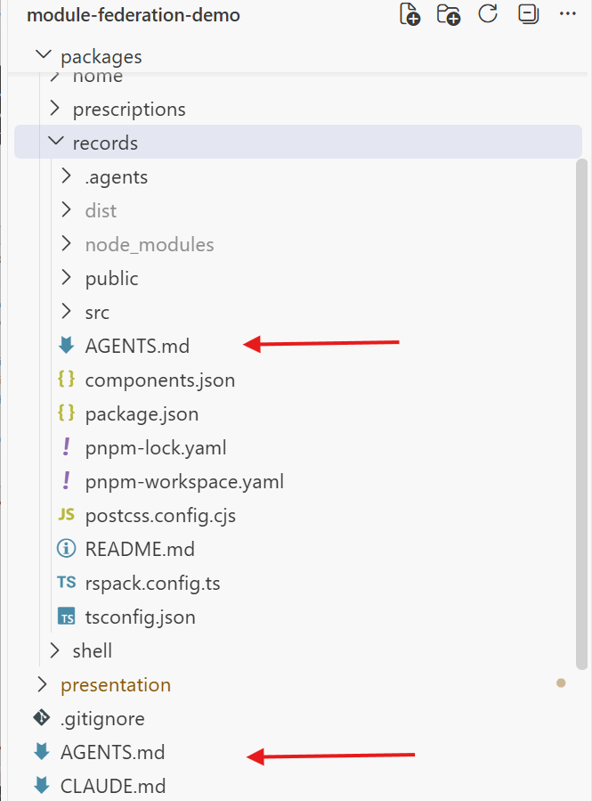
Notes:
First is, you can nest AGENTS.md files to your different micro frontend apps that’s good for your AI agents. And Rspack published agent skills that you can use just in case today’s frontier models still don’t have any idea what the Rspack v2.0 can do.

Slide 33
Knowledge atrophy is the gradual weakening of human thinking and problem-solving skills through overreliance on AI to do our mental work.
Notes:
Knowledge atrophy, or cognitive atrophy, is the gradual decline of memory, critical thinking, and problem-solving skills caused by overreliance on AI tools like LLMs for mental work. Keep learning the technical details of things that you are building. This will help you in the future in guiding agents to the right directions. It will save you money because of lesser prompting. And lastly it will improve your skills

Slide 34

Thank you.
@DevlinDuldulao
Social links

