Slide 1
When do developers go broke?

Slide 2
When do developers go broke?
Answer:
if they ran out of 💶 “cache”.. 🤣🤣

Slide 3
10x React Development with TanStack Query, HeyAPI, and AI Copilots
Devlin duldulao

Slide 4
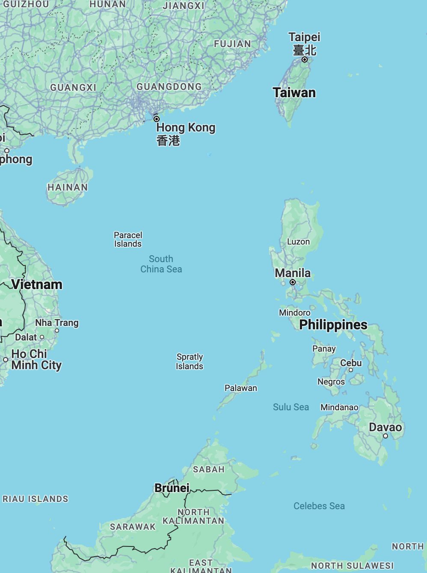

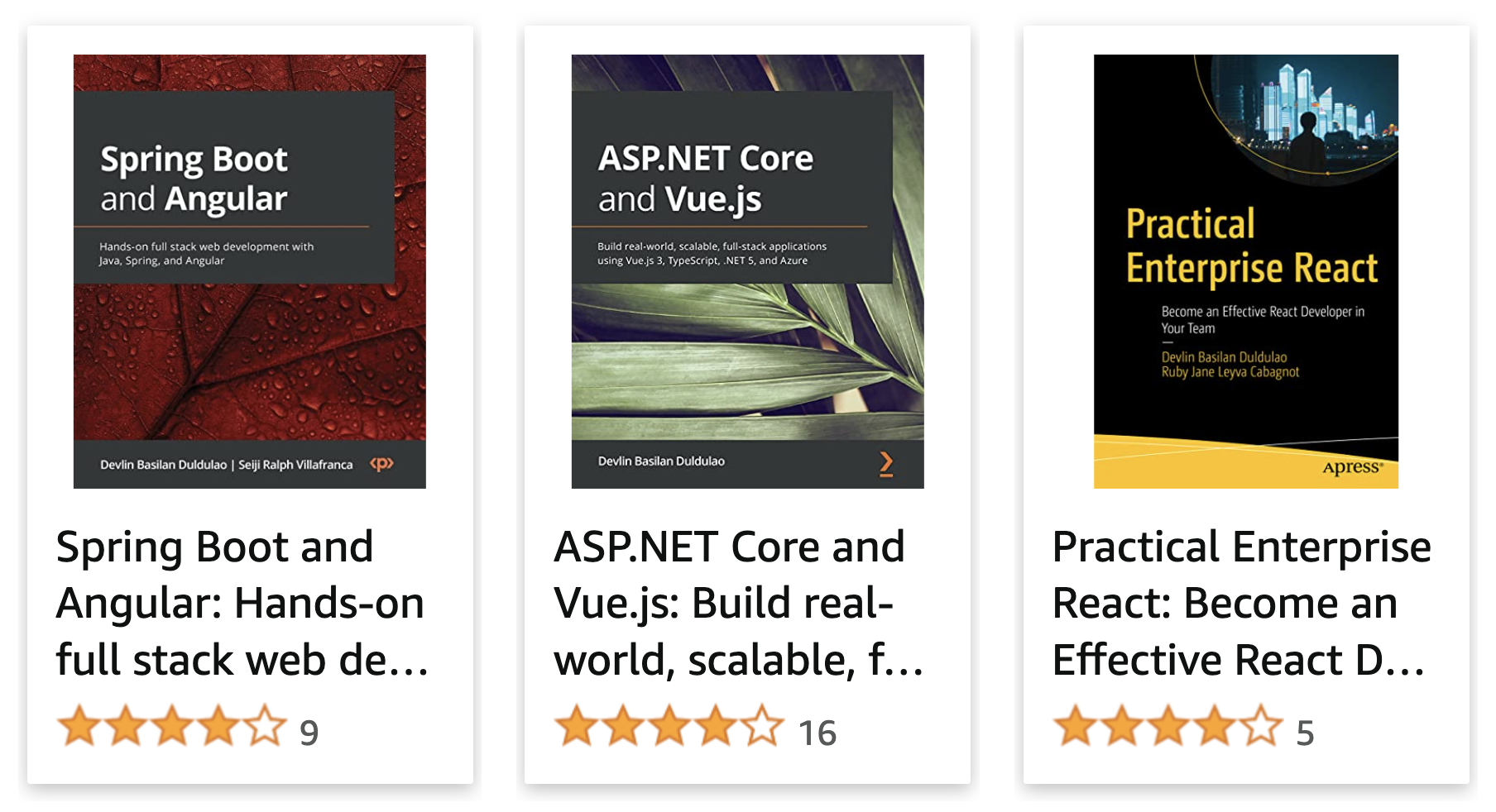



Slide 5

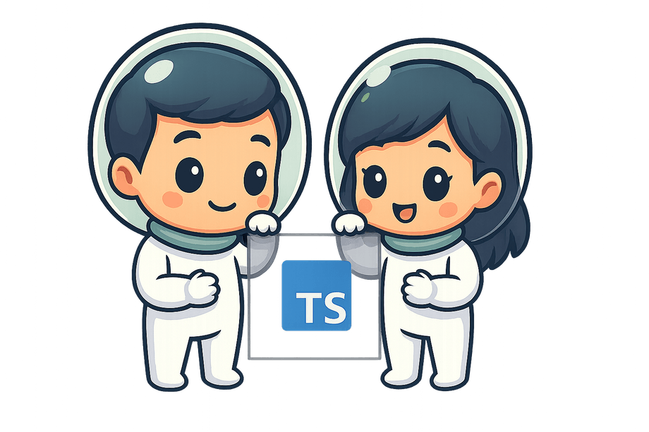

Notes:
My journey using tanstack libraries, HeyApi, and a coding model to build a big enterprise application.

Slide 6
TanStack Query gives you declarative, always-up-to-date auto-managed queries and mutations that directly improve both your developer and user experiences.
Notes:
Let’s get to the point here in the beginning. This is not a data fetching library or an HTTP client library. This is managing tool for asynchronous data. A proper term can be a server state data management.

Slide 7
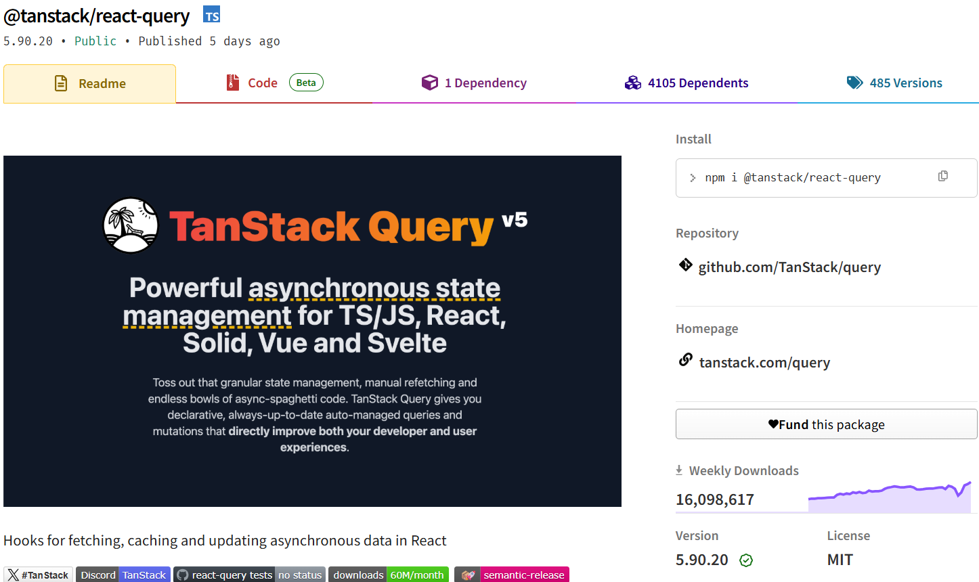
Notes:
TanStack Query, formerly React Query, became very popular not long time ago. It used to be just for React but now it has modules for Svelte, Solidjs, Vuejs, and Angular.

Slide 8
Let’s get started

Slide 9


Redux/Mobx
Notes:
In redux, there is a single source of truth. We save states from user’s synchronous actions, And we also save state from the data that we get from HTTP requests.

Slide 10


Loading..
Notes:
The spinner always show when user navigates back and forth for pages that requests data from an API.

Slide 11

Me 5 years ago working from home.
Notes:
Me 4 years ago working from home because of covid. I was playing around React Query, the old name of TanStack Query.

Slide 12




Server state
Client state
Notes:
After few days of playing around React query, I started to understand that TanStack Query's purpose is for server-state data management while Redux, NGRX, and Pinia or any state management libraries that offers stores are ideal for client-state management.

Slide 13
Server state
Notes:
Server state is simply the data you get from HTTP requests which are your async functions most of the time. In Redux, the state you get from your side-effects, it could be an error message or the response data you will get.

Slide 14
Client state
Notes:
Client state is your application’s state that comes from synchronous functions. An example of this would be user settings dark theme light theme, user profile from an auth token, etc.

Slide 15

Notes:
A cache can do so many things.

Slide 16

Cache
Notes:
This cache. Which I think is underrated in web and mobile frontend.

Slide 17
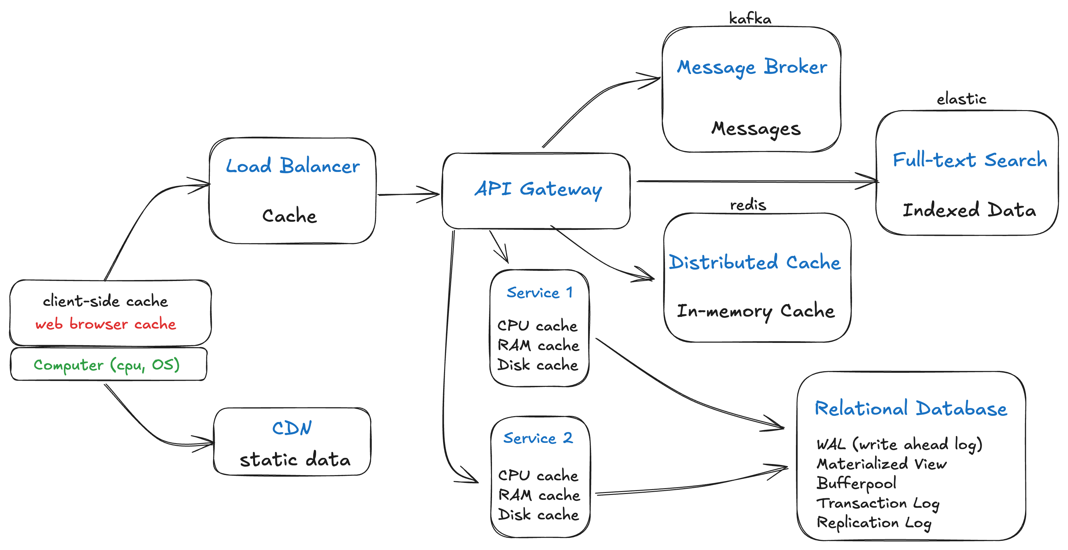
Notes:
While caches can be implemented as physical hardware components (like CPU caches), from a software perspective, caching is a fundamental architectural pattern used to improve system performance and efficiency.
You can see here that there is caching happening in your laptops' CPU and OS, in load balancer, in CDN, in an API Gateway, in your Redis distributed cache, in full-text search also, in a message broker, and of course in a relational database instance.

Slide 18
😊
Notes:
This caching is designed to make your visitors or app users happy, but we often take it for granted because it's always been available to us.

Slide 19
So why not cache your server state in in your app?
Maybe most frontend developers don't know?
Notes:
So why not cache your server state? Maybe most frontend developers don't know?

Slide 20
TanStack Query
known for its powerful data-fetching and caching capabilities, offers several benefits that can significantly enhance the performance and user experience of your applications.
Notes:
TanStack Query is known for its powerful data-fetching and caching capabilities, offers several benefits that can significantly enhance the performance and user experience of your applications.
Let’s take a look at several benefits of TanStack Query caching mechanism.

Slide 21
Here are some of the powerful things you can do because of its caching mechanism:

Slide 22
1. Automatic Caching and Retries
Leads to faster data retrieval, fault tolerant, and a more responsive user interface
Notes:
TanStack Query automatically caches the results of your queries, reducing the number of network requests your application needs to make. This leads to faster data retrieval and a more responsive user interface. It also has 3 default retries.

Slide 23
2. Optimistic Updates
Makes the application feel more responsive by reducing the perceived latency.
Notes:
You can implement optimistic updates, where the UI is updated immediately with an assumed successful response. This makes the application feel more responsive by reducing the perceived latency.

Slide 24
3. Stale-While-Revalidate (no more spinners/loaders)
Ensures that users see the fastest possible data while keeping it fresh.
Notes:
TanStack Query supports a stale-while-revalidate strategy. This means it can show cached data while simultaneously fetching updated data in the background. This approach ensures that users see the fastest possible data while keeping it fresh.
Your states in the UI are still visible even they are not fresh, but it is being updated in the background.

Slide 25
4. Background Refetching
Ensures that your data is always up-to-date without the user needing to manually refresh.
Notes:
You can configure queries to refetch in the background when certain conditions are met (e.g., when the component is mounted, when the window is focused, or when the network is reconnected). This ensures that your data is always up-to-date without the user needing to manually refresh.

Slide 26
5. Offline Support (async storage, Indexed DB, etc.)
Retains and displays cached data even when the user is offline
Notes:
TanStack Query can retain and display cached data even when the user is offline, improving the robustness and usability of your application in scenarios with intermittent or no network connectivity.

Slide 27
6. Prefetching
Ensures that the data is ready before the user needs it
Notes:
You can prefetch data for your app's UI based on user actions or navigation to ensure that the data is ready before the user needs it. This is particularly useful for improving the performance of applications where users frequently navigate between different views.

Slide 28
7. Query Invalidation
Ensure that the displayed data is always current.
Notes:
TanStack Query allows you to invalidate queries manually, triggering refetches. This is useful when you know that the data has changed (e.g., after a mutation) and you want to ensure that the displayed data is always current.

Slide 29
8. Query Deduplication
Ensures that only one network request is made even if the same query is fired multiple times within a short period.
Notes:
TanStack Query can deduplicate multiple requests for the same data, ensuring that only one network request is made even if the same query is fired multiple times within a short period. One of my favorite because this makes your components composable. You don’t have to worry that 2 or more components that fetches the same api will send multiple requests if rendering at the same time. No, it will only send once.

Slide 30
9. Custom garbage collection Time and Stale Time
Gives you fine-grained control over the trade-off between data freshness and performance.
Notes:
You can customize the gcTime (how long data stays in the cache) and stale time (how long data is considered fresh) for each query. This gives you fine-grained control over the trade-off between data freshness and performance.

Slide 31
10. Infinite Queries and Pagination
Reduces redundant requests and allows users to navigate back and forth between pages seamlessly.
Notes:
TanStack Query provides built-in support for paginated and infinite scrolling data. By caching each page of data, it reduces redundant requests and allows users to navigate back and forth between pages seamlessly.
You will be facing bugs and performance issues if you write it for yourself.

Slide 32
10. Infinite Queries and Pagination
The perfect combo:
TanStack Query ensures you're fetching data smartly (not over-fetching, caching properly, loading incrementally)
Virtualized lists ensure you're rendering smartly (not rendering thousands of components at once)

Slide 33
10. Infinite Queries and Pagination
So even if you have 10,000 items total:
TanStack Query might only fetch 20 items at a time as needed
FlashList might only render 10-15 visible items at any moment
Result: Fast, smooth, memory-efficient infinite scrolling

Slide 34
Streamed Query
Broadcast Query (browser only)
Notes:
broadcastQueryClient is a utility for broadcasting and syncing the state of your queryClient between browser tabs/windows with the same origin.

Slide 35
TanStack Query Demo time
Notes:
I made the code simpler for demo purposes.

Slide 36
TanStack Query Demo time
Notes:
Live coding now!

Slide 37
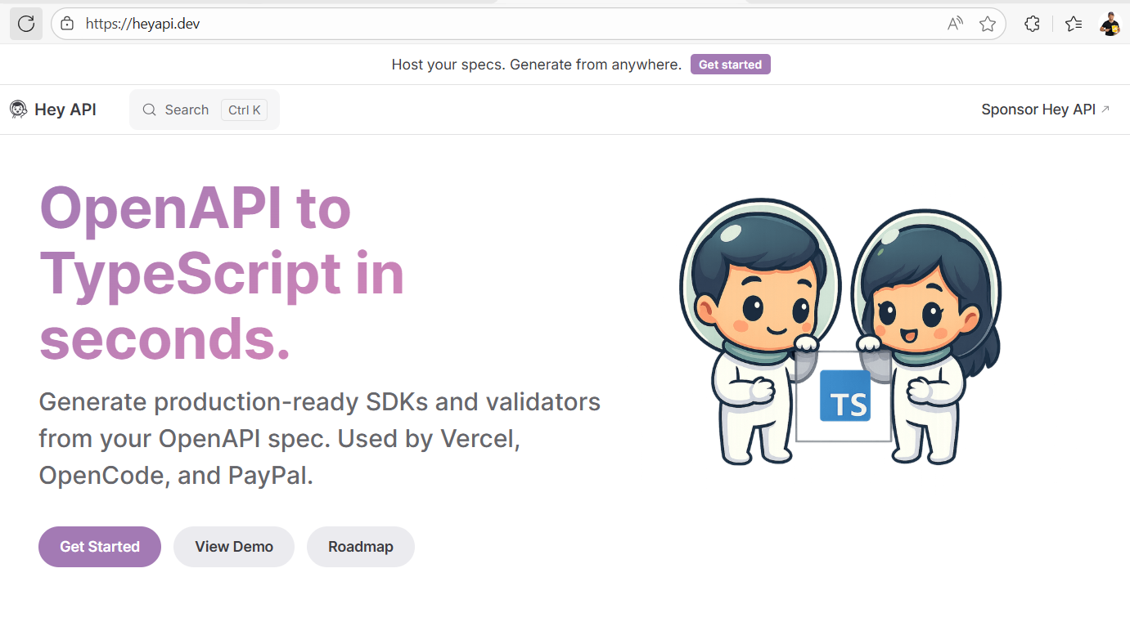
Notes:
Generate automatically TypeScript types or interfaces, validations using validation libraries Zod, services using HTTP Client libraries like Axios, and hooks for server state management libraries like TanStack Query... No need for using the “React Query Key Manager”.

Slide 38
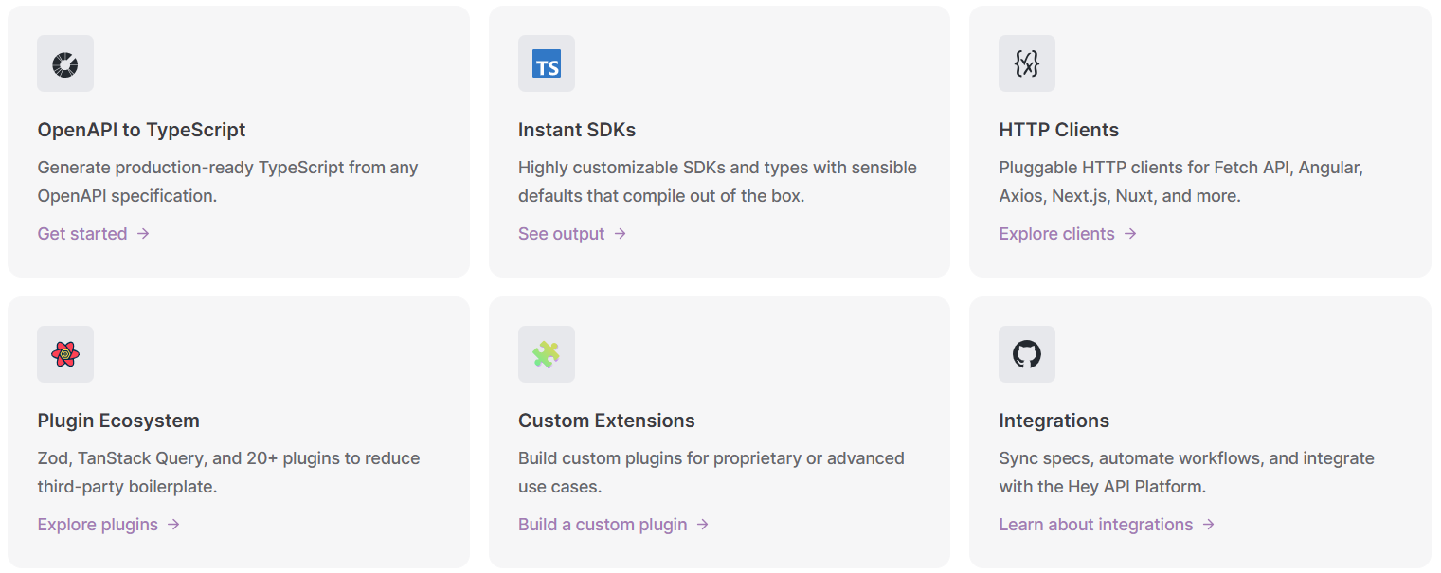

Slide 39

Notes:
I am so happy using HeyApi that I decided to support it by sponsoring it.

Slide 40
TanStack Query + HeyApi Demo time
Notes:
Live coding now!

Slide 41
Key takeaways
Streamed Query for LLMs responses
Broadcast Query for multi-tab application open
HeyApi SDK to generate ts or py files
SKILL.md or any custom instructions md files
Notes:
Streamed Query for applications requiring real-time updates like chat or AI responses.
Broadcast Query reduces unnecessary API calls and ensuring data consistency when a user has a multi-tab application open.
HeyApi saves you from coding tanstack query abstractions, validations, and types just by running some cli commands.
Custom instructions in markdown files saves you time from always retyping your prompts in your copilot chat window.

Slide 42
Resources:
github.com/devlinduldulao/tanstack-query-2026-demo
github.com/devlinduldulao/tanstack-query-and-heyapi-demo
heyapi.dev

Slide 43
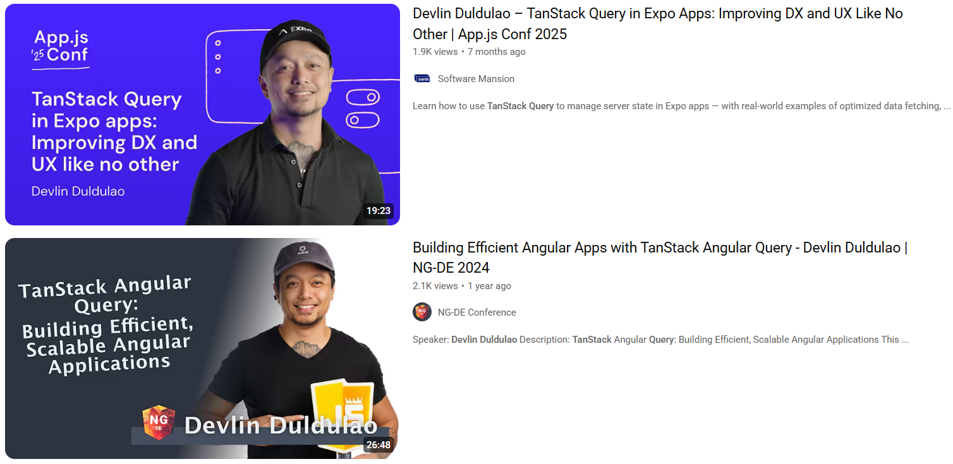

Slide 44

Thank you!
Social Links
Notes:
Peace out..!

