Slide 1


Presentation ON “Knowledge Representation and Insight Generation from Structured Dataset”
Submited by
Mr. Pranav K. Rajput
Mr. Yash S. Lawankar
Mr. Yash N. Dighade
Under the Guidance of:
Faculty Mentor:
Dr. R.R. Karwa
Prof A. U. Chaudhari
Intel Industry Expert
Prof. Ram Meghe Institute of Technology and Research, Badnera
Amravati
(An Antonomous Institute & NAAC Accredited)
Sant Gadge Baba Amravati University, Amravati
2024-2025

Slide 2
Problem Statement
Global variations in life expectancy and the need to understand influencing factors.
The challenge of dealing with large, complex datasets to derive meaningful insights.

Slide 3
Unique Idea Brief(Solution)
A comprehensive data analysis approach to explore and predict life expectancy.
Integrates data preprocessing, visualization, clustering, and predictive modeling.
Dual path methodology for handling both small and large datasets efficiently.

Slide 4
Features Offered
Data Preprocessing: Handling missing values, outliers, and encoding.
Visualization: Interactive and static visualizations (histograms, scatter plots, choropleth maps).
Clustering: PCA Transformation, K-Means, and DBSCAN clustering.
Predictive Modeling: Linear Regression and Random Forest models.
Text Generation: Generating insights using a pre-trained language model.

Slide 5
Process Flow
Upload: Users upload CSV files via a web interface.
Temporary Storage: Files saved temporarily for processing.
Spark Session: Data loaded into Spark DataFrame for initial processing.
Conversion to Pandas: Data converted to Pandas DataFrame.
Exploratory Analysis: Basic statistics, handling missing values, outlier detection.
Visualization: Creating various plots and maps.
Clustering & Modeling: Applying PCA, clustering, and predictive models.
Insight Generation: Generating Human Readable insights.

Slide 6
Architecture Diagram
Dataset
User Interface HTML/CSS/Javascript/Bootstrasp
Flask (Web Framework)
Data Ingestion (Pyspark & Pandas)
Data Cleaning and Preprocessing (Pandas & Scikit-learn)
Exploratory Data Analysis (Matplotlib, Seaborn, Plotly)
Predictive Modeling (Scikit-Learn)
Insight Generation (Transformer Library)
Visualization (Ploltly & Flask)

Slide 7
Technologies Used
Frontend: Flask, HTML, CSS, JavaScript, Bootstrap.
Backend: Spark, Pandas, Flask, SQLAlchemy.
Visualization: Matplotlib, Seaborn, Plotly.
Text Generation: Pre-trained language model.

Slide 8
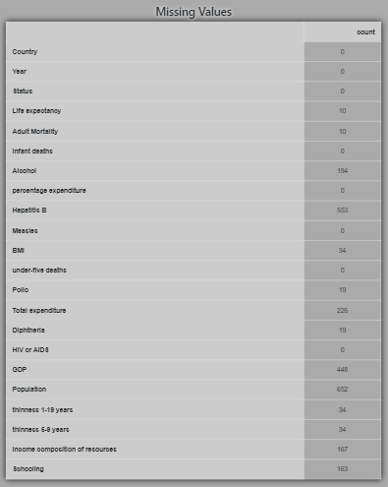
Implementations and Results:
Data Summary: Displays the first and last 10 rows for a quick overview.
Missing Values Analysis: Reports missing data percentages for each column.
Descriptive Statistics: Provides key statistical metrics for each column.

Slide 9
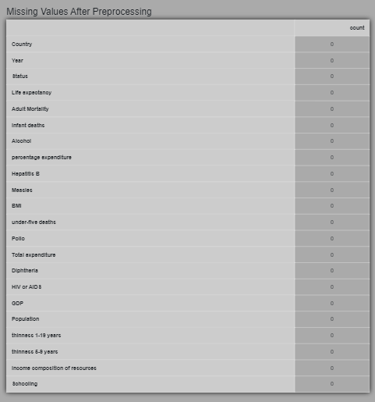
Data Preprocessing:
Encoding Categorical Variables: One-hot encoding, Label encoding.
Imputation: Filling missing values with mean, median, mode, or using predictive models.

Slide 10
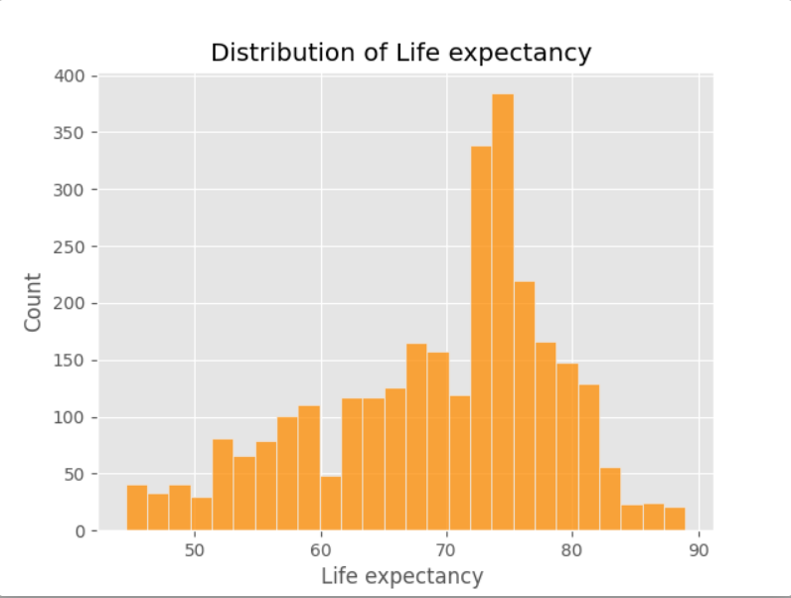
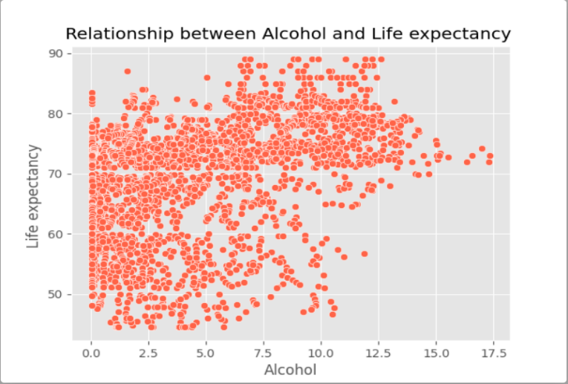
Knowledge Representation:
Graph Based Representation: Represent entities as nodes and relationships as edges.
Identification of Patterns and Trends: Visual tools like histograms and heatmaps help reveal underlying patterns and correlations in data.

Slide 11
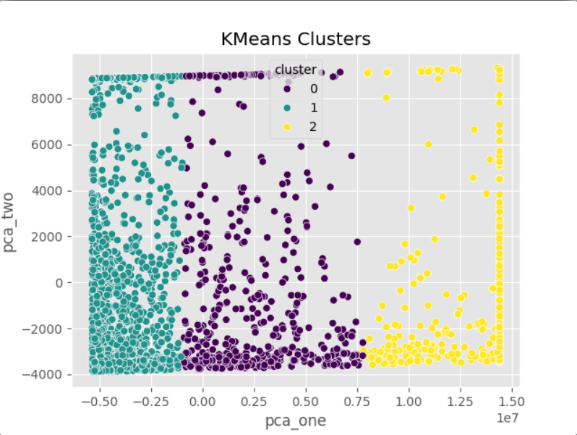
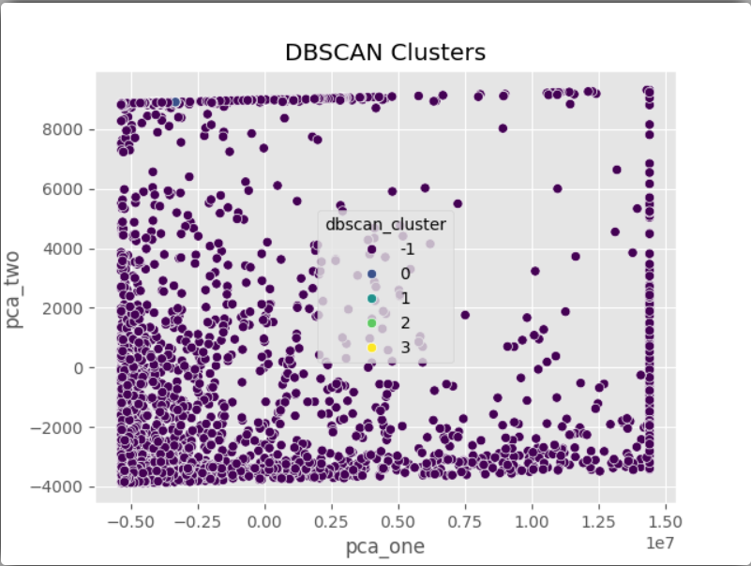
Pattern Identification:
In order to find innate groupings in the data, clustering algorithms like K-means and DBSCAN are frequently used in pattern discovery in data analysis. These techniques play a crucial role in uncovering hidden patterns and connections between data pieces, offering insightful information for a range of uses.

Slide 12
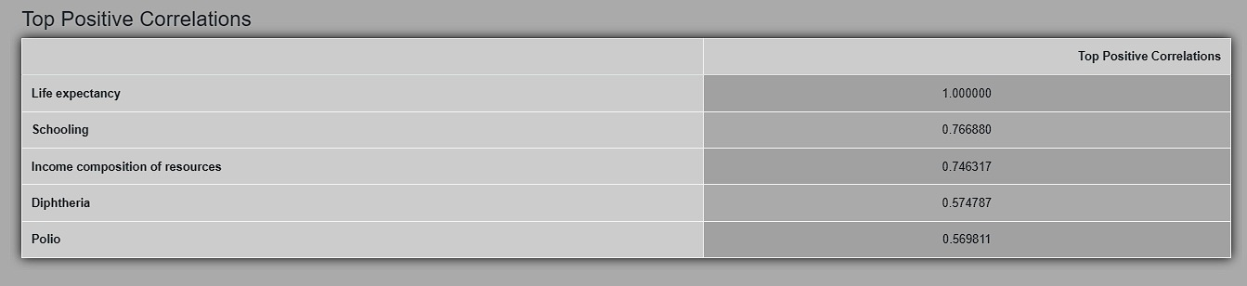
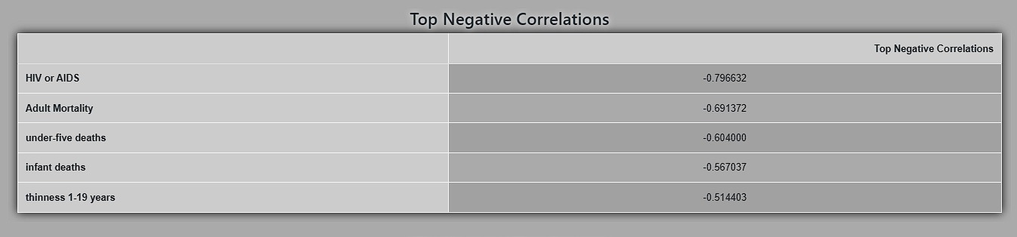
Insights Generation:
.
Descriptive Analysis: To comprehend data distribution and important metrics, use summary statistics and visualizations.

Slide 13
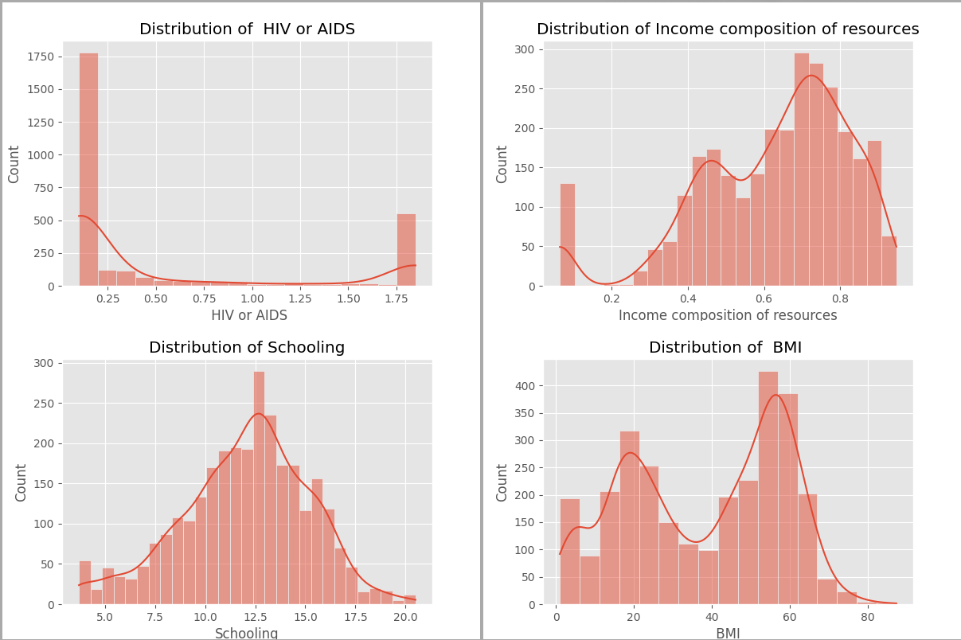
Predictive Modeling: Construct and assess models to predict results and pinpoint patterns.
Actionable Insights: Convert data discoveries into suggestions and plans for bettering operations and making decisions.
Importance of characteristics: Use machine learning models and statistical tests to assess the importance of characteristics.

Slide 14
Team Members and Contribution
1. Name : Pranav Rajput
Contribution:
1. Data Preprocessing
2. Visualization
3. Scalability
4. Backend Development
5. Report
6. Parallel Processing
7. Dataset Finding
8. Model Training
2. Name : Yash Lawankar
Contribution:
1. Knowledge Representation
2. Visualization
3. Flask
4. Frontend Development
5. Connectivity
6. Insight Generation
7. Planning
8. Error Handling
Name : Yash Dighade
Contribution:
1. Pattern Identification
2. Frontend Development
3. Algorithms Implementation
4. Roadmap
5. Data Collection
6. Testing
7. Solution Finding

Slide 15
Conclusion
The project effectively demonstrates the transformation of structured datasets into actionable insights through data preprocessing, visualization, clustering, and predictive modeling. By addressing missing values, outliers, and using advanced visualizations, it ensures thorough exploratory data analysis. Clustering methods like PCA, K-Means, and DBSCAN reveal hidden patterns, while predictive models provide robust life expectancy predictions. The integration of a pre-trained language model to generate insights highlights the project's emphasis on making complex data understandable. This balanced methodology showcases the power of structured data in driving informed decision-making, illustrating the synergy between data science techniques and human intuition.

Slide 16
Future Scope
Enhance predictive models with more advanced machine learning techniques.
Integrate real-time data processing for dynamic analysis.
Extend the application to other health-related datasets.
Implement more interactive and user-friendly visualizations.
Develop a comprehensive dashboard for continuous monitoring and analysis.

