Slide 1
TEAM GO-MAPPERS
PROJECT NAME:
TRIPS
TEAM MEMBERS:
MAYANK GUPTA
MANTHAN SHARMA
RITESH BEHERA
VINAY CHAUHAN
COLLEGE NAME:
MAHARAJA AGRASEN INSTITUTE OF TECHNOLOGY

Slide 2
PROBLEMS:
Migration of people to cities in search of employement
Deviation of rural people from their main stream.
Lack of good livelihood.
Lack of sufficient and good infrastructure
Exploitation of natural resources
Only seasonal demand
Low level of education
Poor marketing facilities
CONCLUSION:
As per the stats the only profit generating from agriculture is falling down day by day and these villagers are lacking sufficient alternative job scope .
This situation is enforcing them to settle down in nearby urban localities in search of better income and better livelihood.

Slide 3
PROPOSED SOLUTION:
Our focus will be on following:
Heritage conservation
Revival of traditional art and craft
Poverty alleviation
Better utilisation of natural resources
Reduce migration of rural people
Bring rural people into main stream
Improve livelihood
Exploration of rural india
Increase job opportunities

Slide 4
IDEA/APPROACH:
The idea is to tackle the problem by making a Web – App which redefines rural tourism and connects tourists to the rural India
This web-app will basically offer the users/tourists to live a traditional rural lifestyle by selection of places(villages) of their choices which will be shown on our web-app.
The Here maps API will be used to show the nearest rural destination for the selected city and show them the 360 view and total travel expenses
The user/tourists will be provided with proper hospitality and services by the people(villagers who are hired for this job) of that particular village chosen by the users/tourists.
Certain activities that are selected by the the tourist will be performed under the guidance of villager hired for this job.
We’ll provide them with pure and natural environment along with relaxed and rejuvenated lifestyle.

Slide 5
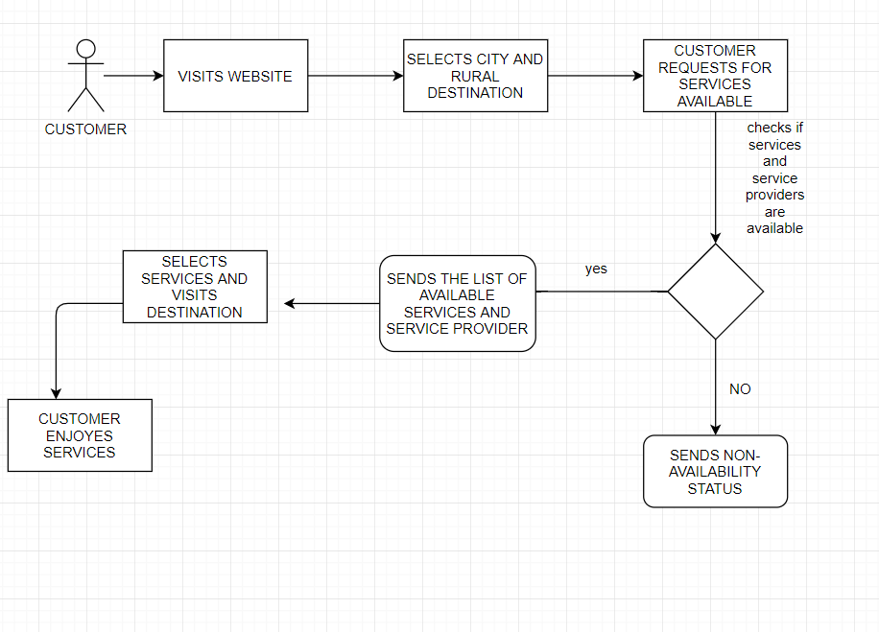
PROCESS FLOW DIAGRAM

Slide 6
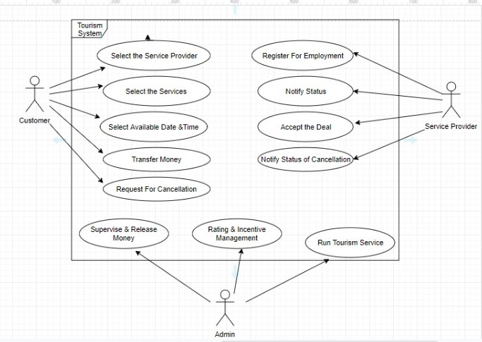
USE CASE DIGRAM:

Slide 7
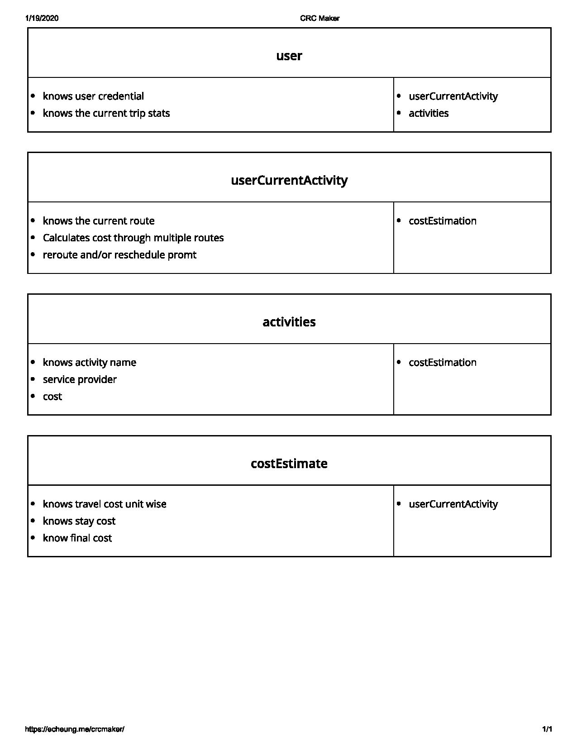
CRC MODEL

Slide 8
RURAL TOURISM ACTIVITIES IN INDIA
• Staying in rural village houses, Tents and Huts
• Working in agricultural fields
• Local cuisine
• Use of eco-friendly transportation modes
• Bird and animal watching, nature walk
• Exhibiting local folk art
• Participating in Fairs and Festivals, Celebrations
• Playing Rural games
• A move towards Short-Break Holidays.
• Increased Interest in alternative and off-beat attractions
• Rural locations are ideal for relaxation and rejuvenation.
POSITIVE IMPACTS OF RURAL TOURISM:
1. Economic benefits
2. contributes for the Growth and preserving industries, handicrafts and
souvenir
3. Allocation of responsibilities and revenue
4. Over dependence on agriculture will reduce.
5. Socio-cultural benefits
6. Demands investments in developing infrastructure
7. Cleanliness and hygiene.

Slide 9
TECHNOLOGY STACK:
It will use HTML, CSS , Bootstrap, Javascript, Jquery framework for front-end
In back-end :- Django
For database management and connectivity SQLite3 will be used
Here maps API
For a short preview of destination 3D IMAGES will be used.
For Digital Marketing Blockchain Technology will be used.
FUTURE ADAPTABILITY:
In future when we get sufficient number of customers we can make certain required changes like enabling online payment method , incentives for service providers etc. can be made.

