Slide 1
Autonomous electricity saving system
Submitted By: Team Alpha CAA
Chirag Kaushik
Aaryan Sharma
Akhil Sharma

Slide 2

Technology Used
HERE MAPS
SENSORS
SMARTLIGHTS
SONAR TECHNIQUE

Slide 3
PROBLEM
IMPROPER USAGE OF ELECTRICITY IN FOLLOWING MANNER
IF STREET LIGHTS ARE ON IN DAYLIGHT
IF STREET LIGHTS ARE OFF IN NIGHT
LOW INTENSITY DURING FOG( IN WINTER )

Slide 4
SOLUTION
CHANGE OF COLOR TO INCREASE THE INTENSITY
SENSORS FITTED ON LIGHTS SENDS THE MESSAGE TO THE RESPECTIVE AUTHORITY IF LIGHTS ARE ON DURING DAYTIME AND OFF AND NIGHT
SENSORS FITTED ON STREET LIGHTS SENDS THE LOCATION OF THE LIGHTS ,IF ANY FAULT ARISES
SOLAR PANELS ARE FITTED IN THE STREET LIGHTS ,TO REDUCE THE LOAD ON OTHER ENERGY RESOURCE
IF EXTRA POWER IS PRODUCED BY THE PANELS WE CAN STORE IT AND CAN SELL IT TO EARN PROFITS

Slide 5
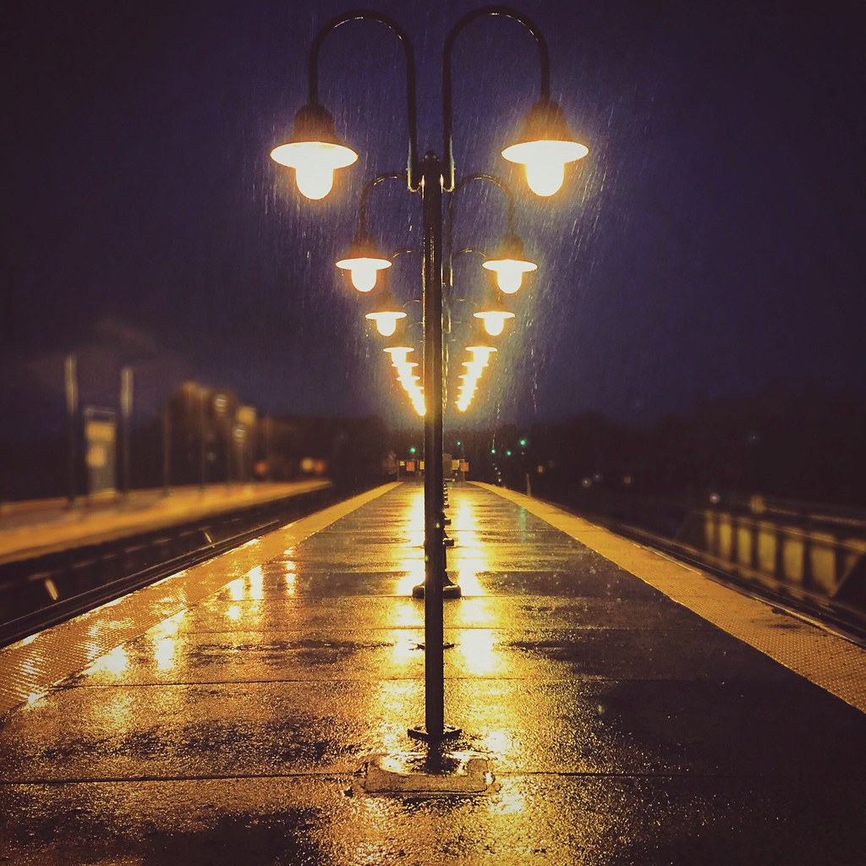
BUSINESS PROSPECtIVE
PROFIT EARNING BY SELLING THE EXTRA ELECTRICITY PRODUCED BY SOLAR PANELS
LESS WASTAGE OF ELECTRICITY
REDUCED OPERATIONAL COST OF STREET LIGHTS BY USING SOLAR PANELS

Slide 6
THANK YOU

