Slide 1
INDIA HACKATHON SERIES
BAAP CODERS
Bhaskar
Aayush Kedawat
Abhishek Shukla
Pradeep Singh

Slide 2

App aimed towards the safety of people
Featuring individual’s live location tracking
Direction and information of nearest police stations

Slide 3

SAFTEY DOESN’T COME WITH
BEING LUCKY
IT HAS TO BE PREPARED

Slide 4
FEATURES
SIMPLE AND INTERACTIVE USER INTERFACE
SEPARATE APPS FOR USERS AND POLICE STATION
SENDING PRECISE USER LOCATION TO NEAREST POLICE STATION
LIVE LOCATION UPDATES TO TRUSTED CONTACTS
DISPLAYING OF DETAILS OF NEARBY POLICE STATIONS

Slide 5
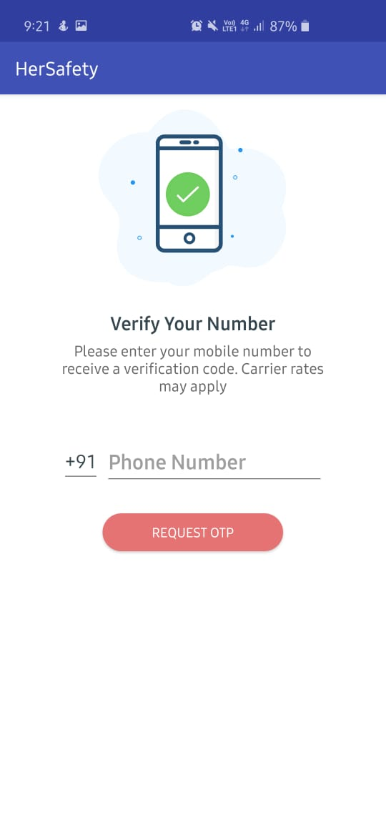
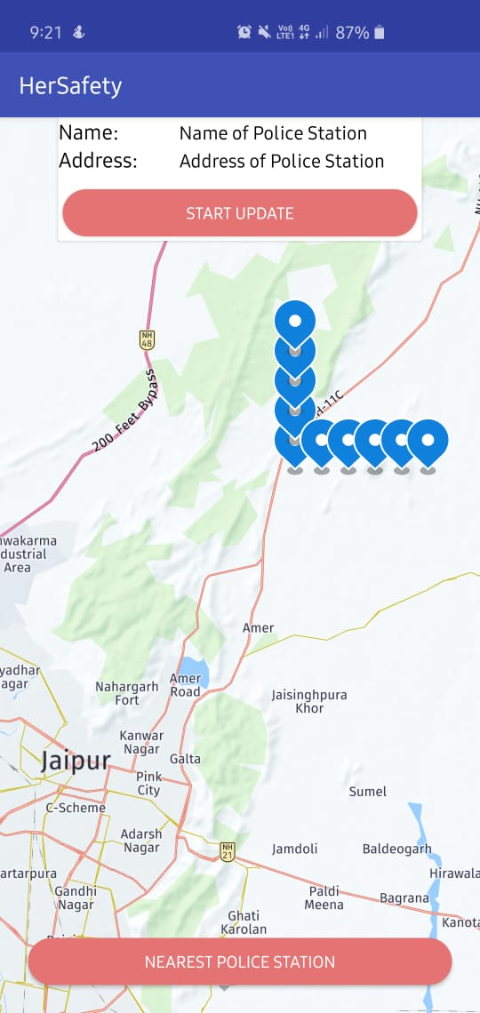
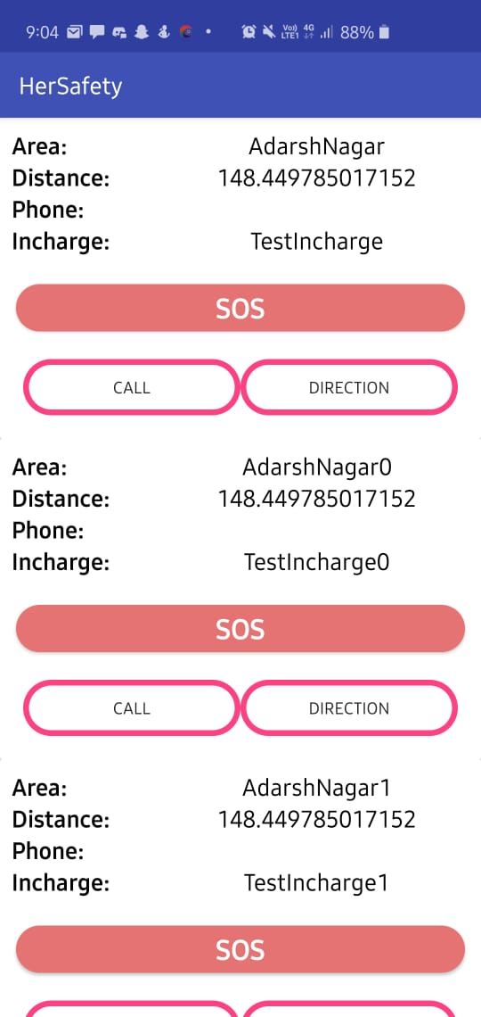
GLIMPSE OF OUR APP

Slide 6
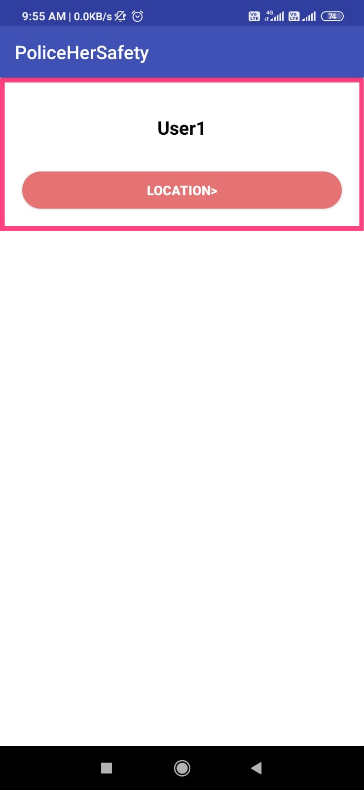
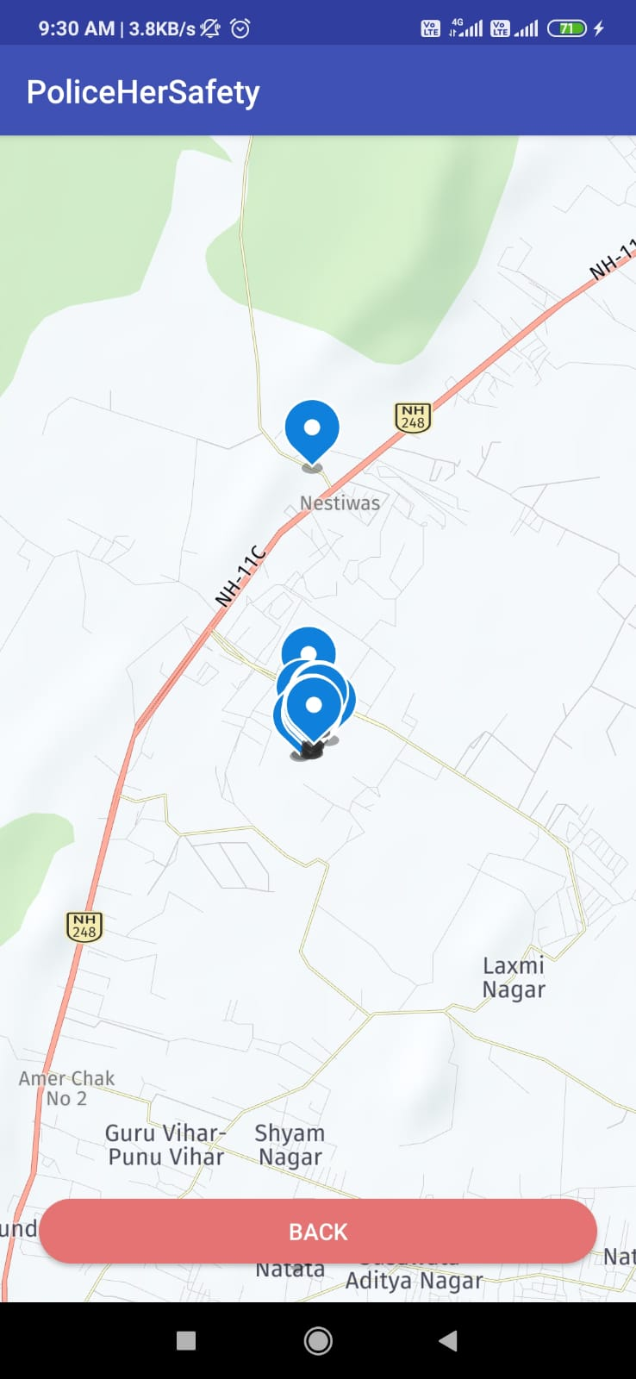
POLICE APP INTERFACE

Slide 7
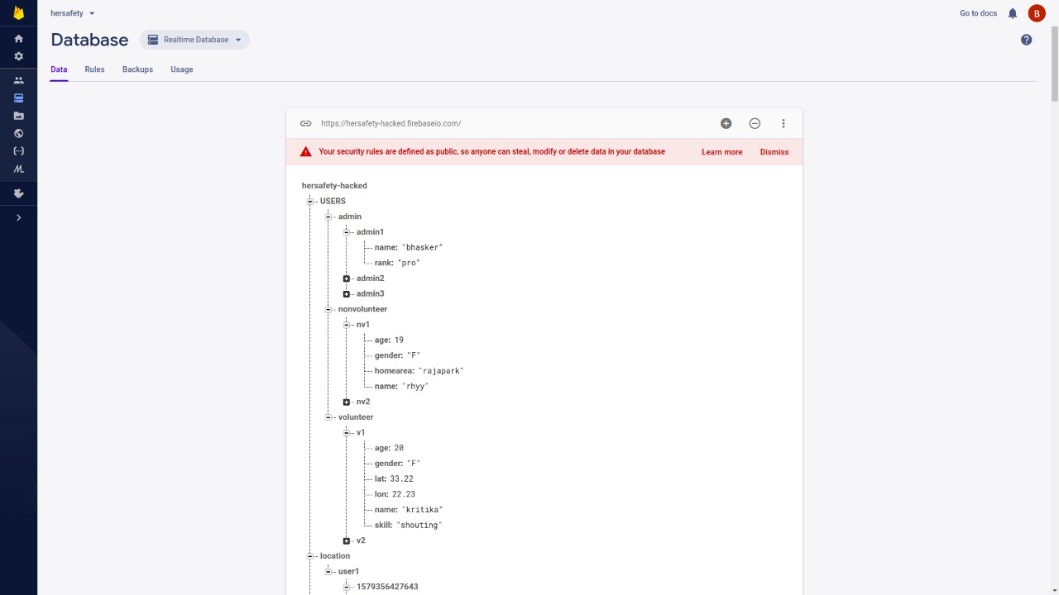

Slide 8
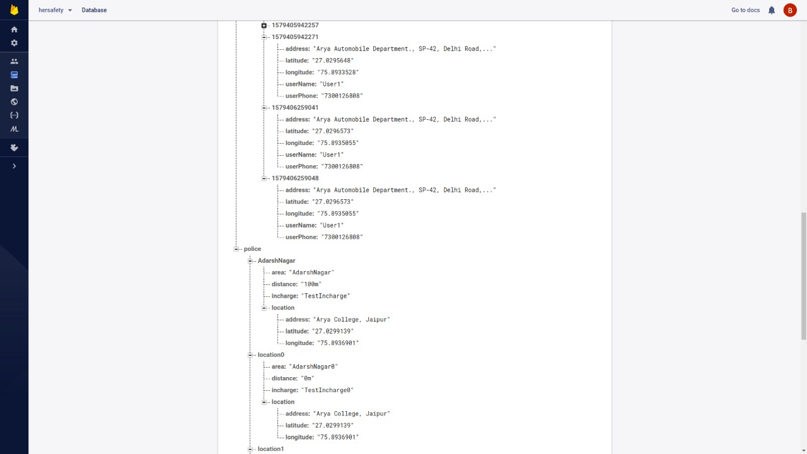

Slide 9
WHY US ??
HELPFUL IN TIME WHEN YOU ARE IN UNFAMILIAR PLACES
EASY COMMUNICATION
FAST RESPONSE
GIVE SECURE FEELING
GET IN TOUCH WITH NEAREST POLICE STATION

Slide 10
THANK YOU

