Slide 1
Team name –
Cybersquad

Slide 2
Team members-
1. Hemant sharma
2. Rupasi yadav
3. Sanchita agrawal
4. Shubham kumar

Slide 3
Team captain-
Sanchita agrawal

Slide 4
But in our team no one
Is a dominator.
A captain is just another
Member of your team.
Every member puts equal
effort to make this project
Successful. The source of
being every member of
this team.

Slide 5
Topic of the
Project –
“ inclusion of the
Small traders
On the HERE map.”

Slide 6
MAIN CONCEPT :-
“TODAY MOST OF THE SMALL TRADERS SUFFER FROM INADEQUACY OF CAPITAL
DUE TO REASONS LIKE ABSENCE OF SECURITIES TO OFFER OR THEIR ACCOUNTS
ARE NOT VERY ATTRACTIVE, THEY FIND IT DIFFICULT TO APPROCH TO BANK FOR
LOANS. THEY MANAGE WITH SHORT TERM MARKETING BORROWINGS AND WITH
PRIVATE FINANCERSAND END UP PAYING HUGE INTEREST WHICH IS DIFFICULT TO
SUSTAIN AT THEIR SCALEOF BUSINESS. SO TO HELP THEM TO COMPLETE WITH THE
UPGROWING MARKET WE TRIED TO LINK THEIR BUSINESS WITH MAPS AND ENHANCE
THEIR BUSINESS.”

Slide 7
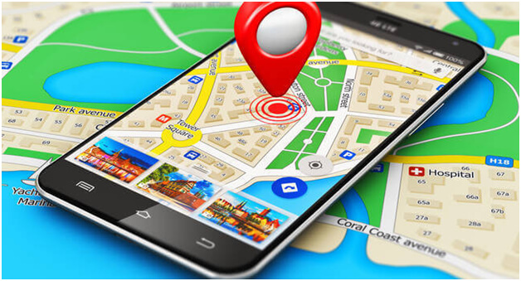

Slide 8
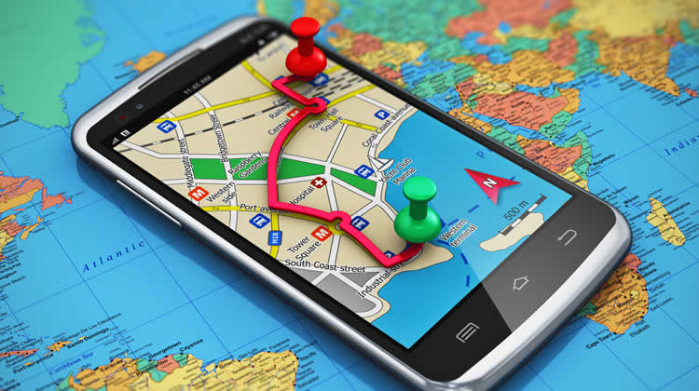

Slide 9
Google maps
V/S
HERE MAPS :

Slide 10
Google Maps is a web mapping service developed by Google. It offers satellite imagery, aerial photography, street maps, 360° panoramic views of streets (Street View), real-time traffic conditions, and route planning for traveling by foot, car, bicycle and air (in beta), or public transportation.
Google Maps began as a C++ desktop program at Where 2 Technologies. In October 2004, the company was acquired by Google, which converted it into a web application. After additional acquisitions of a geospatial data visualization company and a realtime traffic analyzer, Google Maps was launched in February 2005.^{[1]} The service's front end utilizes JavaScript, XML, and Ajax. Google Maps offers an API that allows maps to be embedded on third-party websites,^{[2]} and offers a locator for businesses and other organizations in numerous countries around the world. Google Map Maker allowed users to collaboratively expand and update the service's mapping worldwide but was discontinued from March 2017. However, crowdsourced contributions to Google Maps were not discontinued as the company announced those features would be transferred to the Google Local Guides program.^{[3]}
Google Maps' satellite view is a "top-down" or bird's-eye view; most of the high-resolution imagery of cities is aerial photography taken from aircraft flying at 800 to 1,500 feet (240 to 460 m), while most other imagery is from satellites.^{[4]} Much of the available satellite imagery is no more than three years old and is updated on a regular basis.^{[5]} Google Maps used a variant of the Mercator projection, and therefore could not accurately show areas around the poles.^{[6]} However, in August 2018, the desktop version of Google Maps was updated to show a 3D globe as the default projection. It is still possible to switch back to the Mercator Projection in the settings.
Google Maps for Android and iOS devices was released in September 2008 and features GPS turn-by-turn navigation along with dedicated parking assistance features. In August 2013, it was determined to be the world's most popular app for smartphones, with over 54% of global smartphone owners using it at least once.^{[7]}
In 2012, Google reported having over 7,100 employees and contractors directly working in mapping.^{[8]}
In 2017, along with several other services including YouTube, Chrome, Gmail, Search, and Google Play, Google Maps reached over 1 billion monthly users.^{[9]}

Slide 11
Here Technologies (trading as HERE) is a company that provides mapping and location data and related services to individuals and companies. It is majority-owned by a consortium of German automotive companies (namely Audi, BMW, and Daimler), whilst other companies also own minority stakes. Its roots date back to U.S.-based Navteq in 1985, which was acquired by Finland-based Nokia in 2007. Here is currently based in Amsterdam.
Here captures location content such as road networks, buildings, parks and traffic patterns. It then sells or licenses that mapping content, along with map related navigation and location services to other businesses such as Alpine, Garmin, BMW, Oracle and Amazon.com. In addition, Here provides platform services to smartphones.^{[1][2]} It provides location services through its own Here applications, and also for GIS and government clients and other providers, such as Bing, Facebook and Yahoo! Maps.^{[3][4]} Here has maps of nearly 200 countries, offers voice guided navigation in 94 countries, provides live traffic information in 33 countries and has indoor maps available for about 49,000 unique buildings in 45 countries.^{[5]} The company is also working on self-driving technology.^{[6]} HERE Technologies India Private Limited is recognized among India's Best Companies to Work For 2019 ranking at place #33 and among India's Best Workplaces for Women 2019 (Top 25) from "Great Place to Work".

Slide 12
HERE is once again the highest-ranked location platform vendor in the index. HERE has cemented its leadership position thanks to the continuous improvements it has made to its core Open Location Platform, doubling down on its efforts for developers, and a string of new initiatives including a renewed focus on data privacy.
Here Map Creator is a service launched in November 2012 to allow users to update the Here map. The service is available for more than 100 countries and in 47 languages. It can be accessed from their website mapcreator.here.com and dedicated HERE Map Creator Android and iPhone apps.
Users are able to add new roads (trails are included here), edit a road or remove it, add a new place, edit a place or remove it and finally add a house number, edit or remove it. In addition, users can edit road details such as speed limits, number of lanes, one- or two-way, type "open road", "tunnel" or "bridge", pavement type, etc. and also add local shops and businesses into various categories such as a grocery store, clothing store, types of restaurants (including cuisine and name of food joint), sports equipment store among several other categories and subcategories. and give various details about them including photos, telephone numbers, addresses, hours and days of operations in a week, payment info in the shops (whether they accept cash, cards, discount coupons or not). Users can also report map changes. Tutorial videos and instructions to carrying out the editing operations are available on their website.

Slide 13
Google Maps is a web mapping service developed by Google. It offers satellite imagery, aerial photography, street maps, 360° panoramic views of streets (Street View), real-time traffic conditions, and route planning for traveling by foot, car, bicycle and air (in beta), or public transportation.
Google Maps began as a C++ desktop program at Where 2 Technologies. In October 2004, the company was acquired by Google, which converted it into a web application. After additional acquisitions of a geospatial data visualization company and a realtime traffic analyzer, Google Maps was launched in February 2005.^{[1]} The service's front end utilizes JavaScript, XML, and Ajax. Google Maps offers an API that allows maps to be embedded on third-party websites,^{[2]} and offers a locator for businesses and other organizations in numerous countries around the world. Google Map Maker allowed users to collaboratively expand and update the service's mapping worldwide but was discontinued from March 2017. However, crowdsourced contributions to Google Maps were not discontinued as the company announced those features would be transferred to the Google Local Guides program.^{[3]}

Slide 14
Google Maps' satellite view is a "top-down" or bird's-eye view; most of the high-resolution imagery of cities is aerial photography taken from aircraft flying at 800 to 1,500 feet (240 to 460 m), while most other imagery is from satellites.^{[4]} Much of the available satellite imagery is no more than three years old and is updated on a regular basis.^{[5]} Google Maps used a variant of the Mercator projection, and therefore could not accurately show areas around the poles.^{[6]} However, in August 2018, the desktop version of Google Maps was updated to show a 3D globe as the default projection. It is still possible to switch back to the Mercator Projection in the settings.
Google Maps for Android and iOS devices was released in September 2008 and features GPS turn-by-turn navigation along with dedicated parking assistance features. In August 2013, it was determined to be the world's most popular app for smartphones, with over 54% of global smartphone owners using it at least once.^{[7]}
In 2012, Google reported having over 7,100 employees and contractors directly working in mapping.^{[8]}
In 2017, along with several other services including YouTube, Chrome, Gmail, Search, and Google Play, Google Maps reached over 1 billion monthly users.^{[9]}

Slide 15
Importance of
HERE maps :-

Slide 16
Or more specifically, here are the 10 things that Google Maps can do for you:
1.Get transportation directions
2.Creating a map
3.Measuring distance and ETA
4.Mixing maps information
5.Finding your location
6.Setting routes
7.Getting traffic information
8.Verbal instructions
9.Location sharing
10.Location editing

Slide 17
Traders
encouragement
MAPPING

Slide 18
Problems faced by
small traders
1. Poor capacity utilization
2. Incompetent management
3. Inadequate Finance
4. Raw material shortages
5. Lack of marketing support
6. Problem of working capital
7. Problems in Export
8. Lack of technology up-gradation
9. Multiplicity of labor laws
10. Inability to meet environmental standards
11. Delayed payments
12. Poor industrial relations
13. Strain on government finances

Slide 19
Poor Capacity
Utilisation
In many of the Small Scale Industries, the capacity utilization is not
even 50% of the installed capacity. Nearly half of the machinery remains idle.
Capital is unnecessarily locked up and idle machinery also
occupies space and needs to be serviced resulting in increased costs.

Slide 20
Incompetent
Management
Many Small Scale Industries are run in an incompetent manner by poorly qualified entrepreneurs without much skill or experience. Very little thought has gone into matters such as demand, production level and techniques, financial availability, plant location, future prospects etc. According to one official study, the major reason for SSI sickness is deficiency in project Management i.e., inexperience of promoters in the basic processes of production, cash flow etc

Slide 21
Inadequate Finance
Many Small Scale Industries face the problem of scarcity of funds. They are not able to access the domestic capital market to raise resources. They are also not able to tap foreign markets by issuing ADR’s (American Depository Receipts) GDR’s (Global Depository Receipts) etc because of their small capital base. Banks and financial institutions require various procedures and formalities to be completed. Even after a long delay, the funds allocated are inadequate.
Bank credit to the small scale sector as a percentage of total credit has been declining. It fell from 16% in 1999 to 12.5% in 2002. Small Scale Industries are not able to get funds immediately for their needs. They have to depend on private money lenders who charge high interest. Finance, as a whole, both long and short term, accounts for as large as 43% of the sector’s sickness.

Slide 22
Lack Of Marketing
Support
Small Scale Industries lack market knowledge with regard to competitors, consumer preferences, market trends. Since their production volume is small and cannot meet demand for large quantities their market is very restricted. Now with the process of liberalization and globalization they are facing competition from local industries as well as foreign competitors who sell better quality products at lower prices. For e.g. heavily subsidized but better quality imports from China has made most of the Indian SSI units producing toys, electronic goods, machine tools, chemicals, locks and paper etc., unviable. Lack Of Marketing SupportLack Of Marketing SupportLack Of Marketing SupportLack Of Marketing Support

Slide 23
Problems In Export
They lack knowledge about the export procedures, demand patterns, product preferences, international currency rates and foreign buyer behavior. Small Scale Industries are not able to penetrate foreign markets because of their poor quality and lack of cost competitiveness. In countries like Taiwan, Japan etc. products produced by Small Scale Industries are exported to many foreign countries. But in India not much thought and focus has gone into improving the export competitiveness of Small Scale Industries. Problems In Export

Slide 24
Basic layout:-

Slide 25
BILL
LOCATION
GST
CUSTOMERS
PRODUCTS
REVIEWS
QUALITY

Slide 26
IMPLEMENTATION
OF THE IDEA :-

Slide 27
BASICALLY THE IDEA IS ABOUT SAFEGUARD AND INCLUSION OF THE SMALL TRADERS ON THE HERE MAPS.
SO,FIRSTLY THE QUESTION ARISES THAT WHY WE WANT TO ADD THE SMALL TRADERS ON THE MAP ?
THE ANSWER IS THAT WE KNOW THAT THE SMALL TRADERS HAVE A LOW CAPITAL,A LOWER PROFIT AND LESS MEDIUM AND SOURCE TO ADVERTISE THEIR SHOPS DESPITE HAVING THE GOODS,PRODUCTS AND STUFFS OF SUPERIOR QUALITY. SO TO MAKE THE SMALL TRADERS AND VENDORS STAND IN THE TRADE RACE AND COMPETITION OF THE BIGGER BRANDS. BIGGER BRANDS GENERALLY DOMINATE THE RACE AS THEY HAVE ALL THE RESOURCES, THE MEDIUM AND THE TECHNOLOGY TO MAKE CUSTOMERS ATTRACTED TO THEM. SO THE IDEA IS TO HELP THE SMALL SCALE TRADERS AND VENDORS TO UPLIFT THEIR BUSINESS.

Slide 28
THIS IDEA IS BASICALLY AN E-COMMERCE INNOVATION IN THE HERE MAP. HERE WE WILL KEEP THINGS OFFFLINE, IT’S NOT LIKE AMAZON OR FLIPKART. THE MAJOR DIFFERENCE IS THAT IN AMAZON OR FLIPKART THE TRADERS PUT THEIR PRODUCTS ONLINE FOR SELL BUT IN THIS IDEA WE WILL REGISTER THE ENTIRE SHOP ON THE LOCATION OF A PARTICULAR AREA OFFLINE.
THE COMMON PEOPLE LIVING IN THAT TARGET LOCATION WILL THE MOST IMPORTANT ROLE, AS THEY ARE THE HEART OF THIS IDEA. THIS IS A REVIEW AND COMPARE INNOVATION. LET US EXPLAIN THIS WITH AN EXAMPLE-
SUPPOSE THERE ARE TWO SHOPS (ONE A BIGGER BRAND AND THE OTHER ONE IS A SMALLER SHOP) IN A LOCALITY NAMELY “A” AND “B” RESPECTIVELY. SO FIRSTLY WE WILL HAVE TO MAKE THE SHOP “B” REGISTER TO THE MAP. THIS REGISTRATION CAN BE THE DONE BY THE SHOP OWNER IF THEY HAVE THE KNOWLEDGE AND OTHERWISE THE CUSTOMERS COMING TO THE SHOP TO BUY SOMETHING CAN HELP THE OWNER MAKE THEIR SHOPS REGISTER ON THE MAP.

Slide 29
BUT SINCE THIS IS A CUSTOMER BASED INNOVATION SO THE CUSTOMERS WILL GIVE THE REVIEW AND THE UNKNOWN PEOPLE WHO WANT TO BUY SOME PRODUCTS WILL GET TO KNOW ABOUT THIS NOTUFICATION AND AFTER READING AND COMPARING THE REVIEWS THEY CAN HAVE AN INSPECTION OF THE QUALITY AND IF THEY ATTRACTED THEY CAN BUY THAT PRODUCT.
BUT THE QUESTION ARISES THAT HOW COME THE COMMON CUSTOMER WILL BE BENEFITTED IF THEY HELP THE SMALL TRADERS
SO THE ANSWER IS THAT IF THEY SHOP OWNERS SELL MORE OF THEIR PRODUCTS THEN THEIR PROFIT WILL INCREASE THUS THEIR GST SLAVE WILL DECREASE, THUS THEY CAN OFFER DISCOUNT TO THE THE CUSTOMERS.

Slide 30
THANK YOU

