Slide 1
Team Name- STUPENDOUS ( T-10)
PROBLEM : Better and faster emergency care during accidents and vehicle impact.
OVERVIEW
In current situation it requires someone to call the emergency service and delays in calling for care , results in loss of life . During accidents while we have sophisticated technology that opens airbags with this device and service the call is automatically made and emergency care can be provided promptly. add functionality that can start recording and inform the closest emergency service care of the incident o Share Location, situation within the accident spot , broadcast images, videos to all the nearby Emergency Vehicle.

Slide 2
Working of the Project
We will have this device connected with an Accelerometer that will detect the change in speed as well as the vibrations produced due to the Accident.
The device will be consisting of GPS, GSM, Wi-fi , RF and Camera modules.
As soon as the accident is reported , device will send the GPS data to a cloud server using the GSM and Wi-Fi modules and activates a trigger in the car for the passenger. (to stop ,if not required)
Camera Module gets activated and it will start sending images of the accident spot to the Cloud in real time.

Slide 3
Working of the Project
At the same time application(installed on emergency vehicles) reads the data in real time and give a warning to all the ambulances police vans, etc in the near by area.
Also a SMS will be sent to the relatives of accident victim.
Application has its self database with which all the matching is done on servers.
As soon as the application get the alert, minimum distance is shown to emergency van to reach the accident spot with its Images so as to analyse the extent of damage caused.
Additionally this device also enables a person to get alerted whenever his/her car is being stolen or whenever any attempt to break the windshield is detected.
In case of any theft with the cloud we can reverse track the driver and car’s GPS coordinates.

Slide 4
PROTOTYPE
The front end will be highly Simple and will be developed keeping in mind the smooth functioning of whole project.. We had analyzed the data on a large scale for every entry for which all the required details are checked. This System will automatically sends the signal to the Required part and upload it on cloud and display on applications in real time.

Slide 5
TECHNOLOGIES USED:
FRONT-END TECHNOLOGIES
System on Chip(SOC) (installed on both train and crossing)
Mobile Application
Web Dashboard
BACK-END TECHNOLOGIES
Internet of Things(the whole
communication between the devices on train and level crossing).
Cloud Computing(the whole processing on the cloud).
GPS(To fetch the real time location)
GSM(To upload and receive the data from cloud).
ML and AI.

Slide 6
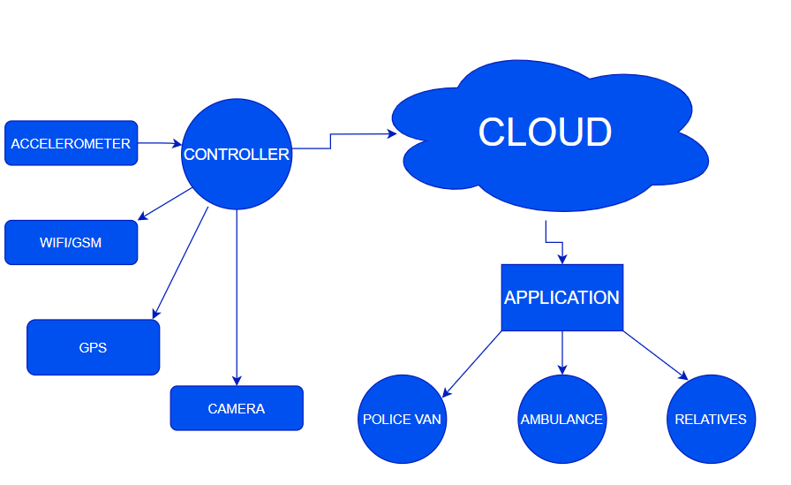
FLOWCHART

Slide 7
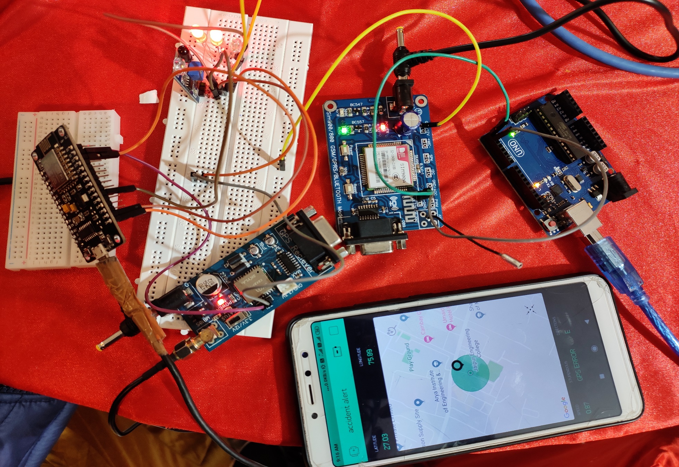
Prototype

Slide 8
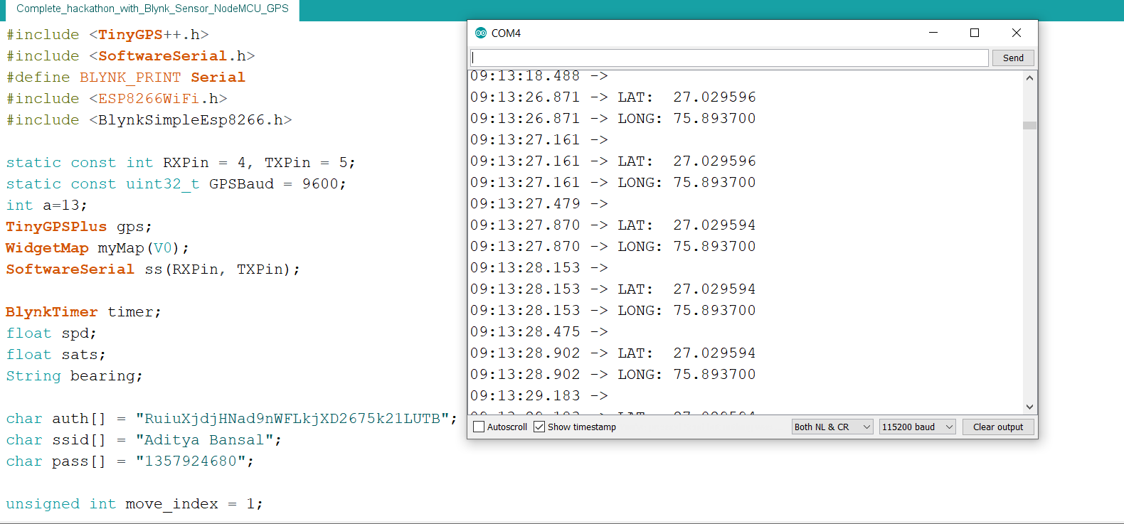
Editor window & Serial Monitor

Slide 9
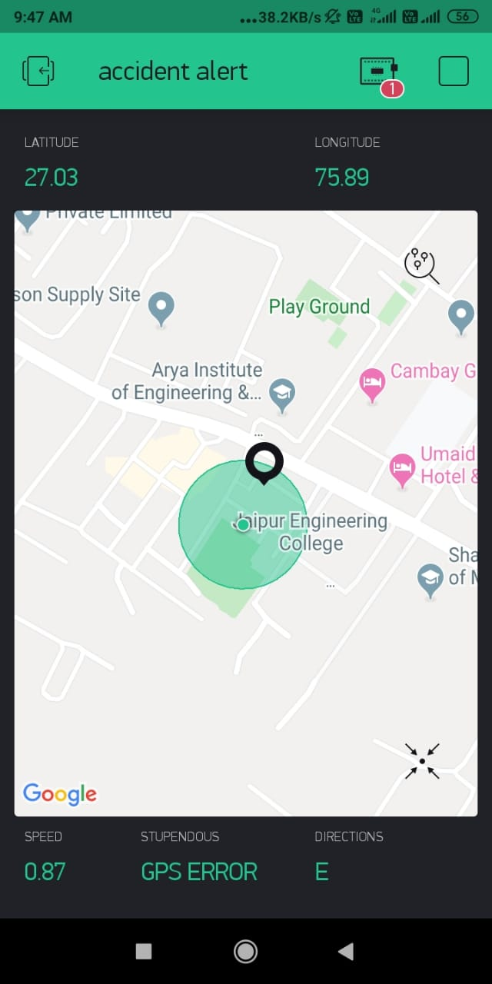
Application Dashboard

Slide 10
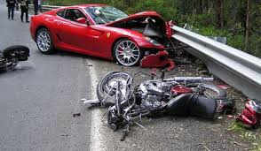
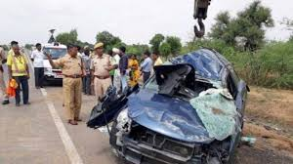
ADVANTAGES
The project is mobile.
It is feasible and easy to install.
It is cost efficient.
It does not replace the existing mechanism but modifies it.
It enables a person to get alerted whenever his/her car is being stolen
In case of any theft with the cloud we can reverse track the driver and car’s GPS coordinates

Slide 11
Thank you
Team Details
Team Leader- Aditya Bansal
Member 1- Vikas Gupta
Member 2- Uma Shankar Agarwal

