Slide 1
INDIA HACKATHON SERIES

Slide 2
Medicare On Ease
🚑
🚑
🏥
🚑
🏥
🚑

Slide 3
As the name implies, Medicare on ease is about taking healthcare to those who are unable to access medical services on time because of many reasons which we discuss later. Our this innovation takes a well-equipped medical team and a Mobile Hospital onto the location of the patient where we provide every possible medicare and first aid to the patient.

Slide 4
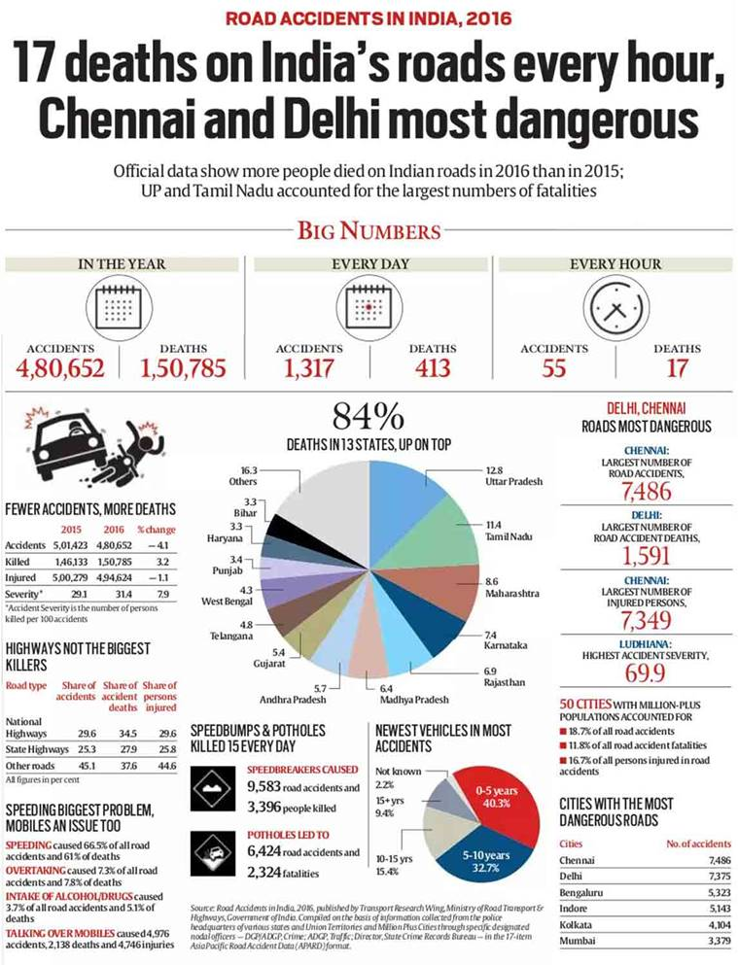
Need :
According to Times of India about 146,133 people were killed in road accidents in India in the year 2019. Unfortunately about 30% of deaths are caused due to delayed ambulance.

Slide 5
Ambulance delay causes women death
Bhubaneswar: The falling healthcare system in the state has apparently accounted for yet another life. This time a pregnant woman died after the ambulance reportedly reached late
When her condition deteriorated, she was shifted to Nayagarh district headquarters hospital (DHH) for better treatment. Saraswati's husband Santosh called an ambulance to take her wife to the Nayagarh DHH, but it allegedly came late. She reached the hospital where she breathed her last.
Reference: https://timesofindia.indiatimes.com/city/bhubaneswar/Ambulance-delay-leads-to-patient-death/articleshow/54455881.cms

Slide 6

About our idea….
Basically , our idea deals with increasing the possibility of saving a life by avoiding the unnecessary time delay due to various reasons like delayed ambulance or the long distance between the patient’s location and the hospital.
Here we , by using location tracking technique , trace the location of the patient and provide the every possible aid to the patient by identifying the shortest route from our collaborated centre.
BUT HOW DOES WE GET TO KNOW ABOUT THE PATIENT ?
So, this requires an mobile application which is an important unit of our system.

Slide 7
WHAT DOES THIS APP DO ?
When a person meet with an injury he/she just had to press the report button in the mobile app if he/she is awake enough to do this and if not , then the person with the patient have to do this. This will provide your current location to the nearest health centre and soon the possible aids will be provided to the patient.

Slide 8
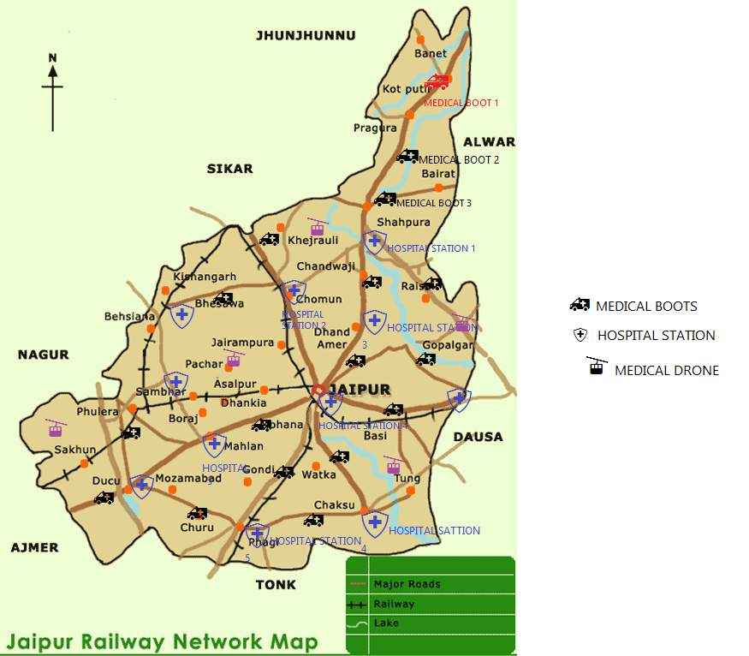
As shown we can install the medical boots at fixed distance between
Two hospitals so whenever required the patient can contact the ambulance and get the required help.
Tracing the users location app will show near by services available and the nearest ambulance would take the patient to the hospital.

Slide 9
User calls for the service
Location
traced
Emergency medical service would be send by
drone
Nearest ambulance
Will be send to user
According to location
Nearby ambulance would
Be traced
Doctor can say
Temporary treatment
To keep patient alive
Patient taken safely to nearest hospital

Slide 10
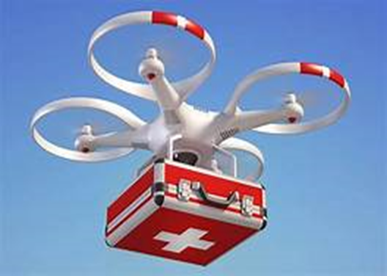
DRONES IN MEDICAL FEILD
Drone can be used in medical field also. likewise in case of an emergency , any person/patient can call the toll free number or can open the app to get help. This will trace the current location of that person and we can send him required help .

Slide 11
BENEFITS OF THIS IDEA
As we know that all other online medical sites take a bit time to send the required help but we can overcome this issue using drones.
It will lead to reduce death rate.
It will take less time to reach medical help.
It will be economically benifitial.

Slide 12


