Slide 1
TEAM ALPHA-4 PRESENTATION TOPIC NAME-ATTENTATION

Slide 2
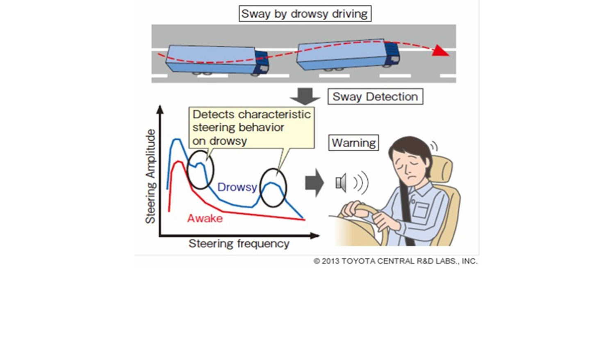
Diagram representation

Slide 3
INTRODUCTION
Driver drowsiness detection is a car safety technology which helps prevent accidents caused by theDrowsiness and Fatigue of drivers are amongst the significant causes of road accidents. this system deals with automatic driver drowsiness detection based on visual information and Artificial Intelligence. We propose an algorithm to locate, track, and analyze both the drivers face and eyes driver getting drowsy.

Slide 4
OBJECTIVE
this system deals with automatic driver drowsiness detection based on visual information and Artificial Intelligence. We propose an algorithm to locate, track, and analyze both ththis system deals with automatic driver drowsiness detection based on visual information and Artificial Intelligence. We propose an algorithm to locate, track, and analyze both the drivers face and eyese drivers face and eyes

Slide 5
WORKING
The driver drowsiness detection is based on an algorithm, which begins recording the driver’s steering behavior the moment the trip begins. It then recognizes changes over the course of long trips, and thus also the driver’s level of fatigue. Typical signs of waning concentration are phases during which the driver is barely steering, combined with slight, yet quick and abrupt steering movements to keep thIf the eye lid movements are abnormal than usual then the detection system triggers the alarm thussensors will scan the head and face to ensure that the eyes are open and the driver is alert before the car turns over the steering wheel alerting the driver about the condition.e car on track.

Slide 6
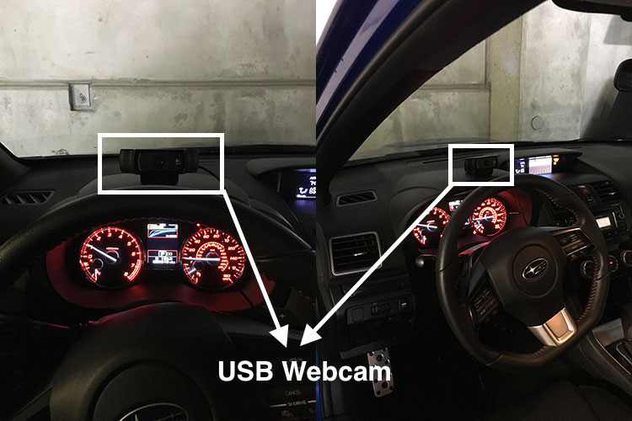

Slide 7
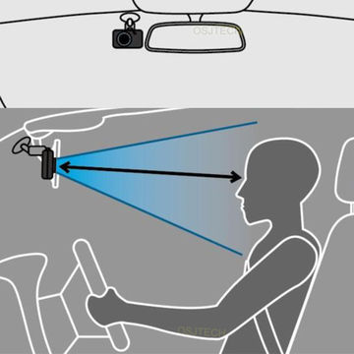

Slide 8
ADVANTAGES
It is not safe and ethical to make a drowsy driver drive on road. Hence, researchers have used simulated environments to carry out their experiments. Experimental control, efficiency, low cost, safety, and ease of data collection are the main advantages of using simulators

Slide 9
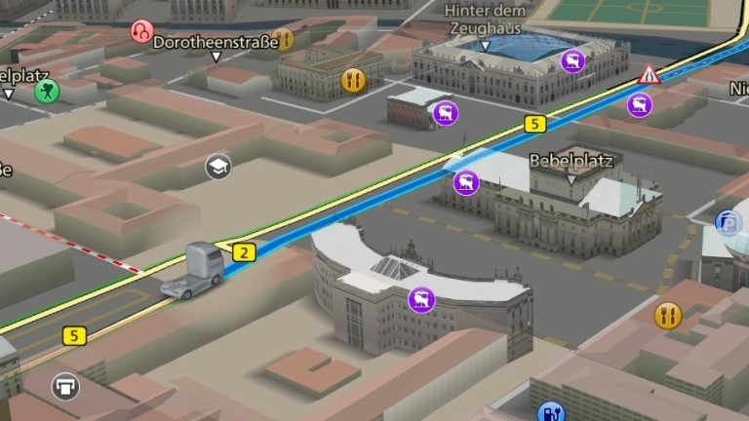
Use of Navigation
Send the driver current live location to their family members.
So they quick responds and take some actions.

