Slide 1

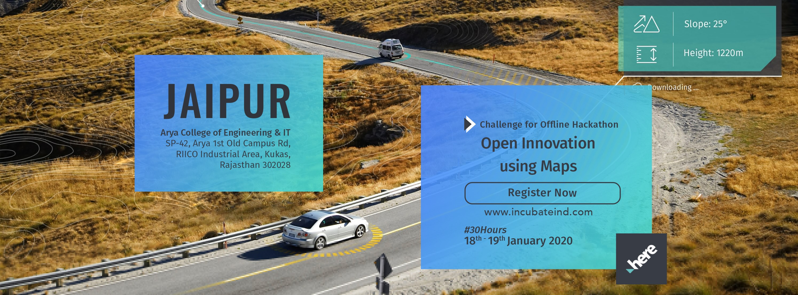
Arya College Of Engineering And IT

Slide 2

Group Name - Ignite
Topic :- Awareness from diseases by HERE maps

Slide 3
Our Technology Stack :-
HTML
Javascript ( VS code)
Use API link of HERE map
Reference Link :- HERE APIs TECHNOLOGY

Slide 4
Importance of maps :-
To understand roads and subways at new places.
To know whether there are two or more paths to the same place and which is the shortest.
We can also mark crops, weather reports, direction of wind, rainfall on the maps.
Today, the most advanced digital mapping technologies- satellite imagery, GPS devices, location data and of course maps are more accessible.
Government needs the map to keep the record of the owners.

Slide 5
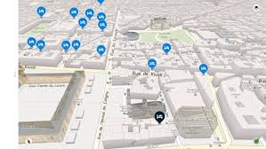
Idea :-
This idea is all about the disease map which helps and make the journey safe and healthy. It works as we enter or search any particular location on map.

Slide 6
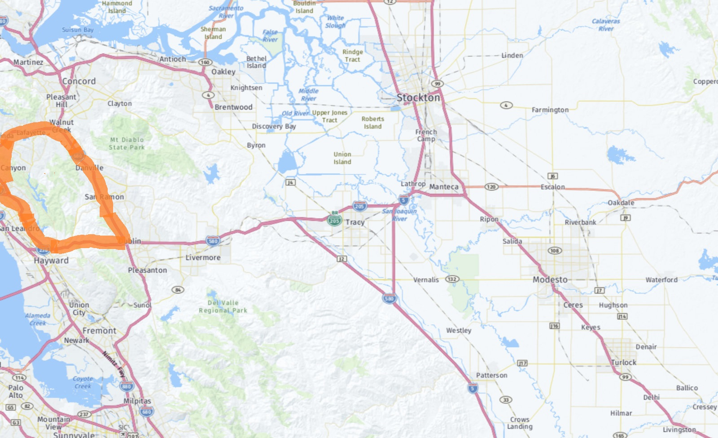
For the times when people travel without maps i.e. often we visit the places unknowingly whether its safe or not but at this time too this app plays a vital role by sensing the environmental condition and making us aware prior to our visit to any place.
This also show and guide as about the state of location i.e. if there is any kind of viral or disease spread in that particular environment.

Slide 7

Thank You
Group Members :- Sahil Modi
Prasanna Jain
Vanshita Jain
Mansi Yadav

