Slide 1
INTEGRATION AND DEPLOYEMENT OF
POTHOLE DETECTOR
TEAM : TECH_WIZARDS

Slide 2
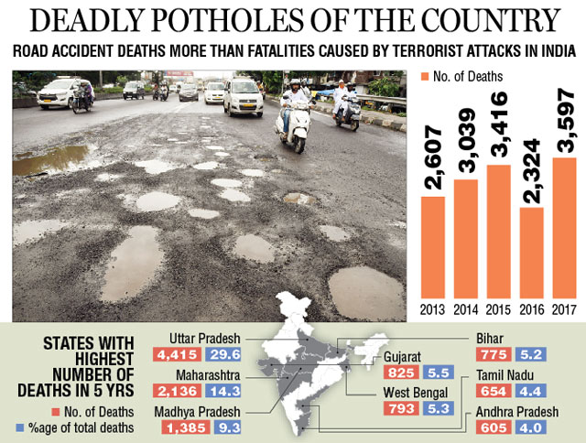
Timeline Infographic
POTHOLES, the most dangerous termed by UkDaily Mail caused most deaths in India in past decades. They were termed more fatal than terrorist attacks and thus still remains a major problem causing many of the beings their life.
Speed-Breakers, rash turns are also major reasons of time delaying and major traffic conditions. These major traffic leads to the time wastage as well as more and more fuel consumption.

Slide 3
OUR INVENTION
POTHOLE DETECTOR
KEY FEATURES
3 AXIS-ACCELEROMETER
It helps to detect jolts and will help us to get the location of the potholes.
ANDROID APPLICATION.
USING MODERN TECH
Integration of Pothole_Detector in the vehicles that are GPS enabled will help to get condition of roads.
Using the Algorithms of Machine Learning we will be able to predict the further condition and real time condition of roads.
COST EFFICIENT
A simple Android application and a 3-Axis Accelerometer is presented with optimum and low cost.

Slide 4
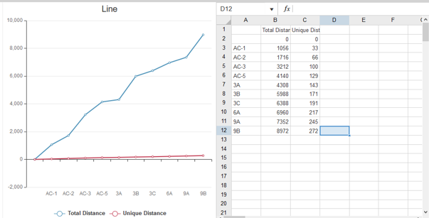
DISTANCE COVERED BY SAMPLE VEHICLES

Slide 5
VALUE PROPOSED
DETECTION OF POTHOLES
We simply with the help of potholes detector will give the real location and timing of condition of roads.
With the help of Machine learning we will predict where potholes and accidents can happen.
INFORMING THE GOVERNMENT AND PUBLIC
We will give the precise location of potholes and the real time condition of the withered roads that will help government to repair and thus help people to avoid such areas.
EFFICIENCY
With all the algorithms used, we will give the roads to avoid that will eventually reduce the traffic and accidents. Time saving will also be the integrated part that is most important on current scenario.
IMPROVISATION OF HERE TECH.
As seen the HERE Technologies map system we can integrate this method inside their map drivers that will enhance their system of Maps.

Slide 6
ENHANCING DATASET
 | By weather prediction we can predict the condition of roads and pothole formation.
 | WEATHER CONDITON
 | Using the existing data we predict the condition of already bad roads with that data we can predict the roads could be worsen quickly.
 | ROUGH ROADS
 | The more number of vehicles over a single route or a group of roads will eventually catalyze the destruction of roads.
 | TRAFFIC CONDITON
 | The I-shaped pillars that supports will get weaken by continuously usage by heavy vehicles. We will predict the condition of flyovers too.
 | FLYOVERS
PREDICTING
PARAMETERS

Slide 7
CUSTOMER SEGMENT
Contents _ Android Application
Our Android based application will locate the potholes formed with the connectivity of our Hardwell_ware device and will give the real time tracking. It will also predict where the condition of roads can worsen and will inform accordingly.
An android application and hardware based system that will help to predict and give the precise condition of roads to prevent accidents and traffic condition.
Vehicle
Android App
Hardwell
Contents _ Vehicle
Contents _ Hardwell_Hardware
As we proceed to the Modernization in Technology, every vehicle now comes with the GPS based System. Our device will use it to give us the location of the withered road.
Our device contains 3-axis Accelerometer and uses GPS of the vehicle and will send the time and location of jolts received to the android application.

Slide 8
THANK YOU

