Slide 1
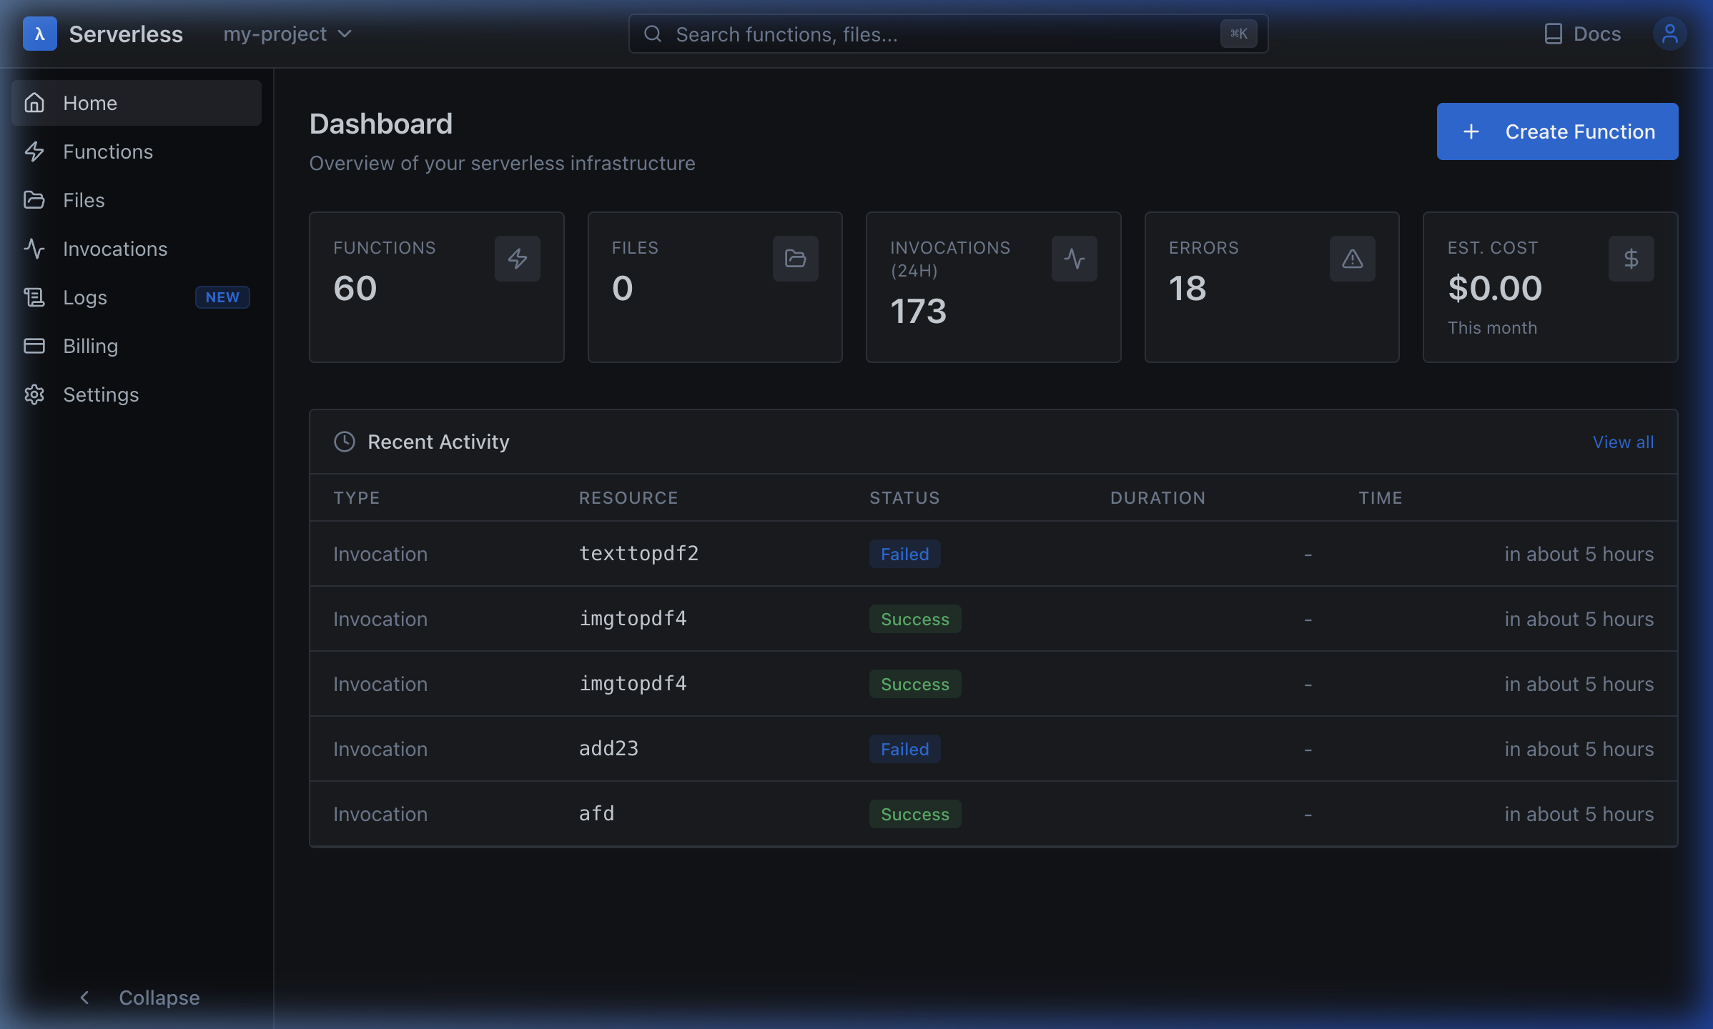
MILF
Mobile Infra for Lambdas and Files
A Distributed Serverless Platform Leveraging Consumer Edge Devices
for Secure WebAssembly-Based Compute
Final Evaluation · DevLup Labs · April 2026
Open Dashboard
Open API
MILF · Mobile Infra for Lambdas and Files
Dashboard
Title
1/22

Slide 2
Problem Statement
Why current cloud infrastructure fails for the next generation of workloads
• Centralized Cloud Overhead: Traditional cloud computing requires expensive proprietary data centers with high operational costs ($0.20/GB egress, $3.50/hr GPU instances) and deep vendor lock-in. Small teams are priced out.
• Underutilized Edge Resources: 6.8 billion smartphones globally — millions sit idle at any moment with unused CPU, 4-16 GB RAM, and storage. A globally distributed supercomputer gathering dust in people's pockets.
• Serverless Cold-Start Bottlenecks: Traditional FaaS (AWS Lambda, Cloud Functions) use container-based deployments with cold-start delays of 100ms–5s, memory starvation issues, 15-min timeout limits, and expensive idle billing.
• Untrusted Code on Edge: Running arbitrary code on consumer devices is historically dangerous. Docker containers are too heavy (100MB+ images) for mobile, and native execution risks host compromise without deep sandboxing.
MILF · Mobile Infra for Lambdas and Files
Dashboard
Title
2/22

Slide 3
Our Solution: Edge-Powered Serverless
Harnessing idle consumer devices for distributed, secure compute via WebAssembly
• Core Idea: Build an infinitely scalable distributed computing network using consumer smartphones as compute nodes. Every idle device becomes part of a global compute mesh — like UBER for compute power, we don't own any servers.
• WebAssembly as the Vehicle: WASM is the universal compilation target — code written in C, C++, Rust, or Go compiles to a portable, sandboxed binary (10-50 KB) that runs securely on any CPU architecture without Docker, VMs, or containers.
• Pull-Based Architecture: Instead of 'Server-Pushes-to-Worker', devices pull tasks when ready (Bulletin Board model). The server maintains zero state about device connections. If the server crashes, devices simply reconnect. Inherently self-healing.
• Near-Zero Cold Start: WASM modules load in <1ms (vs. 100ms–5s for containers). Combined with stateless pull-based dispatch, the invoke-to-result pipeline targets sub-10ms latency for cached functions.
MILF · Mobile Infra for Lambdas and Files
Dashboard
Title
3/22

Slide 4
System Architecture: Central Server
Go modular monolith for auth, compilation, dispatch, storage
React Dashboard
Auth
PostgreSQL (users, lambdas, executions)
Gateway API (REST + WebSocket)
Compiler
Consumer Nodes
Queue Service
File Store (binary outputs)
Sink Manager
wasi-sdk clang (C → WASM)
Orchestrator
Key idea: the server stays stateless about device connections; nodes pull work via heartbeats.
Compilation produces small WASM modules (10–50 KB) executed securely on consumer devices.
MILF · Mobile Infra for Lambdas and Files
Dashboard
Title
4/22

Slide 5
System Architecture: React Dashboard
Developer UI for deploy, invoke, monitor, and download outputs
React App (Vite + TypeScript + Tailwind)
Browser (Developer)
Central Server API
Pages
Components
Auth (OAuth/JWT)
Charts + Logs
Typical interaction: Create function → compile → invoke → view logs/results → download files.
The deck links to the live dashboard at http://localhost:5173 for interactive demos.
MILF · Mobile Infra for Lambdas and Files
Dashboard
Title
5/22

Slide 6
System Architecture: Consumer Node (Android)
Secure WASM execution pipeline: Flutter → isolated service → JNI → WAMR
Flutter Orchestrator
Kotlin Service (isolatedProcess)
Central Server (WebSocket)
JNI Bridge (C++)
Binder IPC (AIDL)
WAMR Runtime (load → instantiate → call → teardown)
Isolation: WASM sandbox + interpreter-only runtime + Android isolated process + Linux namespaces + seccomp.
Result returns through the same chain (WAMR → JNI → Binder → Flutter) to the server.
MILF · Mobile Infra for Lambdas and Files
Dashboard
Title
6/22

Slide 7
Compiler Architecture (Concise Flow)
How source becomes a deployable WASM artifact ready for dispatch
Compilation Queue
Auto-Wrapper
Source Intake
Inline editor / file upload / GitHub import
wasi-sdk clang
Compiler Worker
Dequeues requests, validates, produces WASM
WASM Artifact
Persist Metadata
Store + Activate
PostgreSQL: function, compilation, status
Output: Activated lambda with a compiled WASM binary ready for dispatch to consumer nodes.
MILF · Mobile Infra for Lambdas and Files
Dashboard
Title
7/22

Slide 8
Compilation Pipeline: Source → WASM
How user code becomes a portable, sandboxed binary via wasi-sdk clang
• Intake Layer: Accepts source code as raw text (inline JSON), file upload (.c, .zip), or GitHub URL. Code is extracted to isolated temp directories under /tmp/job-id/src/. For ZIP: expects single entry file or build config.
• Auto-Wrapper Generation: User functions are automatically wrapped. For add(a,b), the system generates: run(input_ptr, input_len, output_ptr, output_cap) — handles JSON deserialize, calls user function, serializes result back into WASM linear memory. Compilation = user code + wrapper → .wasm file.
# wasi-sdk/bin/clang invocation from compiler.go
$ clang \
--target=wasm32-wasi # Target: WASM 32-bit, WASI interface
--sysroot=wasi-sdk/share/wasi-sysroot # Custom sysroot (no host headers)
-I common_headers/ # Inject: milf.h, milf_printf.h, pdf.h
-O1 # Optimization level 1
-mno-bulk-memory # WAMR compat: disable bulk memory ops
-mno-mutable-globals # Disable mutable globals import
-mno-sign-ext # Disable sign extension ops
-fno-builtin -nostdlib # No libc — we provide our own via milf.h
-Wl,--no-entry # No _start entry — we call run() directly
-Wl,--export-all # Export all symbols for host access
-Wl,--allow-undefined # Allow host-provided function imports
-Wl,--strip-all # Strip debug symbols (smaller binary)
-Wl,--no-check-features # Skip WASM feature section validation
input.c -o output.wasm # Typical output: 10–50 KB
MILF · Mobile Infra for Lambdas and Files
Dashboard
Title
8/22

Slide 9
Consumer Node: Execution Pipeline on Android
Flutter → Kotlin → C++/WAMR — complete step-by-step flow (from project documentation)
• Step 1: Flutter Orchestrator: NodeController manages the full lifecycle. CloudSync handles server registration and WebSocket. On receiving TaskAssignment, it base64-decodes the WASM binary, writes to temp file, invokes native bridge via MethodChannel('wamr_channel').invokeMethod('runWasm', {...}).
• Step 2: Kotlin Bridge (AIDL Binder IPC): MainActivity receives Flutter MethodChannel call, binds to WasmService with BIND_AUTO_CREATE. WasmService runs in android:isolatedProcess='true' — separate process, no app permissions, no filesystem, no network, separate PID. Data crosses processes via Binder serialization.
• Step 3: C++ WAMR Runtime (31 KB binary): native-lib.cpp: wasm_runtime_full_init() → wasm_runtime_load() parses + validates module → wasm_runtime_instantiate() allocates linear memory + stack → wasm_runtime_lookup_function() finds exported 'run' → wasm_runtime_call_wasm() executes → cleanup: destroy env, de-instantiate, unload. Execution-only mode (interpreter), AOT/JIT disabled.
• Step 4: Result Propagation: Result flows: native C++ → JNI → WasmService (Binder) → MainActivity → Flutter MethodChannel. Duration + memory stats collected by ExecutionMonitor. MemoryTracker reads RSS from /proc/self/status, refuses instantiation if RSS > 80% of 1.5 GB hard limit.
MILF · Mobile Infra for Lambdas and Files
Dashboard
Title
9/22

Slide 10
Five-Layer Security Model
Defense-in-depth: protecting infrastructure AND consumer devices running untrusted code
① WASM Linear Memory Sandbox
② WAMR Runtime Isolation
③ Process Isolation (Android)
4 GB max linear memory boundary
No pointer escape to host memory
Bounds-checked array access at runtime
Stack overflow protection enabled
No raw syscall capability from WASM
Interpreter-only mode (no JIT/AOT)
Restricted WASI API surface
No filesystem / network / env access
Function import whitelist only
Tight execution control and monitoring
android:isolatedProcess=true
No app permissions in isolated process
Separate PID, no host filesystem
No network access for WASM process
Binder IPC is ONLY cross-process channel
④ OS-Level Sandbox (Linux)
⑤ Memory Admission Control + Kill Switch
Seccomp-BPF syscall whitelisting — process killed on disallowed syscall
PID namespace: process cannot see host processes
Mount namespace: virtual filesystem boundary keeps host safe
Network namespace: disables/scopes network visibility
Cgroups: hard CPU, memory, I/O bandwidth limits enforced by kernel
MemoryTracker reads RSS from /proc/self/status
Refuses new instantiation if RSS > 80% of 1.5 GB hard limit
Hard 30-second execution timeout (configurable)
ExecutionMonitor tracks duration + warns on slow execution
Module loaded and destroyed per call — stateless, no residual state
MILF · Mobile Infra for Lambdas and Files
Dashboard
Title
10/22

Slide 11
Live Demo: Developer Dashboard
Real-time overview — 60 functions deployed, 173 invocations tracked, cost estimation
MILF · Mobile Infra for Lambdas and Files
Dashboard
Title
11/22

Slide 12
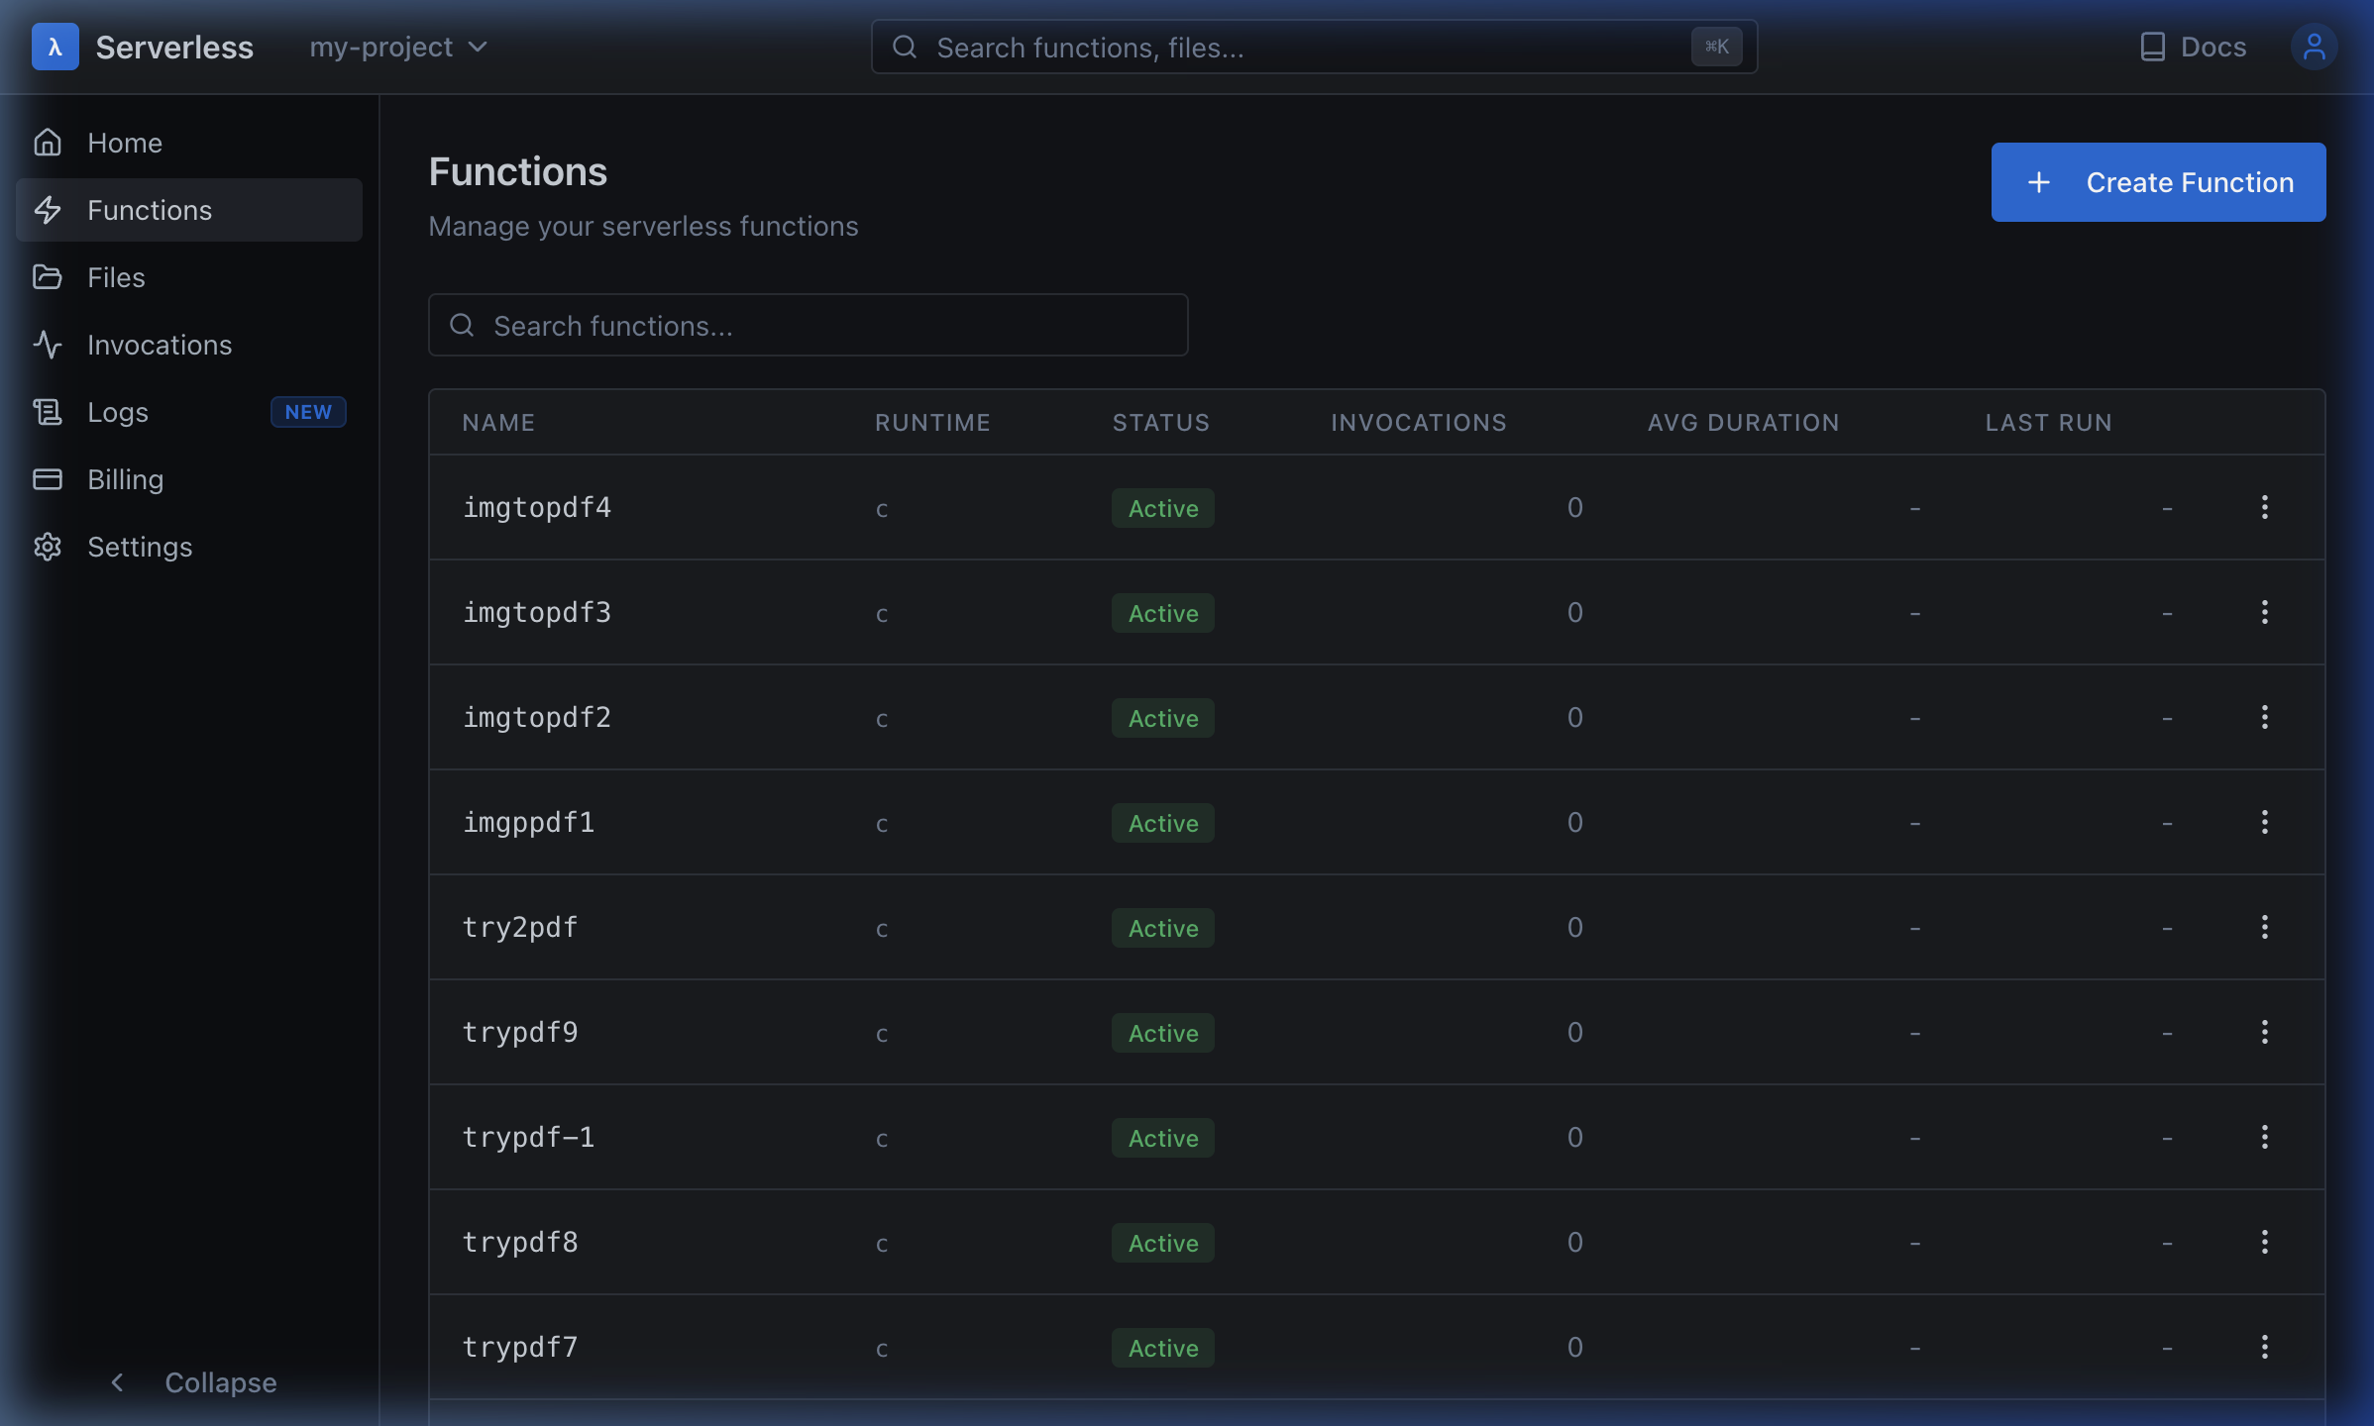
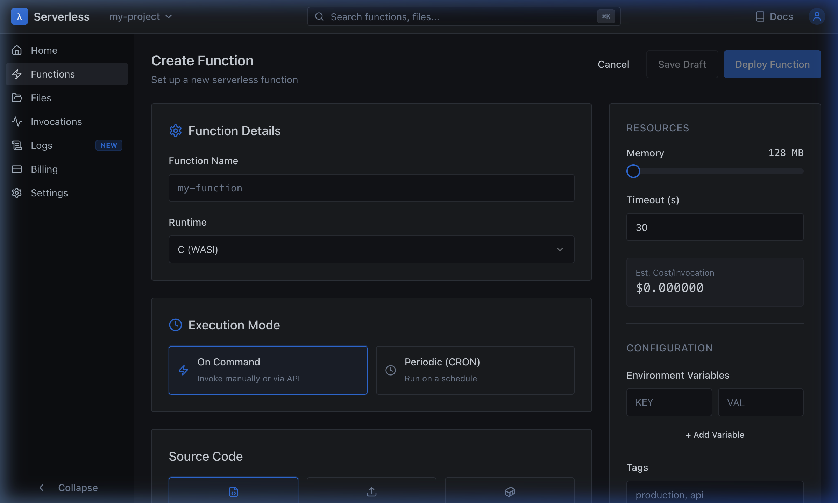
Live Demo: Functions — List & Create
AWS Lambda parity: runtime selection, execution modes (on-command / CRON), resource config
▸ Function Details: Name, Runtime (C/WASI), Tags ▸ Execution Mode: On Command (manual/API) or Periodic (CRON schedule)
▸ Resources: Memory 128–8192 MB slider, Timeout 1–30s ▸ Source Input: Inline editor (Monaco), file upload, GitHub import
MILF · Mobile Infra for Lambdas and Files
Dashboard
Title
12/22

Slide 13
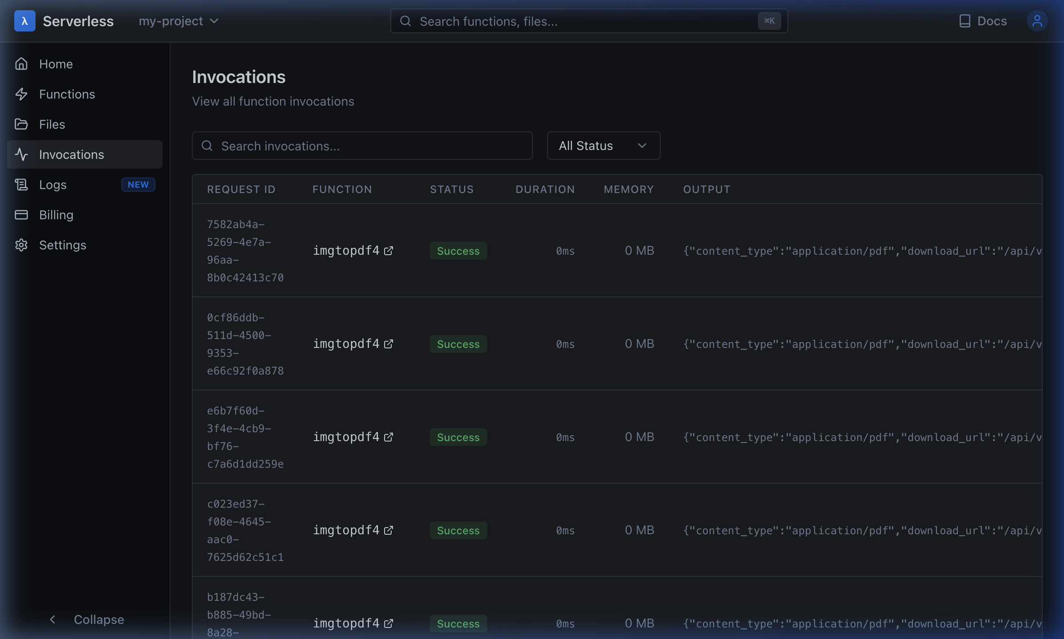
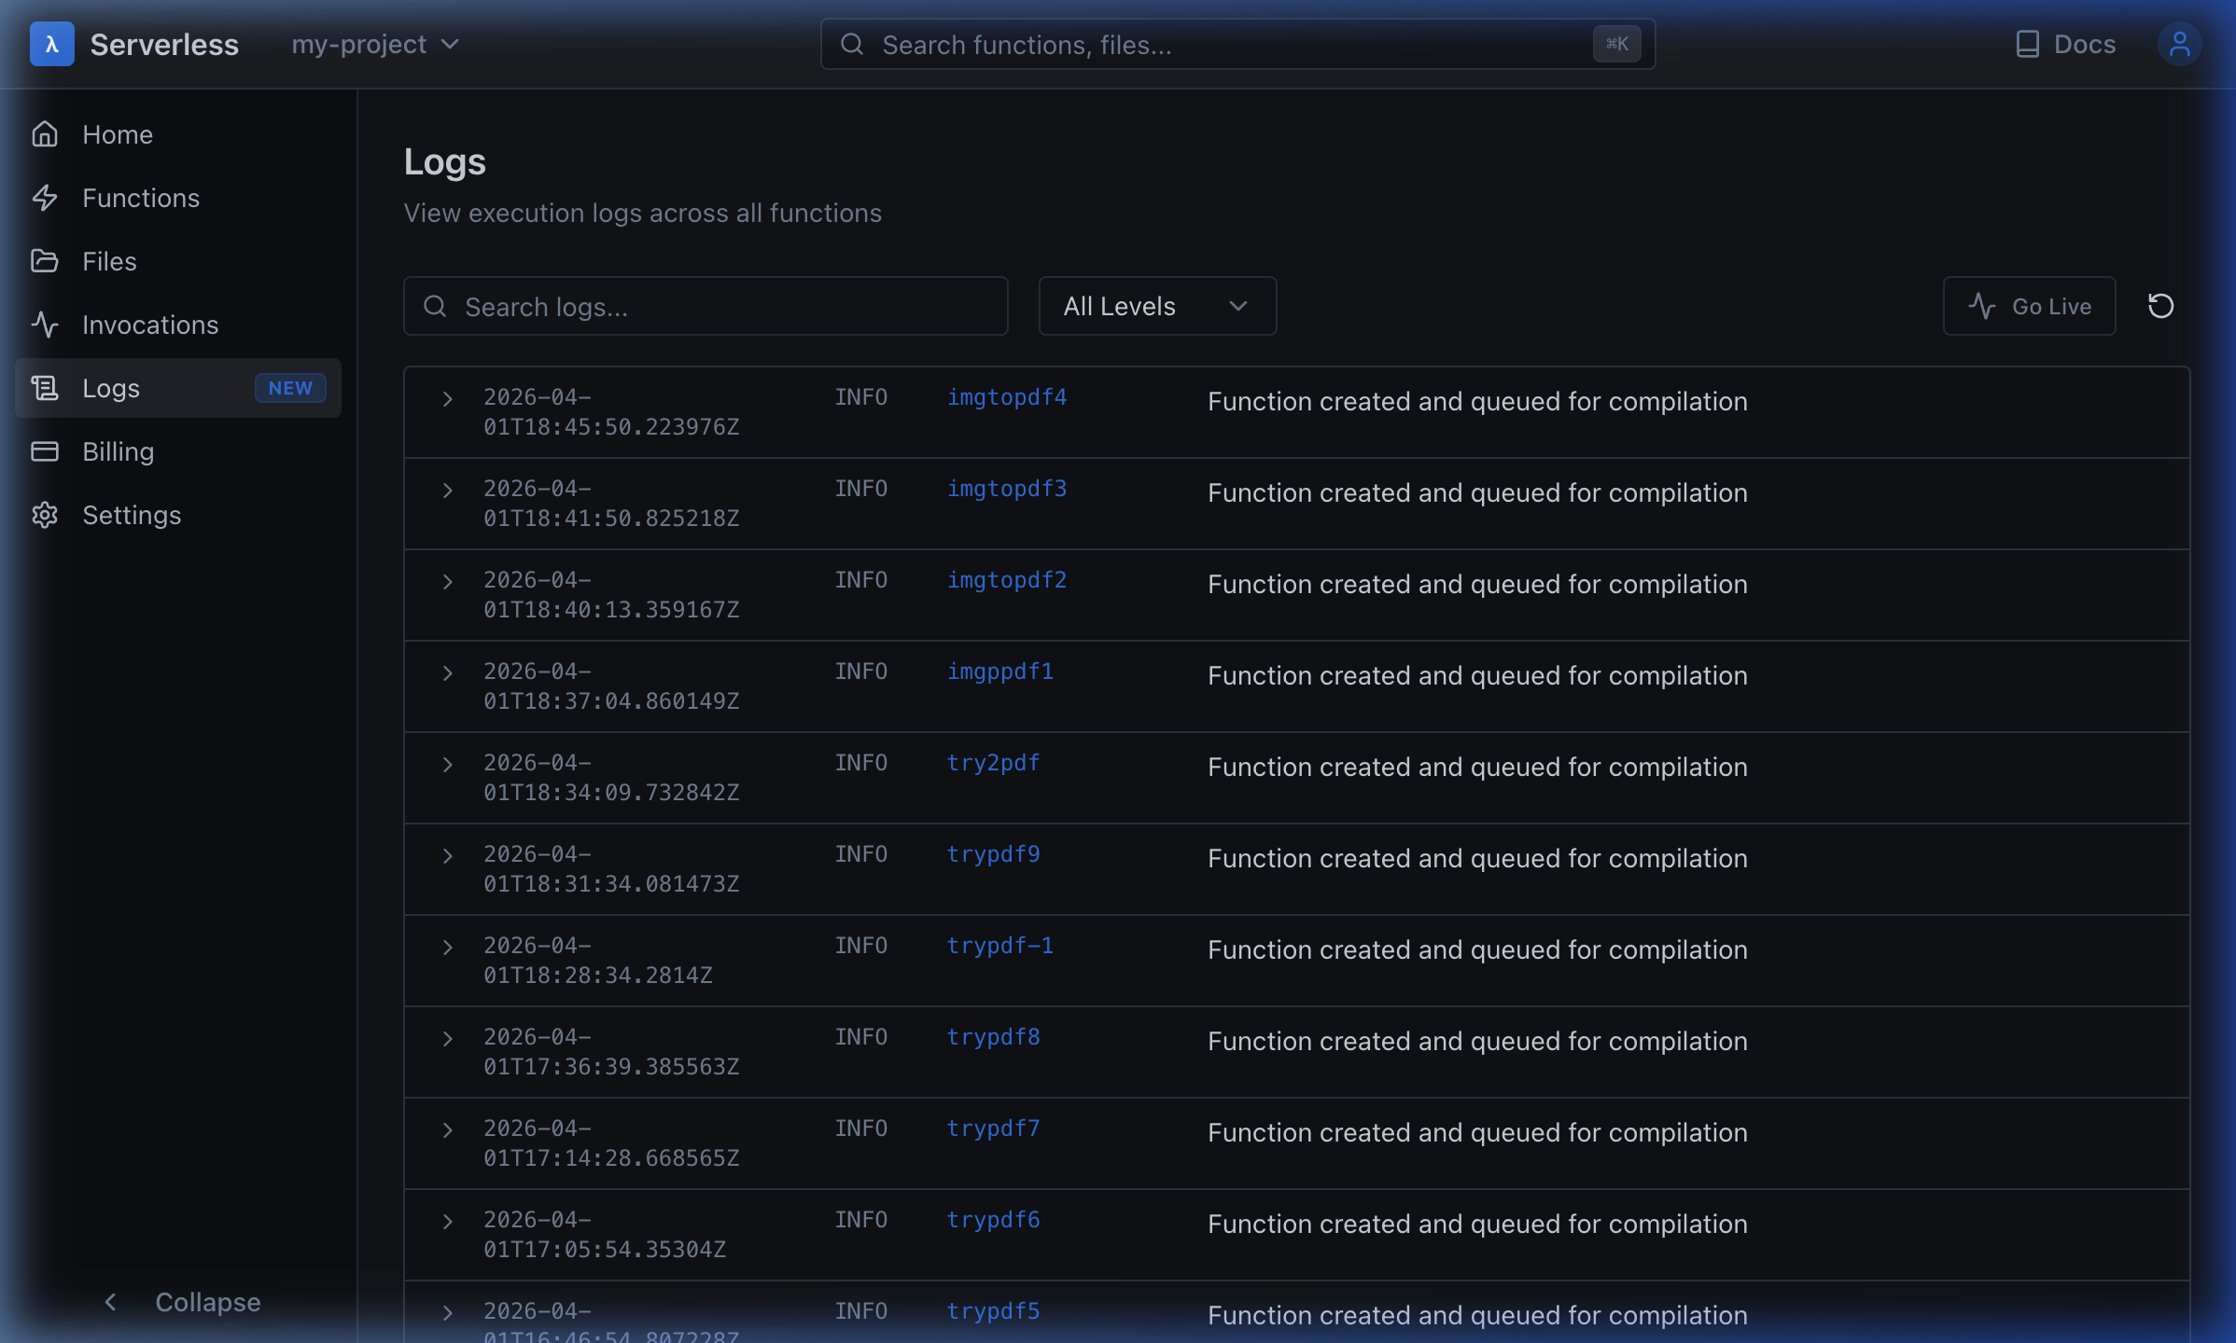
Live Demo: Invocations & Logs
Complete execution audit trail with structured logging and live streaming
▸ Invocations: Request ID, function, status (Success/Failed), duration, memory, output (JSON or file download URL)
▸ Logs: Timestamp, level (INFO/WARN/ERROR), function name, message + expandable detail. Go Live for real-time streaming.
MILF · Mobile Infra for Lambdas and Files
Dashboard
Title
13/22

Slide 14
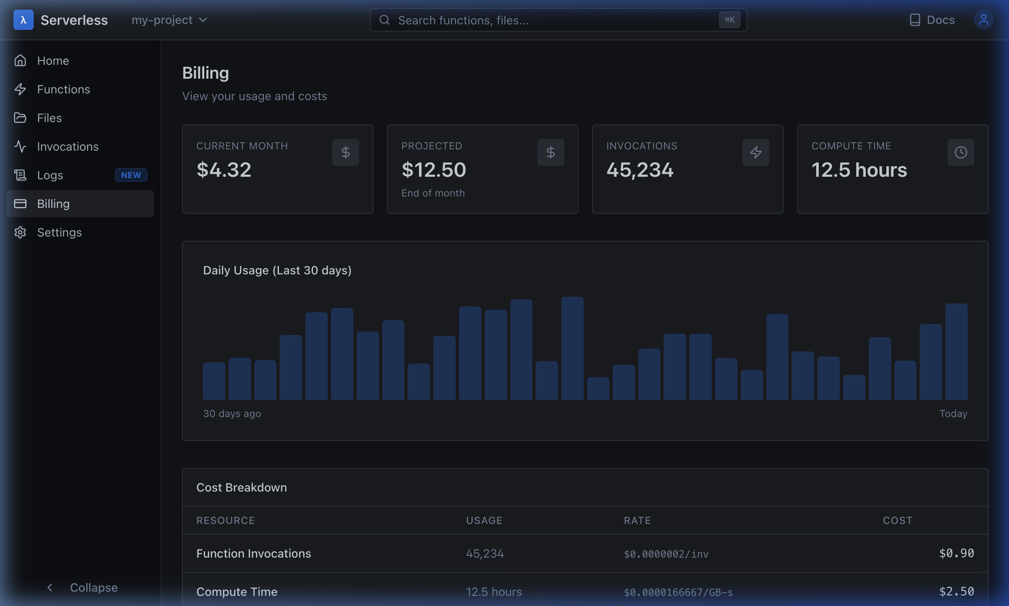
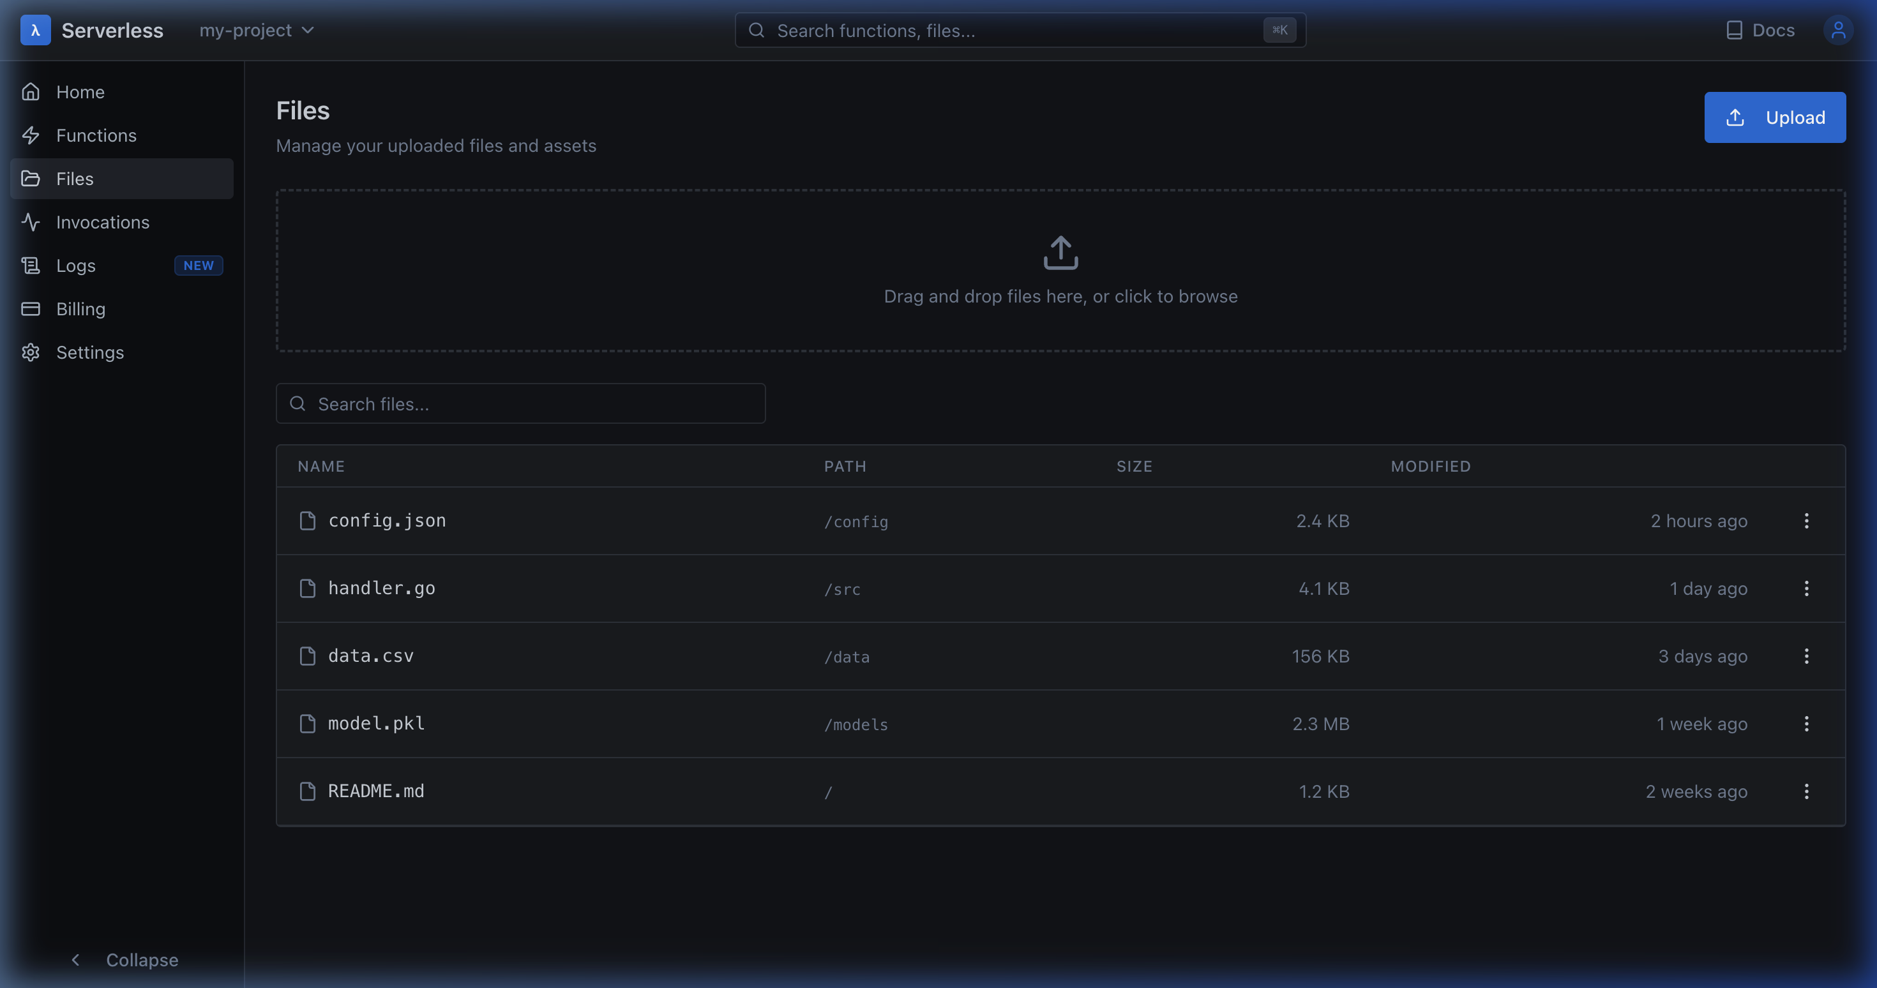
Live Demo: Billing & File Storage
AWS-style cost tracking with usage charts and drag-and-drop file management
▸ Billing: Current month ($4.32), projected ($12.50), 45K invocations, 12.5h compute. Cost breakdown: $0.0000002/inv, $0.0000166667/GB-s
▸ Files: Drag-and-drop upload, search, file listing with path/size/date. Supports binary outputs (PDFs, images) from function executions.
MILF · Mobile Infra for Lambdas and Files
Dashboard
Title
14/22

Slide 15
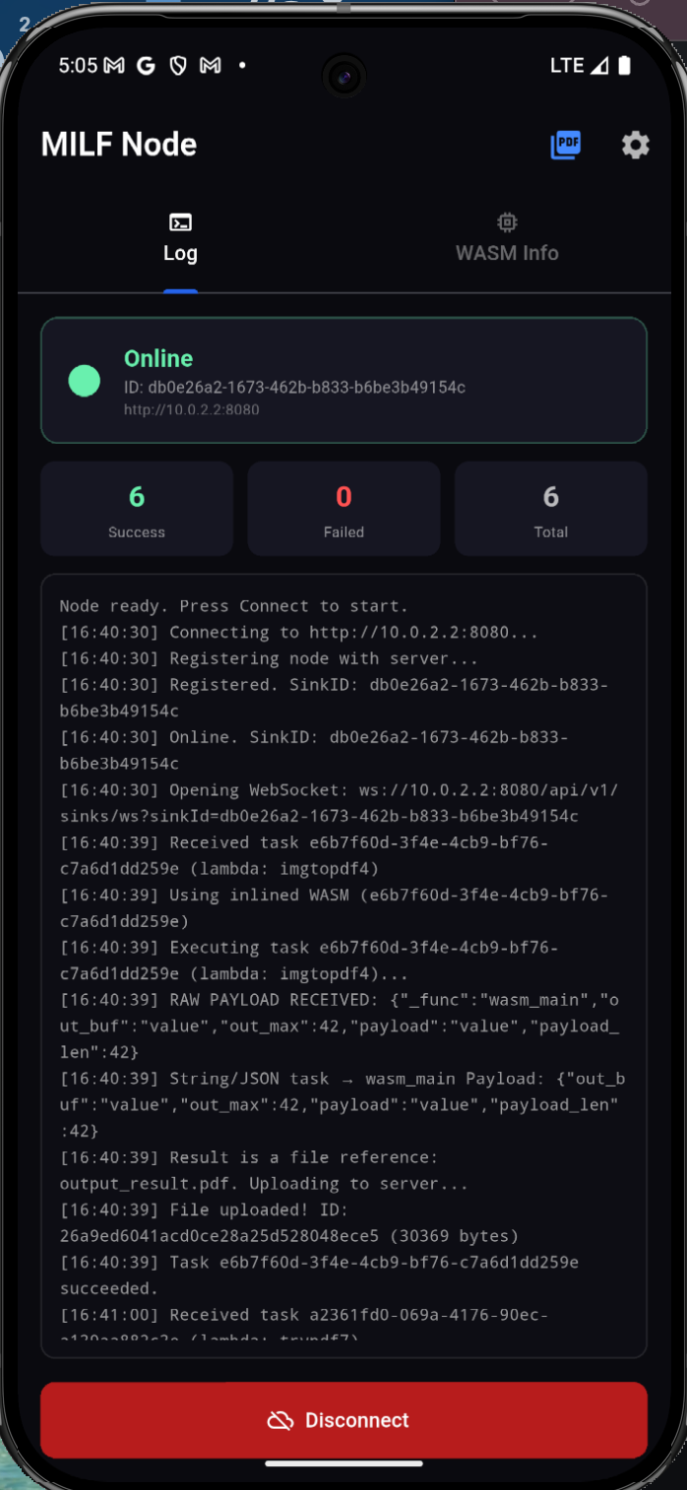
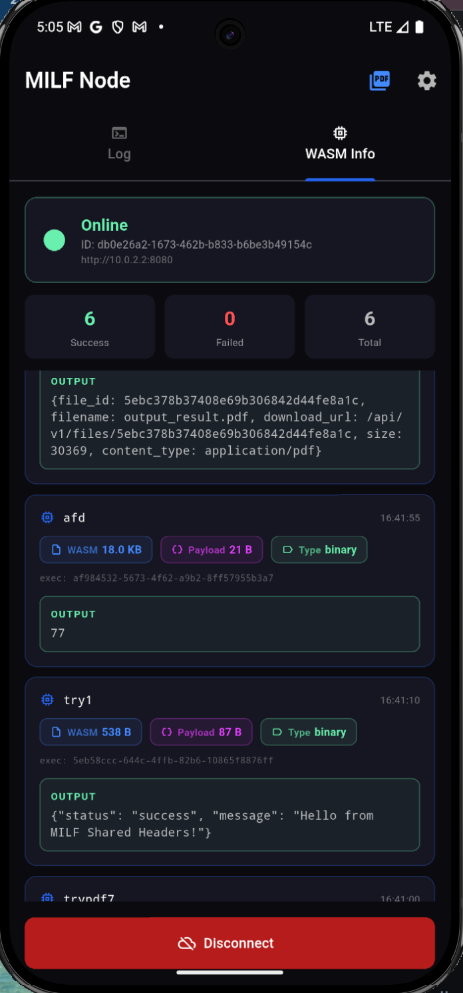
Live Demo: Mobile Consumer Node (Android)
Real Android device running the MILF Node — 6 successful WASM executions including PDF generation
Live Execution Evidence
Status: Online, 6 Success, 0 Failed, 6 Total
Log Tab (left screenshot):
• WebSocket connection to server
• Received task: imgtopdf4 (image→PDF)
• WASM inlined, executed, result uploaded
• output_result.pdf (30,369 bytes) uploaded
• File ID returned to server
WASM Info Tab (right screenshot):
• afd: WASM 18 KB, Payload 21 B → Output: 77
• try1: WASM 538 B, Payload 87 B →
Output: {"status":"success","message":
"Hello from MILF Shared Headers!"}
• PDF output with download URL shown
Two tabs: Log (execution trace) + WASM Info
(per-task binary size, payload, type, output)
MILF · Mobile Infra for Lambdas and Files
Dashboard
Title
15/22

Slide 16
Real-Time Communication: WebSocket Protocol
Bidirectional message types between Central Server and Consumer Nodes
• Connection Upgrade: GET /api/v1/sinks/ws?sinkId=<uuid> — HTTP → WebSocket upgrade via gorilla/websocket. On connect, sink joins the in-memory ConnectionHub. Server starts read loop for heartbeat/result messages.
• Heartbeat (Sink → Server): {"type":"heartbeat","payload":{"sink_id":"uuid","ram_available_mb":512,"storage_available_mb":1024}} — Sent every 5-10 seconds. SinkManager instantly matches reported capacity against queued jobs and responds with a task assignment if one fits.
• Task Assignment (Server → Sink): {"type":"task_assignment","payload":{"execution_id":"uuid","lambda_id":"text","wasm_bytes":"<base64>","input":{...},"timeout_seconds":30}} — Complete WASM binary is base64-encoded inline in the payload. No separate download step needed.
• Task Result (Sink → Server): {"type":"task_result","payload":{"execution_id":"uuid","output":{...},"success":true,"duration_ms":12,"memory_used_mb":2.4}} — Updates Execution record to "completed" and unblocks synchronous HTTP waiters via condition variable (NotifyResult).
MILF · Mobile Infra for Lambdas and Files
Dashboard
Title
16/22

Slide 17
REST API Surface: 25+ Endpoints
Complete API reference from the Gateway and Sink Manager modules
── Gateway Endpoints ────────────────────────────────────────────────────────────
POST /api/v1/auth/register Register new developer (bcrypt hash)
POST /api/v1/auth/login Login → JWT access token (24hr)
POST /api/v1/functions/create Create + auto-compile lambda to WASM
POST /api/v1/functions/invoke Invoke function → dispatch to sink
GET /api/v1/lambdas List all lambdas for authenticated user
GET /api/v1/lambdas/{id} Get lambda details + metadata
GET /api/v1/lambdas/{id}/wasm Download raw compiled WASM binary
DELETE /api/v1/lambdas/{id} Delete lambda + cascade WASM binary
POST /api/v1/lambdas/activate Set lambda status to active
POST /api/v1/lambdas/{id}/schedule/pause Pause CRON schedule
POST /api/v1/lambdas/{id}/schedule/resume Resume CRON schedule
GET /api/v1/executions/{id} Get execution details + result
GET /api/v1/logs Query structured execution logs
── Sink Endpoints ──────────────────────────────────────────────────────────────
POST /api/v1/sinks/register Register consumer device (email/pass)
POST /api/v1/sinks/login Authenticate sink → JWT
POST /api/v1/sinks/heartbeat Report RAM/storage (HTTP fallback)
POST /api/v1/sinks/result Submit task result (HTTP fallback)
GET /api/v1/sinks/ws?sinkId=... Upgrade to WebSocket (bidirectional)
── Files + Health ──────────────────────────────────────────────────────────────
POST /api/v1/files Upload binary file (multipart)
GET /api/v1/files/{id} Download file by ID (PDF, images)
GET /health Full JSON health check
MILF · Mobile Infra for Lambdas and Files
Dashboard
Title
17/22

Slide 18
Database Schema (PostgreSQL)
Relational storage for users, functions, executions, logs, sinks, and policies
-- USERS: Authentication & identity
CREATE TABLE users (
id UUID PRIMARY KEY, username VARCHAR(255) UNIQUE NOT NULL,
password_hash TEXT NOT NULL, created_at TIMESTAMPTZ, updated_at TIMESTAMPTZ
);
-- FUNCTIONS: Lambda definitions + compiled WASM binaries
CREATE TABLE functions (
id TEXT PRIMARY KEY, user_id UUID REFERENCES users(id),
name VARCHAR(255), runtime VARCHAR(50) DEFAULT 'c', memory_mb INT DEFAULT 128,
source_code TEXT, wasm_ref BYTEA, -- Base64 WASM binary
run_type VARCHAR(20) DEFAULT 'on-command', -- 'on-command' | 'periodic'
cron_expression VARCHAR(100), -- e.g. '*/5 * * * *'
status VARCHAR(20), created_at TIMESTAMPTZ, updated_at TIMESTAMPTZ
);
-- EXECUTIONS: Complete invocation audit trail
CREATE TABLE executions (
id UUID PRIMARY KEY, lambda_id TEXT REFERENCES functions(id),
reference_id TEXT, input JSONB, status VARCHAR(20), output JSONB,
error TEXT, started_at TIMESTAMPTZ, finished_at TIMESTAMPTZ,
duration_ms BIGINT, memory_used_mb INT
);
-- SINKS: Consumer devices | LOGS: Structured observability
-- POLICIES: Per-user quotas | BILLING: Usage tracking per cycle
-- Full CRUD via interfaces.Repository pattern — database is plug-and-play
MILF · Mobile Infra for Lambdas and Files
Dashboard
Title
18/22

Slide 19
End-to-End Execution Flow
Complete journey: Developer writes code → Phone executes WASM → Result returned
• ① Developer Submits Code: Developer writes a C function (e.g., add(a,b) or image-to-PDF converter) via the React dashboard and clicks 'Deploy Function'. The source code is sent as a JSON payload to POST /api/v1/functions/create.
• ② Server Compiles to WASM: Gateway queues the code for compilation. CompilerWorker dequeues it, runs wasi-sdk clang with 15+ safety flags, produces a 10-50 KB WASM binary, base64-encodes it, stores as BYTEA in PostgreSQL. Auto-activates the function after successful compilation.
• ③ Developer Invokes Function: POST /api/v1/functions/invoke with {function_id, input}. Orchestrator validates activation status, creates an Execution record (status='pending'), and dispatches to the Queue Service based on memory requirements.
• ④ Phone Pulls and Executes: A connected Android phone sends a heartbeat via WebSocket with its available RAM. Sink Manager matches capacity against queued jobs. If a match is found, the entire WASM binary is sent inline in the WebSocket payload. Phone's WAMR runtime loads, instantiates, executes, and returns the result.
• ⑤ Result Delivered: Phone sends task_result via WebSocket. Server updates Execution record to 'completed', unblocks any synchronous HTTP waiters. Developer sees the result in the dashboard. For file outputs (e.g., PDF), the file is uploaded to /api/v1/files and a download URL is returned.
MILF · Mobile Infra for Lambdas and Files
Dashboard
Title
19/22

Slide 20
Completed Proofs of Concept
Working demonstrations that validate the full distributed pipeline
✅ Implemented & Working
📊 Project Metrics
Phase 1: Lambda CRUD + full WASM compilation pipeline
Phase 2: CRON scheduler (pause / resume / status)
Phase 3: WebSocket real-time bidirectional task dispatch
Phase 4: Observability (structured logs, billing, usage analytics)
Phase 5: Binary file I/O (PDF generation proof of concept)
Key Working Demos:
• add(a, b): C code → WASM → Android execution → result in 12ms
• imgtopdf4: Image URL fetch → JPEG parse → PDF embed → file upload
• texttopdf2: Text content → PDF generation → binary download
• Full React dashboard with AWS Lambda UX parity
• Google OAuth + JWT authentication end-to-end
• 60 deployed functions, 173+ invocations tracked in production
Central Server: ~15,000 LoC (Go)
7 internal packages, 25+ REST endpoints
1 WebSocket endpoint, 4 message types
React Dashboard: ~5,000 LoC (TypeScript)
12 pages, 30+ reusable components
Real-time log streaming via polling
Mobile Node: ~3,000 LoC (Dart/Flutter)
31 KB C++ JNI bridge (native-lib.cpp)
AIDL Binder IPC for process isolation
WASM Binaries: 10–50 KB (production)
Cold Start: <1ms module load time
Target Throughput: ~250K jobs/sec (theoretical)
MILF · Mobile Infra for Lambdas and Files
Dashboard
Title
20/22

Slide 21
Key Design Decisions & Tradeoffs
Why we chose this architecture over alternatives — deliberate engineering choices
• Monolithic Server (not microservices): The pull-based dispatcher requires instant matching between heartbeats and queued jobs. A single Go binary eliminates inter-service network hops (5-30ms per gRPC call). Queue memory, storage, and dispatch APIs in one process = sub-ms dispatch. Unified type system (Go structs) prevents schema drift. Single binary deployment — critical for a small research team.
• Pull-Based Bulletin Board (not Push): Server tracks zero device connections — no connection tables, no heartbeat timers, no device registries. If a phone dies, nothing happens on the server side. No thundering herd, no cascade failures, no connection cleanup. Inherently self-healing. Evolved through 7 algorithm iterations (from priority queue → bucket reservation → segment tree → bitmask → pull-based).
• Interpreter-Only WAMR (no AOT/JIT): Reduced binary size and attack surface. Tight execution control — every instruction goes through the interpreter. No native code generation that could be exploited. Well-suited for mobile sandboxed execution. Tradeoff: slower than AOT, but security > speed for untrusted code.
• Stateless Per-Call Execution: Module loaded and destroyed per call — no residual state between invocations. Extra cost: WASM bytes copied across Binder + JNI boundaries each time. Benefit: strong isolation, no state leakage between different users' code, simplified error recovery.
MILF · Mobile Infra for Lambdas and Files
Dashboard
Title
21/22

Slide 22
Technology Stack & Future Roadmap
What powers MILF today and where we are headed next
Technology Stack
Research References
Backend: Go 1.21+ · net/http stdlib · gorilla/websocket · PostgreSQL · JWT · slog
Frontend: React 18 · Vite 5 · TypeScript · TailwindCSS · ShadcnUI · Recharts
Mobile: Flutter 3.x · Kotlin · C++ (JNI) · WAMR (WebAssembly Micro Runtime)
Compiler: wasi-sdk clang · --target=wasm32-wasi · Custom common_headers (milf.h, pdf.h)
WAMR: Bytecode Alliance wasm-micro-runtime (execution-only mode)
Android Memory: developer.android.com/Debug.MemoryInfo + /proc/self/status
Edge Computing: BOINC, Folding@home, fog computing, cloudlet patterns
Security: Seccomp-BPF filters, Linux namespaces, WASM linear memory model
Short-Term Roadmap
Long-Term Vision
Multi-language runtime: Rust, Go, C++ compilation targets
Event-driven activation (replace time.Sleep(2s) polling)
PostgreSQL connection pooling for high concurrency
WASM streaming: chunk-based binary delivery for large modules
Production observability: OpenTelemetry traces + Prometheus metrics
iOS consumer app (WAMR on Swift/Objective-C)
Geo-distributed queue routing (edge-aware dispatch)
Incentive model: crypto/credits for contributing compute
WASM Component Model: composable function chains
Enterprise multi-tenancy with resource isolation guarantees
Warm-start caching: keep modules instantiated for repeat calls
Real-time memory tracking: sampler_loop, trend_analyzer, OOM predictor
MILF · Mobile Infra for Lambdas and Files
Dashboard
Title
22/22

