Slide 1
CUDA
Compute Unified Device Architecture

Slide 2
Agent Based Modeling in CUDA
Implementation of basic agent based modeling on the GPU using the CUDA framework.

Slide 3
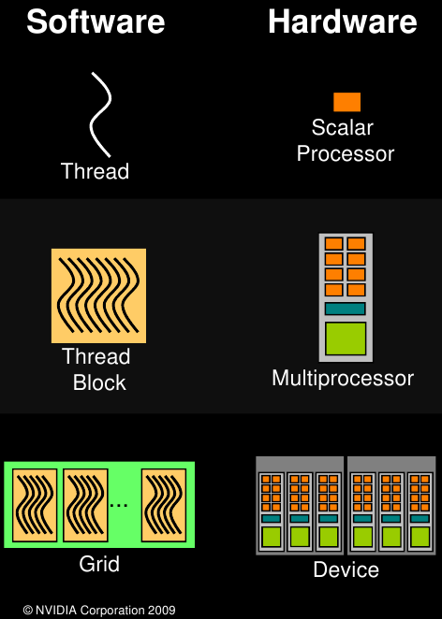
GPU Architecture
Source: NVIDIA
Notes:
Each thread is run on a scalar processor which is analogous to a core. The threads are grouped into into thread blocks on multiprocessors where they share some fast access memory for registers and some small amount of data. The GPU then has many multiprocessors which individually process thread blocks. The group of thread block is called the grid. Thread blocks across the device access a shared global memory but can not access each other's on card shared memory.

Slide 4
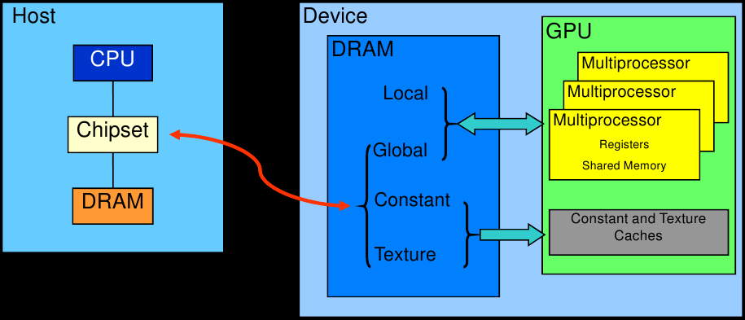
GPU Architecture
Source: NVIDIA
Notes:
The CPU then can access the global memory on the device through the PCI at a communication cost. The CPU makes calls to the GPU sending it instruction sets then orchestrating when to run the sets on the GPU.

Slide 5
GPU Architecture
Device Specifics
Device Specifics
Name
"GeForce GTX 285"
Name
"GeForce GTX 120"
Clock rate
1.47 GHz
Clock rate
1.40 GHz
30
Number of multiprocessors
4
Number of multiprocessors
32
Number of cores
240
Number of cores
Compute capacity
1.3
Compute capacity
1.1
Memory
Memory
Global
1.1 GB
Global
0.5 GB
Constant
65 KB
Constant
65 KB
16 KB
Shared
16 KB
Shared
8192
32-bit registers per block
16384
32-bit registers per block
Bandwidth
Bandwidth
Host to device
294.4 MB/s
Host to device
292.6 MB/s
Device to host
3.810 GB/s
Device to host
1.493 GB/s
Device to device
124.4 GB/s
Device to device
18.44 GB/s
Pinned host to device
5.772 GB/s
Device to pinned host
5467.6 GB/s
Notes:
The 120 is only being used for graphics display while the 285 is dedicated to CUDA.
Compute capacity refers to the version of features available on the device. 1.3 is the most recent and is capable of double accuracy, at a cost, and pinning host memory, which has evident benefits. As well as, internal upgrades and speed ups.

Slide 6
Programming Model
Notes:
Major benefit of using CUDA is the ease of programming and the developer community. The ease of programming includes be able to program in java, python, FORTRAN, opencl, and c with cuda extensions. The developing community includes a large trend of general purpose gpu programming using cuda i.e. gpgpu.com and supported by NVIDIA as well. Even though NVIDIA is proprietary and closed source they do give source code to developers registered with them. (becoming a registered developer is not difficult)‏
Major benefit of using CUDA is the ease of programming and the developer community. The ease of programming includes be able to program in java, python, FORTRAN, opencl, and c with cuda extensions. The developing community includes a large trend of general purpose gpu programming using cuda i.e. gpgpu.com and supported by NVIDIA as well. Even though NVIDIA is proprietary and closed source they do give source code to developers registered with them. (becoming a registered developer is not difficult)‏

Slide 7
Programming Model
cudaSetDevice()‏
  cudaGetDeviceCount()‏
  cudaGetDeviceProperties()‏
Notes:
Chose the best device based on the different devices’ properties. Then use the device properties to dynamically tailor the code to the device’s capabilites. It is also possible to use multiple devices at a communication cost, unless of course SLI is in place.

Slide 8
Programming Model
cudaSetDevice()‏
  cudaGetDeviceCount()‏
  cudaGetDeviceProperties()‏
cudaMalloc() & cudaMemcpy()‏
  Constant memory cache
  Texture memory cache
Notes:
Since I am transferring data constantly one would expect memcpy to be a bottleneck but scaled to 1mil agents on a 1000 square grid the data processing amortizes the cost of communicating the data between the CPU and GPU down to 1.8% of each epoque

Slide 9
Programming Model
cudaSetDevice()‏
  cudaGetDeviceCount()‏
  cudaGetDeviceProperties()‏
cudaMalloc() & cudaMemcpy()‏
  Constant memory cache
  Texture memory cache
<<<dimGrid, dimBlock>>>kernel()‏
Notes:
Kernel’s are launched thusly partitioning block dimensions and grid dimensions dynamically.

Slide 10
Programming Model
cudaSetDevice()‏
  cudaGetDeviceCount()‏
  cudaGetDeviceProperties()‏
cudaMalloc() & cudaMemcpy()‏
  Constant memory cache
  Texture memory cache
<<<dimGrid, dimBlock, sMem>>>
  Optional argument to dynamically allocate shared memory
Notes:
Shared memory can be useful for speeding up global memory access since global memory access is often a bottleneck.

Slide 11
Programming Model
cudaSetDevice()‏
  cudaGetDeviceCount()‏
  cudaGetDeviceProperties()‏
cudaMalloc() & cudaMemcpy()‏
  Constant memory cache
  Texture memory cache
<<<dimGrid, dimBlock, sMem, stream>>>
  Optional argument to dynamically allocate shared memory
  Optional stream ID for asynchronous, independent launches
Notes:
Using multiple streams for asynchronous running of code can also be a potential speed up. (i.e. asynchronous mem tranfers)‏

Slide 12
Impure Parallelism
__syncthreads()‏
    Synchronize within a thread block
    Used for SISD approaches to parallelism
CudaThreadSynchronize()‏
    Block CPU until all threads on device finish
    Used to prevent large scale read-after-write issues
atomicAdd(), atomicExch(), etc.
    CUDA Built-in atomic operations
    Used to replace classic locking mechanisms
Notes:
Parallelism on the GPU is 'impure.' The supposedly parallel threads are divided into thread blocks which have no guarantee on being run in parallel or serial instead are simply run on multiprocessors as they are available The threads within a block are also not run in pure parallelism, instead they are run in warps of threads which are 32 threads. Threads within a warp are synchronized with the __syncthreads() command. On the CPU when a kernel is launched it is asynchronous.
The cudaThreadSynchronize() command blocks the CPU until the GPU has finished processing the kernel.
A standard block clearly cannot be used since there is no guarantee on the threads running in parallel. To circumvent this dilemma CUDA has provided some extended atomic intrinsics. Also with respect to ABM, instead of having the agent's waiting on a lock to avoid collisions I had agents lock specific cells in the memory. Then upon hitting a lock instead of waiting which would cause obvious problems the agent would simply try another location.

Slide 13
Sugarscape Model
Data:
  2 NxN single accuracy matrices for sugar levels and maximums
  NxN matrix of pointers to agents
    To facilitate locating agents
  N*N array of Agent data
    Agent struct contains location, vision, sugar level, and metabolism.
    Vision is an integer uniformly chosen between [1,10]
    Metabolism is a floating point uniformly chosen between [0.1, 1.0)‏

Slide 14
Sugarscape Model
Each iteration:
grow_sugars<<<>>> //updates sugar patches
  Registers: 4
feed_agents<<<>>> //agents eat from the sugar patches
  Registers: 10
move_agents<<<>>> //agents search and move to a location
  Registers: 17
  Collisions are prevented with atomicExch() operation
  Upon colliding losing agent reevaluates
memcpy //sugar levels and agent matrices are copied for display

Slide 15
Potential Optimization Techniques
OpenGL interoperability
  To eliminate unnecessary memory transfers
  Maps data to OpenGL on the graphics card
  Runs slower than transferring data to CPU and back
Notes:
Mapping data on the graphics card using openGL interop is very inefficient
Texture fetching present negligible performance gain

Slide 16
Potential Optimization Techniques
OpenGL interoperability
  To eliminate unnecessary memory transfers
  Maps data to OpenGL on the graphics card
  Runs slower than transferring data to CPU and back
Texture fetching
  To cache data accesses based on locality
  No significant speed up without optimized locality
Notes:
Mapping data on the graphics card using openGL interop is very inefficient
Texture fetching present negligible performance gain

Slide 17
Potential Optimization Techniques
OpenGL interoperability
  To eliminate unnecessary memory transfers
  Maps data to OpenGL on the graphics card
  Runs slower than transferring data to CPU and back
Texture fetching
  To cache data accesses based on locality
  No significant speed up without optimized locality
Constant memory
  64KB of global memory cached on card
  Too small for this model’s purposes
Notes:
Mapping data on the graphics card using openGL interop is very inefficient
Texture fetching present negligible performance gain

Slide 18
Potential Optimization Techniques
OpenGL interoperability
  To eliminate unnecessary memory transfers
  Maps data to OpenGL on the graphics card
  Runs slower than transferring data to CPU and back
Texture fetching
  To cache data accesses based on locality
  No significant speed up without optimized locality
Constant memory
  64KB of global memory cached on card
  Too small for this model’s purposes
Shared memory
  On chip, fast access
  Requires SISD parallelism
Notes:
Mapping data on the graphics card using openGL interop is very inefficient
Texture fetching present negligible performance gain

Slide 19
Potential Optimization Techniques
OpenGL interoperability
  To eliminate unnecessary memory transfers
  Maps data to OpenGL on the graphics card
  Runs slower than transferring data to CPU and back
Texture fetching
  To cache data accesses based on locality
  No significant speed up without optimized locality
Constant memory
  64KB of global memory cached on card
  Too small for this model’s purposes
Shared memory
  On chip, fast access
  Requires SISD parallelism
Multiple streams
  To launch multiple instruction sets simultaneously
  Instruction sets most be independent of each other
Notes:
Mapping data on the graphics card using openGL interop is very inefficient
Texture fetching present negligible performance gain

Slide 20
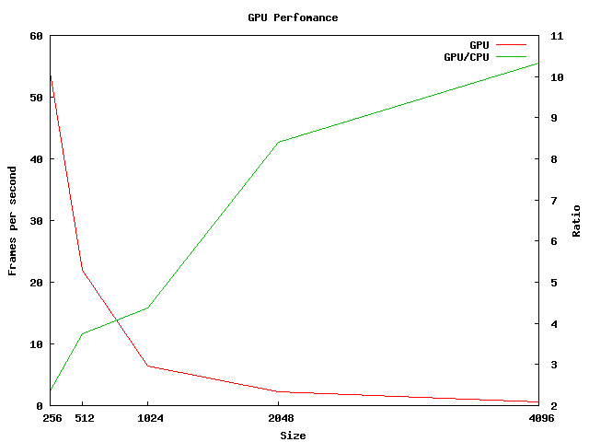
Results
Notes:
Using pinned memory only showed minimal performance over the standard GPU memory transfers.
Each testing point is the average of frames per second over the first 100 iterations.
Standard deviation remained below 15%

Slide 21
Further Research
Increasing agent complexity
  Internal processing
    Register limit is already pushed with minimal processing
    High cost of thread divergence on the GPU’s scalar processors
  External interactions
    Operations such as searching around an agent and communication between agents present bottlenecks
  Block approach to processing agents
Notes:
I would suggest consider treating each agent’s processing as a block rather than a thread as agent’s become more complex and divergent: implementing SISD within agent’s, speed search, only minor drawback is communication between agents would have to go through global

