Slide 1

5DAY Works Management Platform
Sprint 25 Demo
By Product Team
30-Dec-2022

Slide 2
Sprint Highlights
Back-end | Design and implementation of
7102 7101 7103 7597 | Backend: Design: User specific view settings; Kanban View Backend: Design: User specific view settings Backend: Design: Task Action (All remaining) Backend: Design: Tags
Front-end | Designs
7299 | Frontend: API Integration: Tenant -> Client
7302 | Frontend: Unit Testing
DevOps
QA | API Automation: project Invite member, workspace Invite member Project Features, Project Settings, Create Project Workspace Settings Performance Testing |  | Test Execution:(using Azure Test Plan) Preparation of Test Cases – Timer, section, Timesheet Settings Kanban View of Task, List view of Task, Views Panel common features, Activity Stream Test Case Reviews

Slide 3
Sprint 25 Progress
Sprint Progress(%)
Done – 50%
Remaining– 50%
Total Scoped – 160 Story Points
Done – 80 Story Points
Remaining – 80 Story Points
Sprint update Click here:

Slide 4
Anil
7626– QA- Bug Verification (1)
Bug verification on AWS QA environment (9 Bugs verified)
7601- QA: Manual Testing – Workschedule (Add/Edit /List
6542- QA- Test Case Review-Workitems (1)
6541 -QA- Test Case Review for Status Workflow(0.5)
5089- QA- Misc Work Activities and Scrum Work(3)
QA Updates:
Bugs – All Open Bugs #52|| New Bugs in sprint – #7|| Verified Bug- #12|| Dashboard – Click here
Test Case Preparation – Click here
Automation Coverage – Click here

Slide 5
Chintan
7308- QA API Testing- Spaces
Cover the spaces related scenario and Automate
3062- QA Performance Testing – Login and Logout script
Check the performance with 2 security-service instances with 97 unique account and users

Slide 6
Harmeet

Slide 7
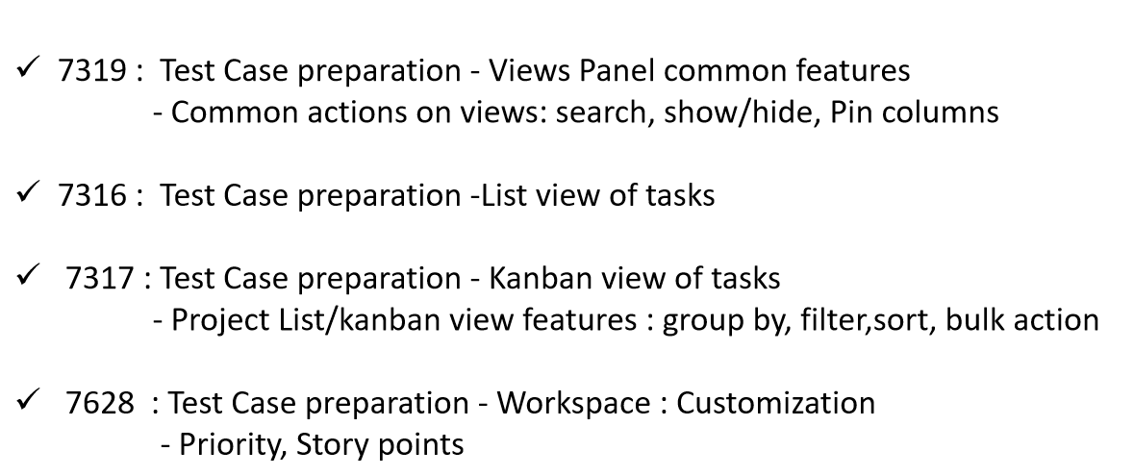
Fena

Slide 8
Vrushali
1.7321: QA: Test Case Preparation: Timer Panel
(Quick Add)Timer , Timer Tray ,Log Time, Edit Time, Delete Time Log.
2.7320: QA: Test Case Preparation: Sections
Basic Details ,Section Actions.
3.7322: QA: Test Case Preparation: Workspace -> Timesheet Settings
(Categories, Reminder , Generals)
4.7586: QA: Manual Testing: Account Profile, People.
5.7587: QA: Manual Testing: Workspace Profile, People.

Slide 9
Pragya
7046-DevOps - Add WAF rules
SQL Injection- Request Body>8KB
Cloud Metadata Potentially Exposed
DDOS: if no. of requests in 5mins from an IP>2000
7047-DevOps - Integrate ZAP to the Jenkins Pipelines
Test Job – to be used by devops
Lightweight installation on jenkins
Integrate with FE jobs and used as postman proxy for BE requests
7581-DevOps - Dynamic environments for test automation
Move away from kops created cluster to terraform
Dynamic creation of AWS Infra
Dynamic Provisioning of k8s infra
Deploy platform, configmap, saas services
Delete Infra
5199-Devops Support

Slide 10
Nagendra
6133.DevOps - Backup strategy for monitoring
Created storage class and pvc for grafana and prometheus
Enable back up for volumes
6132.DevOps - KOPS/Terraform - VPC/Subnet IDs to a file/variable
Created script
Output file as a input to infra
7582.DevOps - DR for S3 - Cross-region replication
Enabled bi directional CRR
Added in CDN for failover
7583.DevOps - Look into the Medium issues reported by ZAP
Created policy in CDN
5114.DevOps - Support development/QA teams
Interim release
Adhoc task

Slide 11
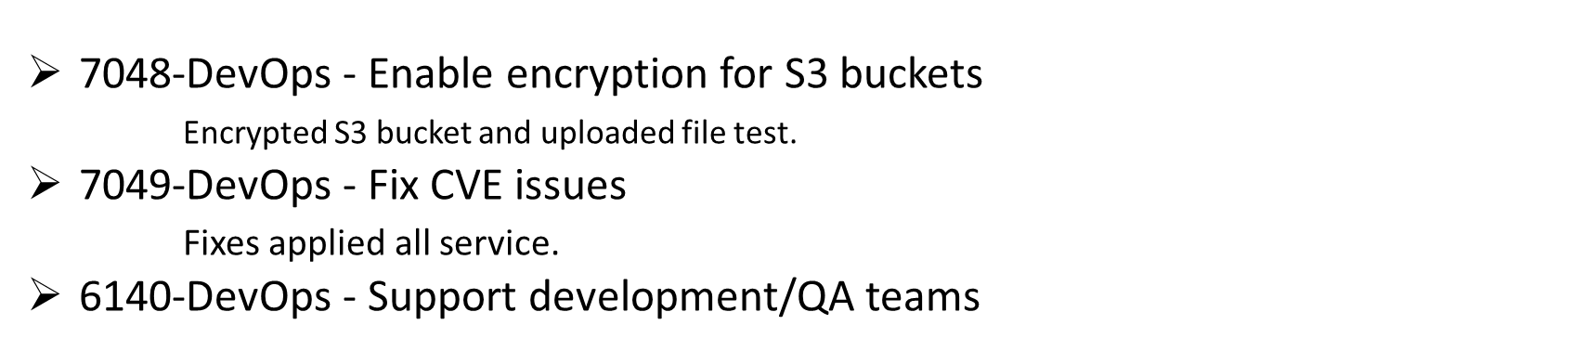
Maheshwara

Slide 12
Vishal
Vishal

Slide 13
Mohammad Ahmad
7102 - Backend: Design: User specific view settings; Kanban View
7101 - Backend: Design: User specific view settings
856 - Bulk Action 2105 - Kanban Board: Applicability 3384 - Kanban Board: Group By and Column Creation 919 - Kanban Board: Column Details 920 - Kanban Board: Card Display 2104 - Kanban View: Impact of Group By on Sort, Filer & Show/Hide | 3461 - List View: Applicability 813 - List of Tasks 3460 - List View: Row Details & Features 3462 - List View: Group Creation & Details 2100 - List View: Task List via Group By Features 2101 - List View: Impact of Group by on Sort, Filer & Show/Hide
7103 - Backend: Design: Task Action (All remaining)
7597 - Backend: Design: Tags
826 - Duplicate Task
825 - Delete Task
1654 - Multiple Task Selection
1655 - Task Status
1656 - Update Assignee
1661, 837: Tags

Slide 14
Akash
4635 - Backend - Create data for dedicated schema- part -2(SpillOver)
8208 - Backend - Fix known issues related dedicated schema
Public Schema //tenant saved with owner user //user not save with tenantid //roles not saved with tenantid
New Schema //Address not saved in new db with same UUID //roles not saved //user role map not saved
//tenant & user saved with same issue of public schema
7095 - Backend: Design: Collaboration (File + Comments)
980 – Add Message 983 – Message Format 984 – Tag People 987 – Tag Workitem 985 – Attach File | 990 - Edit Message 991 - Delete Message 988 – Reply Message 982 – View Message

Slide 15
Afzal

Slide 16
Raj
Bug:
- Assigned: 8
- Fixed: 1
- Ready for Testing: 5
- Done: 2

Slide 17
Sharad

Slide 18
Shubham
7314 - Backend: Development: Section (Add, Edit, Get, Delete)
CRUD operation on projects section.

Slide 19
Kishan
7299 Frontend: API Integration: Tenant -> Client
CRUD operation for client module with Ag-Grid.
Integrated upload/download image API

Slide 20
Saiteja

Slide 21
Stalin
7292 Frontend: Save/Discard Button​
Global setup of Save/Discard button in Client
7632 Frontend: Refresh page
7751 Adhoc support – Bug fixing during QA smoke testing

Slide 22
Pavan
Stories
7293 – Frontend: API Integration: Workspace -> People
-- API Integration -Workspace -> People (List, Add, Delete, Invite, Sort, Filter, Group BY)
7794 - Frontend: API Integration: Project -> People
-- API Integration -Project-> People (List, Add , Delete, Invite, Sort, Filter, Group BY)
7295 - Frontend: API Integration: Project Action​
-- API Integration: Project Action - Move Project
7296 -Frontend: API Integration: Project Action
-- API Integration: Project Action - Pin/Unpin Project
Improvements
7297 - Frontend: Fix Issue: Sometimes setting menu close, sometimes not
4891 - Change Password - No password policy criteria displayed to the user for New Password field
4892 - Change Password - Missing Green tick Red Cross validations and Standard Validations Input
​

Slide 23
Swar
7302,7588 – Frontend – unit testing
7785 - Frontend: Pending UI Components
7298 - Frontend: Static Screen: Project List View

Slide 24
Shreyansh
7303 - Frontend: Unit Testing
7291 - Frontend: API Integration: 5Day Account
Improvements:
4841 Change Password - New Password field if we enter just 2 characters no error is throw or password checking is happening

Slide 25
Nishat
7301-Frontend: Expand/Collapse icon for all secondary menu
7300-Frontend: Icons for secondary menu

Slide 26
Utsav

Slide 27
Vijay

Slide 28
Idrish
8045 Help Ali in onboarding.
8046 Create a working sample of networking component.
8047 Review UI design and prepare definition of UI components.
UI is not state where we can review and identify components.
8242 Start exploring List component.

Slide 29
Sprint#26 Goals (upcoming sprint)
Backend
Frontend
DevOps
QA
Sprint 25 – click here

Slide 30


