Slide 1



INDIVIDUAL DEVELOPMENT PLAN (IDP)

Slide 2
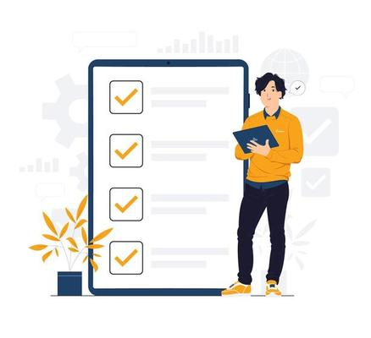
Agenda of this Presentation
Individual Development Plan (IDP)
IDP Process
Employee, Line Manager and BU Heads: How we can work together toward employee development
How to fill-out, validate and submit the IDP @ myTranscom

Slide 3
Structured Process
for taking charge of your career roles
Tool
to help you set expectations for specific learning & development objectives
Way
to build
Employee-Manager experiences to support the objectives
What is IDP?

Slide 4

IDP- A joint process between Supervisor and Employee
The Supervisor understands the role and company requirements
An Employee is more aware about individual career & growth

Slide 5



Ingredients of
IDP
Where do I want to be?
What are my strengths?
What is important to learn?
Competence
What does the organization need?
What do I love doing?
Organizational
Needs
Passion

Slide 6









Anatomy of IDP
Success starts with an effective IDP process
for individuals and the organization.
Previous Year Retrospective
Asses past performance and recalibrate the year ahead.
Excel The Existing
Acknowledge and build upon existing skills
Yearly Plan
To support individual and organizational objectives.
Identify Gaps
Align goals with areas needing improvement and reduce gaps in workforce.
S.M.A.R.T. Goals
Goals should be specific, measurable, attainable , realistic and timely.
Learning Needs
Invest in Employee skills development to support organizational needs and commit to personal growth.
Desired Outcomes
What will be gained from the employees completing these goals?

Slide 7


IDP
is not a one-time process.
We plan it ever year,
from July to June

Slide 8

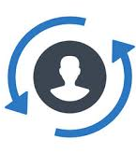



Get Proper Direction
Lower Turnover
Improves Performance
Benefits of IDP
Creates Loyalty
Creates Feeling of Accomplishment

Slide 9







Individual Development Plan (IDP)
via
myTranscom
Launching in August 2024
IDP Cycle from July to June
Employees Set their Development Goals
Development Goals reviewed by LM
Agrees on IDP
IDP
Execution by BU HR
Monitored by Corp. HR
On-the-Job Learning: Coaching: Training (70:20:10 principle)
Best Practicing Organizations with IDP in Bangladesh

Slide 10

Step-by-Step Guidelines to fill-out IDP template

Slide 11
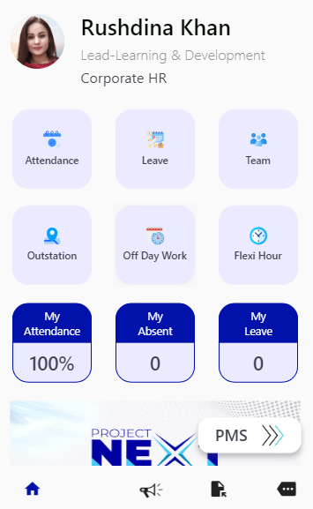
Step 1
Login to myTranscom
Click on the ‘more’ icon at the bottom-right corner of the page as shown in the screenshot marked with red arrow.
Click here

Slide 12
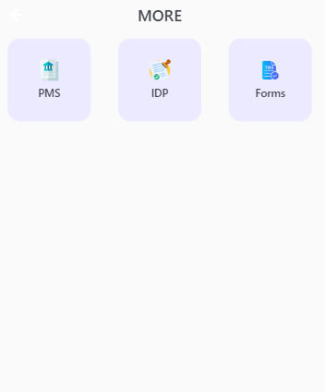
Click here
Step 2
When you click the “more” icon the screen that appears next is shown here.
Click on the ‘IDP’ icon at the top-middle of the page as shown in the screenshot marked with red arrow.
If you are an Employee (not a Line Manager), after clicking on the ‘IDP’ icon here, you will be taken straight to the IDP template.

Slide 13
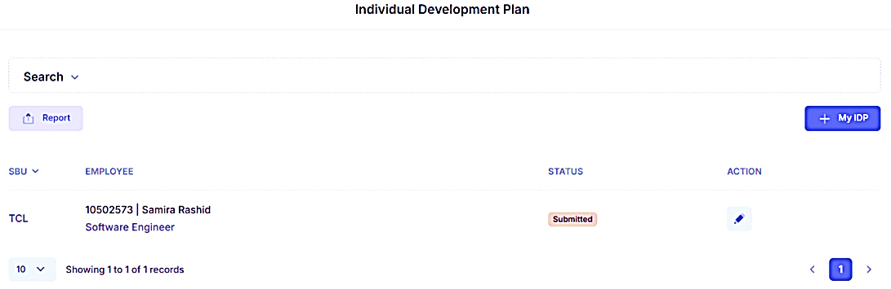
Step 2 -- Line Manager’s View
Follow the numbered Red Arrows in the screenshots shown below.
If you are a Line Manager and you want to view the IDP of your Direct Report, then click as the name of your direct report appears.
Even if you are a Line Manager, and you want to view your own IDP, then click on My IDP tab.
1
2
2
1

Slide 14
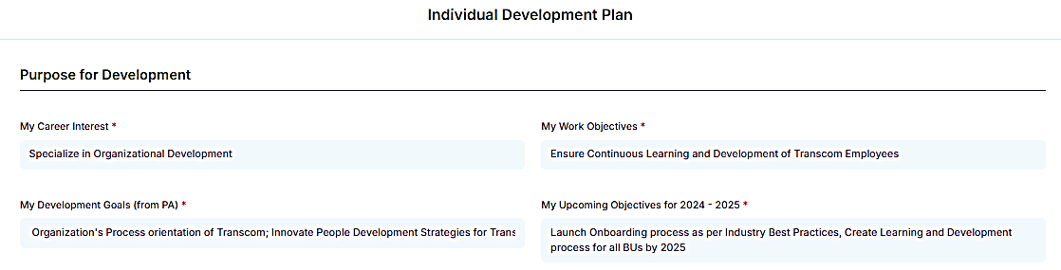
Step 3
Follow the numbered Red Arrows in the screenshots shown below.
Write in brief what you aim for your career.
Write down your development areas that your LM & you identified during your performance appraisal.
1
3
Write down the objective(s) of your role.
Write down your objective(s) for the next 1 year.
2
4
1
2
3
4

Slide 15
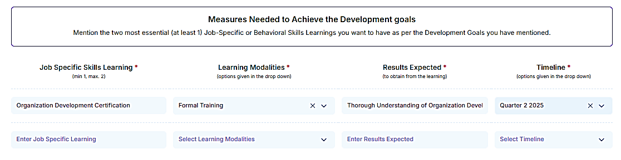
Follow the numbered Red Arrow(s) in the screenshots shown below.
Step 4
Write down at least 1 Job-Specific skill that you need to learn or develop in one of the boxes (or max. 2 in two boxes).
Job-Specific skills are technical know-how that help you perform your job properly.
1
1

Slide 16
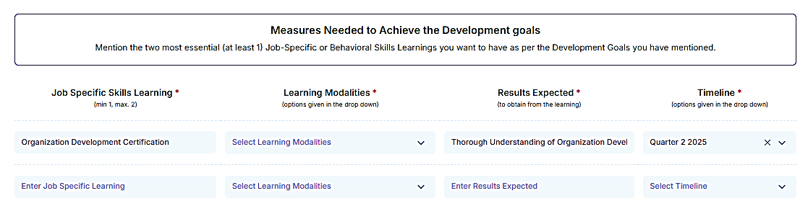
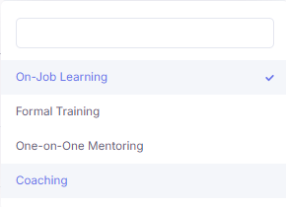
2
Step 5
3
For the “Job-Specific Skills” you want to develop, click on the downward arrow of the respective “Learning Modality” section.
2
When you click the downward arrow, a drop-down list with 4 options will open:
1. On-Job Learning, 2. Formal Training, 3. One-to-One Mentoring and 4. Coaching are the options.
From this list we will select our preferred modality by clicking on any one option.
3

Slide 17




What do the various Learning Modalities mean?
On-Job Learning- This learning happens from our hands-on experience at work, daily tasks and challenging assignments.
Formal Training: It is the structured, organized learning that is usually offered in a classroom or online setting. It is job-specific and sometimes related to earning a qualification. It has clear goals and objectives set and facilitated by an instructor or trainer.
One-on-One Mentoring: It is when learning is facilitated by a mentor for one learner at a time. The mentor can be an experienced facilitator, a co-worker or senior who has already mastered the skills s/he is teaching.
Coaching: is a developmental process where a coach helps a learner achieve personal or professional goals. It can be conducted one-on-one or in focused group. The coach provides training and guidance, and works together with the learner to develop skills and behaviors to make progress.

Slide 18
1
2
Follow the numbered red arrows in the screenshots shown below.
Step 6
For the job-specific skills that you need to develop, mention the Results you want to obtain from the learning experience.
1
For the job-specific skills that you need to develop, mention the Timeline for the learning. Timeline is the month or quarter by which you want to complete your learning process. Click on the downward arrow and select your timeline from the dropdown list.
2

Slide 19
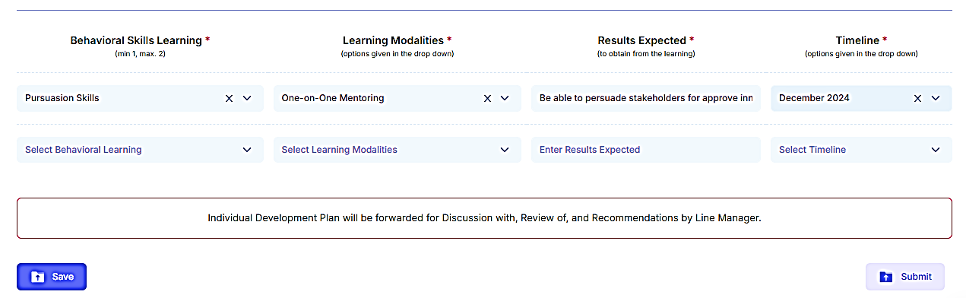
Click on the downward arrow and select at least 1 Behavioral skills from the drop-down list that you need to learn or develop. Please pick at least one for one of the boxes (or max. 2 in two boxes).
Behavioral skills are the abilities that influence how people interact with others and respond to situations. They can also be called soft skills or transferable skills, and they can help people succeed in their careers
1
Step 7
Pick the Learning Modality by clicking the downward arrow and selecting from the drop-down list with 4 options of learning modalities:
1. On-Job Learning, 2. Formal Training, 3. One-to-One Mentoring and 4. Coaching will open. From this list we will select our preferred modality by clicking.
2
2
1

Slide 20
1
2
Step 8
Follow the numbered red arrows in the screenshots shown below.
For the Behavioral skills that you need to develop, mention the results you want to obtain from the learning experience.
1
For the Behavioral skills that you need to develop, mention the timeline for the learning. Timeline is the month or quarter by which you want to complete your learning process. Click on the downward arrow and select your timeline from the dropdown list.
2

Slide 21
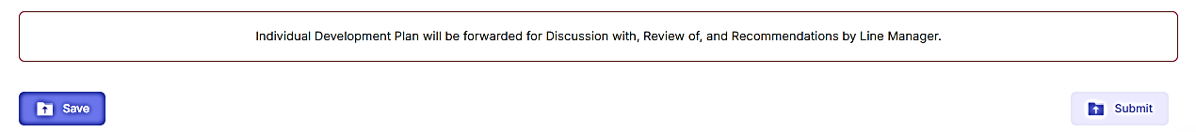
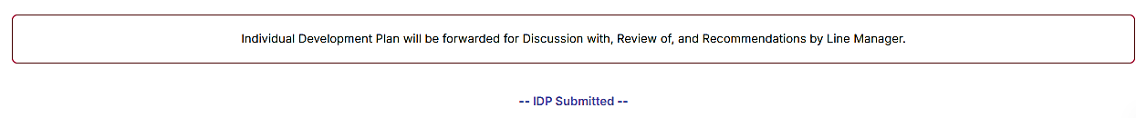
Employees’ View
Step 9
2
1
If want to save your input and make some modifications to your IDP afterwards, then click Save tab.
If you want to submit your IDP, click on the Submit tab.
2
1
When submission is completed

Slide 22

Line Manager’s View
Step 9
2
1
If want to make some modifications to the IDP of your Direct Report, click on the Update tab and do the necessary modifications.
If want to make approve the IDP of your Direct Report, click on the Approve tab.
2
1

Slide 23
The IDP Process is continuous, starts in July and will be evaluated in June every year.

