Slide 1


U20CSPR01-MINI PROJECT
BATCH No: D5
DOMAIN: ARTIFICAL INTELLIGENCE AND MACHINE LEARNING
PROJECT TITLE : AI-BASED CAREER RECOMMENDATION WITH SECURE RESUME AND CERTIFICATE VERIFICATION
S. No. | Register number | Name of the Student
1 | U23CS0281 | JADA DEVMANI
2 | U23CS0272 | HARSHAVARDHAN REDDY
3 | U23CS0269 | GUTHIREDDY NANDIESHWAR REDDY
4 | U23CS0287 | JAMPANI RAHUL
GUIDED BY: Ms. R. C. Dyana Priyatharsini

Slide 2
CONTENTS
Abstract
Objective
Introduction
Motivation of the project
Literature Survey
Problem Statement
Existing System
Proposed System
System Architecture
Modules Description
Expected outcome
References

Slide 3
ABSTRACT
The AI-Based Career Recommendation with Secure Resume and Certificate Verification system is designed to support students and job seekers in identifying suitable career paths from their skills, qualifications, experience, and certifications. The system uses NLP and AI/ML techniques to extract and normalize information from resumes, compare the profile with career requirements, generate ranked recommendations, and identify missing skills. Uploaded certificates are checked using secure verification evidence and assigned a status such as valid, revoked, invalid, or unverifiable. The integrated platform combines career guidance, skill-gap analysis, and credential verification in one workflow.

Slide 4
OBJECTIVES
• Develop an AI-based platform for personalized career recommendation.
• Extract skills, education, experience, projects, and certifications from resumes.
• Match candidate profiles with suitable career roles using AI/ML techniques.
• Identify skill gaps and suggest areas for improvement and learning.
• Verify uploaded certificates using secure and machine-verifiable evidence.
• Provide a simple web interface with clear, explainable recommendations.

Slide 5
INTRODUCTION
• Career selection is an important decision for students, graduates, and job seekers.
• Traditional career guidance is often manual, generic, and dependent on limited profile information.
• Modern resumes contain valuable signals about skills, education, projects, and experience that can be processed automatically.
• The proposed system combines AI-based career matching with resume analysis and secure credential verification for a unified workflow.

Slide 6
MOTIVATION OF THE PROJECT
• Increasing skill mismatch makes it difficult to identify career paths aligned with a candidate profile.
• Students and job seekers need personalized guidance rather than only keyword-based job suggestions.
• Manual verification of educational and professional certificates can be time-consuming and unreliable.
• A unified AI platform can connect career recommendation, skill-gap analysis, and credential verification.

Slide 7
LITERATURE SURVEY
S. NO. | PAPER TITLE | YEAR | METHOD | INPUT DATA | ACCURACY
1 | Generating Unified Candidate Skill Graph for Career Path Recommendation | 2018 | Open IE; entity-to-skill mapping; skill graph | Candidate profiles; PDF/Word; public sources | Precision 80.54%; Recall 86.44%
2 | An Advanced Real-Time Job Recommendation System and Resume Analyzer | 2023 | NLP; NER; GNN; TF-IDF; Cosine Similarity | Resumes; Job Descriptions | Evaluation of resume-job matching
3 | Career Craft AI: A Personalized Resume Analysis and Job Recommendations System | 2024 | NLP; Cosine Similarity; Classification | Resumes; Skills; Job Information | Resume analysis & job recommendation

Slide 8
LITERATURE SURVEY
S. NO. | PAPER TITLE | YEAR | METHODOLOGY | INPUT DATA | ACCURACY
4 | An uncertain knowledge graph-based approach for recommending online courses and predicting in-demand skills based on career choices | 2024 | Uncertain knowledge graph; skill extraction; link-confidence prediction | Job postings; online courses; labor-market entities | KG quality evaluation; link-confidence prediction; course-recommendation case study
5 | AI-Powered Career Guidance: A Scalable Model for Personalized Recommendations | 2026 | RIASEC; SVM; Decision Tree; XGBoost; Cosine Similarity | 81,267 survey records; RIASEC interests; O*NET occupations | Accuracy 66.35%

Slide 9
PROBLEM STATEMENT
• Existing career guidance does not always combine resume analysis, skill-gap identification, and credential verification.
• Keyword-only matching can miss related or semantically similar skills and roles.
• Manual resume screening and certificate checking require significant time and effort.
• A unified system is needed to recommend suitable career paths while providing trustworthy credential evidence.

Slide 10
EXISTING SYSTEM
Limited Career–Credential Integration – Career recommendations and certificate verification are often handled as separate processes.
Insufficient Skill-Gap Analysis – Existing systems often fail to identify the specific skills a candidate needs to develop for a desired career.
Limited Career-Path Reasoning – Job portals and resume screening tools mainly focus on keyword matching rather than understanding a candidate’s complete career path.
Lack of Explainable Recommendations – Many systems do not clearly explain why a particular job or career is recommended.
Fragmented Candidate Data – Resume details, skills, career information, and credential verification are often stored in separate systems, reducing efficiency.

Slide 11
PROPOSED SYSTEM
• Accept resume and certificate uploads through a secure web interface.
• Parse resumes and extract education, skills, experience, projects, and certifications.
• Normalize extracted skills and compare them with a career knowledge base.
• Generate ranked career recommendations using semantic and weighted profile matching.
• Perform skill-gap analysis and highlight missing or lower-priority skills.
• Verify certificates using issuer information and secure proof/integrity evidence.
• Present recommendations, reasons, skill gaps, and verification status in one dashboard.

Slide 12
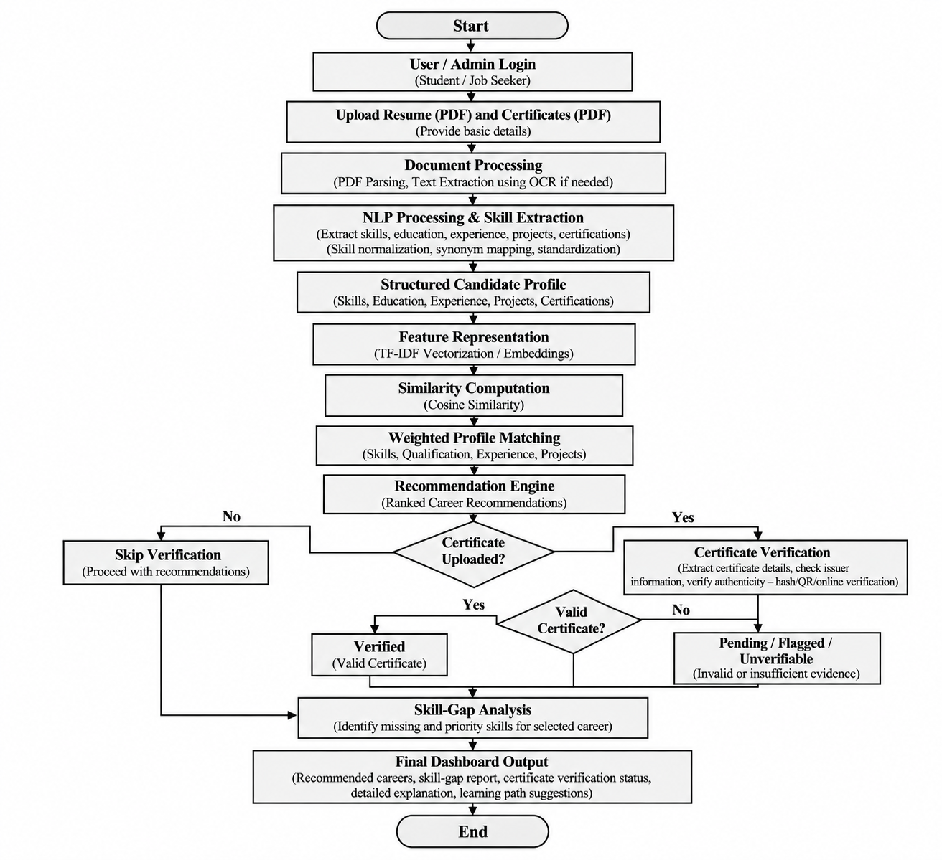
SYSTEM ARCHITECTURE

Slide 13
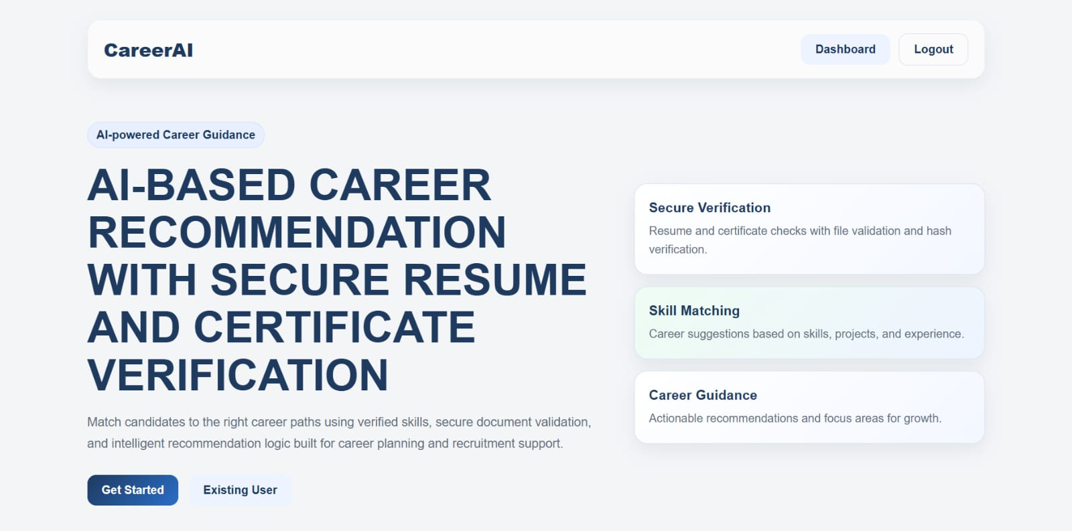
MODULES DESCRIPTION
Work Done for MODULE 1: User Interface and Authentication

Slide 14
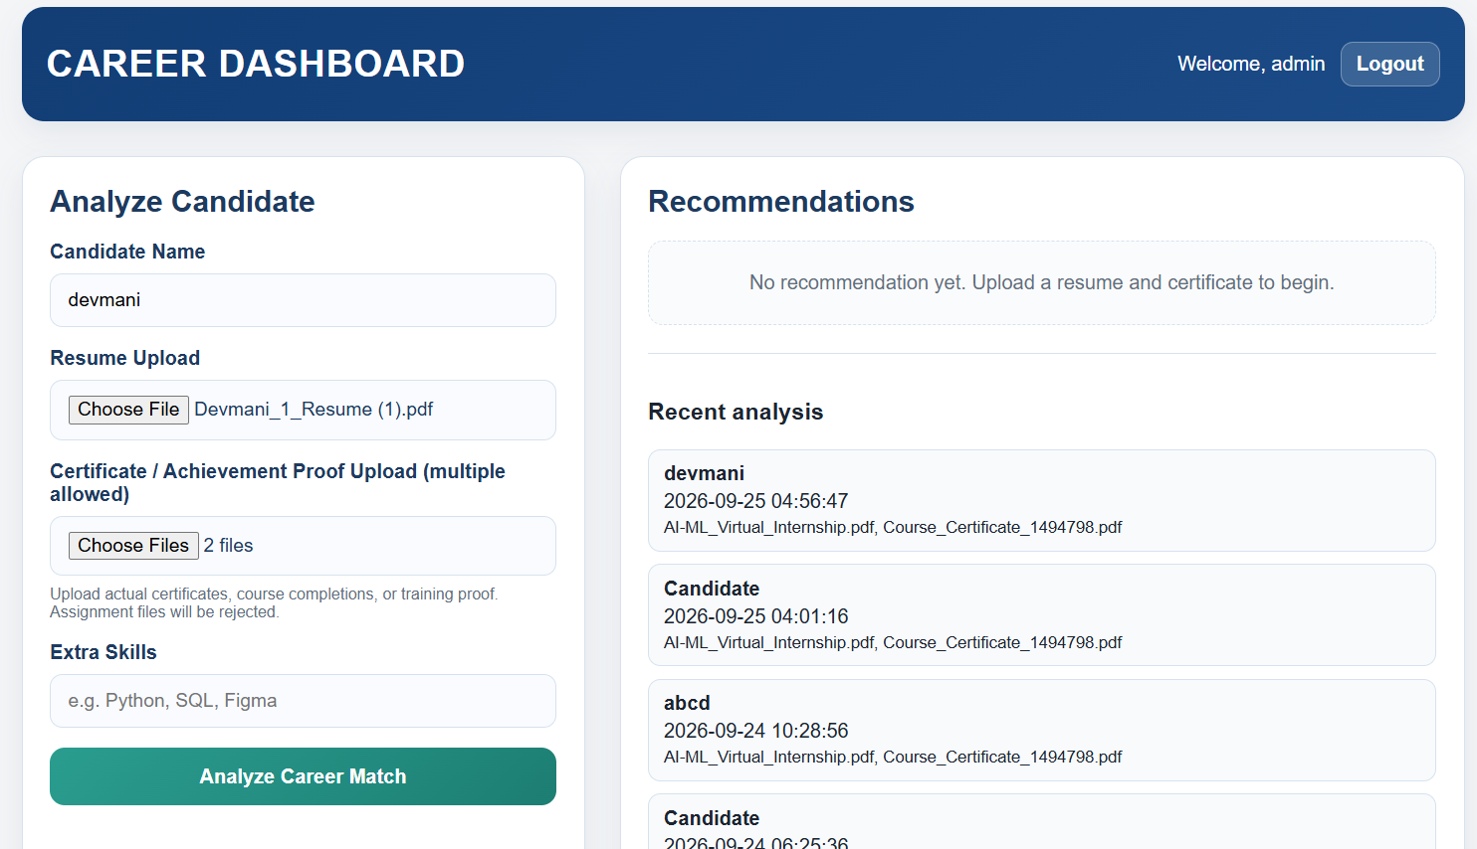
MODULES Description
Work Done for MODULE 2: Document Processing & Ingestion Module

Slide 15
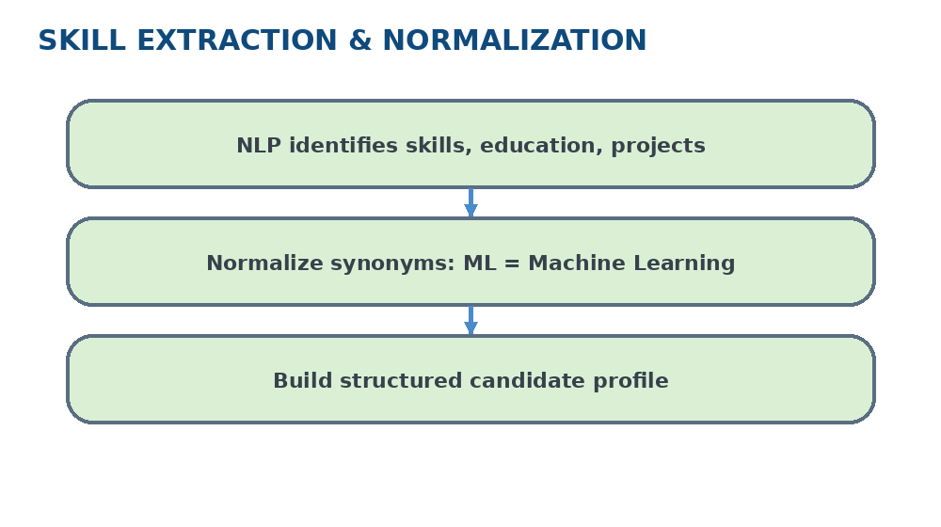
MODULE 3: SKILL EXTRACTION
Uses NLP and semantic processing to identify skills, qualifications, experience, projects, and certifications from the resume.
DEPARTMENT OF COMPUTER SCIENCE AND ENGINEERING
15

Slide 16
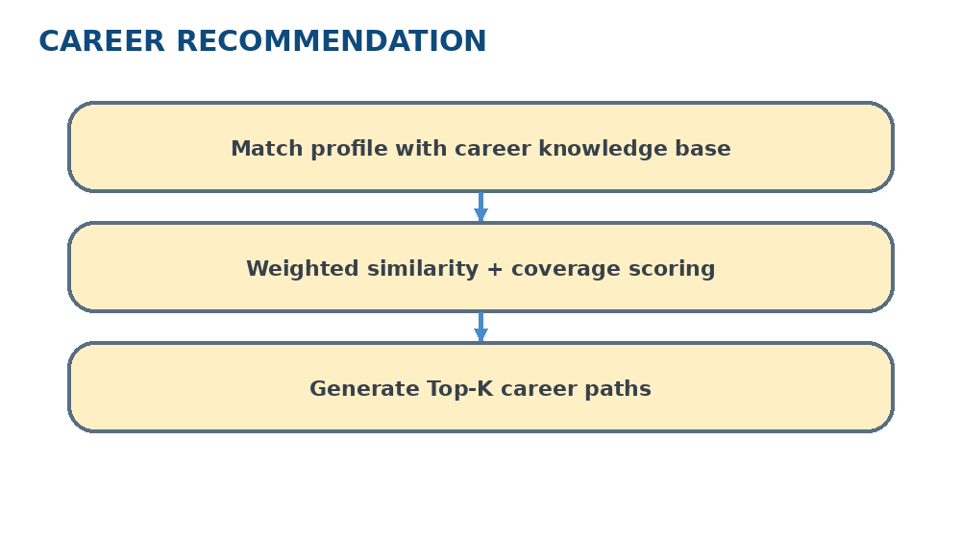
MODULE 4: CAREER RECOMMENDATION
Matches the normalized candidate profile with career roles using skill similarity, skill coverage, qualification fit, and experience fit.
DEPARTMENT OF COMPUTER SCIENCE AND ENGINEERING
DEPARTMENT OF COMPUTER SCIENCE AND ENGINEERING
16
16

Slide 17
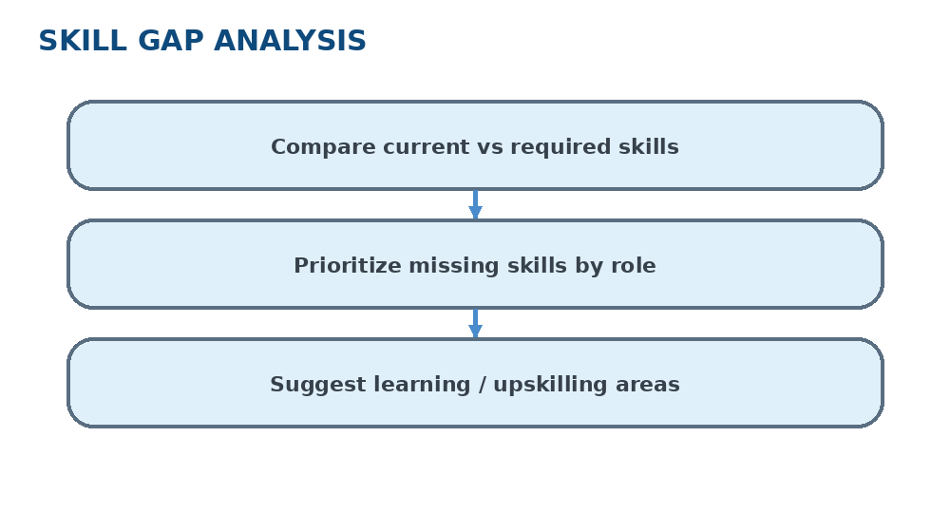
MODULE 5: SKILL GAP ANALYSIS
Compares current skills with target-role requirements and identifies missing skills that should be developed for career readiness.
DEPARTMENT OF COMPUTER SCIENCE AND ENGINEERING
DEPARTMENT OF COMPUTER SCIENCE AND ENGINEERING
DEPARTMENT OF COMPUTER SCIENCE AND ENGINEERING
17
17
17

Slide 18
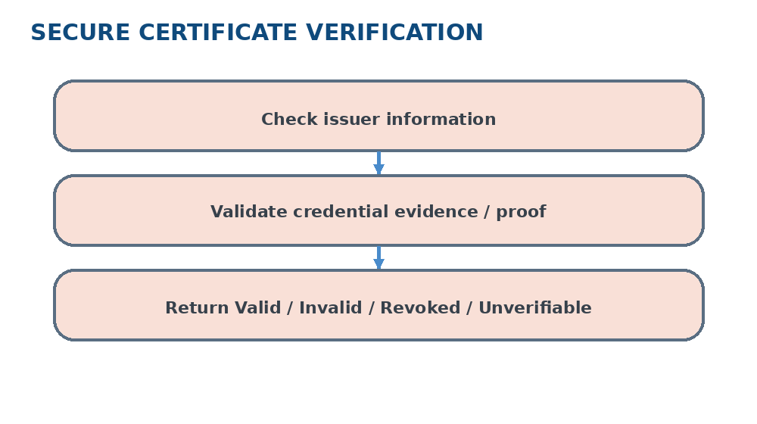
MODULE 6: CERTIFICATE VERIFICATION
Checks uploaded certificate evidence against issuer information and integrity/verification signals and reports a verification status.
DEPARTMENT OF COMPUTER SCIENCE AND ENGINEERING
DEPARTMENT OF COMPUTER SCIENCE AND ENGINEERING
DEPARTMENT OF COMPUTER SCIENCE AND ENGINEERING
DEPARTMENT OF COMPUTER SCIENCE AND ENGINEERING
18
18
18
18

Slide 19
Expected outcome
Personalized career recommendations based on skills, education, and experience.
Skill-gap identification to show missing skills required for a target career.
Automatic resume analysis to extract skills, qualifications, projects, and certifications.
Secure certificate verification with clear verification status.
Integrated and explainable dashboard showing career recommendations, skill gaps, and verification results.

Slide 20
REFERENCES
1. A. Gugnani, S. R. Kasireddy, and K. Ponnalagu, “Generating Unified Candidate Skill Graph for Career Path Recommendation,” IEEE ICDMW, 2018.
2. S. Kumar et al., “An Advanced Real-Time Job Recommendation System and Resume Analyzer,” 2023 International Conference on Self Sustainable Artificial Intelligence Systems (ICSSAS), 2023.
3. “Career Craft AI: A Personalized Resume Analysis and Job Recommendations System,” 2024 1st International Conference on Innovative Sustainable Technologies for Energy, Mechatronics, and Smart Systems (ISTEMS), 2024
4. Y. Fettach, A. Bahaj, and M. Ghogho, "JobEdKG: An uncertain knowledge graph-based approach for recommending online courses and predicting in-demand skills based on career choices," Engineering Applications of Artificial Intelligence, vol. 131, p. 107779, May 2024.
5.M. Roy and K. Sharma, “AI-Powered Career Guidance: A Scalable Model for Personalized Recommendations,” IEEE Access, vol. 14, pp. 20927–20941, 2026, doi: 10.1109/ACCESS.2026.3661573.

