Slide 1


Erlang Multicore
Tomas Mannerstedt

Slide 2
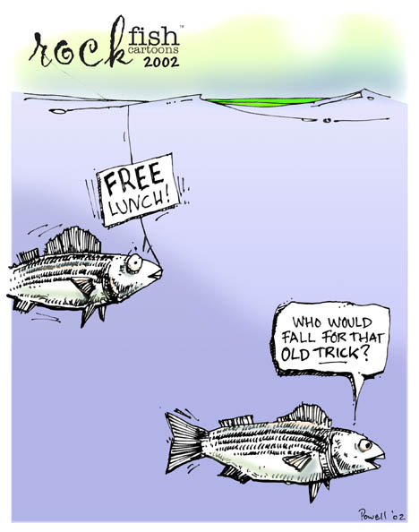
Your free lunch will soon be over. What can you do about it? What are you doing about it?
Herb Sutter
Dr. Dobb’s Journal
30(3), March 2005
Notes:
Hur skall vi få linjärt bättre prestanda med fler kärnor på samma sätt som vi tidigare fått med högre klockfrekvens.

Slide 3
Erlang Multicore
Purpose:
    To show why Erlang is a good choice when developing in multicore architecture.
    Not go deeply into syntax but show some examples.

Slide 4
What is Erlang?
  Measurement of traffic intensity.
  ERicsson LANGuage.
  Run-time environment
  Operating system

Slide 5
Erlang History
  1981: Project began as an extension of Prolog.
  1987: First version released
  1996: OTP
  1998: 1:st AXD301 (1.7 million lines of Erlang code)
  1998: Erlang open source
  2006: R11B with SNMP

Slide 6
Erlang – Crash course
  Dynamically typed:
    int
    float
    atom
    list
    tuple
    binary

Slide 7
Erlang – Crash course
  Single assignment:
    X = foo().
    Y = bar().
    X = Y.
    X = X + 1.

Slide 8
Erlang – Crash course
  Functional, pattern matching:
    No for(), while() etc.
    Only functions:
    fac(0) ->
    1;
    fac(N) when N > 0 ->
    N * fac(N-1).

Slide 9
Erlang – Crash course
-module(shapes).
-export([area/1]).
area({square, X}) ->
X*X;
area({triangle, Base, Height}) ->
Base * Height / 2;
area({circle, Radius}) ->
math:pi() * Radius * Radius;
area([]) ->
0;
area([Shape|Rest]) ->
area(Shape) + area(Rest).

Slide 10
Erlang – Crash course
  Functional, true functional languages have no side effects:
    Functions have no state. Same answer every time.
    No shared data.

Slide 11
Erlang – Crash course
  Functional, no side effects, or?:
    Output
    Databases
    send / receive messages
    Fairly easy to control though ☺

Slide 12
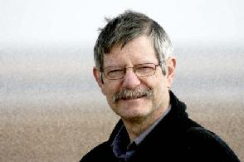
COPL – Concurrency Oriented Programming Language
  Programming paradigm defined by Joe Armstrong.
  The real world is parallel, nothing is sequential.

Slide 13
Characteristics of a COPL
  Support processes
  Have strongly isolated processes. Crash cannot affect other processes.
  Have Unique PID:s. Message passing via PID.
  No shared state.
  Message passing is unreliable.
  Possible for one process to detect problems in other process.

Slide 14
Erlang is designed for
  Share nothing concurrency
  IPC by asynchronous message passing
  Fault tolerance
  No mutexes, since no shared memory
  Telecomunication applications (which contains lots of parallelizable tasks).

Slide 15
Erlang processess
  Lightweight processes.
  “Does what it’s supposed to do or crashes”
  Creating a process is fast!
  An Erlang application can contain thousands of processes.

Slide 16
Simple example – Server
  start() ->
  spawn(fun() -> do_start() end).
  do_start() ->
  true = register(?MODULE, self()),
  loop().
  loop() ->
  receive
  kill ->
  io:format("~p: I'm dieing now!~n", [?MODULE]);
  Message ->
  io:format("~p: Message: ~p~n", [?MODULE, Message]),
  loop()
  end.

Slide 17
Erlang SMP support
  First release in May 2006 (R11B).
    ”Make it work”
    ”Find bottlenecks”
    ”Remove bottlenecks”

Slide 18
The Erlang Scheduler
  Erlang VM runs in one OS process.
  Deafult:
    Uses one posix-thread per scheduler.
    One scheduler per core.
  Up to 1024 schedulers.
  All schedulers (currently, R12) share one run queue.
  Erlang VM with SMP support is 10% slower than non SMP VM.

Slide 19
Result of using Erlang SMP support
  Ericsson TGC:
    Required to have 99.999% availability. (< 6min/year downtime)
    Performance increaced by 1.7, by enabling dual core!
    Minor code changes.

Slide 20
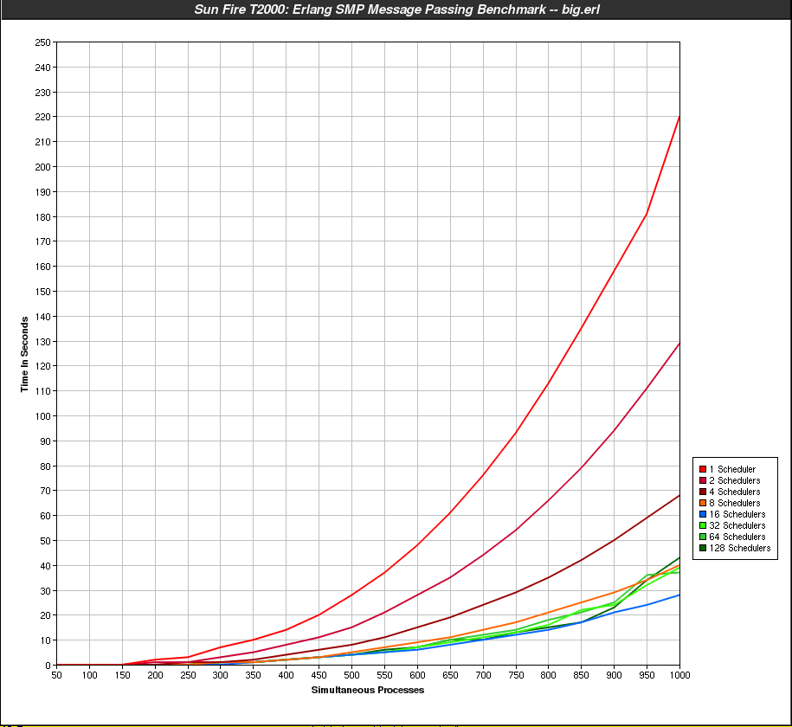
Performance - Big Bang
  Sun Fire T2000 has UltraSparc T1.

Slide 21
Current bottlenecks
  One run-queue.
    Will be changed to one run-queue per scheduler.
  ETS locks ”per table”:
    Will be changed to lock ”per row”.
  Message passing.

Slide 22
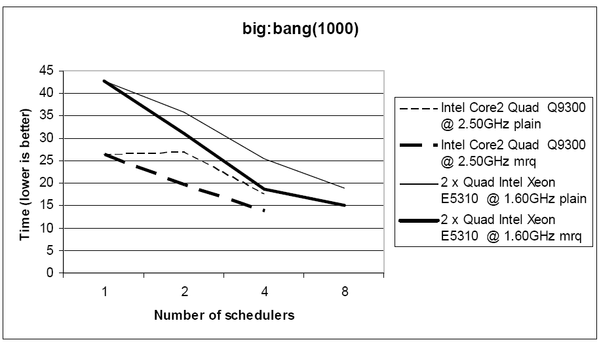
Experiment with multiple run-queue

Slide 23
Programming example
  lists:map/2:
  lists:map(fun(X) -> X*X end, lists:seq(1,5)).
  [1,4,9,16,25]
  plists:map/2:
  plists:map(fun(X) -> X*X end, lists:seq(1,5)).
  [1,4,9,16,25]

Slide 24
Programming example
  map(Fun, List) ->
  Pids = spawn_workers(self(), Fun, List),
  collect_answers(Pids).
  spawn_workers(_Parent, _Fun, []) ->
  [];
  spawn_workers(Parent, Fun, [Head|Tail]) ->
  Pid = spawn(fun() -> Parent ! {self(), Fun(Head)} end),
  [Pid | spawn_workers(Parent, Fun, Tail)].
  collect_answers([]) ->
  [];
  collect_answers([Pid|Pids]) ->
  receive
  {Pid, Result} ->
  [Result | collect_answers(Pids)]
  end.

Slide 25
Benchmark pmap
  Show pmap benchmark.

Slide 26
Nodes
  An Erlang Node is an instance of the Erlang VM.
  Two nodes that share a secret (cookie) can:
    Spawn a process on another node as easy as on the local node.
    Send RPC to the remote node.
  Nodes have unique name on the form:
    my_node@my_computer

Slide 27
Is Erlang fast?
  Yes:
    Handling large amount requests.
    BIF:s are written in C.
    HiPE
  No:
    Many languages are faster.

Slide 28
OTP – Open Telephony Platform
  Standard library modules:
    lists
    set
    file
    erlang
    ets
    mnesia
    etc.

Slide 29
OTP – Open Telephony Platform
  Protocols:
    TCP
    UDP
    RTP
    IP
    SSL
    HTTP
    SNMP
    megaco (H.248)
    etc.

Slide 30
OTP – Open Telephony Platform
  Tools:
    common_test
    edoc
    debugger
    dialyzer (static analysis tool)
    percept (profiler)
    etc.

Slide 31
OTP – Open Telephony Platform
  Design Patterns:
    gen_server
    gen_fsm
    gen_event

Slide 32
Erlang users
  Ericsson - Telecommunication nodes
  Kreditor - Economics
  Tail-f - Netconf
  Mochi Media – Ad service

Slide 33
References
  Making reliable distributed systems in the presence of software errors, Joe Armstrong, 2003
  Erlang Multicore, Ulf Wiger
  Inside the Erlang VM, Kenneth Lundin, 2008
  Erlang Reference Manual, Jonas Barklund, Robert Virding

Slide 34
Gör dina egna slides...
Färdig företagspresentation kommer.

Slide 35


