Slide 1
B-Trees

Slide 2
Motivation for B-Trees
Thus far we have assumed that we can store an entire data structure in main memory
What if we have so much data that it won’t fit?
We will have to use disk storage
  but when this happens our time complexity fails
The problem is that Big-Oh analysis assumes that all operations take roughly equal time
  This is not the case when disk access is involved
CSCI 2720

Slide 3
Motivation (cont.)
Assume that a disk spins at 3600 RPM
  one revolution occurs in 1/60 of a second, 16.7ms
On average what we want is half way round this disk
  takes 8ms
Sounds good until:
  you realize that we get 120 disk accesses a second – the same time as 25 million instructions
CSCI 2720

Slide 4
Bottom line …
One disk access takes about the same time as 200,000 instructions
  It is worth executing many instructions to avoid a disk access
CSCI 2720

Slide 5
Motivation (cont.)
Assume that we use an AVL tree to store records on the 20 million owners of iPods
We still end up with a very deep tree with lots of different disk accesses; log₂ 20,000,000 is about 24, so this takes about 0.2 seconds (if there is only one user of the program)
We know we can’t improve on the log n for a binary tree
But, the solution is to use more branches and thus less height!
As branching increases, depth decreases
CSCI 2720

Slide 6
Definition (B-tree of order m)
A B-tree of order m is an m-way search tree that is either empty, or has the following properties:
All leaves are on the same level.
All internal nodes except the root have at most m (nonempty) children and at least [m/2] children.
(Note that [m/2] denotes the ceiling of m/2.)
The root has at least 2 children if it is not a leaf, and at most m children.
CSCI 2720

Slide 7
Definition of a B-tree
A B-tree of order m is an m-way tree (i.e., a tree where each node may have up to m children) in which:
    the number of keys in each non-leaf node is one less than the number of its children and these keys partition the keys in the children in the fashion of a search tree
    all leaves are on the same level
    all non-leaf nodes except the root have at least ⎡m / 2⎤ children
    the root is either a leaf node, or it has from two to m children
    a leaf node contains no more than m – 1 keys
    Every leaf node must contain ceil(m/2)-1keys
CSCI 2720

Slide 8
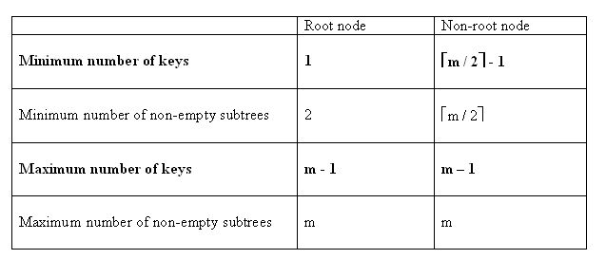
What is a B-tree? (cont’d)
For a non-empty B-tree of order m:
This may be zero, if the node is a leaf as well
These will be zero if the node is a leaf as well

Slide 9
An example B-Tree
26
A B-tree of order 5 containing 26 items
6
12
42
51
62
1
2
4
7
8
13
15
18
25
27
29
45
46
48
53
55
60
64
70
90
Note that all the leaves are at the same level
CSCI 2720

Slide 10
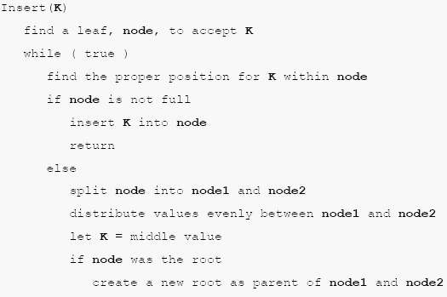

Inserting into a B-Tree
B-Trees

Slide 11
Inserting into a B-Tree
Attempt to insert the new key into a leaf
If this would result in that leaf becoming too big, split the leaf into two, promoting the middle key to the leaf’s parent
If this would result in the parent becoming too big, split the parent into two, promoting the middle key
This strategy might have to be repeated all the way to the top
If necessary, the root is split in two and the middle key is promoted to a new root, making the tree one level higher
CSCI 2720

Slide 12
Constructing a B-tree
Suppose we start with an empty B-tree and keys arrive in the following order: 1 12 8 2 25 5 14 28 17 7 52 16 48 68 3 26 29 53 55 45
We want to construct a B-tree of order 5
The first four items go into the root:
To put the fifth item in the root would violate condition 5
Therefore, when 25 arrives, pick the middle key to make a new root
1
2
8
12
CSCI 2720

Slide 13
Constructing a B-tree (contd.)
8
1
2
12
25
6, 14, 28 get added to the leaf nodes:
8
1
2
6
12
14
25
28
CSCI 2720

Slide 14
Constructing a B-tree (contd.)
Adding 17 to the right leaf node would over-fill it, so we take the middle key, promote it (to the root) and split the leaf
8
17
1
2
6
12
14
25
28
7, 52, 16, 48 get added to the leaf nodes
8
17
1
2
6
7
12
14
16
25
28
48
52
CSCI 2720

Slide 15
Constructing a B-tree (contd.)
Adding 68 causes us to split the right most leaf, promoting 48 to the root, and adding 3 causes us to split the left most leaf, promoting 3 to the root; 26, 29, 53, 55 then go into the leaves
3
8
17
48
1
2
6
7
12
14
16
25
26
28
29
52
53
55
68
Adding 45 causes a split of
25
26
28
29
and promoting 28 to the root then causes the root to split
CSCI 2720

Slide 16
Constructing a B-tree (contd.)
17
3
8
28
48
1
2
6
7
12
14
16
25
26
29
45
52
53
55
68
CSCI 2720

Slide 17
Exercise in Inserting a B-Tree
Insert the following keys to a 5-way B-tree:
3, 7, 9, 23, 45, 1, 5, 14, 25, 24, 13, 11, 8, 19, 4, 31, 35, 56
7,15,3,16,5,1,18,10,33,28,60,17,14,20,22,25,26
Insert the following keys to a 3-way B-tree:
10,20,30,40,50,60,70,80,90
CSCI 2720

Slide 18
Deletion in B-Tree
UNDERFLOW CONDITION
A non-root node of a B-tree of order m underflows if, after a key deletion, it contains ⎡m / 2⎤ - 2 keys
The root node does not underflow. If it contains only one key and this key is deleted, the tree becomes empty.

Slide 19
Deletion in B-Tree
Deletion algorithm:
If a node underflows, rotate the appropriate key from the adjacent right- or left-sibling if the sibling contains at least ⎡m / 2⎤ keys; otherwise perform a merging.
A key rotation must always be attempted before a merging
There are five deletion cases:
  1. The leaf does not underflow.
  2. The leaf underflows and the adjacent right sibling has at least ⎡m / 2 ⎤ keys.
  perform a left key-rotation
  3. The leaf underflows and the adjacent left sibling has at least ⎡m / 2 ⎤ keys.
  perform a right key-rotation
  4. The leaf underflows and each of the adjacent right sibling and the adjacent left sibling has at least ⎡m / 2 ⎤ keys.
  perform either a left or a right key-rotation
  5. The leaf underflows and each adjacent sibling has ⎡m / 2⎤ - 1 keys.
  perform a merging

Slide 20
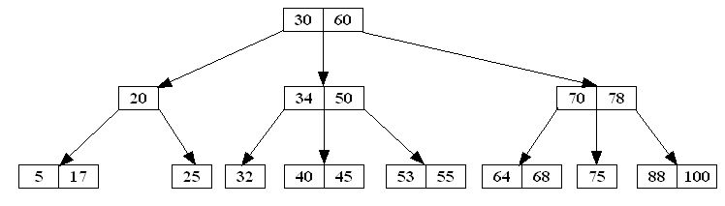
Deletion in B-Tree
Like insertion, deletion must be on a leaf node. If the key to be deleted is not in a leaf, swap it with either its successor or predecessor (each will be in a leaf).
The successor of a key k is the smallest key greater than k.
The predecessor of a key k is the largest key smaller than k.
IN A B-TREE THE SUCCESSOR AND PREDECESSOR, IF ANY, OF ANY KEY IS IN A LEAF NODE
Example: Consider the following B-tree of order 3:
key | predecessor | successor
20 | 17 | 25
30 | 25 | 32
34 | 32 | 40
50 | 45 | 53
60 | 55 | 64
70 | 68 | 75
78 | 75 | 88

Slide 21
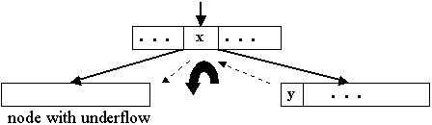
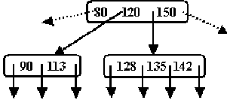
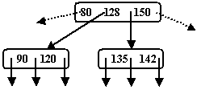
Deletion in B-Tree (cont’d)
Case2: The leaf underflows and the adjacent right sibling has at least ⎡m / 2 ⎤ keys.
Perform a left key-rotation:
1. Move the parent key x that separates the siblings to the node with underflow
2. Move y, the minimum key in the right sibling, to where the key x was
3. Make the old left subtree of y to be the new right subtree of x.
Example:
B-tree of order 5
Delete 113

Slide 22
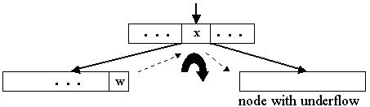
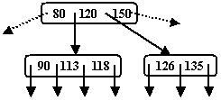
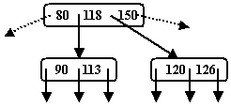
Deletion in B-Tree (cont’d)
Case 3: The leaf underflows and the adjacent left sibling has at least ⎡m / 2⎤ keys.
Perform a right key-rotation:
1. Move the parent key x that separates the siblings to the node with underflow
2. Move w, the maximum key in the left sibling, to where the key x was
3. Make the old right subtree of w to be the new left subtree of x
Example:
B-tree of order 5
Delete 135

Slide 23
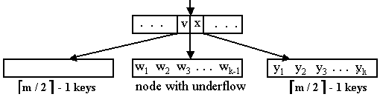
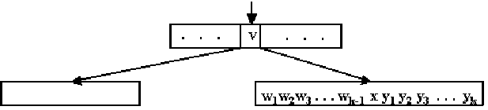
Deletion in B-Tree (cont’d)
Case 5:The leaf underflows and each adjacent sibling has ⎡m / 2⎤ - 1 keys.
merge node, sibling and the
separating key x
If the parent of the merged node underflows, the merging process propagates upward. In the limit, a root with one key is deleted and the height decreases by one.
Note: The merging could also be done by using the left sibling instead of the right sibling.

Slide 24
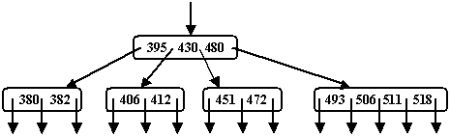
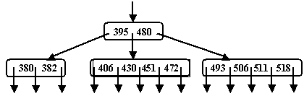
Deletion in B-Tree (cont’d)
Example:
B-tree of order 5
Delete 412
The parent of the merged node does not underflow. The merging process does not propagate upward.

Slide 25
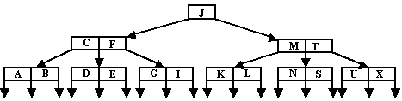
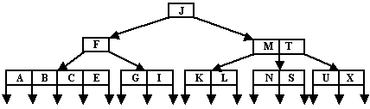

Deletion in B-Tree (cont’d)
Example:
B-tree of order 5
Delete D

Slide 26
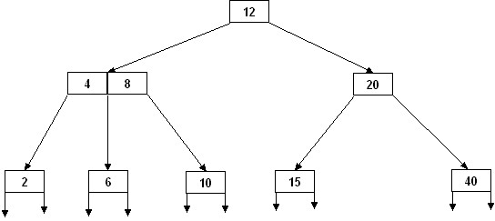
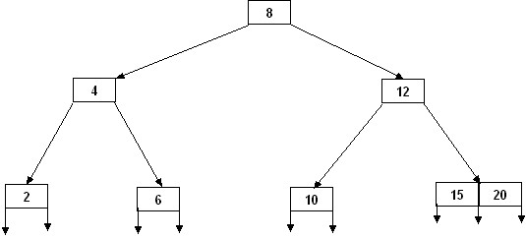
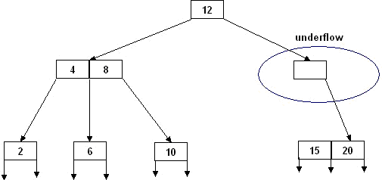
Deletion : Special Case, involves rotation and merging
Example:
Delete the key 40 in the following B-tree of order 3:
B-tree of order 5
merge 15 and 20
rotate 8 and its right subtree

Slide 27
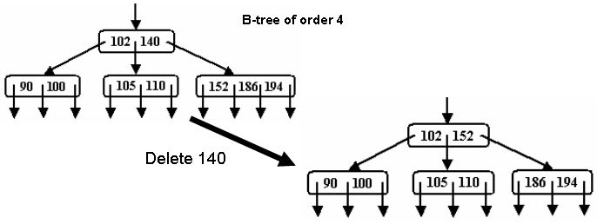
Deletion of a non-leaf node
Deletion of a non-leaf key can always be done in two different ways: by first swapping the key with its successor or predecessor. The resulting trees may be similar or they may be different.
Example: Delete the key 140 in the following partial B-tree of order 4:

Slide 28
B-Tree Deletion Algorithm
deleteKey (x) {
if (the key x to be deleted is not in the tree)
throw an appropriate exception;
if (the tree has only one node) {
delete x ;
return;
}
if (the key x is not in a leaf node)
swap x with its successor or predecessor; // each will be in a leaf node
delete x from the leaf node;
if(the leaf node does not underflow) // after deletion numKeys ≥ ⎡m / 2⎤ - 1
return;
let the leaf node be the CurrentNode;
done = false;

Slide 29
Removal from a B-tree
During insertion, the key always goes into a leaf. For deletion we wish to remove from a leaf. There are three possible ways we can do this:
1 - If the key is already in a leaf node, and removing it doesn’t cause that leaf node to have too few keys, then simply remove the key to be deleted.
2 - If the key is not in a leaf then it is guaranteed (by the nature of a B-tree) that its predecessor or successor will be in a leaf -- in this case can we delete the key and promote the predecessor or successor key to the non-leaf deleted key’s position.
CSCI 2720

Slide 30
Removal from a B-tree (2)
If (1) or (2) lead to a leaf node containing less than the minimum number of keys then we have to look at the siblings immediately adjacent to the leaf in question:
  3: if one of them has more than the min number of keys then we can promote one of its keys to the parent and take the parent key into our lacking leaf
  4: if neither of them has more than the min’ number of keys then the lacking leaf and one of its neighbours can be combined with their shared parent (the opposite of promoting a key) and the new leaf will have the correct number of keys; if this step leaves the parent with too few keys then we repeat the process up to the root itself, if required
CSCI 2720

Slide 31
Type #1: Simple leaf deletion
Assuming a 5-way
B-Tree, as before...
12
29
52
2
7
9
15
22
31
43
56
69
72
Delete 2: Since there are enough
keys in the node, just delete it
Note when printed: this slide is animated
CSCI 2720

Slide 32
Type #2: Simple non-leaf deletion
12
29
52
Delete 52
56
7
9
15
22
31
43
56
69
72
Borrow the predecessor
or (in this case) successor
Note when printed: this slide is animated
CSCI 2720

Slide 33
Type #4: Too few keys in node and its siblings
12
29
56
Join back together
7
9
15
22
31
43
69
72
Too few keys!
Delete 72
Note when printed: this slide is animated
CSCI 2720

Slide 34
Type #4: Too few keys in node and its siblings
12
29
7
9
15
22
31
43
56
69
Note when printed: this slide is animated
CSCI 2720

Slide 35
Type #3: Enough siblings
12
29
Demote root key and
promote leaf key
7
9
15
22
31
43
56
69
Delete 22
Note when printed: this slide is animated
CSCI 2720

Slide 36
Type #3: Enough siblings
12
31
7
9
15
29
43
56
69
Note when printed: this slide is animated
CSCI 2720

Slide 37
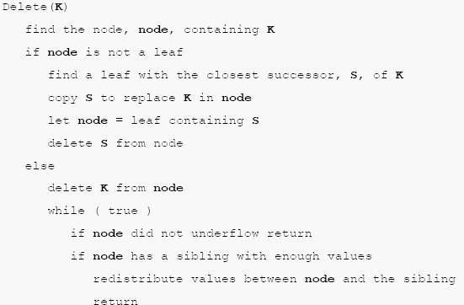
Algorithm for deletion
B-Trees

Slide 38
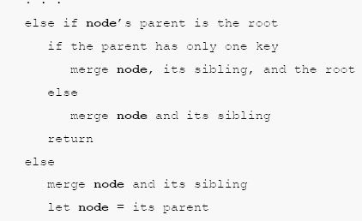
Continued…
B-Trees

Slide 39
Exercise in Removal from a B-Tree
Given 5-way B-tree created by these data (last exercise):
  3, 7, 9, 23, 45, 1, 5, 14, 25, 24, 13, 11, 8, 19, 4, 31, 35, 56
Add these further keys: 2, 6,12
Delete these keys: 4, 5, 7, 3, 14
Again, check your approach with a neighbour and discuss any differences.
CSCI 2720

Slide 40
Analysis of B-Trees
The maximum number of items in a B-tree of order m and height h:
  root m – 1
  level 1 m(m – 1)
  level 2 m²(m – 1)
  . . .
  level h m^{h}(m – 1)
So, the total number of items is
(1 + m + m² + m³ + … + m^{h})(m – 1) =
[(m^{h+1} – 1)/ (m – 1)] (m – 1) = m^{h+1} – 1
When m = 5 and h = 2 this gives 5³ – 1 = 124
CSCI 2720

Slide 41
Reasons for using B-Trees
When searching tables held on disc, the cost of each disc transfer is high but doesn't depend much on the amount of data transferred, especially if consecutive items are transferred
  If we use a B-tree of order 101, say, we can transfer each node in one disc read operation
  A B-tree of order 101 and height 3 can hold 101⁴ – 1 items (approximately 100 million) and any item can be accessed with 3 disc reads (assuming we hold the root in memory)
If we take m = 3, we get a 2-3 tree, in which non-leaf nodes have two or three children (i.e., one or two keys)
  B-Trees are always balanced (since the leaves are all at the same level), so 2-3 trees make a good type of balanced tree
CSCI 2720

Slide 42
Comparing Trees
Binary trees
  Can become unbalanced and lose their good time complexity (big O)
  AVL trees are strict binary trees that overcome the balance problem
  Heaps remain balanced but only prioritise (not order) the keys
Multi-way trees
  B-Trees can be m-way, they can have any (odd) number of children
CSCI 2720

