Slide 1
Software Construction
Chapter 31-35 Pressman

Slide 2
Learning Outcomes
Explain the activities involved in project planning
Develop a Gantt chart including serial and parallel work activities, and resource allocation for a project (Lab)
Adapted from
Software Engineering A Practitioner’s Approach by R.S. Pressman
& Software Engineering A lifecycle approach by P. Mohapatra
Lecture1

Slide 3
Project Management
Involves the
  Planning
  Monitoring
  Control
  of people, process and events that occur as a software evolves from a concept to an operational implementation
Work Product
  Project Plan
Adapted from
Software Engineering A Practitioner’s Approach by R.S. Pressman
& Software Engineering A lifecycle approach by P. Mohapatra

Slide 4
The 4 P’s
People — stakeholders
Product — the software to be built
Process — the set of framework activities and software engineering tasks to get the job done
Project — all work required to make the product a reality
Adapted from
Software Engineering A Practitioner’s Approach by R.S. Pressman
& Software Engineering A lifecycle approach by P. Mohapatra

Slide 5
Project Planning Task Set for You
Establish project scope
Analyze Risks
Define required resources
  Determine required human resources
  Define reusable software resources
  Identify environmental resources
Develop a project schedule
  Establish a meaningful task set
  Define a task network
  Use scheduling tools to develop a timeline chart
  Define schedule tracking mechanisms
Adapted from
Software Engineering A Practitioner’s Approach by R.S. Pressman
& Software Engineering A lifecycle approach by P. Mohapatra

Slide 6
What is Scope?
Software scope describes
  the functions that are to be delivered to end-users
  the data that are input and output
  the project constraints that bound the system.
Adapted from
Software Engineering A Practitioner’s Approach by R.S. Pressman
& Software Engineering A lifecycle approach by P. Mohapatra

Slide 7
Scope
Context. How does the software to be built fit into a larger system, product, or business context, and what constraints are imposed as a result of the context?
Information objectives. What customer-visible data objects are produced as output from the software? What data objects are required for input?
Function and performance. What function does the software perform to transform input data into output? Are any special performance characteristics to be addressed?
Adapted from
Software Engineering A Practitioner’s Approach by R.S. Pressman
& Software Engineering A lifecycle approach by P. Mohapatra
Lecture1

Slide 8
Scope (IEEE std. 830-1998)
Identify the software product(s) to be produced by name (e.g., Host DBMS, Report Generator, etc.)
Describe the application of the software being specified, including relevant benefits, objectives, and goals
Explain what the software product(s) will, and, if necessary, will not do
Adapted from
Software Engineering A Practitioner’s Approach by R.S. Pressman
& Software Engineering A lifecycle approach by P. Mohapatra
Lecture1

Slide 9
Steps
Recognize the stakeholders of the project
Brainstorm the appropriate stakeholders
Determine the work context and the product scope
Preliminary estimates of project time, cost, and risks involved
Go/no go decision
Adapted from
Software Engineering A Practitioner’s Approach by R.S. Pressman
& Software Engineering A lifecycle approach by P. Mohapatra
Lecture1

Slide 10
Timeline Charts
Tasks
Week 1
Week 2
Week 3
Week 4
Week n
Task 1
Task 2
Task 3
Task 4
Task 5
Task 6
Task 7
Task 8
Task 9
Task 10
Task 11
Task 12
Adapted from
Software Engineering A Practitioner’s Approach by R.S. Pressman
& Software Engineering A lifecycle approach by P. Mohapatra

Slide 11
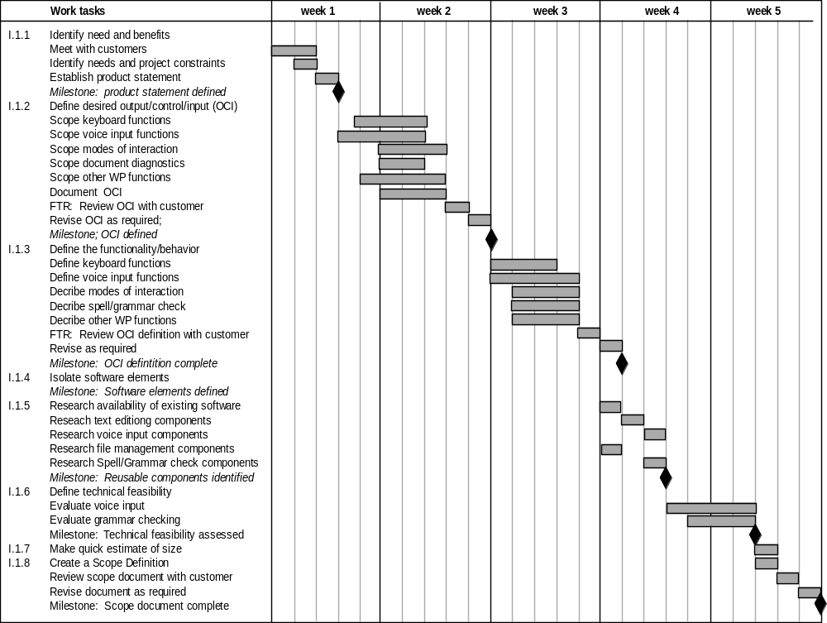
Use Automated Tools to
Derive a Timeline Chart
Adapted from
Software Engineering A Practitioner’s Approach by R.S. Pressman
& Software Engineering A lifecycle approach by P. Mohapatra

