Slide 1
Software Construction
Department of Computer Science
Quaid-i-Azam University
Chapters Larman

Slide 2
Analysis vs. Design
Analysis focuses on do the right thing
Design work will stress do the thing right;

Slide 3
Design
Design emphasizes a conceptual solution that fulfills the requirements
For example, a description of a database schema
Ultimately, designs can be implemented.
During object-oriented design, there is an emphasis on
defining software objects
how they collaborate to fulfill the requirements

Slide 4
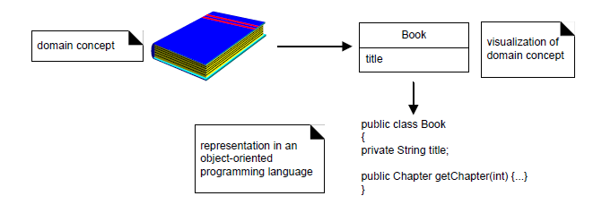
Object-Oriented Design

Slide 5
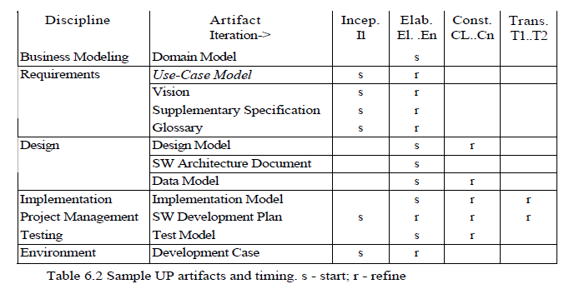
Design Artifacts in the UP

Slide 6
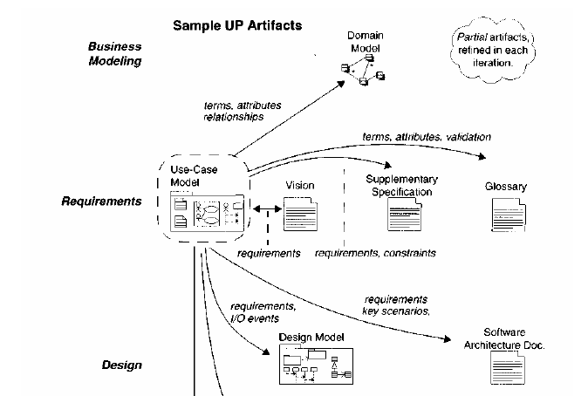
Design Artifacts in the UP

Slide 7
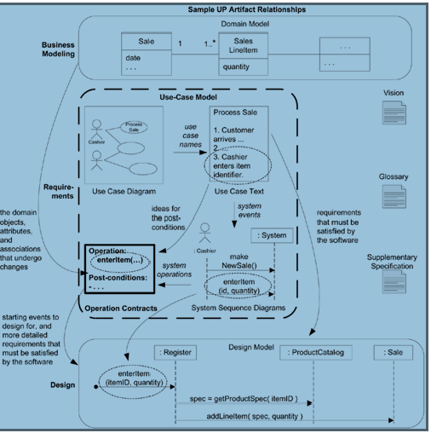

Slide 9
Software Architecture
An architecture is the set of significant decisions about
the organization of a software system,
the selection of the structural elements and their interfaces
their behavior as specified in the collaborations among those elements
the composition of these structural and behavioral elements into progressively larger subsystems, and
the architectural style that guides this organization---these elements and their interfaces, their collaborations, and their composition.

Slide 10
Architecture as a Verb
Architectural investigation involves identifying
functional and
(especially) non-functional requirements
that have (or should have) a significant impact on the system design, such as
market trends,
performance,
cost,
maintainability, and
points of evolution.
Broadly, it is requirements analysis with a focus on those requirements that have special influence on the major system design decisions.

Slide 11
Architecture as a Verb
Architectural design is the resolution of these forces and requirements in the
design of the software,
hardware and networking
Architectural investigation and design are together called architectural analysis

Slide 12
Design Principles
Core design principles applicable to small-scale object design are still dominant principles at the large-scale architectural level
low coupling
high cohesion
protected variation
However, the granularity of the components is larger—it is low coupling between applications, subsystems, or process rather than between small objects

Slide 13
Design Principles
Another principle is to achieve a separation of concerns
Cross-cutting concerns are those with a wide application or influence in the system, such as data persistence or security
One could design persistence support in the NextGen application such that each object (that contained application logic code) itself also communicated with a database to save its data
This would interweave persistence and application logic
Cohesion drops and coupling rises

Slide 14
Design Principles
Designing for a separation of concerns factors out persistence support and security support into separate things
An object with application logic just has application logic, not persistence or security logic
Similarly, a persistence subsystem focuses on the concern of persistence, not security
Separation of concerns is a large-scale way of thinking about low coupling and high cohesion at an architectural level

Slide 15
Achieving Separation of Concerns
Three large-scale techniques:
Modularize the concern into a separate component (for example, subsystem) and invoke its services
Layered architectures illustrate this separation of concerns
Use decorators.
Concern (such as security) is decorated onto other objects with a Decorator object that wraps the inner object and interposes the service
The Decorator is called a container
Use post-compilers and aspect-oriented technologies
These approaches maintain the illusion of separation during development work, and weave in the concern before execution
Aspect-oriented technologies such as AspectJ support post-compilation weaving in of cross-cutting concerns into the code, in a manner that is transparent to the developer

Slide 16
Probably the most common mechanism to achieve
low coupling
protected variation, and
a separation of concerns
at the architectural level is the Layers pattern
A typical object-oriented information system is designed in terms of several architectural layers or subsystems
User Interface—graphical interface; windows.
Application Logic and Domain Objects —software objects representing domain concepts
Technical Services—general purpose objects and subsystems that provide supporting technical services, such as interfacing with a database or error logging

Slide 17
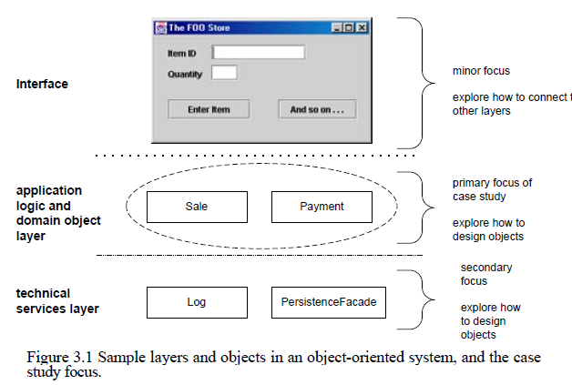
OOA/D is generally most relevant for modeling the application logic and technical service layers.

Slide 18
Architectural Views in the SAD
Architectural View
A view of the system architecture from a given perspective
focuses primarily on structure, modularity, essential components, and the main control flows
An architectural view should explain why the architecture is the way it is
An architectural view is a window onto the system from a particular perspective that emphasizes the key noteworthy information and ignores the rest

Slide 19
Logical
Conceptual organization of the software in terms of the most important layers, subsystems, packages, classes, and interfaces.
Also summarizes the functionality of the major software elements, such as each subsystem.
Shows outstanding use-case realization scenarios (as interaction diagrams) that illustrate key aspects of the system.
A view onto the UP Design Model, visualized with UML package, class, and interaction diagrams

Slide 20
Process
Processes and threads. Their responsibilities, collaborations, and the allocation of logical elements (layers, subsystems, classes, ...) to them
A view onto the UP Design Model, visualized with UML class and interaction diagrams, using the UML process and thread notation.
Deployment
Physical deployment of processes and components to processing nodes, and the physical network configuration between nodes.
A view onto the UP Deployment Model, visualized with UML deployment diagrams.
Normally, the "view" is simply the entire model rather than a subset

Slide 21
Data
Overview of the persistent data schema, the schema mapping from objects to persistent data (usually in a relational database), the mechanism of mapping from objects to a database, database stored procedures and triggers.
A view onto the UP Data Model, visualized with UML class diagrams used to describe a data model.
Use case
Summary of the most architecturally significant use cases and their non-functional requirements
A view onto the UP Use-Case Model, expressed in text and visualized with UML use case diagrams.

Slide 22
Implementation
Implementation Model: In contrast to the other UP models, which are text and diagrams, this "model" is the actual source code, executables,
Two parts:
deliverables,
things that create deliverables (such as source code and graphics)
The Implementation Model is all of this stuff, including web pages, DLLs, executables, source code, and so forth, and their organization—such as source code in Java packages
A view onto the UP implementationModel, expressed in text and visualized with UML package and component diagrams

Slide 23
Essential ideas of the Layers pattern
Solution
Organize the large-scale logical structure of a system into discrete layers
distinct, related responsibilities, with a clean, cohesive separation of concerns
“lower" layers are low-level and general services, and the higher layers are more application specific
A layer is a large-scale element, often composed of several packages or subsystems
The Layers pattern relates to the logical architecture; that is, it describes the conceptual organization of the design elements into groups, independent of their physical packaging or deployment

Slide 24
Problem
Source code changes are rippling throughout the system—many parts of the systems are highly coupled.
Application logic is intertwined with the user interface, and so can not be reused with a different interface, nor distributed to another processing node
Potentially general technical services or business logic is intertwined with more application-specific logic, and so can not be reused, distributed to another node, or easily replaced with a different implementation.

Slide 25
There is high coupling across different areas of concern. It is thus difficult to divide the work along clear boundaries for different developers.
Due to the high coupling and mixing of concerns, it is laborious and costly to evolve the application's functionality, scale up the system, or update it to use new technologies

Slide 26
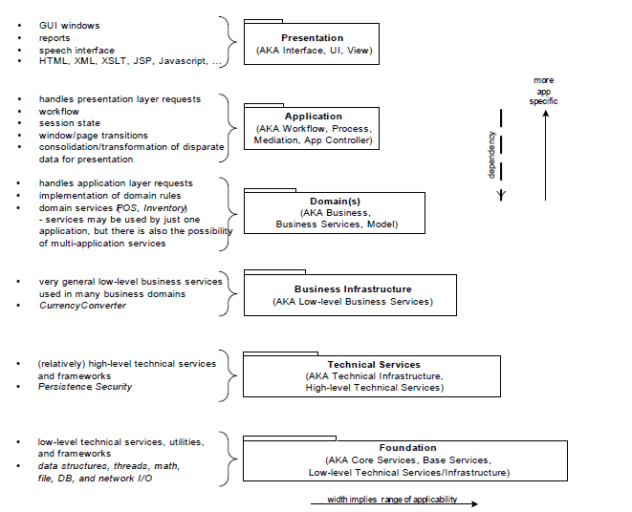

Slide 27
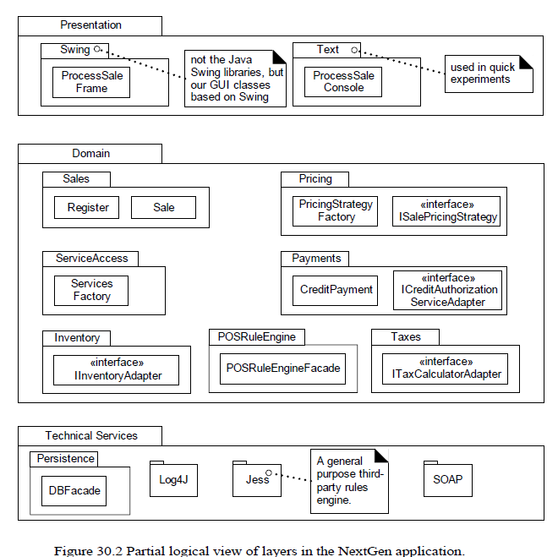

Slide 28
A tentative logical architecture is designed in the early iterations, and it evolves incrementally through the elaboration phase

Slide 29
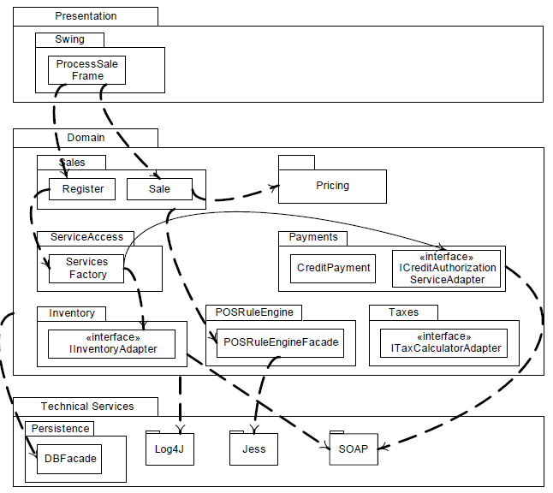

Slide 30
Observe that dependency lines can be used to communicate coupling between packages or types in packages
The use of a dependency line emitting from a package is useful when
Either the specific dependent type is not interesting, or
the communicator wants to suggest that many elements of the package may share that dependency
Another common use of a package diagram is to hide the specific types, and focus on illustrating the package-package coupling

Slide 31
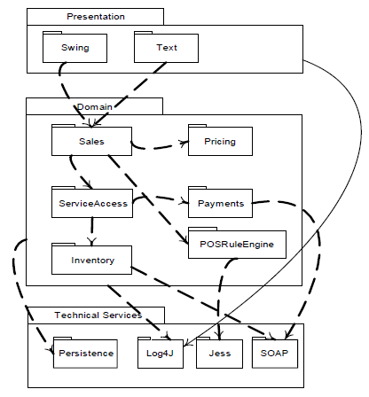

Slide 32
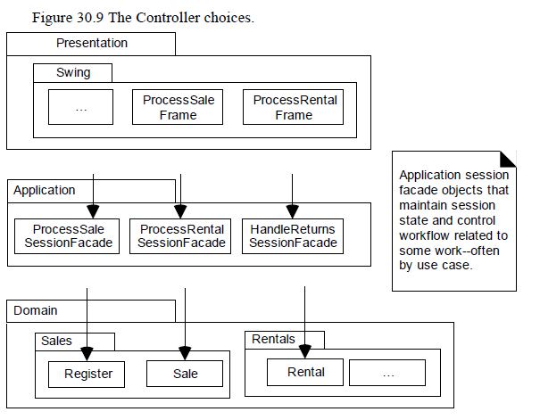

Slide 33
