Slide 1
Software Construction
Department of Computer Science
Quaid-i-Azam University
Chapter 6,9,10,28,29 Larman

Slide 2
Learning Outcomes
To explain the usecase model, the domain model and other well known UML analysis models
To describe purpose of acceptance tests and acceptance test plan and develop acceptance tests
To discover and record requirements using use cases, and analyze requirements using analysis models (lab)

Slide 3
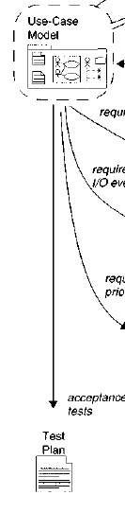
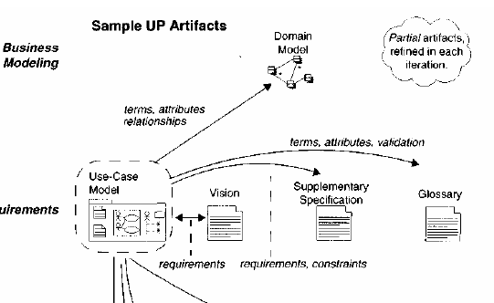

Slide 4
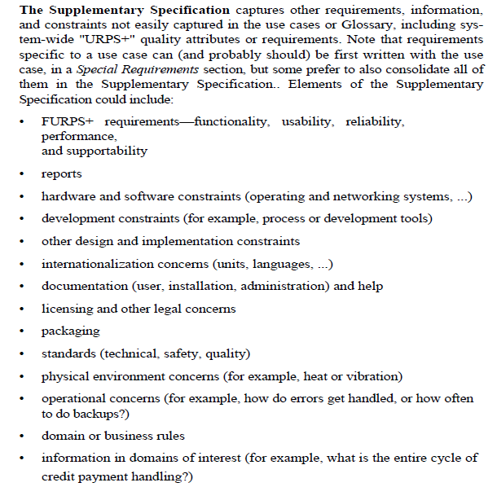

Slide 5
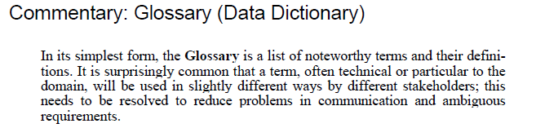
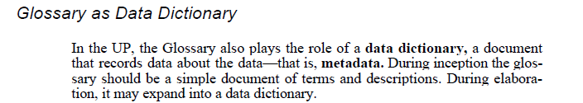

Slide 6
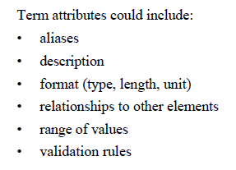
Data Dictionary

Slide 7
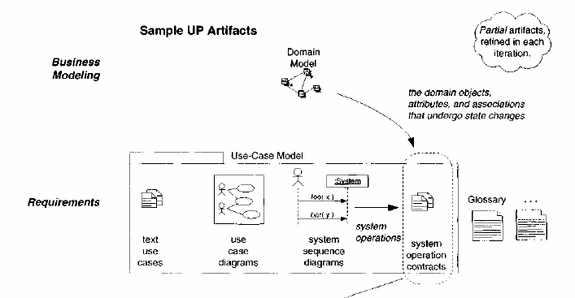

Slide 8
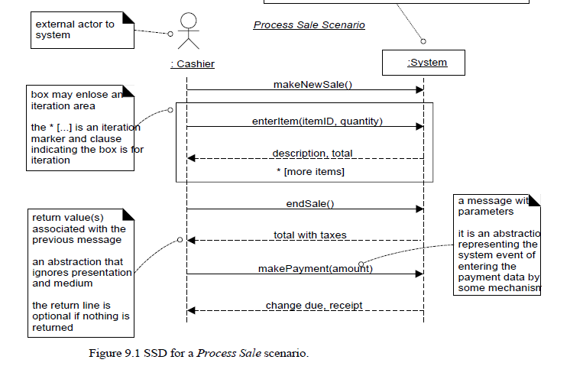
System Sequence Diagram

Slide 9
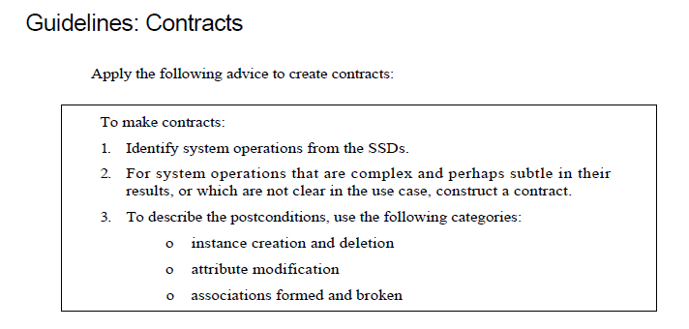

Slide 10
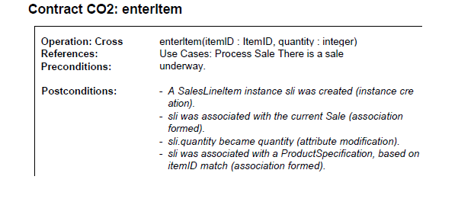

Slide 11
Domain model is a visual representation of conceptual classes or real-world objects in a domain of interest
Using UML notation, a domain model is illustrated with a set of class diagrams in which no operations are defined. It may show:
domain objects or conceptual classes
associations between conceptual classes
attributes of conceptual classes

Slide 12
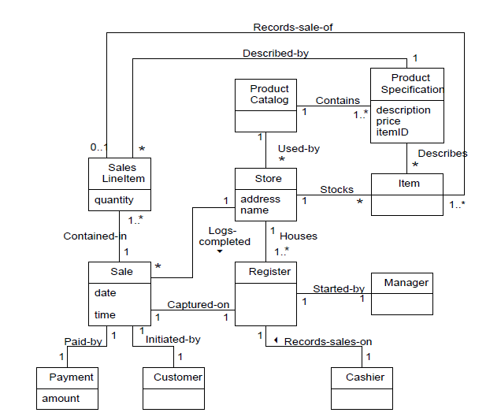
Domain Model

Slide 13
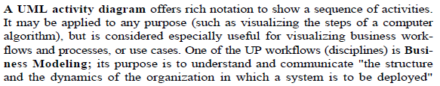

Slide 14
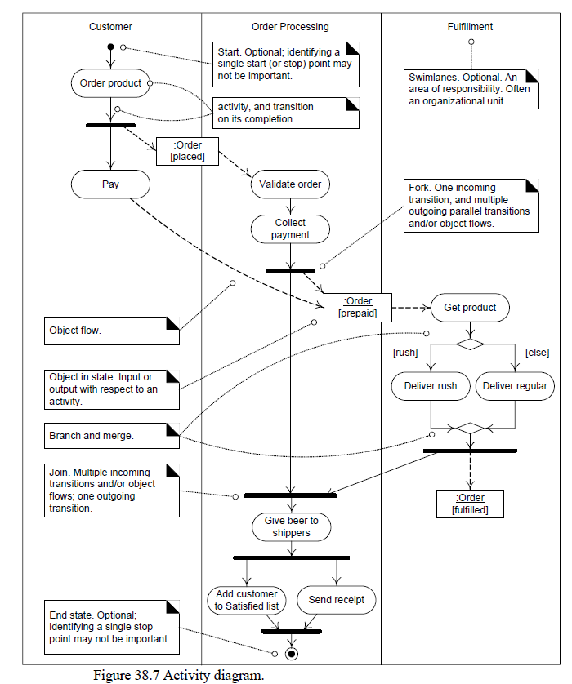

Slide 15
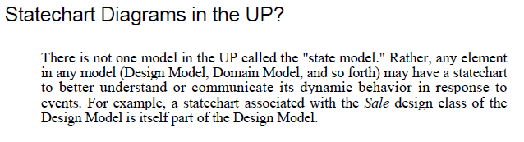
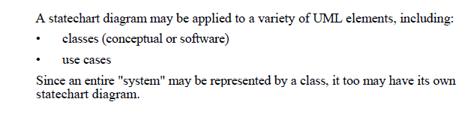

Slide 16
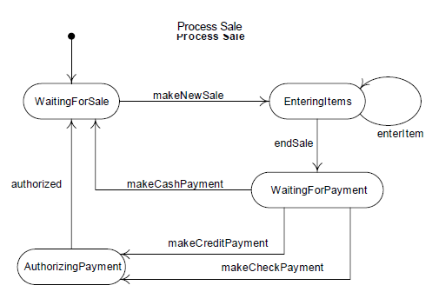

Slide 17
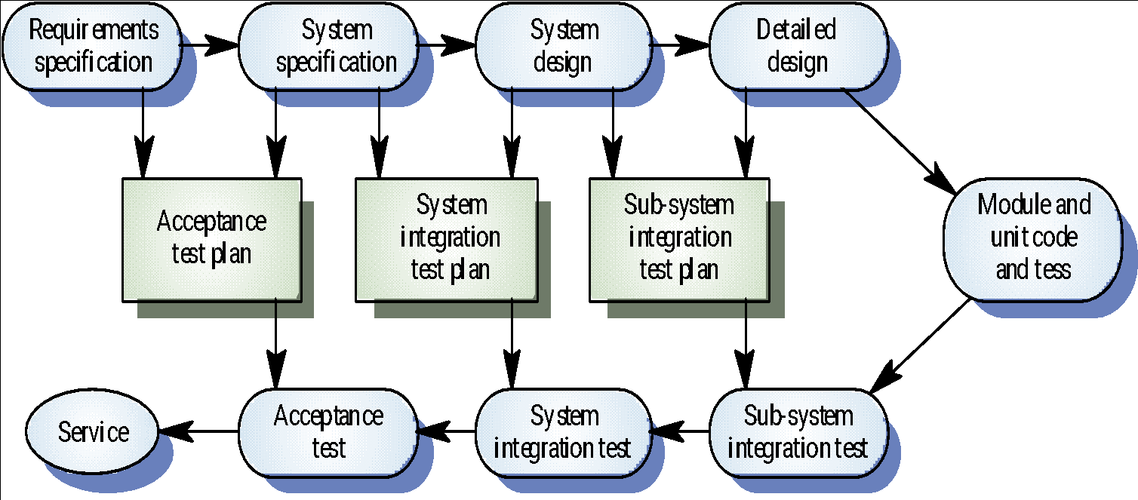
The V Model of Software Development

Slide 19
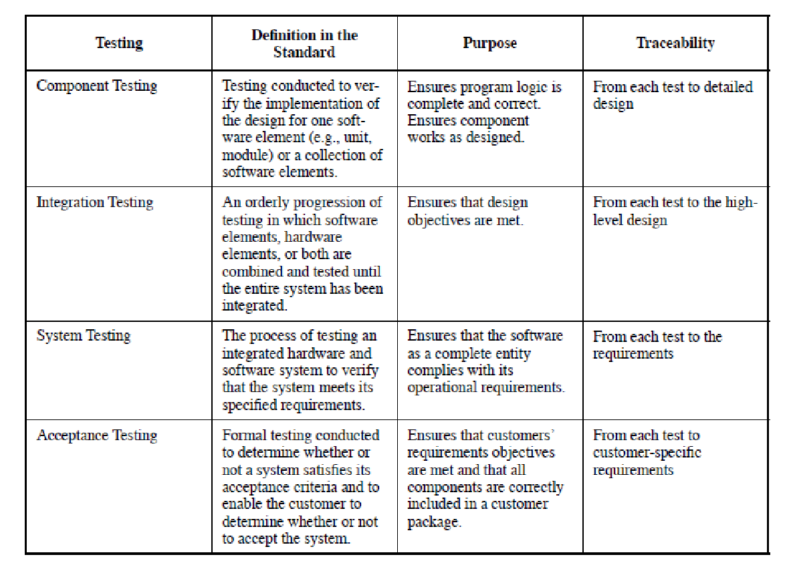
IEEE Std 1059-1993
IEEE Guide for Software Verification and Validation Plans

Slide 20
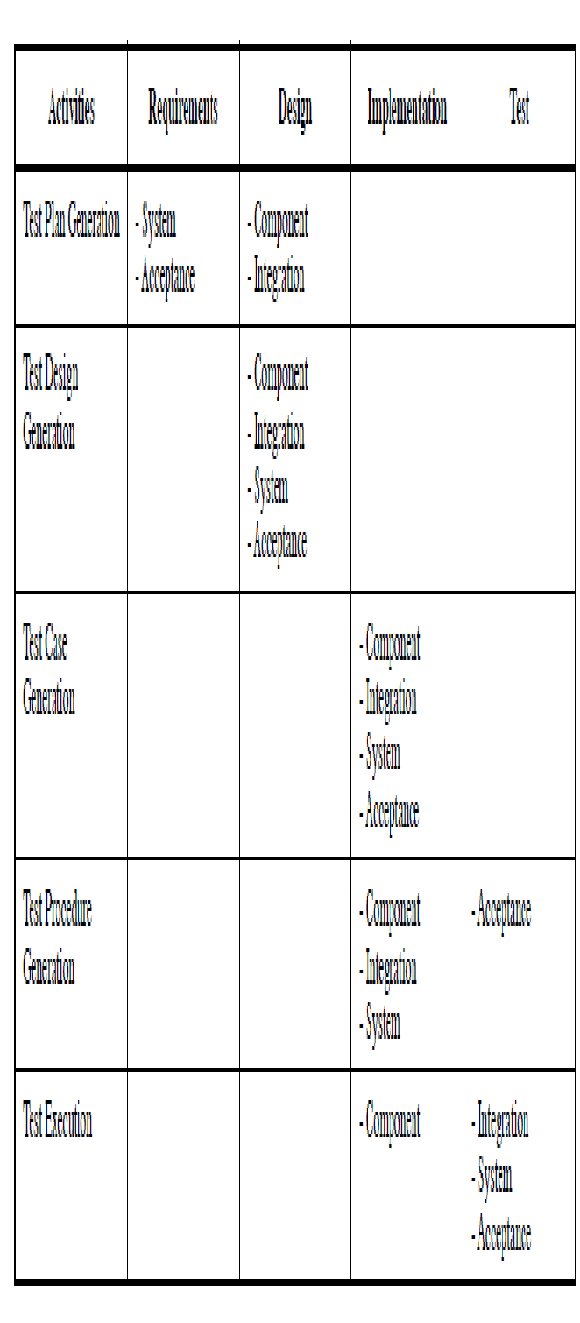

Slide 21
Test Plan
2.1 Test items and their identifiers
2.2 Test Traceability Matrix
2.3 Features to be tested
2.4 Features not to be tested
2.5 Approach
2.6 Item pass/fail criteria
2.8 Test deliverables

Slide 22
Acceptance Tests
Acceptance tests describe the criteria by which stakeholders will determine whether the system meets their needs
Business rules, non-functional requirements, and usage requirements can be captured as acceptance tests
Acceptance tests are sometimes called "conditions of satisfaction“
Adapted from http://www.agilemodeling.com/artifacts/acceptanceTests.htm

Slide 23
Acceptance Tests
Must include the following information
Brief description of what capabilities are being tested ("this test will verify that reserve seat functionality works as described in requirements XX, YY, ZZ")
Which requirements are being verified by this test
Test setup/pre-conditions
Test steps
Expected results

Slide 24
Acceptance Test Template
ID | T0014
Description | Checking accounts have an overdraft limit of $500. As long as there are sufficient funds (e.g. -$500 or greater) within a checking account after a withdrawal has been made the withdrawal will be allowed.
Setup | Create account 12345 with an initial balance of $50 Create account 67890 with an initial balance of $0
Instructions | Withdraw $200 from account #12345 Withdraw $350 from account #67890 Deposit $100 into account #12345 Withdraw $200 from account #67890 Withdraw $150 from account #67890 Withdraw $200 from account #12345 Deposit $50 into account #67890 Withdraw $100 from account #67890

Slide 25
Acceptance Test Template
Expected Results | Account #12345: Ending balance = -$250 $200 Withdrawal transaction posted against it $100 Deposit transaction posted against it $200 Withdrawal transaction posted against it Account #67890: Ending balance = -$500 $350 Withdrawal transaction posted against it $150 Withdrawal transaction posted against it $50 Deposit transaction posted against it Errors logged: Insufficient funds in Account #67890 (balance -$350) for $200 Withdrawal Insufficient funds in Account #67890 (balance -$450) for $100 Withdrawal

Slide 26
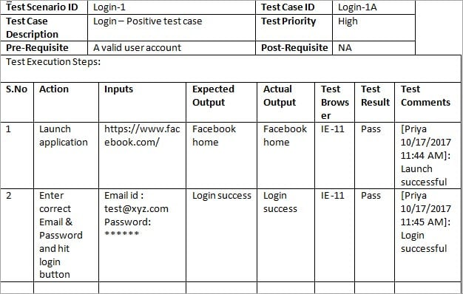

Slide 27
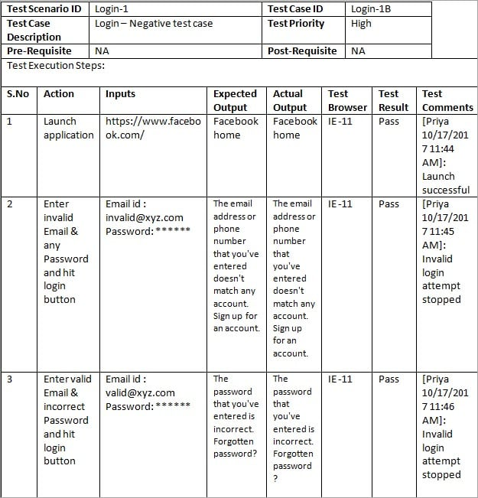

Slide 28
Agile Models Distilled: Potential Artifacts for Agile Modeling

