Slide 1
Software Construction
Department of Computer Science
Quaid-i-Azam University
Chapters Larman

Slide 2
Two design decisions at an architectural level are:
What are the big parts?
How are they connected?
The architectural layers pattern guides defining the big parts
Micro-architectural design patterns such as
Façade
Controller, and
Observer
are commonly used for the design of the connections between layers and packages
A tentative logical architecture is designed in the early iterations, and it evolves incrementally through the elaboration phase

Slide 3
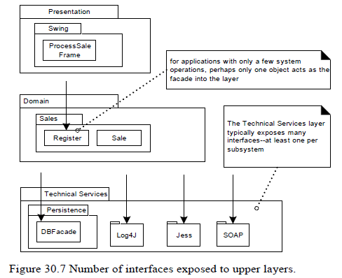

Slide 4
Facade
For packages that represent subsystems, the most common pattern of access is Facade, a GoF design pattern
That is, a public facade object defines the services for the subsystem, and clients collaborate with the facade, not internal subsystem components

Slide 5
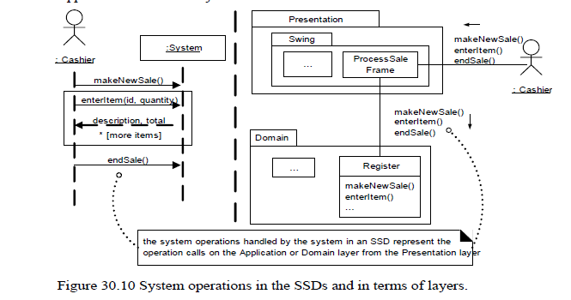
Controller

Slide 6
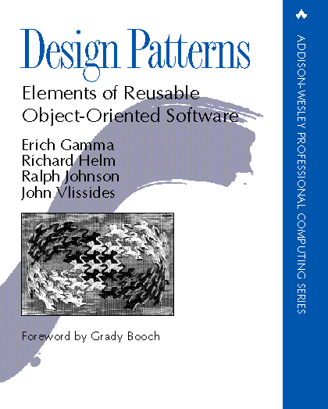
“Gang of Four” (GoF) Book
Design Patterns: Elements of Reusable Object-Oriented Software, Addison-Wesley Publishing Company, 1995
This book solidified thinking about patterns and became the seminal Design Patterns text

Slide 7
Patterns
This book defined 23 patterns, classified into three categories.
Creational patterns, which deal with the process of object creation.
Structural patterns, which deal primarily with the static composition and structure of classes and objects.
Behavioral patterns, which deal primarily with dynamic interaction among classes and objects.

Slide 8
Types of Patterns
Creational patterns:
Deal with initializing and configuring classes and objects
Structural patterns:
Deal with decoupling interface and implementation of classes and objects
Composition of classes or objects
Behavioral patterns:
Deal with dynamic interactions among societies of classes and objects
How they distribute responsibility

Slide 9
Organization of Design Patterns
Two criterion are used to classify patterns:
Purpose
creational,
structural,
behavioral
Scope
Class
Object

Slide 10
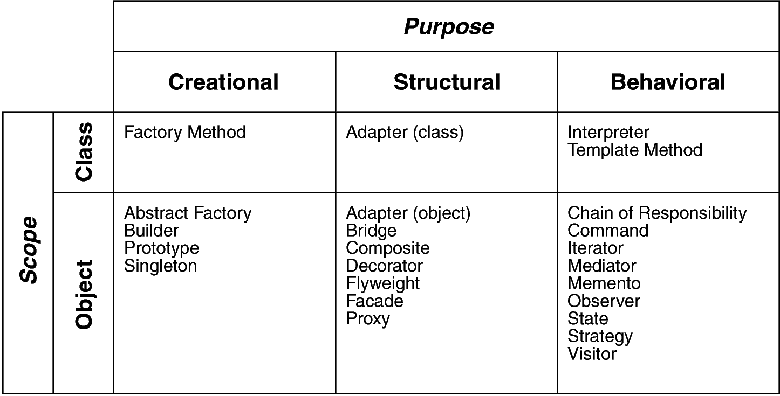
Design Space for GoF Patterns
Scope: domain over which a pattern applies
Purpose: reflects what a pattern does

