Slide 1
Software Construction
Department of Computer Science
Quaid-i-Azam University
Chapters Larman

Slide 2
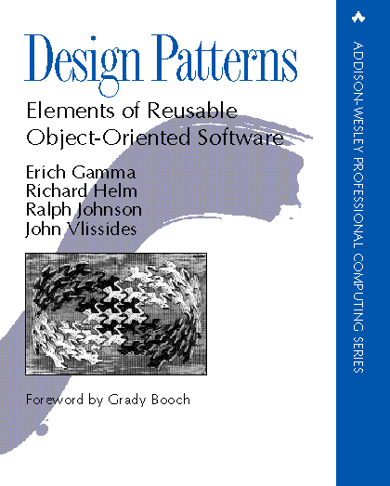
“Gang of Four” (GoF) Book
Design Patterns: Elements of Reusable Object-Oriented Software, Addison-Wesley Publishing Company, 1995
This book solidified thinking about patterns and became the seminal Design Patterns text

Slide 3
Patterns
This book defined 23 patterns, classified into three categories.
Creational patterns, which deal with the process of object creation.
Structural patterns, which deal primarily with the static composition and structure of classes and objects.
Behavioral patterns, which deal primarily with dynamic interaction among classes and objects.

Slide 4
Types of Patterns
Creational patterns:
Deal with initializing and configuring classes and objects
Structural patterns:
Deal with decoupling interface and implementation of classes and objects
Composition of classes or objects
Behavioral patterns:
Deal with dynamic interactions among societies of classes and objects
How they distribute responsibility

Slide 5
Organization of Design Patterns
Two criterion are used to classify patterns:
Purpose
creational,
structural,
behavioral
Scope
Class
Object

Slide 6
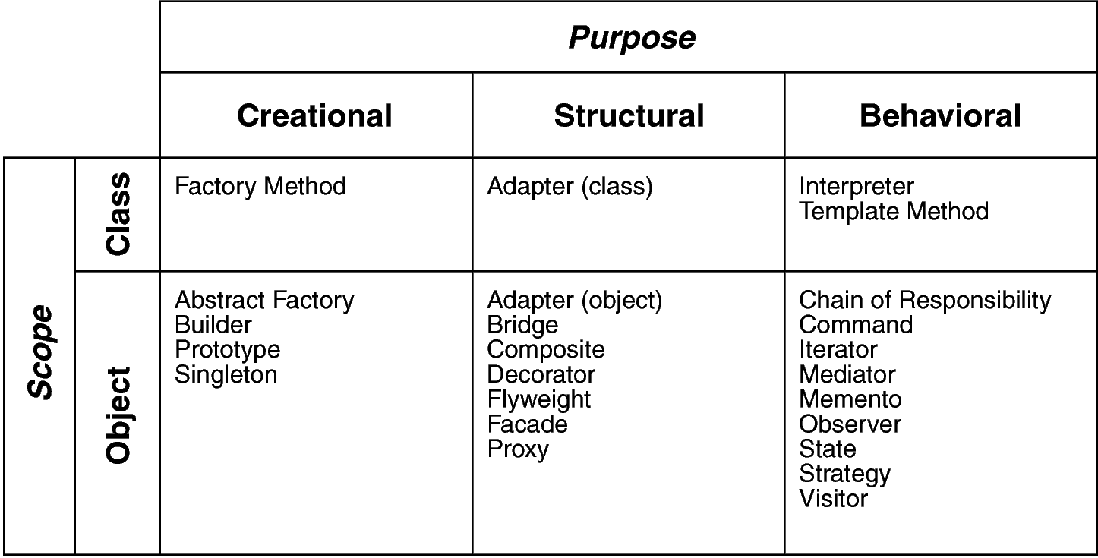
Design Space for GoF Patterns
Scope: domain over which a pattern applies
Purpose: reflects what a pattern does

Slide 7
Most applications require storing and retrieving information in a persistent storage mechanism, such as a relational database (RDB)
ProductSpecification data resides in a relational database. It must be brought into local memory during application use
Persistent objects are those that require persistent storage, such as ProductSpecification instances

Slide 8
Storage Mechanisms and Persistent Objects
Object databases—If an object database is used to store and retrieve objects, no additional custom or third-party persistence services are required
Relational data - Their use is often required, rather than the more convenient object databases
If this is the case, a number of problems arise due to the mismatch between record-oriented and object-oriented representations of data
Other—In addition to RDBs, it is sometimes desirable to store objects in other storage mechanisms or formats, such as flat files, XML structures
A representation mismatch exists between objects and these non-object-oriented formats. Special services are required to make them work

Slide 9
A persistence service (or subsystem) actually provides the service, and will be created with a persistence framework.
Typically, a persistence service must translate objects into records (or some other form of structured data such as XML) and save them in a database, and translate records into objects when retrieving from a database.
In terms of the layered architecture of the NextGen application, a persistence service is a subsystem within the technical services layer.

Slide 10
Suppose we need a persistence service to be built with a persistence framework (which could be used to also create other persistence services).
The framework should provide functions such as:
store and retrieve objects in a persistent storage mechanism
commit and rollback transactions
The design should be extendable to support different storage mechanisms and formats, such as RDBs, records in flat files, or XML in files.

Slide 11
How do you map an object to a record or relational database schema?
The Representing Objects as Tables pattern [BW96] proposes defining a table in an RDB for each persistent object class.
Object attributes containing primitive data types (number, string, boolean, and so on) map to columns.

Slide 12
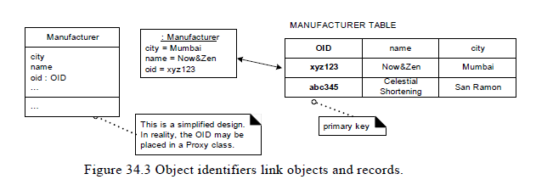

Slide 13
Who should be responsible for materialization and dematerialization of objects (for example, a ProductSpecification) from a persistent store?
The Information Expert pattern suggests that the persistent object class itself (ProductSpecification) is a candidate, because it has some of the data (the data to be saved) required by the responsibility.
If a persistent object class defines the code to save itself in a database, it is called a direct mapping design.

Slide 14
Problems include:
Strong coupling of the persistent object class to persistent storage knowledge—violation of Low Coupling.
Complex responsibilities in a new and unrelated area to what the object was previously responsible for - violation of High Cohesion and maintaining a separation of concerns. Technical service concerns are mixing with application logic concerns.

Slide 15
An indirect mapping approach uses other objects to do the mapping for persistent objects.
It proposes making a class that is responsible for materialization, dematerialization.
This has been called the Database Mapper pattern in [Fowler0l]
A different mapper class is defined for each persistent object class

Slide 16
Defensive Programming
Idea based on defensive driving
Adopt the mind-set - never sure what other drivers will do
If they do something dangerous you won’t be hurt
Take responsibility for protecting yourself even when it’s the other driver’s fault

Slide 17
In defensive programming, the main idea is that if a routine is passed bad data, it won’t be hurt, even if the bad data is another routine’s fault
It’s the recognition that programs will have problems and modifications, and that a smart programmer will develop code accordingly
How to protect yourself from invalid data, events that can “never” happen, and other programmers’ mistakes

Slide 18
Protecting Your Program from Invalid Inputs
Garbage in, garbage out?
For production software, garbage in, garbage out isn’t good enough
A good program never puts out garbage, regardless of what it takes in
A good program uses
“garbage in, nothing out,”
“garbage in, error message out,”
“no garbage allowed in” instead
By today’s standards, “garbage in, garbage out” is the mark of a sloppy, nonsecure program

Slide 19
There are three general ways to handle garbage in:
Check the values of all data from external sources
Check the values of all routine input parameters
Decide how to handle bad inputs

Slide 20
Sources:
File
User
Network
Other external interface
Check the data falls within the allowable range
For a secure application, beware of data that might attack your system:
attempted buffer overflows
injected SQL commands
injected HTML or XML code
integer overflows,

Slide 21
The best form of defensive coding is not inserting errors in the first place
Using iterative design
Writing pseudocode before code
Writing test cases before writing the code, and
having low-level design inspections
are all activities that help to prevent inserting defects
They should thus be given a higher priority than defensive programming.
Use defensive programming in combination with the other techniques.

Slide 22
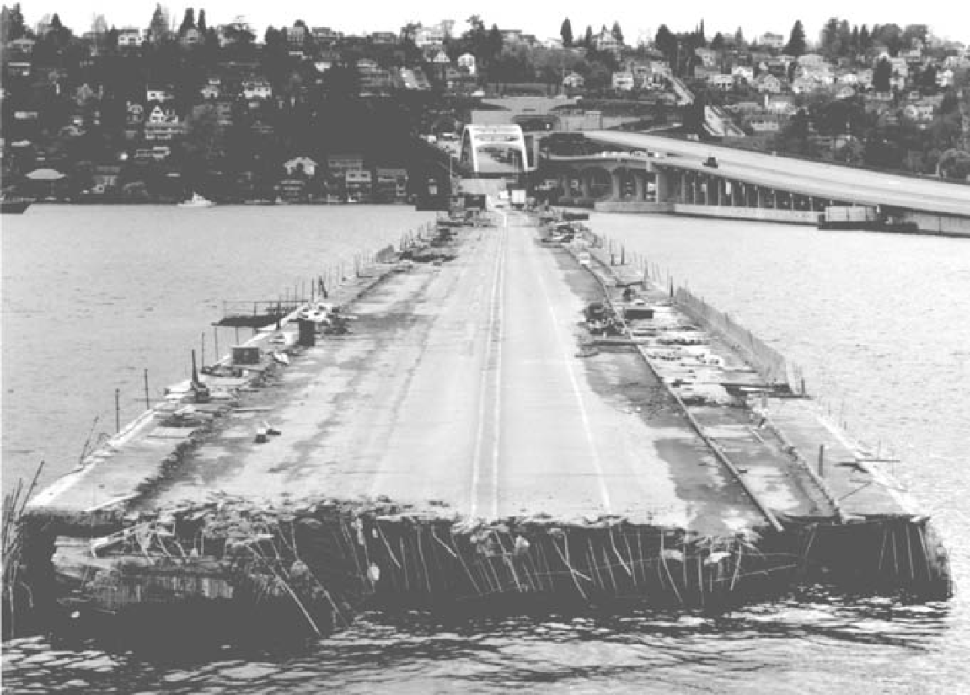
Protecting yourself from seemingly small problems can make more of a difference than you might think
Part of the Interstate-90 floating bridge in Seattle sank during a storm because the flotation tanks were left uncovered, they filled with water, and the bridge became too heavy to float

Slide 23
Barricade Your Program to Contain the Damage Caused by Errors
Barricades are a damage-containment strategy
The reason is similar to that for having isolated compartments in the hull of a ship
If the ship runs into an iceberg and pops open the hull, that compartment is shut off and the rest of the ship isn’t affected
They are also similar to firewalls in a building
A building’s firewalls prevent fire from spreading from one part of a building to another part

Slide 24
One way to barricade for defensive programming purposes is to designate certain interfaces as boundaries to “safe” areas
Check data crossing the boundaries of a safe area for validity, and respond sensibly if the data isn’t valid
This same approach can be used at the class level
The class’s public methods assume the data is unsafe, and they are responsible for checking the data and sanitizing it
Once the data has been accepted by the class’s public methods, the class’s private methods can assume the data is safe

Slide 25
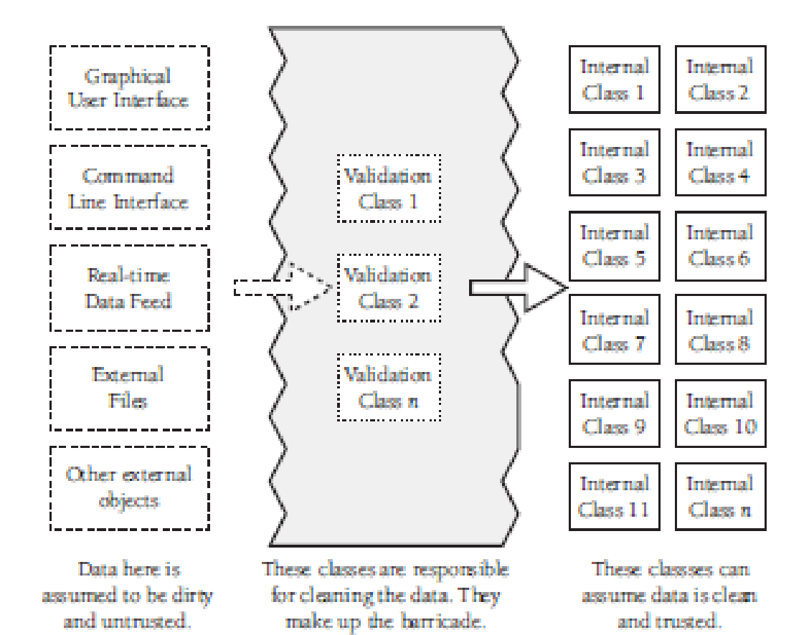

Slide 26
An operating-room technique
Data is sterilized before it’s allowed to enter the operating room
Anything that’s in the operating room is assumed to be safe
The key design decision is
deciding what to put in the operating room
what to keep out, and
where to put the doors—
which routines are considered to be inside the safety zone
which are outside, and
which sanitize the data

Slide 27
Deciding which code is inside and which is outside the barricade is an architecture-level decision.
Convert input data to the proper type at input time
Carrying data of questionable type for any length of time in a program increases complexity
Convert input data to the proper form as soon as possible after it’s input.

Slide 28
Too much defensive programming creates problems of its own
May make your program fat and slow
The additional code needed for defensive programming adds complexity to the software
Code installed for defensive programming is not immune to defects, and you’re just as likely to find a defect in defensive-programming code as in any other code
Think about where you need to be defensive, and set your defensive-programming priorities accordingly

Slide 29
Relationship Between Barricades and Assertions
Distinction between assertions and error handling
Routines that are outside the barricade should use error handling because it isn’t safe to make any assumptions about the data
Routines inside the barricade should use assertions, because the data passed to them is supposed to be sanitized before it’s passed across the barricade
If one of the routines inside the barricade detects bad data, that’s an error in the program rather than an error in the data

Slide 30
Assertions
An assertion is code that’s used during development
Usually a routine or macro—that allows a program to check itself as it runs
When an assertion is true, that means everything is operating as expected
When it’s false, that means it has detected an unexpected error in the code

Slide 31
Java Example of an Assertion
assert denominator != 0 : "denominator is unexpectedly equal to 0.";
Use assertions to document assumptions made in the code and to flush out unexpected conditions

Slide 32
Assertions can be used to check assumptions like these:
That an input parameter’s value falls within its expected range (or an output parameter’s value does)
That a file or stream is open (or closed) when a routine begins executing (or when it ends executing)
That a file or stream is at the beginning (or end) when a routine begins executing (or when it ends executing)
That a file or stream is open for read-only, write-only, or both read and write
That the value of an input-only variable is not changed by a routine
That a pointer is non-null

Slide 33
You don’t want users to see assertion messages in production code
Assertions are primarily for use during development and maintenance
Assertions are normally compiled into the code at development time and compiled out of the code for production
During development, assertions flush out contradictory assumptions, unexpected conditions, bad values passed to routines, and so on
During production, they can be compiled out of the code so that the assertions don’t degrade system performance

Slide 34
Many languages have built-in support for assertions, including C++, Java, and Microsoft Visual Basic
If your language doesn’t directly support assertion routines, they are easy to write

Slide 35
Error-Handling Techniques
Assertions are used to handle errors that should never occur in the code
How do you handle errors that you do expect to occur
Many options
return a neutral value,
substitute the next piece of valid data,
return the same answer as the previous time,
substitute the closest legal value,
log a warning message to a file,
return an error code,
call an error-processing routine or object,
display an error message,
or shut down—or you might want to use a combination of these responses

Slide 36
Robustness vs. Correctness
The style of error processing that is most appropriate depends on the kind of software the error occurs in
Error processing generally favors more correctness or more robustness
Correctness means never returning an inaccurate result; returning no result is better than returning an inaccurate result
Robustness means always trying to do something that will allow the software to keep operating, even if that leads to results that are inaccurate sometimes

Slide 37
Safety-critical applications tend to favor correctness to robustness
It is better to return no result than to return a wrong result
The radiation machine is a good example of this principle
Consumer applications tend to favor robustness to correctness. Any result whatsoever is usually better than the software shutting down
The word processor I’m using occasionally displays a fraction of a line of text at the bottom of the screen
If it detects that condition, do I want the word processor to shut down?

Slide 38
High-Level Design Implications of Error Processing
You need to be careful to handle invalid parameters in consistent ways throughout the program
Deciding on a general approach to bad parameters is an architectural or high level design decision and should be addressed at one of those levels
Once you decide on the approach, make sure you follow it consistently

