Slide 1
Software Construction
Department of Computer Science
Quaid-i-Azam University
Chapter 25 Larman

Slide 2
Domain model

Slide 3
Interaction Diagram

Slide 4
Class Diagram

Slide 5
Sequence diagrams – Classes & instances

Slide 6
Sequence diagrams - Messages
Illustrating returns

Slide 7
Sequence diagrams - Messages to self

Slide 8
Sequence diagrams – Instance creation

Slide 9
Sequence diagrams – Object lifelines

Slide 10
Sequence diagrams – Conditional messages

Slide 11
Sequence diagrams – Mutually exclusive conditional messages

Slide 12
Sequence diagrams – Iteration for a single message

Slide 13
Sequence diagrams – Iteration of a series of messages

Slide 14
Sequence diagrams – Iteration over a multiobject

Slide 15
Responsibilities
Responsibilities are related to the obligations of an object in terms of its behavior.
Basically, these responsibilities are of the following two types:
knowing
doing
Doing responsibilities of an object include:
doing something itself, such as creating an object or doing a calculation
initiating action in other objects
controlling and coordinating activities in other objects
Knowing responsibilities of an object include:
knowing about private encapsulated data
knowing about related objects
knowing about things it can derive or calculate

Slide 16
Responsibilities
A responsibility is not the same thing as a method, but methods are implemented to fulfill responsibilities
Responsibilities are implemented using methods that either act alone or collaborate with other methods and objects.

Slide 17
Grasp Patterns
Information Expert
Creator
High Cohesion
Low Coupling
Controller

Slide 18
Information Expert (or Expert)
Problem What is a general principle of assigning responsibilities to objects?
Solution Assign a responsibility to the information expert, the class that has the information necessary to fulfill the responsibility.
A Design Model may define hundreds or thousands of software classes, and an application may require hundreds or thousands of responsibilities to be fulfilled.
During object design, when the interactions between objects are defined, we make choices about the assignment of responsibilities to software classes.
Done well, systems tend to be easier to
understand,
maintain,
extend,
And there is more opportunity to reuse components in future applications.

Slide 19
Information Expert (or Expert)
Start assigning a responsibility by stating responsibility clearly
Who should be responsible for knowing the grand total of a sale?
By Information Expert, we should look for that class of objects that has the information needed to determine the total.

Slide 20
Information Expert (or Expert)

Slide 21
Information Expert (or Expert)

Slide 22
Creator
Problem Who should be responsible for creating a new instance of some class?
Solution Assign class B the responsibility to create an instance of class A if one or more of the following is true:
B aggregates/contains A objects.
B has the initializing data that will be passed to A when it is created (thus B is an Expert with respect to creating A).

Slide 23
Creator

Slide 24
Low Coupling
Problem How to support low dependency, low change impact, and increased reuse?
Solution Assign a responsibility so that coupling remains low.

Slide 25
Low Coupling

Slide 26
High Cohesion
Problem How to keep complexity manageable?
Solution Assign a responsibility so that cohesion remains high

Slide 27
Controller
Problem Who should be responsible for handling an input system event?
Solution Assign the responsibility for receiving or handling a system event message to a class representing one of the following choices:
Represents the overall system, device, or subsystem
Represents a use case scenario within which the system event occurs, often named <UseCaseName>Handler, <UseCaseName>Coordinator, or <Use-CaseName>Session

Slide 28
Controller

Slide 29
Controller

Slide 30
Controller

Slide 31
Use-case Realizations
"A use-case realization describes how a particular use case is realized within the design model, in terms of collaborating objects”
Use-case realization is a concept to remind us of the connection between the requirements expressed as use cases, and the object design that satisfies the requirements
UML interaction diagrams are a common language to illustrate use-case realizations

Slide 32
System events
The use case suggests the system events are explicitly shown in system sequence diagrams
The system events represent messages that initiate interaction diagrams, which illustrate how objects interact to fulfill the required tasks—the use case realization
The interaction diagrams involve message interaction between software objects whose names are sometimes inspired by the names of conceptual classes in the Domain Model, plus other classes of objects

Slide 33
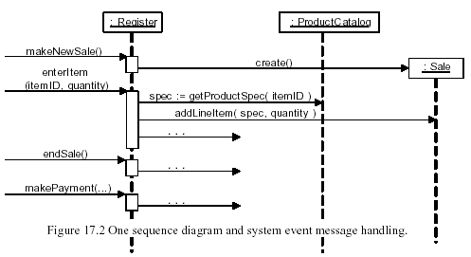
Sequence diagrams and use-cases
If sequence diagrams are used, it may be possible to fit all system event messages on the same diagram

Slide 34
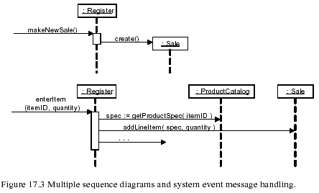
Sequence diagrams and use-cases
However, it is often the case that the sequence diagram is then too complex or long. It is legal, as with interaction diagrams, to use a sequence diagram for each system event message

Slide 35
Changes in domain model
The history of software development is one of invariably discovering that the requirements are not perfect, or have changed
An advantage of iterative development is that it naturally supports the discovery of new analysis and design results during design and implementation work
The existing Domain Model is not likely to be perfect; errors and omissions are to be expected.
You will discover new concepts that were previously missed, ignore concepts that were previously identified, and do likewise with associations and attributes.

Slide 36
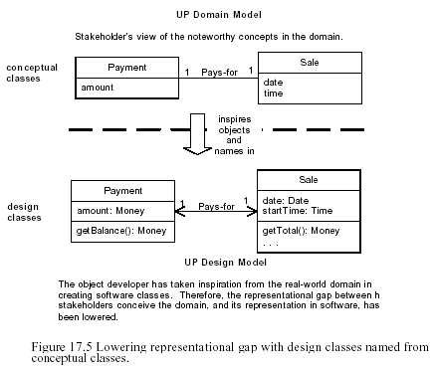
Lowering representational gap

