Slide 1
Software Construction
Department of Computer Science
Quaid-i-Azam University
Chapter 25 Larman

Slide 2
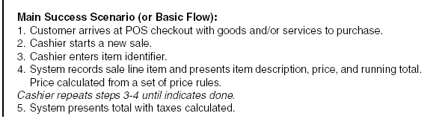
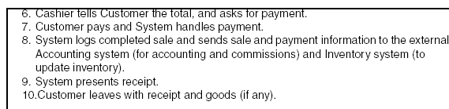
UC1: Process Sale

Slide 3
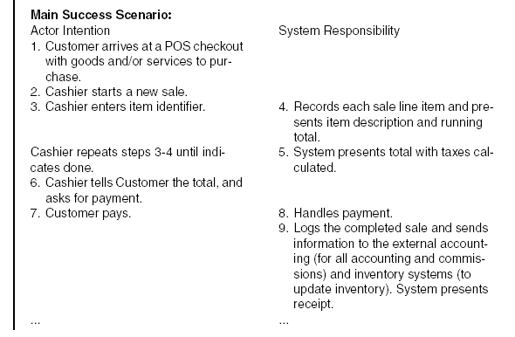
UC1: Process Sale

Slide 4
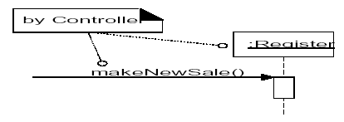
Design: makeNewSale
The makeNewSale system operation occurs when a cashier requests to start a new sale, after a customer has arrived with things to buy
Choosing the Controller Class
This Register is a software object in the Design Model. It is not a real physical register but a software abstraction whose name was chosen to lower the representational gap between our concept of the domain and the software

Slide 5
Design: makeNewSale
Creating a New Sale

Slide 6
Design: enterltem
The enterItem system operation occurs when a cashier enters the itemID and (optionally) the quantity of something to be purchased

Slide 7
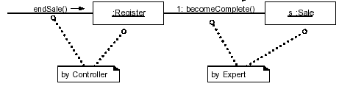
Design: endSale
The endSale system operation occurs when a cashier presses a button indicating the end of a sale

Slide 8
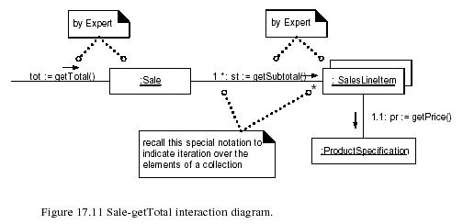
Design: calculateTotal
Calculating the Sale Total

Slide 9
Design: makePayment
The makePayment system operation occurs when a cashier enters the amount of cash tendered for payment

Slide 10
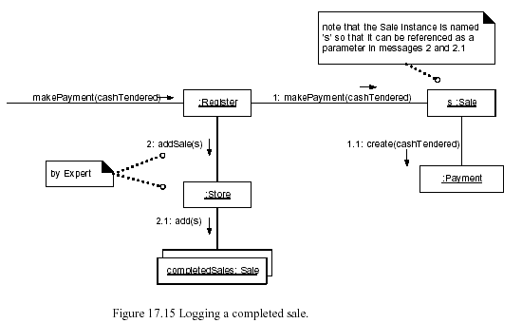
Logging a complete sale

Slide 11
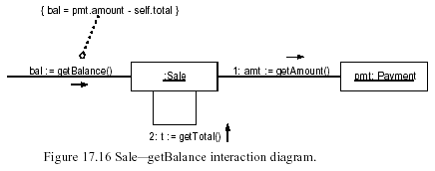
Calculating balance

Slide 12
Design model: Determining visibility
Visibility is the ability of one object to see or have reference to another.
For a sender object to send a message to a receiver object, the sender must have some kind of reference or pointer to the receiver object.
When creating a design of interacting objects, it is necessary to ensure that the necessary visibility is present to support message interaction.

Slide 13
There are four common ways that visibility can be achieved from object A to object B:
Attribute visibility—B is an attribute of A.
Parameter visibility—B is a parameter of a method of A.
Local visibility—B is a (non-parameter) local object in a method of A.
Global visibility—B is in some way globally visible.

Slide 14
Attribute Visibility
Attribute visibility from A to B exists when B is an attribute of A.
It is a relatively permanent visibility because it persists as long as A and B exist. This is a very common form of visibility in object-oriented systems.
To illustrate, in a Java class definition for Register, a Register instance may have attribute visibility to a ProductCatalog, since it is an attribute of the Register.
public class Register
{
…
private ProductCatalog catalog;
…
}

Slide 15
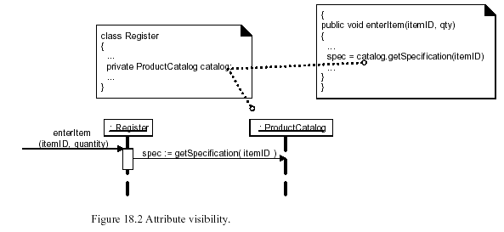

Slide 16
Parameter Visibility
Parameter visibility from A to B exists when B is passed as a parameter to a method of A.
It is a relatively temporary visibility because it persists only within the scope of the method.
After attribute visibility, it is the second most common form of visibility in object-oriented systems.
To illustrate, when the makeLineItem message is sent to a Sale instance, a ProductSpecification instance is passed as a parameter. Within the scope of the makeLineItem method, the Sale has parameter visibility to a ProductSpecification (see Figure 18.3).

Slide 17
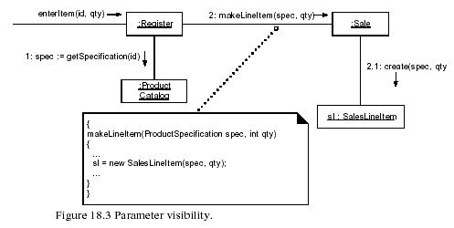

Slide 18
Local Visibility
Local visibility from A to B exists when B is declared as a local object within a method of A.
It is a relatively temporary visibility because it persists only within the scope of the method.
After parameter visibility, it is the third most common form of visibility in object-oriented systems.

Slide 19
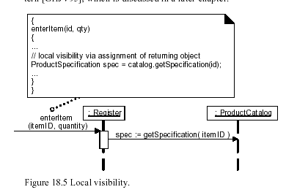

Slide 20
Global Visibility
Global visibility from A to B exists when B is global to A.
It is a relatively permanent visibility because it persists as long as A and B exist.
It is the least common form of visibility in object-oriented systems.

Slide 21
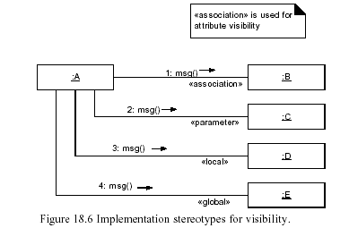

Slide 22
GRASP Patterns
GRASP patterns
Information Expert
Creator
High Cohesion
Low Coupling,
and Controller
Polymorphism
Indirection
Pure Fabrication
Protected Variations

Slide 23
Rich and shared vocabulary with which to discuss design
A short sentence such as,
"I suggest a Strategy generated from a Factory to support Protected Variations and low coupling with respect to <X>"
communicates lots of information about the design
Pattern names tersely convey a complex design concept

Slide 24
Polymorphism
Solution When related alternatives or behaviors vary by type (class), assign responsibility for the behavior—using polymorphic operations—to the types for which the behavior varies
Corollary: Do not test for the type of an object and use conditional logic to perform varying alternatives based on type
Problem How to handle alternatives based on type? How to create pluggable software components?

Slide 25
Alternatives based on type—
Conditional variation is a fundamental theme in programs
If a program is designed using conditional logic, then if a new variation arises, it requires modification of the case logic
This approach makes it difficult to easily extend a program with new variations because changes tend to be required in several places—wherever the conditional logic exists
Pluggable software components—
Viewing components in client-server relationships, how can you replace one server component with another, without affecting the client?

Slide 26
In the NextGen POS application, there are multiple external third-party tax calculators that must be supported
The system needs to be able to integrate with different ones
Each tax calculator has a different interface, and so there is similar but varying behavior to adapt to each of these external interfaces or APIs
One product may support a raw TCP socket protocol, another may offer a SOAP interface, and a third may offer a Java RMI interface.
What objects should be responsible for handling these varying external tax calculator interfaces?

Slide 27
Since the behavior of calculator adaptation varies by the type of calculator, by Polymorphism we should assign the responsibility for adaptation to different calculator (or calculator adapter) objects themselves, implemented with a polymorphic getTaxes operation

Slide 29
UML notation

Slide 30
These calculator adapter objects are not the external calculators
They are local software objects that represent the external calculators, or the adapter for the calculator
By sending a message to the local object, a call will ultimately be made on the external calculator in its native API
Each getTaxes method takes the Sale object as a parameter, so that the calculator can analyze the sale.
The implementation of each getTaxes method will be different: TaxMasterAdapter will adapt the request to different APIs

Slide 31
Benefits
Extensions required for new variations are easy to add
Protected Variations
A number of popular GoF design patterns which will be discussed in this book rely on polymorphism, including Adapter, Command, Composite, Proxy, State, and Strategy

Slide 32
Fabrication
Assign a highly cohesive set of responsibilities to an artificial or convenience class that does not represent a problem domain concept
Something made up, to support high cohesion, low coupling, and reuse
Such a class is a fabrication of the imagination
A pure fabrication implies making something up, which we do when we're desperate!

Slide 33
Suppose that support is needed to save Sale instances in a relational database
By Information Expert, there is some justification to assign this responsibility to the Sale class itself, because the sale has the data that needs to be saved.
But consider the following implications:

Slide 34
The task requires a relatively large number of supporting database-oriented operations, none related to the concept of sale-ness, so the Sale class becomes incohesive
The Sale class has to be coupled to the relational database interface (such as JDBC in Java technologies), so its coupling goes up (And the coupling is not even to another domain object, but to a particular kind of database interface)
Saving objects in a relational database is a very general task for which many classes need support

Slide 35
Placing these responsibilities in the Sale class suggests there is going to be poor reuse or lots of duplication in other classes that do the same thing
Thus, even though Sale is a logical candidate by virtue of Information Expert to save itself in a database, it leads to a design with low cohesion, high coupling, and low reuse potential—exactly the kind of desperate situation that calls for making something up

Slide 36
A reasonable solution is to create a new class that is solely responsible for saving objects in some kind of persistent storage medium, such as a relational database; call it the PersistentStorage
This class is a Pure Fabrication—a figment of the imagination

Slide 37
Notice the name: PersistentStorage. This is an understandable concept, yet the name or concept "persistent storage" is not something one would find in the Domain Model.
And if a designer asked a business-person in a store, "Do you work with persistent storage objects?" they would not understand
They understand concepts such as "sale" and "payment." PersistentStorage is not a domain concept, but something made up or fabricated for the convenience of the software developer

Slide 38
This Pure Fabrication solves the following design problems:
The Sale remains well-designed, with high cohesion and low coupling.
The PersistentStorage class is itself relatively cohesive, having the sole purpose of storing or inserting objects in a persistent storage medium.
The PersistentStorage class is a very generic and reusable object

Slide 39
Indirection
Solution Assign the responsibility to an intermediate object to mediate between other components or services so that they are not directly coupled.
The intermediary creates an indirection between the other components.
Problem Where to assign a responsibility, to avoid direct coupling between two (or more) things?
How to de-couple objects so that low coupling is supported and reuse potential remains higher?

Slide 41
These objects act as intermediaries to the external tax calculators.
Via polymorphism, they provide a consistent interface to the inner objects and hide the variations in the external APIs.
By adding a level of indirection and adding polymorphism, the adapter objects protect the inner design against variations in the external interfaces

Slide 42
The Pure Fabrication example of decoupling the Sale from the relational database services through the introduction of a PersistentStorage class is also an example of assigning responsibilities to support Indirection.
The PersistentStorage acts as an intermediary between the Sale and the database

Slide 43
Protected Variations
Solution Identify points of predicted variation or instability; assign responsibilities to create a stable interface around them.
Problem How to design objects, subsystems, and systems so that the variations or instability in these elements does not have an undesirable impact on other elements?

Slide 44
Example
The prior external tax calculator problem and its solution with Polymorphism illustrate Protected Variations
The point of instability or variation is the different interfaces or APIs of external tax calculators.
The POS system needs to be able to integrate with many existing tax calculator systems, and also with future third-party calculators not yet in existence

Slide 45
By adding a level of indirection, an interface, and using polymorphism with various ITaxCalculatorAdapter implementations, protection within the system from variations in external APIs is achieved
Internal objects collaborate with a stable interface; the various adapter implementations hide the variations to the external systems

