Slide 1
Software Construction
Department of Computer Science
Quaid-i-Azam University
Chapter 25 Larman
Chapter 20 McConnell

Slide 2
Design model: Creating design class diagrams
Although this presentation of DCDs follows the creation of interaction diagrams, in practice they are usually created in parallel.
Many classes, method names and relationships may be sketched out very early in design by applying responsibility assignment patterns, prior to the drawing of interaction diagrams.
It is possible and desirable to do a little interaction diagramming, then update the DCDs, then extend the interaction diagrams some more, and so on.

Slide 3
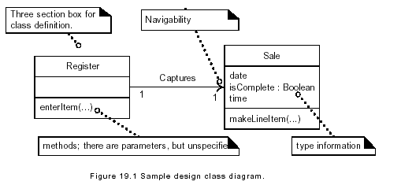

Slide 4
A design class diagram (DCD) illustrates the specifications for software classes in an application.
Typical information includes:
classes and attributes
methods
attribute type information
navigability
dependencies
In contrast to conceptual classes in the Domain Model, design classes in the DCDs show definitions for software classes rather than real-world concepts.

Slide 5
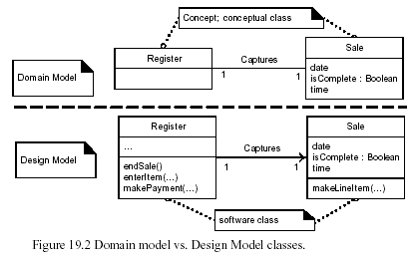

Slide 6
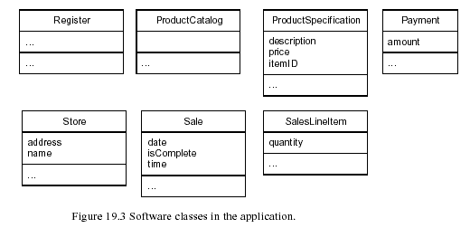

Slide 7
Add Method Names
The methods of each class can be identified by analyzing the interaction diagrams.
For example, if the message makeLineItem is sent to an instance of class Sale, then class Sale must define a makeLineItem method
In general, the set of all messages sent to a class X across all interaction diagrams indicates the majority of methods that class X must define.

Slide 8
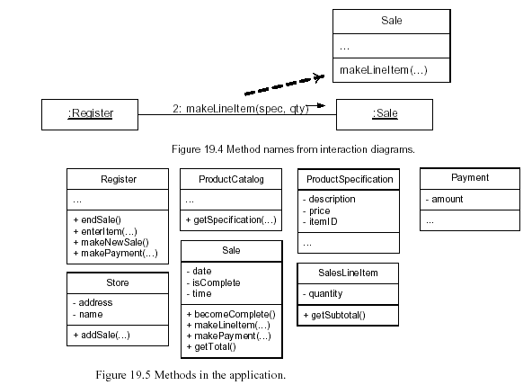

Slide 9
Method Names—create
Method Names—Accessing Methods
These methods are usually excluded from depiction in the class diagram because of the high noise-to-value ratio they generate; for n attributes, there are 2n uninteresting methods.

Slide 10
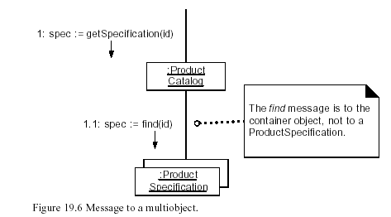

Slide 11
Method Names—Language-Dependent Syntax
Some languages, have a syntax that is very different from the basic UML format.
It is recommended that the basic UML format be used, even if the planned implementation language uses a different syntax.
The translation should ideally take place during code generation time, instead of during the creation of the class diagrams.

Slide 12
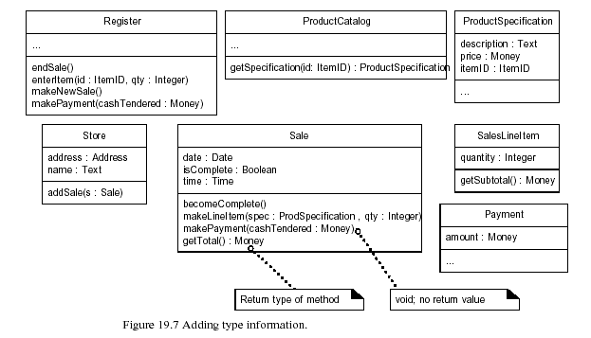
Adding More Type Information
The types of the attributes, method parameters, and method return values may all optionally be shown.

Slide 13
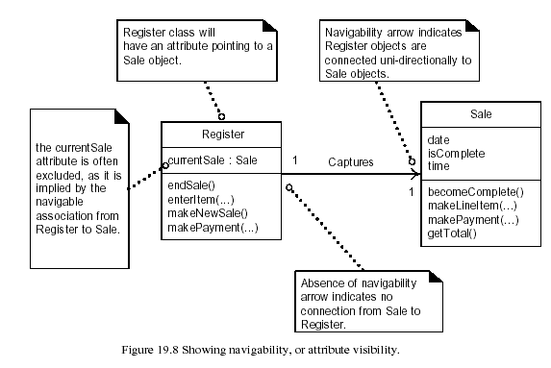
Adding Associations and Navigability
Navigability implies visibility—usually attribute visibility

Slide 14
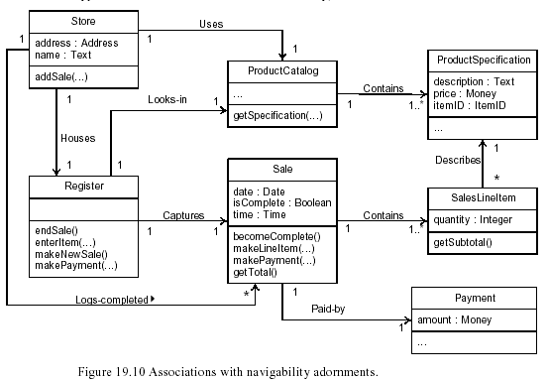

Slide 15
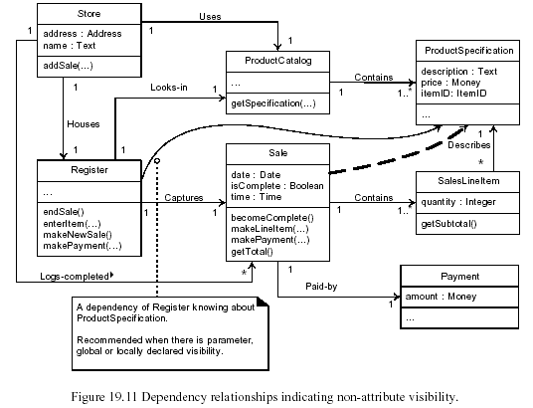
Note that this is not exactly the same set of associations that was generated for the class diagrams in the Domain Model.

Slide 16
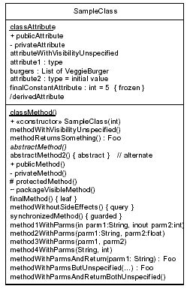

Slide 17
Characteristics of Software Quality
Software has both external and internal quality characteristics
External (users care about them)
Correctness: Free from faults in its specification, design, and implementation
Usability: The ease with which users can learn and use a system
Efficiency: Minimal use of system resources, including memory and time
Reliability: Having a long mean time between failures.
Integrity System prevents unauthorized/improper access to its programs/data
Adaptability System can be used, without modification, in other environments
Accuracy The degree to which a system, as built, is free from error
Robustness System continues to function in the presence of invalid inputs

Slide 18
Internal (Programmers care about them, and also about external)
Maintainability The ease to change or add capabilities/improve performance, adapt to new environments, correct defects, or improve code
(Perfective, Adaptive, Corrective, Preventive)
Flexibility Can you modify a system for environments other than those for which it was specifically designed
Portability Can you modify a system to operate in an environment different from that for which it was specifically designed
Reusability Can you use parts of a system in other systems.
Readability Can you read and understand the source code of a system, especially at the detailed-statement level.
Testability The degree to which you can verify that the system meets its requirements.
Understandability Can you comprehend a system at both the system-organizational and detailed-statement levels

Slide 19
Relationship among Quality Characteristics
Internal characteristics affect external ones
Software that isn’t internally understandable or maintainable, impairs your ability to correct defects, which in turn affects the external characteristics of correctness and reliability
The attempt to maximize certain characteristics inevitably conflicts with the attempt to maximize others
Chart shows some typical relationships among the quality characteristics

Slide 20
Correctness
Usability
Efficiency
Reliability
Integrity
Adaptability
Accuracy
Robustness

Slide 21
Techniques for Improving Software Quality
It might seem that the best way to develop a high-quality product would be to focus on the product itself, in software quality assurance you also need to focus on the software-development process
Software-quality objectives
One powerful technique for improving software quality is setting explicit quality objectives from among the external and internal characteristics
Explicit quality-assurance activity
One common problem in assuring quality is that quality is perceived as a secondary goal
Making the quality-assurance activity explicit makes the priority clear, and programmers will respond accordingly.

Slide 22
Testing strategy
Testing can provide a detailed assessment of a product’s reliability
This is too heavy a burden for testing to bear by itself
Software-engineering guidelines
Guidelines should control the technical character of the software as it is developed
Informal technical reviews
Many software developers review their work Informal reviews include desk-checking the design or the code or walking through the code with a few peers.
Formal technical reviews
External audits

Slide 23
Development process
Other processes that aren’t explicitly quality-assurance activities also affect software quality.
Change-control procedures
Measurement of results
Prototyping

Slide 25
Relative Effectiveness of Quality Techniques
If project developers are striving for a higher defect detection rate, they need to use a combination of techniques

Slide 26
Cost of Finding Defects
Most studies have found that inspections are cheaper than testing.
A study at the Software Engineering Laboratory found that Code reading detected about 80 percent more faults per hour than testing
Another organization found that it cost six times as much to detect design defects by using testing as by using inspections
A later study at IBM found that only 3.5 staff hours were needed to find each error when using code inspections, whereas 15–25 hours were needed to find each error through testing

Slide 27
Cost of Fixing Defects
How a defect is found wouldn’t matter, it would always take the same amount to fix
True or False?
It might seem at first glance that how the defect is found wouldn’t matter—it would always cost the same amount to fix.
That isn’t true because the longer a defect remains in the system, the more expensive it becomes to remove.
A detection technique that finds the error earlier therefore results in a lower cost of fixing it.

Slide 28
Inspections detect the symptoms and causes of defects in one step
Testing finds symptoms but require additional work to diagnose and fix the root cause.
The result is that one-step techniques are substantially cheaper overall than two-step ones.
A recommended combination for achieving higher-than-average quality:
Formal inspections of all requirements, all architecture, and designs for critical parts
Modeling or prototyping
Code reading or inspections
Testing

Slide 29
When to Do Quality Assurance
The earlier an error is inserted into software, the more entangled it becomes in other parts of the software and the more expensive it becomes to remove.
A fault in requirements can produce one or more corresponding faults in design, which can produce many corresponding faults in code
In addition, errors in requirements or architecture tend to be more sweeping than construction errors. A single architectural error can affect several classes and dozens of routines
Defects creep into software at all stages. Emphasize quality assurance work in the early stages and throughout the rest of the project.
It should be planned into the project as work begins; it should be part of the technical fiber of the project as work continues; and it should punctuate the end of the project, verifying the quality of the product as work ends

Slide 30
The General Principle of Software Quality
Improving quality reduces development costs
Understanding this principle depends on understanding a key observation:
the best way to improve productivity and quality is to reduce the time spent reworking code, whether the rework arises from changes in requirements, changes in design, or debugging
The single biggest activity on most projects is debugging and correcting code that doesn’t work properly
The most obvious method of shortening a development schedule
Improve the quality of the product and decrease the amount of time spent debugging and reworking the software

Slide 31
Observation on Quality Assurance
Increased quality assurance was associated with decreased error rate but did not increase overall development cost
Software projects with the lowest levels of defects had the shortest development schedules and the highest development productivity....
Software defect removal is actually the most expensive and time-consuming form of work for software

