Slide 1
Software Construction
Department of Computer Science
Quaid-i-Azam University
Readings: Lecture slides
Chapter 6 Larman

Slide 2
Learning Outcomes
To describe devops, the ideas that form its foundation and the role of agile methods within devops
To describe requirements using the use case model i.e. use case diagram and text (lab)

Slide 3
Software Development Trends for 2023
1. Artificial Intelligence
2. Full-stack developers
3. Python
4. Cloud computing
5. 5G Networks And Technology
6. No-code, low code development
7. Augmented And Virtual Reality
8. New Programming Languages
9. DevSecOps
https://insightglobal.com/blog/software-development-trends-2023/

Slide 4
DevOps
DevOps is a software development methodology that
promote cooperation and communication between development and operations (principles, methods, practices) in an organization
emphasizes communication, collaboration, and integration between software developers and information technology (IT) professionals
to improve the quality and speed of software development and deployment
Different from traditional software development because of the tight-knit collaboration between development and operations, with a heavy emphasis on testing and automation.
Complete Guide to DevOps | Smartsheet
https://www.developer.com/project-management/devops-devsecops/

Slide 5
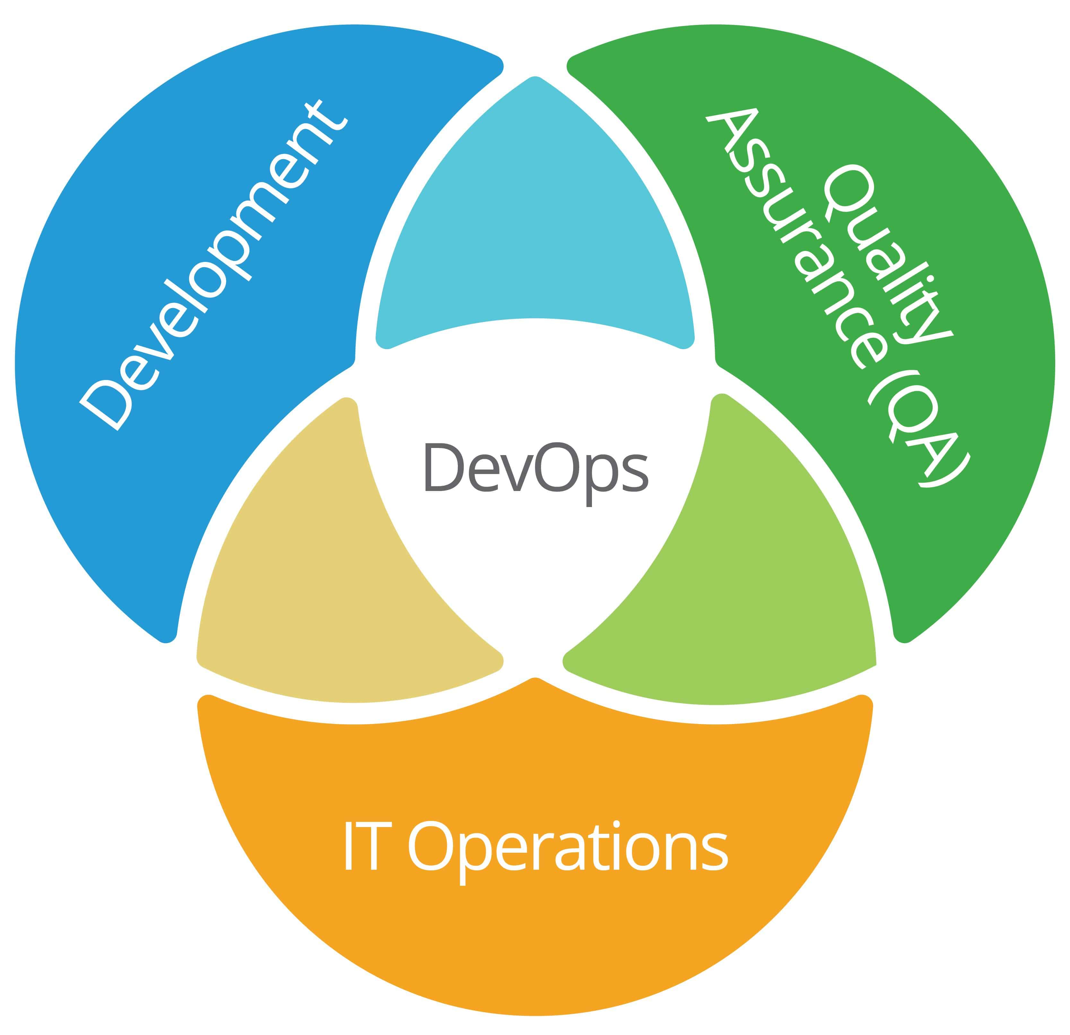

Slide 6
The DevOps culture is reinforced by the practices it borrows from Agile and Lean principles, with an added focus on service and quality
Focuses on improving team communication by encouraging everyone involved in the process – from developers to operations specialists – to work as equals and share responsibility for delivering quality products quickly

Slide 7
Agile Methodology
What is “Agility”?
Effective (rapid and adaptive) response to change
Effective communication among all stakeholders
Drawing the customer onto the team
Organizing a team so that it is in control of the work performed
Yielding …
Rapid, incremental delivery of software

Slide 8
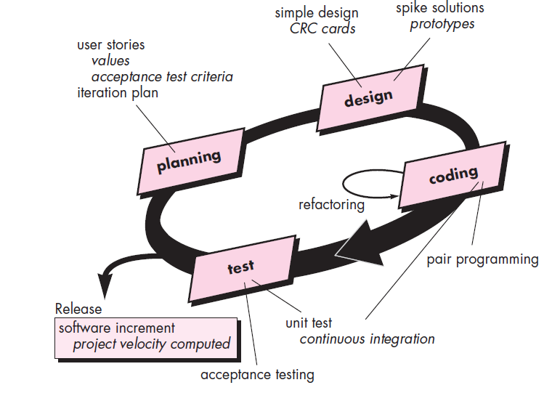
Extreme Programming

Slide 9
Extreme Programming (XP)
The most widely used agile process, originally proposed by Kent Beck
XP Planning
Begins with the creation of “user stories”
Agile team assesses each story and assigns a cost
Stories are grouped to for a deliverable increment
A commitment is made on delivery date
After the first increment “project velocity” is used to help define subsequent delivery dates for other increments
Customer can add stories, change value, split stories or eliminate them

Slide 10
Extreme Programming (XP)
XP Design
Follows the Simplicity principle
Encourage the use of CRC cards
For difficult design problems, suggests the creation of “spike solutions”—a design prototype
Encourages “refactoring”—an iterative refinement of the internal program design
XP Coding
Recommends the construction of a unit test for a store before coding commences
Encourages “pair programming”
XP Testing
All unit tests are executed daily
“Acceptance tests” are defined by the customer and executed to assess customer visible functionality

Slide 11
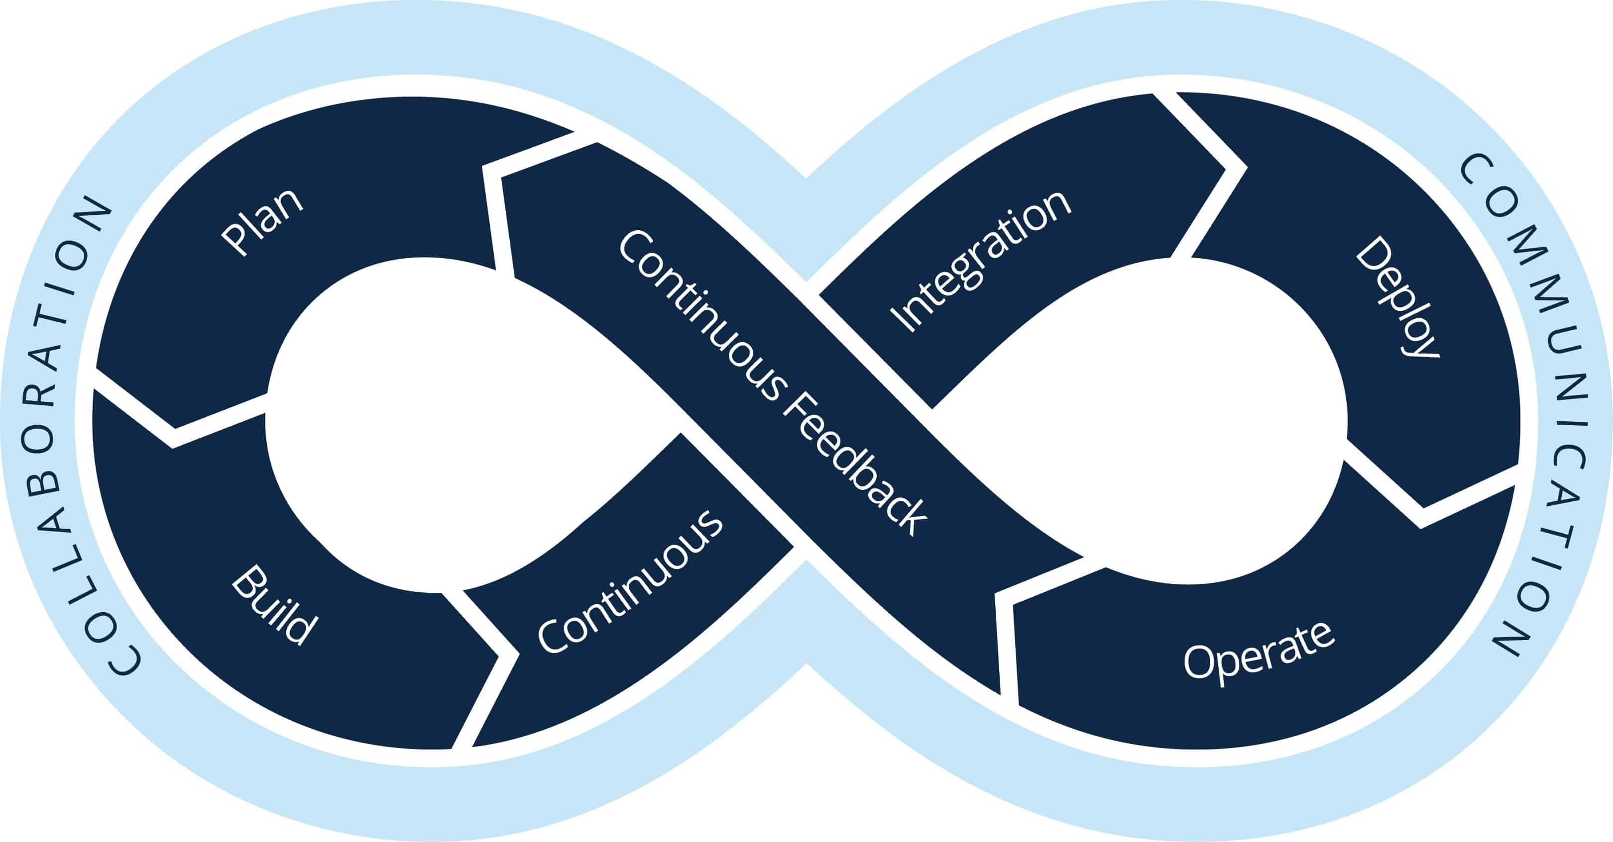

Slide 12
Companies like Google, Netflix, and Amazon demonstrated how to create value by leveraging internal software development and IT operations to innovate and rapidly respond to customer’s increasing demand for reliable, secure, and feature-rich applications

Slide 13
DevSecOps
DevSecOps—development, security, and operations—helps developers implement more robust security practices into the company’s development process
It integrates security as a shared responsibility across multiple IT departments
DevSecOps allows security vulnerabilities to be detected more quickly and efficiently

Slide 14
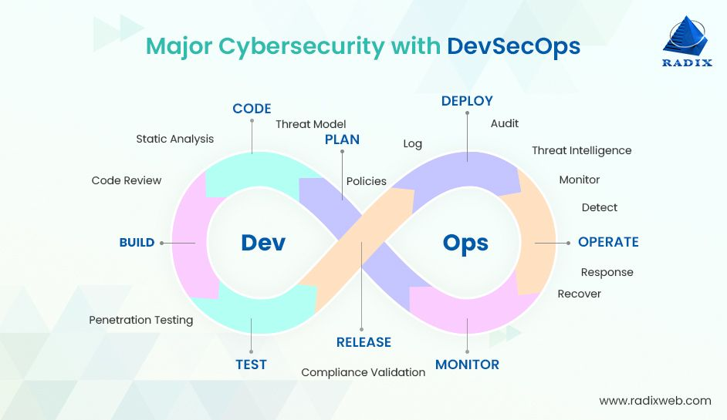

Slide 15
There are particular software tools designed to empower DevOps practices and processes
The technology stack of software tools used in DevOps environments is a toolchain
These include, but are not limited to the following:
Code repository
Build servers
Configuration management tools
Test automation

Slide 16
DevOps Dashboard
In DevOps, it’s critical to create an environment where everyone can see when and where the work in progress is not achieving business and customer goals.
Using dashboards that promote open communication and collaboration, you can measure and share critical data to keep feedback loops amplified and projects on track.
Azure DevOps Services | Microsoft Azure

Slide 17
Effectively implementing DevOps tools and practices to test, deploy, monitor, and modify the complex code and systems often requires a software architecture known as microservices.
Microservices
“the architectural pattern of composing a distributed application from separately deployable services that perform specific business functions and communicate over web interfaces.”
Working with small, reusable building blocks of code ensures that the application under development is not affected by the increase in the velocity of deployments in the DevOps environment
When implementing cloud-based microservice architecture at scale, tech leads often use containers to isolate, package, and deploy code.

Slide 18
Requirements
Requirements are
capabilities and
conditions
to which the system must conform
A prime challenge of requirements work is to
find,
communicate, and
remember/record
what is really needed, in a form clear to the client and development team

Slide 19
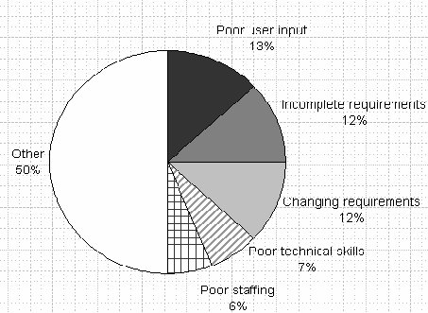
Importance
A study of factors on challenged projects revealed that 37% of factors related to problems with requirements
This makes requirements issues the largest single contributor to problems.
Consequently, masterful requirements management is important

Slide 20
Requirement Categorization
In the UP, requirements are categorized according to the FURPS+ model:
Functional—features, capabilities, security
Usability—human factors, help, documentation
Reliability—frequency of failure, recoverability, predictability
Performance—response times, throughput, accuracy, availability, resource usage.
Supportability—adaptability, maintainability, internationalization, configurability

Slide 21
Requirement Categorization
The "+" in FURPS+ indicates ancillary and sub-factors, such as:
Implementation—resource limitations, languages and tools, hardware
Interface—constraints imposed by interfacing with external systems
Operations—system management in its operational setting
Packaging
Legal—licensing and so forth

Slide 22
Requirement Categorization
Some of these requirements are collectively called the quality attributes, quality requirements, or the "-ilities" of a system.
These include usability, reliability, performance, and supportability.
In common usage, requirements are categorized as
Functional (behavioral)
Non-functional (everything else)

Slide 23
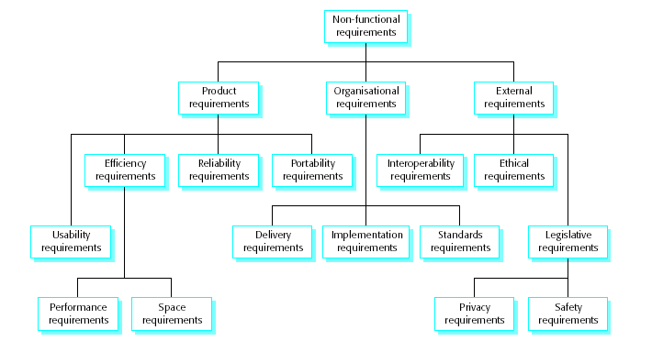
Non-Functional Requirements

Slide 24
Discovering Requirements - Use Cases
Use cases are often the central mechanism that is recommended for discovery and definition of requirements
Use case essence is
discovering and
recording
functional requirements by writing stories of using a system to help fulfill stakeholder goals; that is, cases of use
Use cases are requirements; primarily they are functional requirements that indicate what the system will do.
In terms of the FURPS+ requirements types, they emphasize the "F" (functional or behavioral)

Slide 25
Use Cases
They can also be used for other types, especially when those other types strongly relate to a use case.
To be clear: Use cases are requirements (although not all requirements)
Use cases are text documents, not diagrams, and use-case modeling is primarily an act of writing text, not drawing
However, the UML defines a use case diagram to illustrate the names of use cases and actors, and their relationships

Slide 26
Acceptance Tests
Acceptance tests describe the criteria by which stakeholders will determine whether the system meets their needs
Business rules, non-functional requirements, and usage requirements can be captured as acceptance tests
Acceptance tests are sometimes called "conditions of satisfaction“
Adapted from http://www.agilemodeling.com/artifacts/acceptanceTests.htm

Slide 27
Acceptance Test Template
Must include the following information
Brief description of what capabilities are being tested ("this test will verify that reserve seat functionality works as described in requirements XX, YY, ZZ")
Which requirements are being verified by this test
Test setup/pre-conditions
Test steps
Expected results

Slide 28
Acceptance Test Template
ID | T0014
Description | Checking accounts have an overdraft limit of $500. As long as there are sufficient funds (e.g. -$500 or greater) within a checking account after a withdrawal has been made the withdrawal will be allowed.
Setup | Create account 12345 with an initial balance of $50 Create account 67890 with an initial balance of $0
Instructions | Withdraw $200 from account #12345 Withdraw $350 from account #67890 Deposit $100 into account #12345 Withdraw $200 from account #67890 Withdraw $150 from account #67890 Withdraw $200 from account #12345 Deposit $50 into account #67890 Withdraw $100 from account #67890

Slide 29
Acceptance Test Template
Expected Results | Account #12345: Ending balance = -$250 $200 Withdrawal transaction posted against it $100 Deposit transaction posted against it $200 Withdrawal transaction posted against it Account #67890: Ending balance = -$500 $350 Withdrawal transaction posted against it $150 Withdrawal transaction posted against it $50 Deposit transaction posted against it Errors logged: Insufficient funds in Account #67890 (balance -$350) for $200 Withdrawal Insufficient funds in Account #67890 (balance -$450) for $100 Withdrawal

Slide 30
For usage testing, a simpler format may be followed
A [named user role] can [select/operate] [feature/function]

