Slide 1
Slide 1 Title
Slide 1 Subtitle

Slide 2
Slide 2: Title and Content
Bullet Point 1
Bullet Point 2
Sub-item A
Sub-sub-item I
Sub-sub-sub-item 1
Sub-sub item ii
Sub-item B
Bullet Point 3

Slide 3
Slide 3: Section header
Section header subtext

Slide 4
Slide 4: Two-Content
Left 1
Left 1A
Left 1Ai
Left 1Ai1
Left 1Aii
Left 1B
Left 2
Right 1
You get the rest

Slide 5
Slide 5: Comparison
Left Side
Right Side
Left 1
This is getting old
Yep, really really old

Slide 6
Ahh, just the title for Slide 6

Slide 8
Slide 8: Content w/Caption
This is the content
Blah
Blah
Blah
Blah
Blah
This is the caption text
You know how this goes

Slide 9
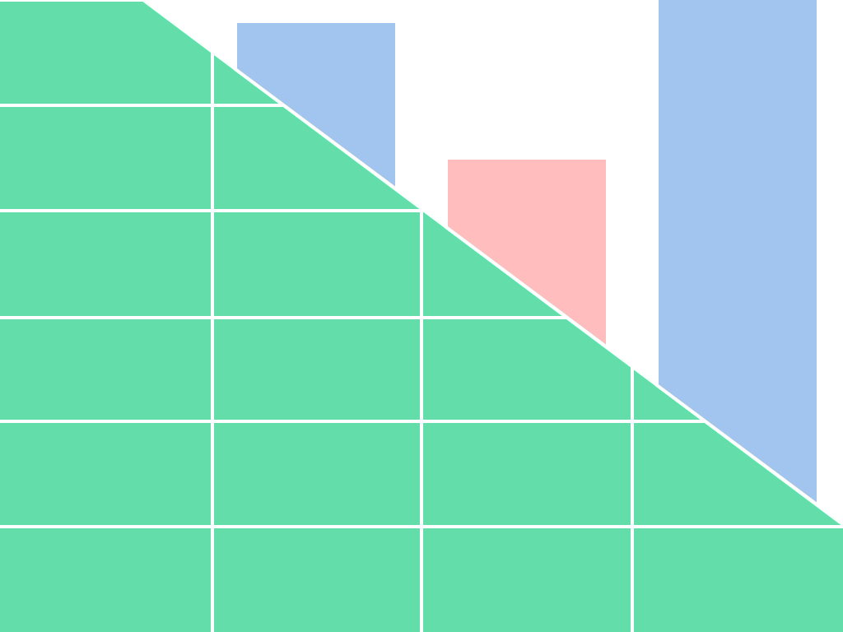
Slide 9: picture with caption
This is the SheetJS logo, cropped

Slide 10
Slide 10: Vertical Text
Who thought this would be a good idea?
Unfortunately the arrow keys act relative to the screen rather than the text
The entire input situation is confusing

Slide 11
Slide 11: Vertical Title and text
Maybe this is for people who decide to lie down on conference room tables?
… or maybe rotating the projector? That seems so barbaric

