Slide 1



Scalable network embedding LouvainNE: Hierarchical Louvain Method for High Quality and Scalable Network Embedding
Ayan Kumar Bhowmick¹, Koushik Meneni¹, Maximilien Danisch², Jean-Loup Guillaume³, and Bivas Mitra1
Department of CSE, Indian Institute of Technology, Kharagpur
Sorbonne Université, CNRS, LIP6, Paris, France
L3I, University of La Rochelle, France

Slide 2
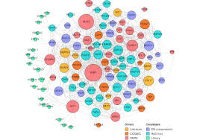
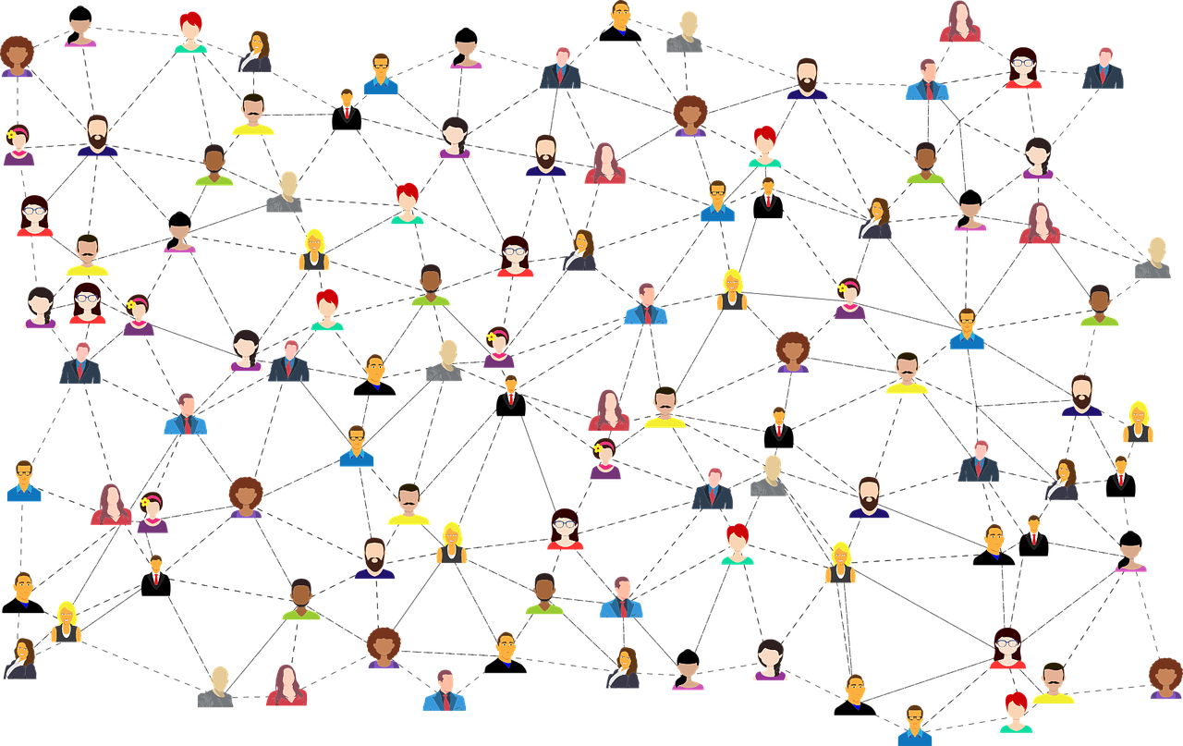

Network data is ubiquitous
Biology networks
Social networks
Information networks

Slide 3
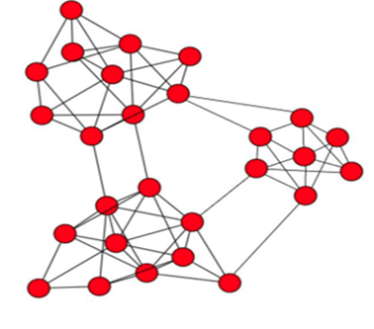
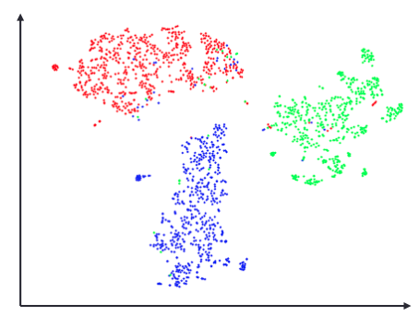
Network embedding = Low dimensional vector representation of nodes
Apply feature-based machine learning algorithms
Fast computing of nodes similarity
As compared to graph distances
Support parallel computing
Applications:
Link prediction
node classification
anomaly detection
network reconstruction....

Slide 4
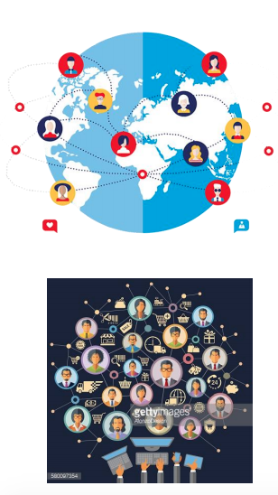
Challenge: Billion-scale network data
Social networks
WeChat: 1 billion monthly active users
Facebook: 2 billion active users
E-commerce networks
Amazon: 353 million products, 310 million users, billion orders/year
Citation networks
Aminer: 130 million authors, 233 million publications, 754 million citations
Challenge: design a (really) scalable network embedding method

Slide 5
existing literature
Domain
Random walk based approaches | Perozzi et al. (KDD’14), Yang et al. (IJCAI’15), Grover et al. (KDD’16), Pan et al. (IJCAI’16), Ribeiro et al. (KDD’17), Zhang et al. (ICDM’18)
Matrix factorization based approaches | Cao et al. (CIKM’15), Ou et al. (KDD’16), Wang et al. (AAAI’17), Huang et al. (WSDM’17), Qiu et al. (WWW’19), Zhang et al. (IJCAI’19)
Deep learning based approaches | Cao et al. (AAAI’16), Wang et al. (KDD’16)
Edge modeling approaches | Tang et al. (WWW’15), Wang et al. (CIKM’16), Wang et al. (AAAI’18)
Hybrid approaches | Yang et al. (ICML’16), Chen et al. (AAAI’18), Zhu et al. (WWW’19)
Hierarchical approaches | Chen et al. (AAAI’18), Ma et al. (KDD’18), Liang et al. (arXiv)

Slide 6
Limitations of existing literature
ProNE (IJCAI’19) – sparse matrix factorization
“we can project that it costs ProNE only ∼29 hours to embed a network of 0.1 billion nodes and 0.5 billion edges by using one thread, while it takes LINE over one week and may take DeepWalk/node2vec several months by using 20 threads”
High quality embedding but limited scaling
RandNE (ICDM’18) - iterative Gaussian random projection approach
“RandNE can boost the efficiency by more than 24 times over the baselines on all networks”
Very fast but quality can be compromised in some cases.
Original code in matlab (and a more recent version in python), we redeveloped it in C
Our goal: propose a network embedding method that:
Scales well for billion-scale graphs, even more than randNE
Preserves embedding quality for billion-scale graphs

Slide 7

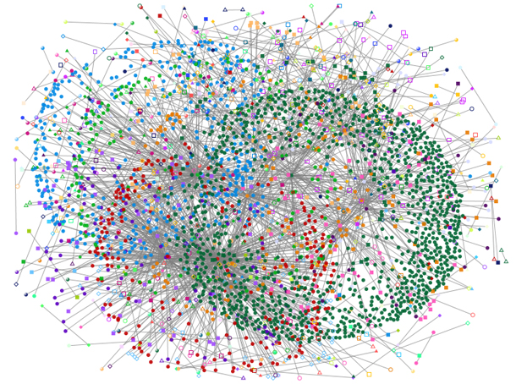
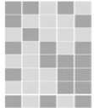
Problem statement
Develop LouvainNE, a fast and highly scalable network embedding framework
Use the notion of a hierarchy of communities
LouvainNE
Large-scale network
Low-dimensional embedding vectors

Slide 8
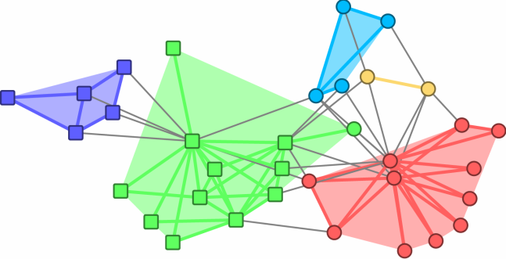
Community in networks: A brief idea
Community: A densely connected group of nodes → “Clique-ish”
Intuitively we want to maximize intra-community edges and minimize inter-community edges
Inter-community edge

Slide 9
Hierarchy of communities
Level 0
IIT Kharagpur

Slide 10
Hierarchy of communities
Level 0
IIT Kharagpur
Level 1
CSE
Electronics

Slide 11
Hierarchy of communities
Level 0
IIT Kharagpur
Level 1
CSE
Electronics
Level 2
Machine Learning
Signal processing
Antenna
Algorithms

Slide 12
Hierarchy of communities
“Clique-ishness”
increases
Level 0
IIT Kharagpur
Level 1
CSE
Electronics
Level 2
Machine Learning
Signal processing
Antenna
Algorithms

Slide 13
Community detection: A brief idea
A research subject with work for more than 20 years
Hundreds of solutions [Fortunato’10, Fortunato’16]
To have a fast embedding, it is necessary to have a fast and efficient community detection method
Label Propagation [Raghavan’07]
Louvain [Blondel’08]
Infomap [Rosvall’08]
Leiden [Traag’19]
Many other solutions could be used but scaling would no longer be possible
Santo Fortunato. Community detection in graphs. Physics Reports 486 (3–5), 2010, Pages 75-174.
Santo Fortunato, Darko Hric. Community detection in networks: A user aguide. Physics Reports 659, 2016, Pages 1-44.
Nandini Raghavan, Réka Albert, Soundar Kumara. Near Linear Time Algorithm to Detect Community Structures in Large-Scale Networks. Physical Review E 76:036106, 2007.
Vincent D Blondel, Jean-Loup Guillaume, Renaud Lambiotte and Etienne Lefebvre. Fast unfolding of communities in large networks. Journal of Statistical Mechanics: Theory and Experiment, Volume 2008, October 2008
Martin Rosvall and Carl T. Bergstrom. Maps of information flow reveal community structure in complex networks. PNAS 105, 1118 (2008)
Traag, V.A., Waltman, L. & van Eck, N.J. From Louvain to Leiden: guaranteeing well-connected communities. Sci Rep 9, 5233 (2019).

Slide 14
wHy Louvain?
Good partitions (in terms of quality)
Listed among the top algorithms in terms of quality of the solutions and the results achieved on benchmarks
Very fast
Only Leiden might be faster
Strong expertise
Developping the LouvainNE solution required a complete redevelopment of Louvain
https://github.com/jlguillaume/louvain
https://github.com/maxdan94/LouvainNE

Slide 15
Our approach to the solution
Rely on the “hierarchy” of communities in a network for
Scalable Network Embedding
Identify communities using Louvain Time complexity → “O(m)”

Slide 16
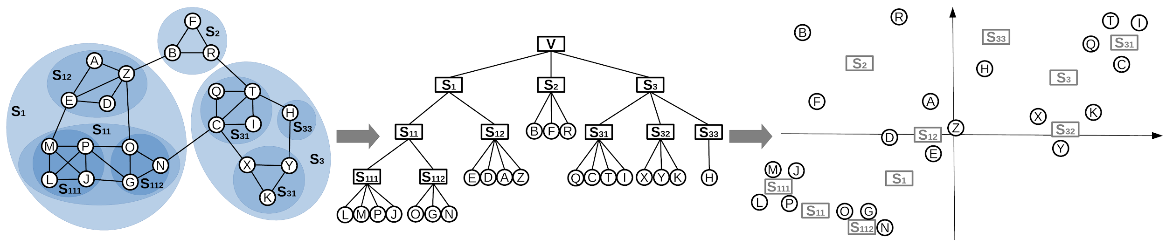
Proposal: Louvain network embedding (Louvain-NE)
Step 1
Step 2
Step 3
Hierarchy construction using Louvain Community Detection
Generating Embedding Vectors for nodes at each level of hierarchy
Combining Embedding Vectors of nodes at every level of hierarchy

Slide 17
Basic Steps involved in LouvainNE: A schematic
Our proposal is more a framework than a practical solution - all steps are generic
Any community detection can be used in step 1
The generation and combination of vectors can be done in different ways
Yet we implemented and compared several solutions
Hierarchy construction using Louvain Community Detection
Generating Embedding Vectors for nodes at each level of hierarchy
Combining Embedding Vectors of nodes at every level of hierarchy

Slide 18
Step 1
Hierarchical Clustering using Louvain

Slide 19
G₀₁
We compute communities as usual using any algorithm (i.e., Louvain)
LEVEL 0
Notes:
vc

Slide 20
G₀₁
We compute communities as usual using any algorithm (i.e., Louvain)
LEVEL 0
The subgraph induced by each community is then decomposed recursively
LEVEL 1
G¹₁₃
G¹₁₂
G¹₁₁
Notes:
vc

Slide 21
G₀₁
We compute communities as usual using any algorithm (i.e., Louvain)
LEVEL 0
The subgraph induced by each community is then decomposed recursively
LEVEL 1
G¹₁₃
G¹₁₂
G¹₁₁
The process stops when a community cannot be decomposed (or at a given depth)
LEVEL 2
G¹₂₂
G¹₂₁
Notes:
vc

Slide 22
G₀₁
We compute communities as usual using any algorithm (i.e., Louvain)
LEVEL 0
The subgraph induced by each community is then decomposed recursively
LEVEL 1
G¹₁₃
G¹₁₂
G¹₁₁
The process stops when a community cannot be decomposed (or at a given depth)
LEVEL 2
G¹₂₂
G¹₂₁
Notes:
vc

Slide 23
Step 2
Generating Node Embeddings at Each Level
(Stochastic Embedding)
Ignoring the inter-community edges

Slide 24
Stochastic
NE
LEVEL 0
G₀₁
Each metanode (community) and leaf is assigned a node embedding randomly
LEVEL 1
G¹₁₃
G¹₁₁
G¹₁₂
LEVEL 2
G¹₂₂
G¹₂₁
Notes:
vc

Slide 25
Stochastic
NE
LEVEL 0
G₀₁
Each metanode (community) and leaf is assigned a node embedding randomly
LEVEL 1
G¹₁₃
G¹₁₁
G¹₁₂
All nodes within a metanode at a specific level get the same embedding vector
LEVEL 2
G¹₂₂
G¹₂₁
Notes:
vc

Slide 26
Step 2 - smarter variant
Generating Node Embeddings at Each Level
(Standard Embedding)
Ignoring the inter-community edges

Slide 27
Standard
NE
LEVEL 0
G₀₁
Form a graph of metanodes:
Create meta-graphPresence of inter-community edges
Apply a state-of-the-art method
LEVEL 1
G¹₁₃
G¹₁₁
G¹₁₂
LEVEL 2
G¹₂₂
G¹₂₁
Notes:
vc

Slide 28
Standard
NE
LEVEL 0
G₀₁
Inter-community edges are colored
Form a graph of metanodes:
Presence of inter-community edges
Apply a state-of-the-art method
LEVEL 1
G¹₁₃
G¹₁₁
G¹₁₂
Standard embedding techniques such as:
Node2vec
Deepwalk
LEVEL 2
G¹₂₂
G¹₂₁
Notes:
vc

Slide 29
Step 3
Combining Node Embeddings Generated at Different Levels

Slide 30
Step 3
LEVEL 0
G₀₁
We have given higher weightage to the lower level network embeddings.
LEVEL 1
G¹₁₃
G¹₁₁
G¹₁₂
LEVEL 2
G¹₂₂
G¹₂₁
Notes:
vc

Slide 31
Step 3
LEVEL 0
G₀₁
We have given higher weightage to the lower level network embeddings.
Let the NE of the red marked node at any level l be y_{l}
To generate its one unique NE y we calculate:
y = 𝛼¹ y₁ + 𝛼² y₂ + 𝛼³ y₃
LEVEL 1
G¹₁₃
G¹₁₁
G¹₁₂
LEVEL 2
G¹₂₂
G¹₂₁
Notes:
vc

Slide 32
Step 3
LEVEL 0
G₀₁
We have given higher weightage to the lower level network embeddings.
Let the NE of the red marked node at any level l be y_{l}
Hence to generate its one unique NE y, we calculate:
y = 𝛼¹ y₁ + 𝛼² y₂ + 𝛼³ y₃
LEVEL 1
G¹₁₃
G¹₁₁
G¹₁₂
LEVEL 2
In general, we use:
y = 𝛼¹y₁+𝛼²y₂+𝛼³y₃+....+𝛼^{t}y_{l}
G¹₂₂
G¹₂₁
Notes:
vc

Slide 33
Time complexity of LouvainNE
Time taken for different steps:
Hierarchy construction step:
O(Louvain(G) x h) where h is height of the hierarchy tree LG
We assume that Louvain on a given graph takes no less time that Louvain on the set of induced subgraphs…
Step 2 (level specific embedding) and Step 3 (combining) together takes:
O(d.N)
If Louvain has a linear complexity = O(M) then
Overall time complexity : O(M.h+d.N)

Slide 34
Evaluation

Slide 35
Datasets
We use 6 real-world network datasets of different scales and parts of a larger one
Network | #Nodes | #Edges | Labels | Density
Blogcatalog [2] | 10312 | 333983 | 39 | 5.5e − 3
Youtube [3] | 1138499 | 2990443 | 47 | 4.6e − 6
Flickr [3] | 1715255 | 15555042 | 195 | 1.05e − 5
Twitter2009 [4] | 5.2 X 10⁷ | 2 X 10⁹ | - | 3e − 6
Friendster [5] | 1.2 X 10⁸ | 1.8 X 10⁹ | - | 2.5e − 7
Moliere [6] | 3 X 10⁷ | 3.3 X 10⁹ | - | 7.3e − 6
[2] [n.d.]. Dataset : BlogCatalog3. http://socialcomputing.asu.edu/datasets/BlogCatalog3
[3] [n.d.]. IMC 2007 Data Sets. http://socialnetworks.mpi-sws.org/data-imc2007.html
[4] Meeyoung Cha, Hamed Haddadi, Fabricio Benevenuto, and Krishna P. Gummadi. 2010. Measuring User Influence in Twitter: The Million Follower Fallacy. ICWSM.
[5] Jure Leskovec and Andrej Krevl. 2014. SNAP Datasets: Stanford Large Network Dataset Collection. http://snap.stanford.edu/data
[6] Justin Sybrandt, Michael Shtutman, and Ilya Safro. 2017. Moliere: Automatic biomedical hypothesis generation system. KDD, 1633–1642

Slide 36
Baseline algorithms
HARP: Meta-strategy [7] for embedding graphs preserving higher-order structural features and employs a hierarchical embedding approach
MILE: Developed a framework [8] similar to [7] where it scales up the performance of a standard embedding method even for large graphs using hybrid graph matching
RandNE: Gaussian random projection based approach [10] to learn embeddings, while preserving the higher-order proximities using an iterative projection procedure
NetSMF: Leverages spectral graph sparsification technique [11] to construct a matrix with significantly fewer non-zero entries to learn high quality node embeddings in a graph
ProNE: Fast and scalable network embedding framework [9], that leverages on spectral propagation to enhance the quality of embeddings
[7] Haochen Chen, Bryan Perozzi, Yifan Hu, and Steven Skiena. 2018. Harp: Hierarchical representation learning for networks. AAAI, 2127–2134
[8] Jiongqian Liang, Saket Gurukar, and Srinivasan Parthasarathy. 2018. MILE: A Multi-Level Framework for Scalable Graph Embedding. arXiv preprint (2018)
[9] Jie Zhang, Yuxiao Dong, Yan Wang, Jie Tang, and Ming Ding. 2019. ProNE: Fast and Scalable Network Representation Learning. IJCAI, 4278-4284
[10] Ziwei Zhang, Peng Cui, Haoyang Li, Xiao Wang, and Wenwu Zhu. 2018. Billion-scale Network Embedding with Iterative Random Projection. ICDM, 787–796
[11] Jiezhong Qiu, Yuxiao Dong, Hao Ma, Jian Li, Chi Wang, Kuansan Wang, and Jie Tang. 2019. Netsmf: Large-scale network embedding as sparse matrix factorization. WWW, 1509–1520

Slide 37
Experimental Evaluation
We evaluate the performance of LouvainNE against the state-of-the-art in 2 ways
Scalabity
Quality
Scalability
Compare the time taken to obtain embeddings on multiple datasets
Most embedding techniques do not really scale
Evaluation on downstream tasks - Validate the embedding quality
Network reconstruction
Multi-label classification

Slide 38
Scalability evaluation
Among baselines, only RandNE can scale to such massive-scale graphs
For LouvainNE we report the time to generate the hierarchy
RandNE execution time is linear in the dimension
 |  | d=128 |  | d=512
Network | Hierarchy | LouvainNE | RandNE | LouvainNE | RandNE
Twitter2009 | 1h 21m | 1h 57m | 5h 49m | 3h 47m | 22h 59m
Friendster | 2h 31m | 3h 17m | 11h 26m | 5h 36m | 45h 24m
MOLIERE | 4h 44m | 5h 5m | 17h 57m | 6h 10m | 71h 13m
Total execution time (in hours)
LouvainNE is 4-5 times faster than the fastest baseline RandNE for d = 128 (7-12 times for d = 512)
Hierarchy construction step takes significant part of overall running time of LouvainNE (~70% for d = 128)

Slide 39
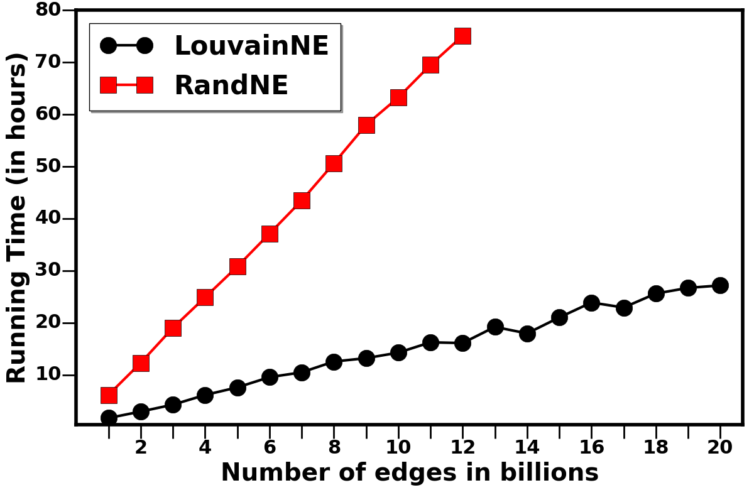
Scalability evaluation – what about larger graphs?
Now we evaluate LouvainNE as a function of M (the number of edges):
We used on a publicly available Twitter graph crawled in 2012 with 500M nodes and 20B edges
We sampled subgraphs of increasing sizes
Time (in hours)
Number of edges (in billions)
LouvainNE scales (empirically) linearly in the number of edges
LouvainNE is much faster than RandNE (which also scales linearly) for d = 128

Slide 40
Downstream task 1: Network reconstruction
Evaluate whether learned embedding vectors of LouvainNE can reconstruct the graph G
Idea: vectors of connected node pairs (link) should be more similar than vectors of non-connected node pairs (no link)
We use AUC and precision@k

Slide 41
Downstream task 1: Network reconstruction
AUC scores: Probability that a randomly selected node pair connected by edge is more similar than a disconnected pair
Network | HARP | RandNE | MILE | NetSMF | ProNE | LouvainNE
Blogcatalog | 0.733 | 0.712 | 0.702 | 0.725 | 0.747 | 0.683
Youtube | 0.883 | 0.818 | 0.907 | 0.932 | 0.917 | 0.939
Flickr | 0.806 | 0.797 | 0.899 | 0.902 | 0.913 | 0.908
AUC scores of network reconstruction
LouvainNE has comparable performance to the best performing baseline i.e. ProNE
LouvainNE outperforms all other baselines for large-scale networks like Youtube and Flickr

Slide 42
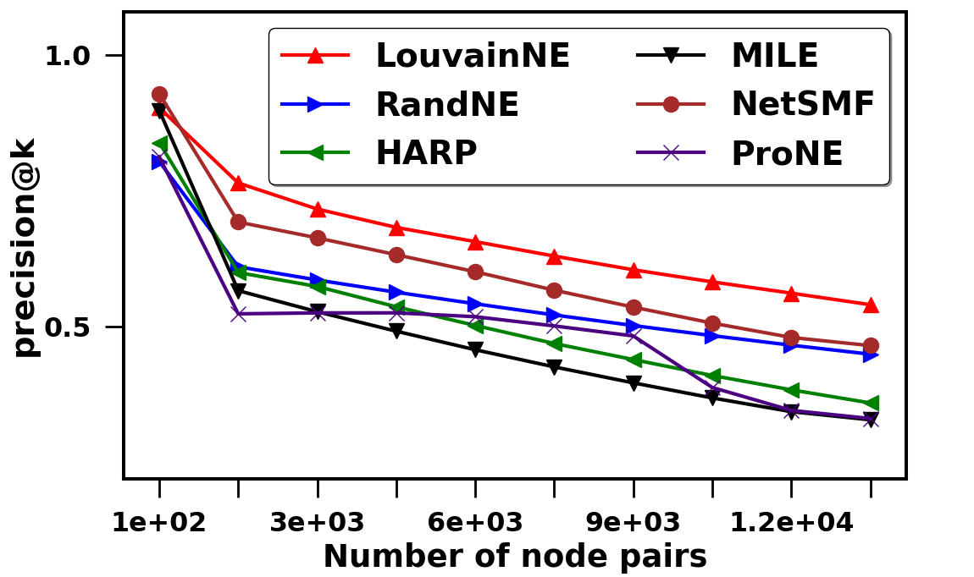
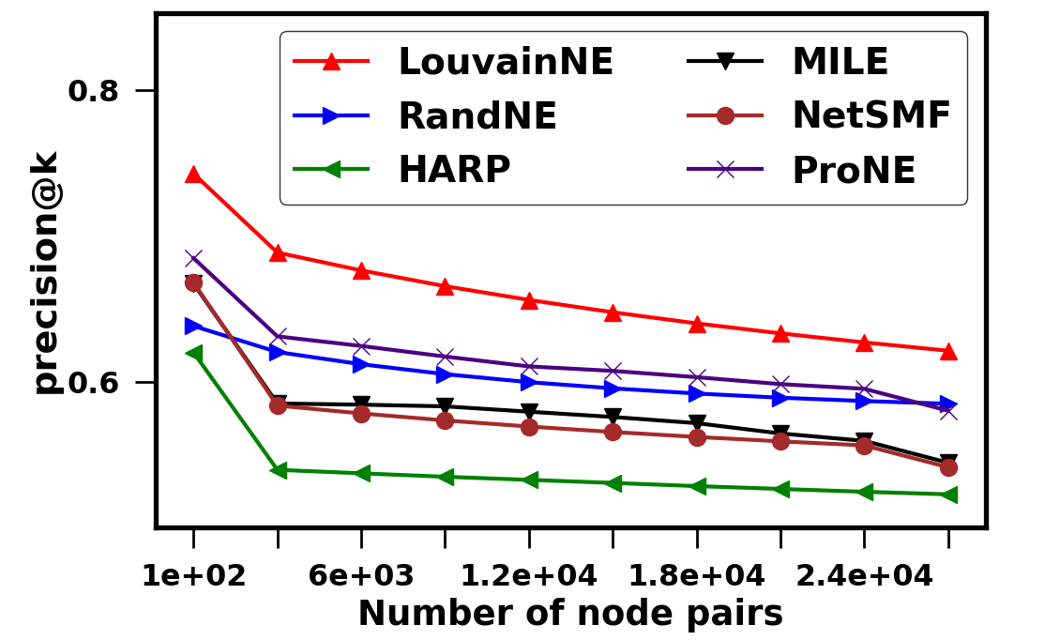
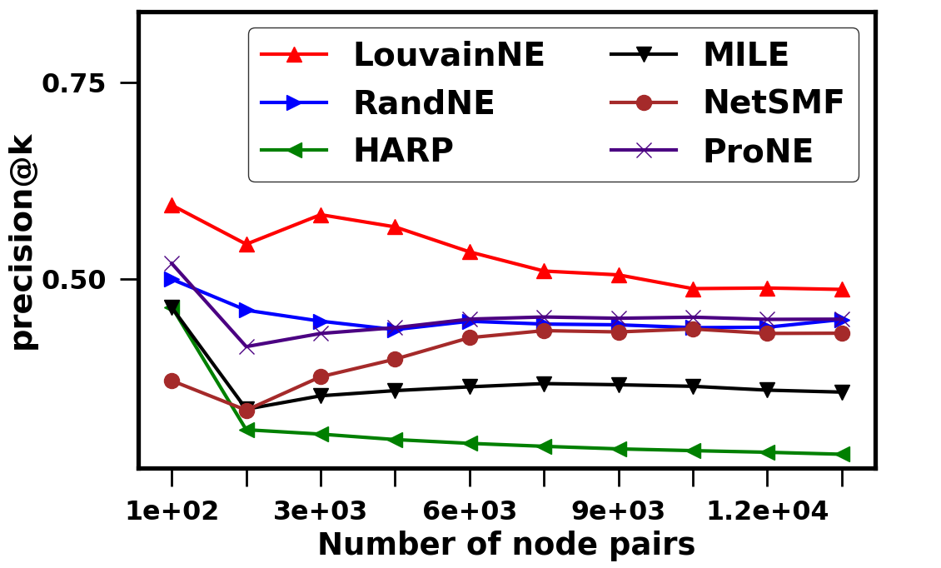
Downstream task 1: Network reconstruction
precision@k: Fraction of edges in Top-k most similar node pairs in terms of learned embedding vectors
Blogcatalog
Youtube
Flickr
precision@k
precision@k
precision@k
k
k
k
LouvainNE outperforms all baselines in terms of precision@k though ProNE performs comparably
LouvainNE preserves pairwise neighborhood relationships in embedding space

Slide 43
Downstream task 2: Multi-label classification
Evaluate whether learned embedding vectors of LouvainNE can help classify nodes
Apply the generated embedding vectors as features in a supervised learning framework
Classify a node into corresponding ground truth label(s)
Multi-label classifier trained on Logistic Regression model
Micro-F1 scores reported
We only apply it on network with a labelled ground-truth…
Network | #Nodes | #Edges | Labels | Density
Blogcatalog [2] | 10312 | 333983 | 39 | 5.5e − 3
Youtube [3] | 1138499 | 2990443 | 47 | 4.6e − 6
Flickr [3] | 1715255 | 15555042 | 195 | 1.05e − 5

Slide 44
Downstream task 2: Multi-label classification
Multi-label classifier trained on Logistic Regression model and Micro-F1 scores reported
Network | HARP | RandNE | MILE | NetSMF | ProNE | LouvainNE
Blogcatalog | 0.316 | 0.308 | 0.264 | 0.334 | 0.323 | 0.306
Youtube | 0.305 | 0.303 | 0.304 | 0.307 | 0.296 | 0.307
Flickr | 0.384 | 0.385 | 0.386 | 0.356 | 0.361 | 0.389
Micro-F1 scores of node classification
LouvainNE outperforms all baselines for large-scale networks of Youtube and Flickr
LouvainNE gives inferior performance to NetSMF and ProNE for moderate-scale Blogcatalog network

Slide 45
Performance of Louvain-NE variants
We implement following variations by modifying level specific embedding step
Stochastic embedding
Standard embedding - We use node2vec and DeepWalk as the embedding technique
Network | Stochastic | Standard (node2vec) | Standard (DeepWalk)
Blogcatalog | 0.683 | 0.691 | 0.695
Youtube | 0.939 | 0.923 | 0.925
Network | Stochastic | Standard (node2vec) | Standard (DeepWalk)
Blogcatalog | 0.306 | 0.311 | 0.314
Youtube | 0.307 | 0.305 | 0.305
AUC scores of network reconstruction
Micro-F1 scores of node classification
Stochastic embedding is the best performing variant of LouvainNE for large-scale Youtube network
Standard embedding (based on DeepWalk) is the best performing variant for moderate-scale Blogcatalog network

Slide 46
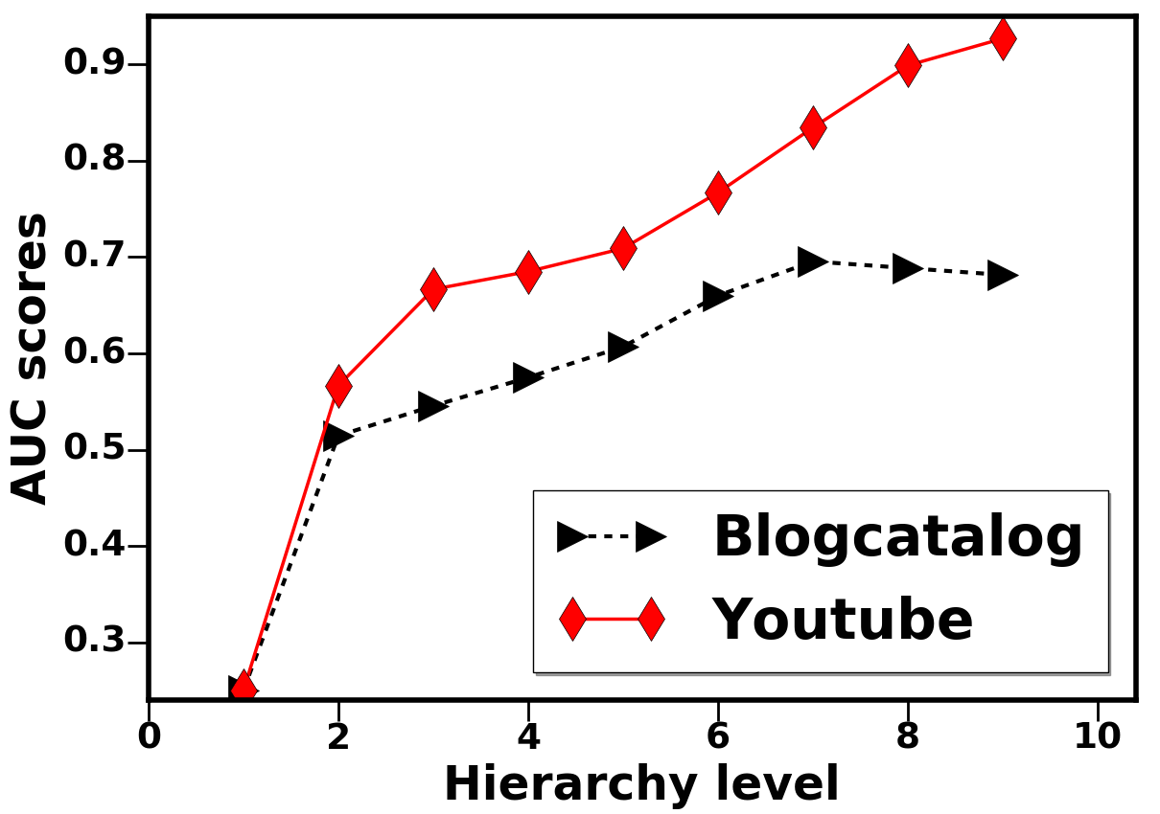
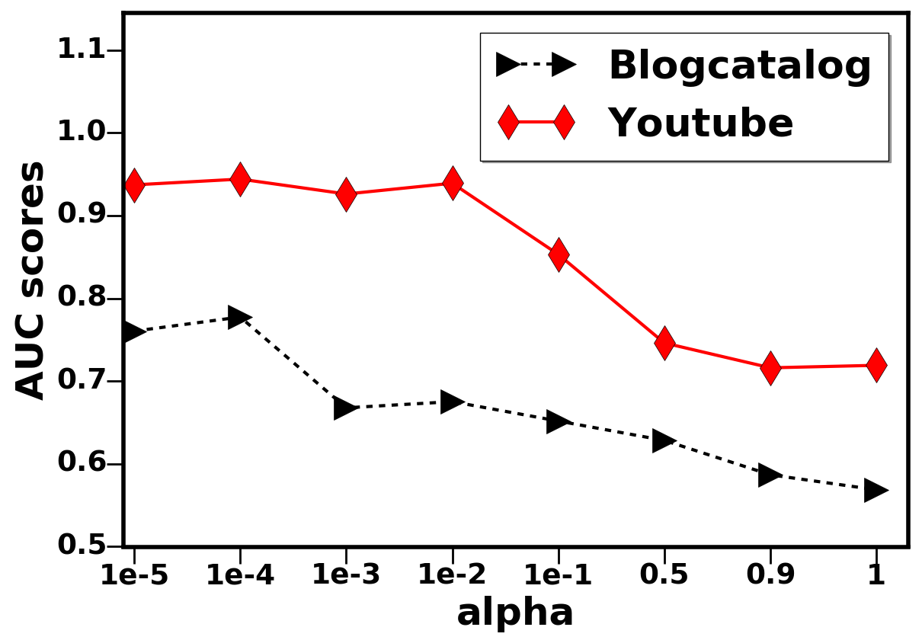
Effect of parameter tuning
Evaluate the impact of varying the following parameters on the performance of LouvainNE
Number of levels of hierarchy tree LG in the range 1 to the maximum depth
Value of 𝛼 in the range [0.00001,1] while combining in Step 3 of LouvainNE
AUC
AUC
Maximum depth
𝛼
Quality increases (distinguish neighbors and non-neighbors inside a community) with increase in the level of L_{G}
Lower values of 𝛼 help to preserve neighborhood relation and similarity between node pairs inside a community

Slide 47
Conclusion
Proposed a fast and scalable embedding framework relying on community hierarchy
Used the Louvain algorithm for fast construction of hierarchy of subgraphs
Proposed model is flexible
Level specific embedding step can accommodate multiple embedding techniques
Evaluated the model on several real-world networks of different scales
Our model is very fast and scales linearly with number of links even for massive-scale graphs
Validated quality of generated embeddings on multiple downstream tasks

Slide 48
Future work
Evaluate on more variants
Other community detection algorithms (those whose scale + consensus)
Compare different embeddings with the same technique
Embed in hyperbolic space?

Slide 49
Questions?
Code: https://github.com/maxdan94/LouvainNE

