Slide 1

Python Fundamentals
1. Getting started

Slide 2
Getting Started - Objectives
What is Python
Why learn and use Python
How is Python managed
How to Install Python
Python IDLE
How to run Python programs
How does Python run your program
How to Install PyCharm
Other Resources

Slide 3
What is Python
Python was created by Guido Van Rossum year 1991
Python is an interpreted high level programming language for general purpose programming
Programming language is formal language which allows programmer to write specific instructions to be executed on computer.
Term ‘Python’ is also used for a software program called interpreter
Python interpreter is the program which reads, evaluates and executes instructions written using python programming language
Python interpreter is started by typing python on command prompt after python install
Notes:
Default Python implementation of Python in Cpython
High level programming language is which uses natural language element
interpreter is a program that executes other programs.

Slide 4
Why learn and use Python
Easy to learn, yet extremely powerful
Simple syntax
Advanced data structure
Software Quality
Easy to read/maintain code
Forces code indentations as per design
Developer productivity
No compile time
Lesser code in comparison to Java/C++
Strong support
Large collection of standard libraries
Strong community support
General purpose
Used for multipurpose e.g. automation/monitoring etc.

Slide 5
How is Python managed
Python Software Foundation (PSF) manages and oversees the development and roadmap for Python development
PSF is a non-profit organization which also organizes conferences and deals with intellectual property issues.
These conferences are called PyCon, and are organized in all major cities in the world

Slide 6
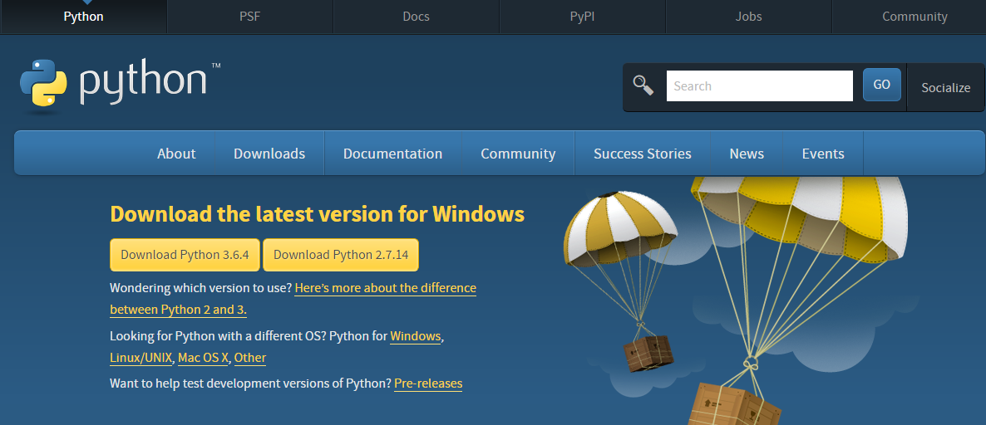
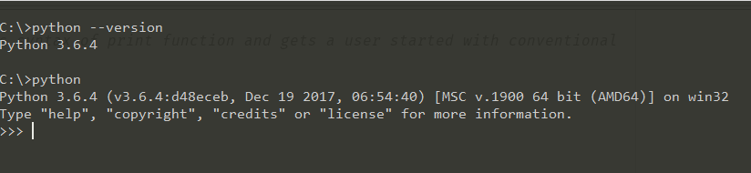
How to install Python
Python can be downloaded and installed from standard installers which are available on Python official website.
https://www.python.org/downloads/
You can get choose from various installers depending on the operating system and version you want to install.
Once the installer has finished the setup you can verify if the python is installed by typing the below command on the command prompt or terminal of your operating system
$ python --version
This will confirm if the python is installed and displays the version of the Python installed on your machine.

Slide 7
Python IDLE
Python IDLE(Integrated Development and Learning Environment) is installed as part of Python installation
IDLE is equivalent of command prompt in windows and terminal session in Linux/Mac environment.
On Windows you can find IDLE in Start button menu for Python after Python install
You can execute python statements in IDLE
Its also known as REPL (R-Read E-evaluate P-Print L-Loop)
Its similar to Python prompt with added features like auto-indent, code completion , code highlighting etc.
Other available IDE are PyCharm, PyDev, Spyder, Eclipse etc
We will use PyCharm through out this course for writing python programs

Slide 8
How to run Python program
You can run your python code interactively or via a python file
You can execute python statements interactively on python prompt or using IDLE
To start an interactive session type python at your operating system’s prompt
Ensure that directory where python is installed is added to your system path
When you see >>> prompt you are in Python’s interactive session
Code typed on python interactive prompt is never stored; lost after execution
For saving your code, you need to write the code in a text file and save this file
Code files are saved with extension “.py”. These are also called modules or programs
Python modules or programs can be run with the same python command and by providing the module name(along with extension)
e.g. python myprogram.py
Myprogram.py is the name of the file you created which contains the python code to be executed.

Slide 9
How Python runs the program
Python first complies your source code in to byte code.
Byte code runs faster than text statements in your python file
Byte code is stored in a file .pyc, if python has write access to your machine
In Python 3.2 and later byte code is stored in __pycache__ directory. File name aslo has the python version which created the byte code.
When you run the program second time, python directly loads the .pyc file and skip the compilation if:
Source code is not changed since the last compilation time
Python version is the same with which the byte code file was created
Source Code
Byte Code
Python Virtual Environment
Compilation
Execution
Notes:
Byte code is created and destroyed in memory if python does not have write permission on your os.
Byte code is only created and stored for modules that are imported not for files which are run directly.

Slide 10
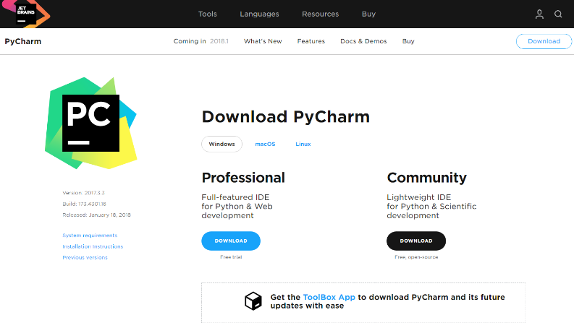
PyCharm – How to install
PyCharm is a complete IDE from JetBrains
PyCharm has a commercial (paid) and community(free) variant.
Besides Windows or Mac OS you can also install PyCharm on Linux Desktop
Installer can be downloaded from https://www.jetbrains.com/pycharm/download/
Double click on the installer and follow the instructions to complete the installation
Once installed you can find PyCharm under Start Menu -> All Programs -> Jet Brains -> PyCharm
Alternatively you can also download JetBrains Toolbox for other products e.g. IntelliJ

Slide 11
Python – Other Resources
Python Official documentation is a great source @ https://www.python.org/doc/
Python Tutor Mailing Lists @ http://www.python.org/mailman/listinfo/tutor
Github Repository for the tutorial https://github.com/quantfineart/Fundamental-Python-Tutorial

