Slide 1
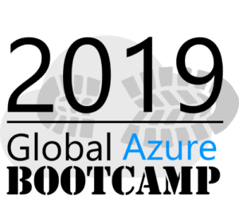


Azure Functions
Azure Functions
Grzegorz Jońca

Slide 2




Azure Functions
2+ lat doświadczenia jako programista .NET
Entuzjasta SCRUMa, zwinności i Ejżura
Trener w Software Development Academy
Po pracy: wspinaczka, bieganie, góry
devmonte
@devgrzegorz
greg.jonca@gmail.com

Slide 3
Azure Functions
Agenda
Let’s start with practice!
What is Serverless?
Azure Functions – a bit of theory!
Let’s make more functions!
What next?

Slide 4
Azure Functions
Let’s start with practice!
https://docs.microsoft.com/learn/paths/create-serverless-applications/
https://portal.azure.com

Slide 5
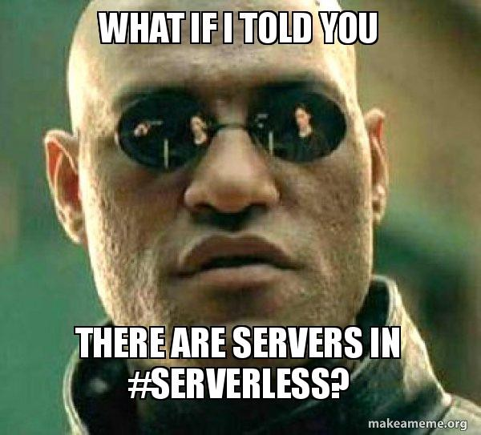
Azure Functions

Slide 6
Azure Functions
Serverless
Serverless compute can be thought of as a function as a service (FaaS), or a microservice that is hosted on a cloud platform. Your business logic runs as functions and you don't have to manually provision or scale infrastructure. The cloud provider manages infrastructure. Your app is automatically scaled out or down depending on load.
https://docs.microsoft.com/en-us/learn/modules/create-serverless-logic-with-azure-functions/2-decide-if-serverless-computing-is-right-for-your-business-need

Slide 7
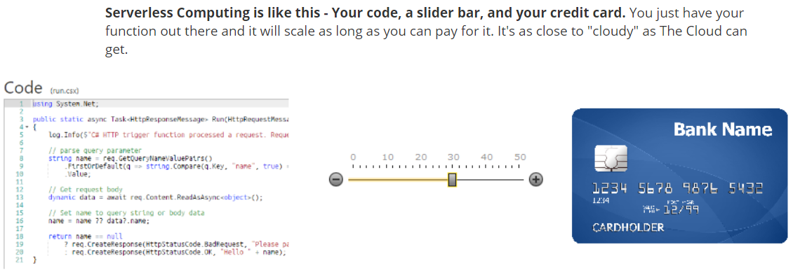
Azure Functions
https://www.hanselman.com/blog/WhatIsServerlessComputingExploringAzureFunctions.aspx

Slide 8
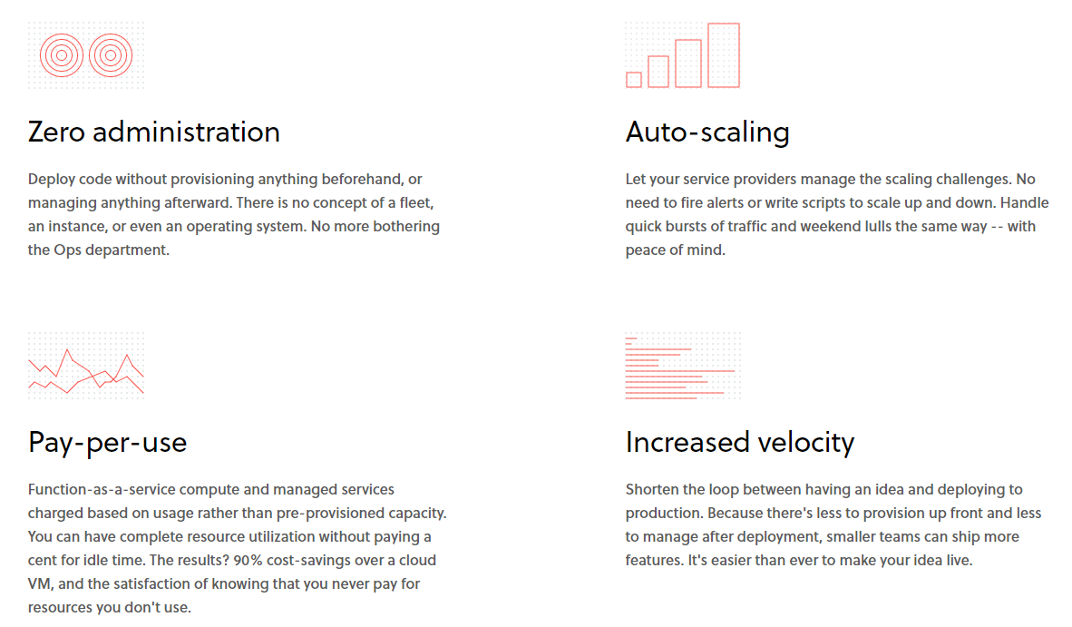
Azure Functions
https://serverless.com/learn/overview/

Slide 9
Azure Functions
Azure Functions
Benefits:
Avoids over-allocation of infrastructure
Can be used in traditional compute environments
Pay-per-use pricing model
Integrated security
Simplified integration
Open-source
Drawbacks:
Limited execution time (5-10, 2.5 for HTTP)
Execution frequency
Notes:
https://docs.microsoft.com/en-us/learn/modules/create-serverless-logic-with-azure-functions/2-decide-if-serverless-computing-is-right-for-your-business-need

Slide 10
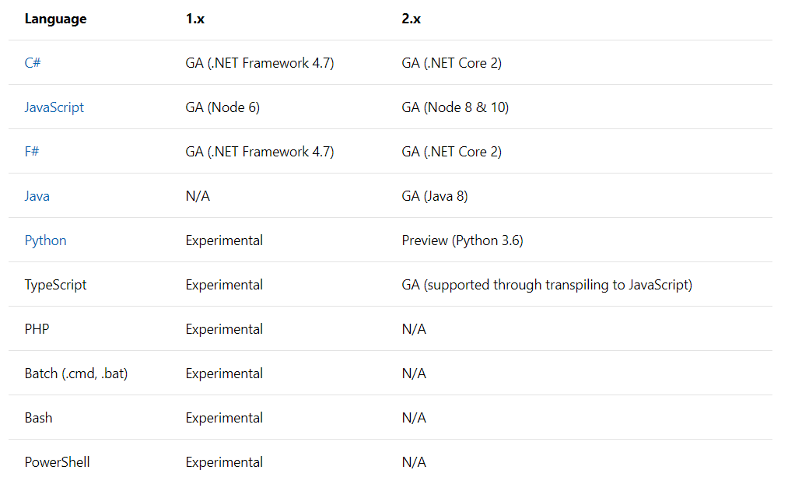
Azure Functions – supported languages
https://docs.microsoft.com/en-us/azure/azure-functions/functions-versions

Slide 11
Azure Functions
Azure Functions
Stateless logic
Event driven
Function App
Service plan:
Consumption
Azure App(technically not a serverless)
Storage Account

Slide 12
Azure Functions
Azure Functions
Triggers
HTTP
Event Grid
Blob Storage
Service Bus
Timer
etc.
Bindings
Blob Storage
Cosmos DB
Event Hubs
Service Bus
SignalR <3
Twilio
etc.
Unlike a trigger, a function can have multiple input and output bindings.
https://docs.microsoft.com/en-us/azure/azure-functions/functions-triggers-bindings#supported-bindings
Notes:
https://docs.microsoft.com/en-us/azure/azure-functions/functions-triggers-bindings#supported-bindings – pełna lista

Slide 13
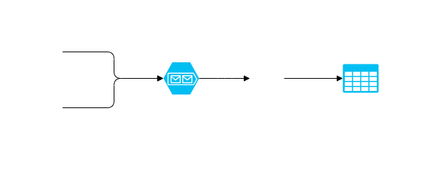
Azure Functions
Let’s back to portal and write more functions!
https://github.com/devmonte/azure-functions-workshop

Slide 14







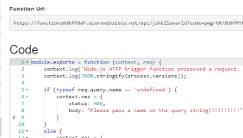





Azure Functions
1) Trigger
2) Input Binding
3) Develop
4) Execute
5) Output Binding
Web
Hooks
App Services
Hosting Plans
Azure Services
Azure Services
Azure Services
7) Develop Locally
6) Monitor and Improve
https://www.slideshare.net/kaluzaaa/serverless-w-azure-czyli-azure-functions

Slide 15
Azure Functions
Run Azure Functions locally!
Azure Functions Core Tools
https://github.com/Azure/azure-functions-core-tools

Slide 16
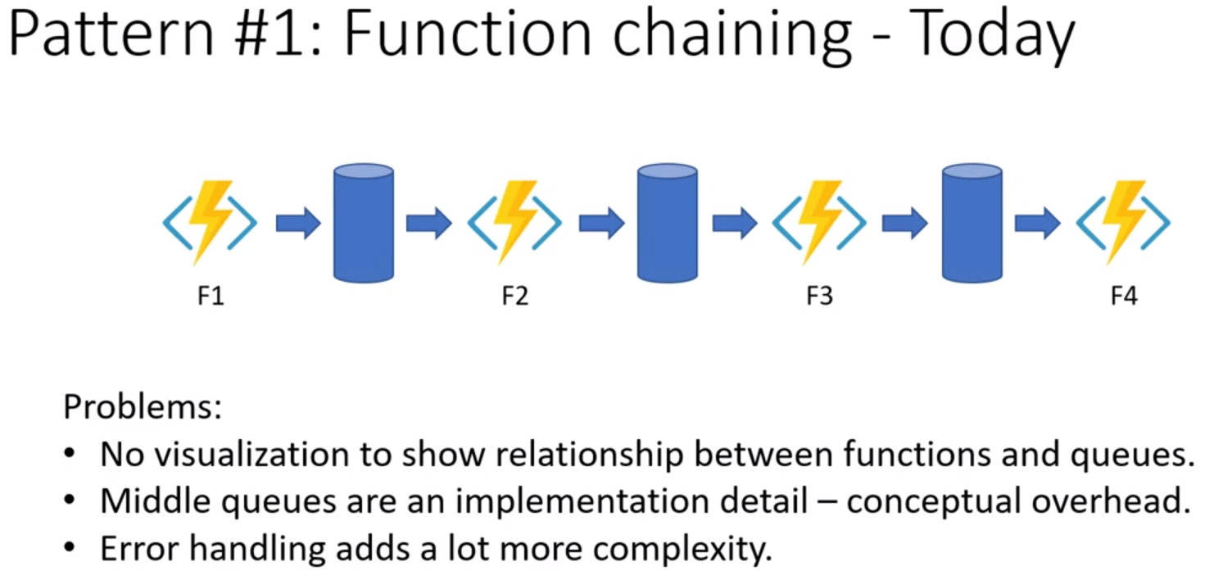
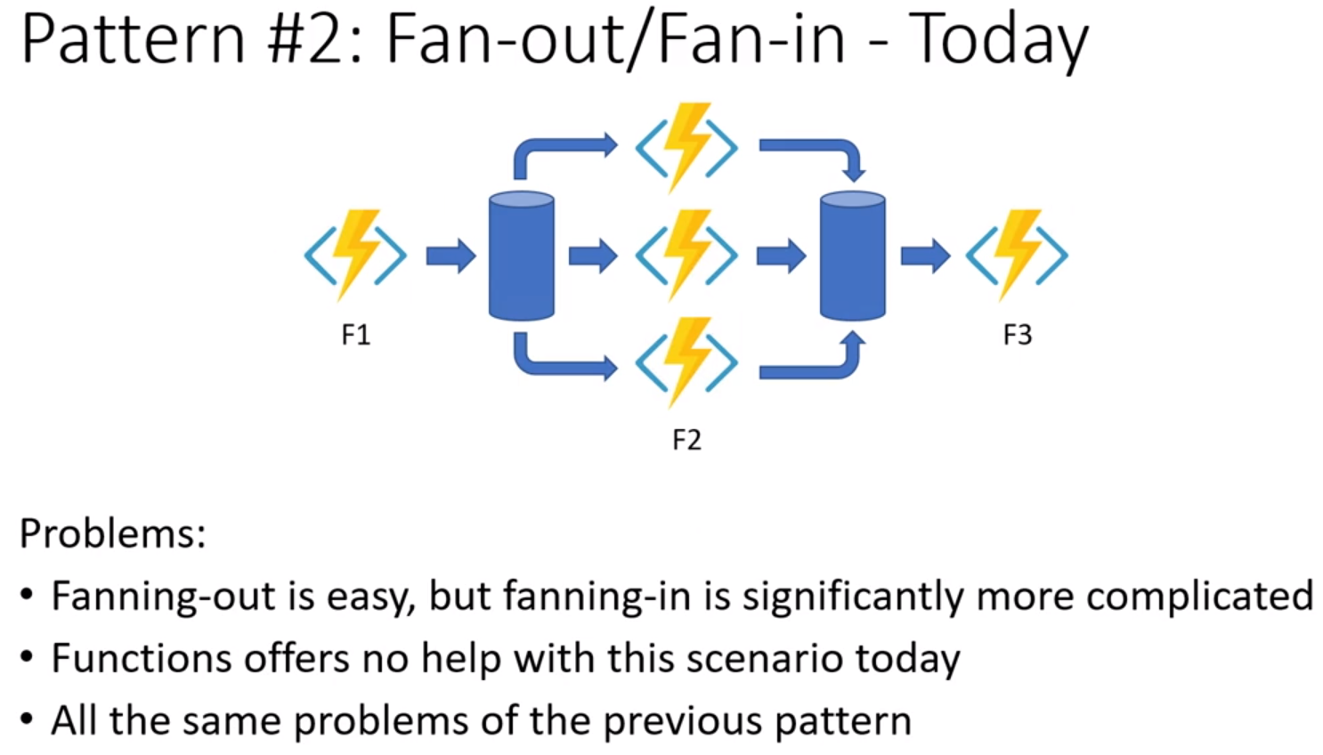
Azure Functions -> Durable Functions
Durable Functions are an extension of Azure Functions that lets you write stateful functions in a serverless environment. The extension manages state, checkpoints, and restarts for you.
https://docs.microsoft.com/en-us/azure/azure-functions/durable/durable-functions-overview

Slide 17
Azure Functions – what next?
Microsoft Learn
https://docs.microsoft.com/en-us/learn/paths/create-serverless-applications/
Pluralsight
https://app.pluralsight.com/library/courses/azure-functions-fundamentals
Docs
https://docs.microsoft.com/en-us/azure/azure-functions/

