Slide 1
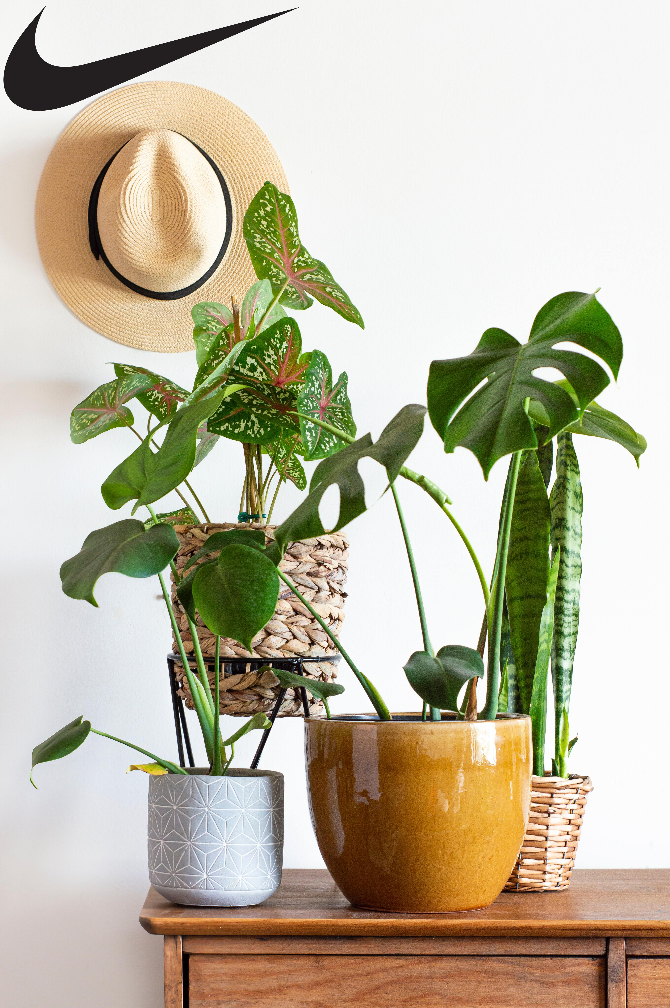
Home Assignment
Image 1

