Slide 1
PDA-Based HTML/XML Validator
Theory of Computation (CSC720) Class Project on
Nabin Bhandari nabin.bhandari@trojans.dsu.edu Student ID: 101213073

Slide 2
Introduction
A validator that checks if HTML/XML code is well-formed
Uses Pushdown Automata (PDA) logic to simulate nesting validation

Slide 3
Pushdown Automaton (PDA)
A Pushdown Automaton (PDA) is a computational model used to recognize context-free languages.
It extends a finite automaton with a stack implementation, which allows it to handle nested structures used in HTML/XML tags.
PDA is simulated in Python programming language to track opening and closing tags using stack operations.

Slide 4
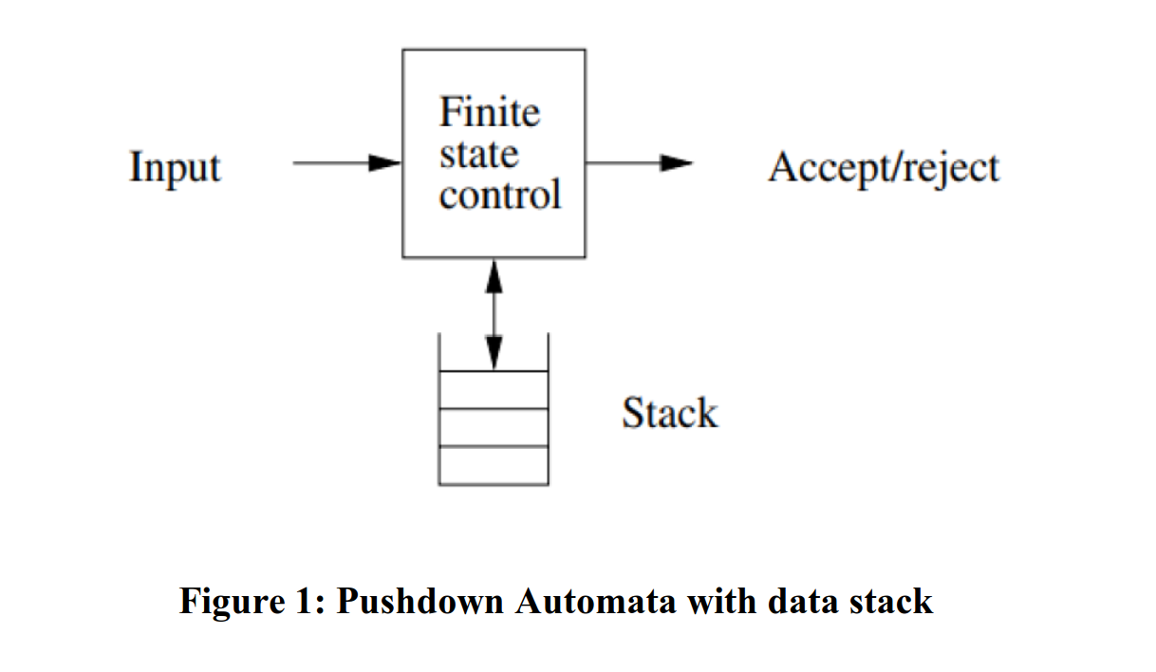
PDA with Data Stack

Slide 5
Objective
Demonstrate how PDA can be used to validate structured documents
Show application of context-free grammar and PDA concepts from Theory of Computation
Build a real Python tool that simulates theoretical automata behavior

Slide 6
Real-world relevance
Web development tools, configuration file validation

Slide 7

Theoretical Aspect
HTML/XML is a context-free language
PDA uses a stack to match nested tags
Deterministic PDA (DPDA) is simulated in code

Slide 8
Project Approach
Tokenize input using regex
1
Classify tags: open, close, self-close
2
Use stack to push/pop tags
3
Show detailed errors if structure breaks
4
Accept if stack is empty at end
5

Slide 9
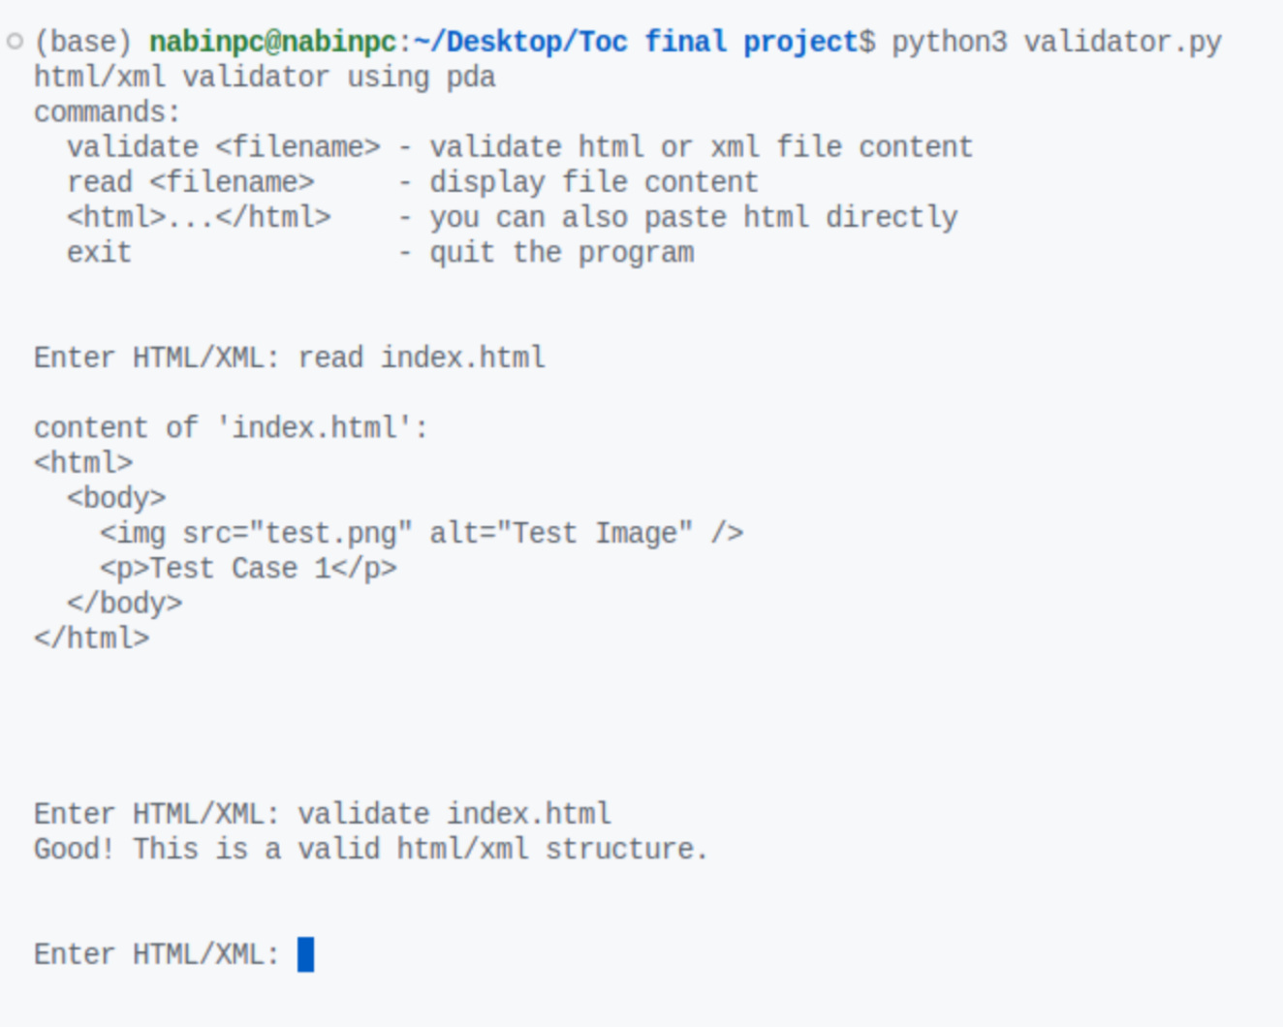
Project CLI Interface for file based validation

Slide 10
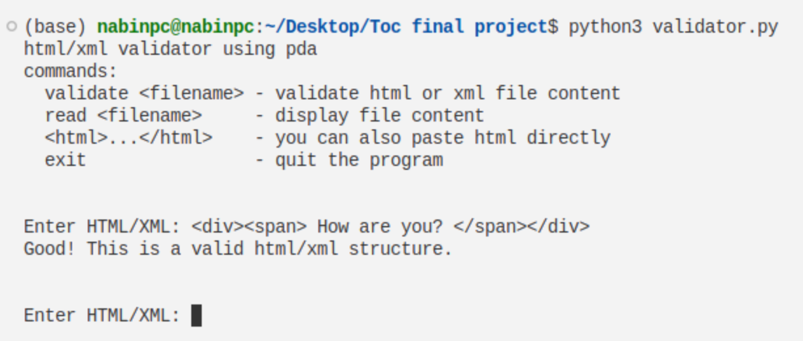
Project CLI Interface for direct data validation

Slide 11
Example
Example 1
Input: <div><p>Hello</p></div>
Stack: push div, push p, pop p, pop div
Result: valid
Example 1
Input: <div><p></div></p>
Stack error: mismatched pop
Result: invalid

Slide 12
Features Implemented
PDA simulation in Python
CLI for file and raw input
Error diagnostics with tag index
Commands: read, validate, exit

Slide 13
Results and Testing
Multiple valid/invalid examples tested
Accurate mismatch detection
Works with nested, self-closing, and unbalanced tags

Slide 14
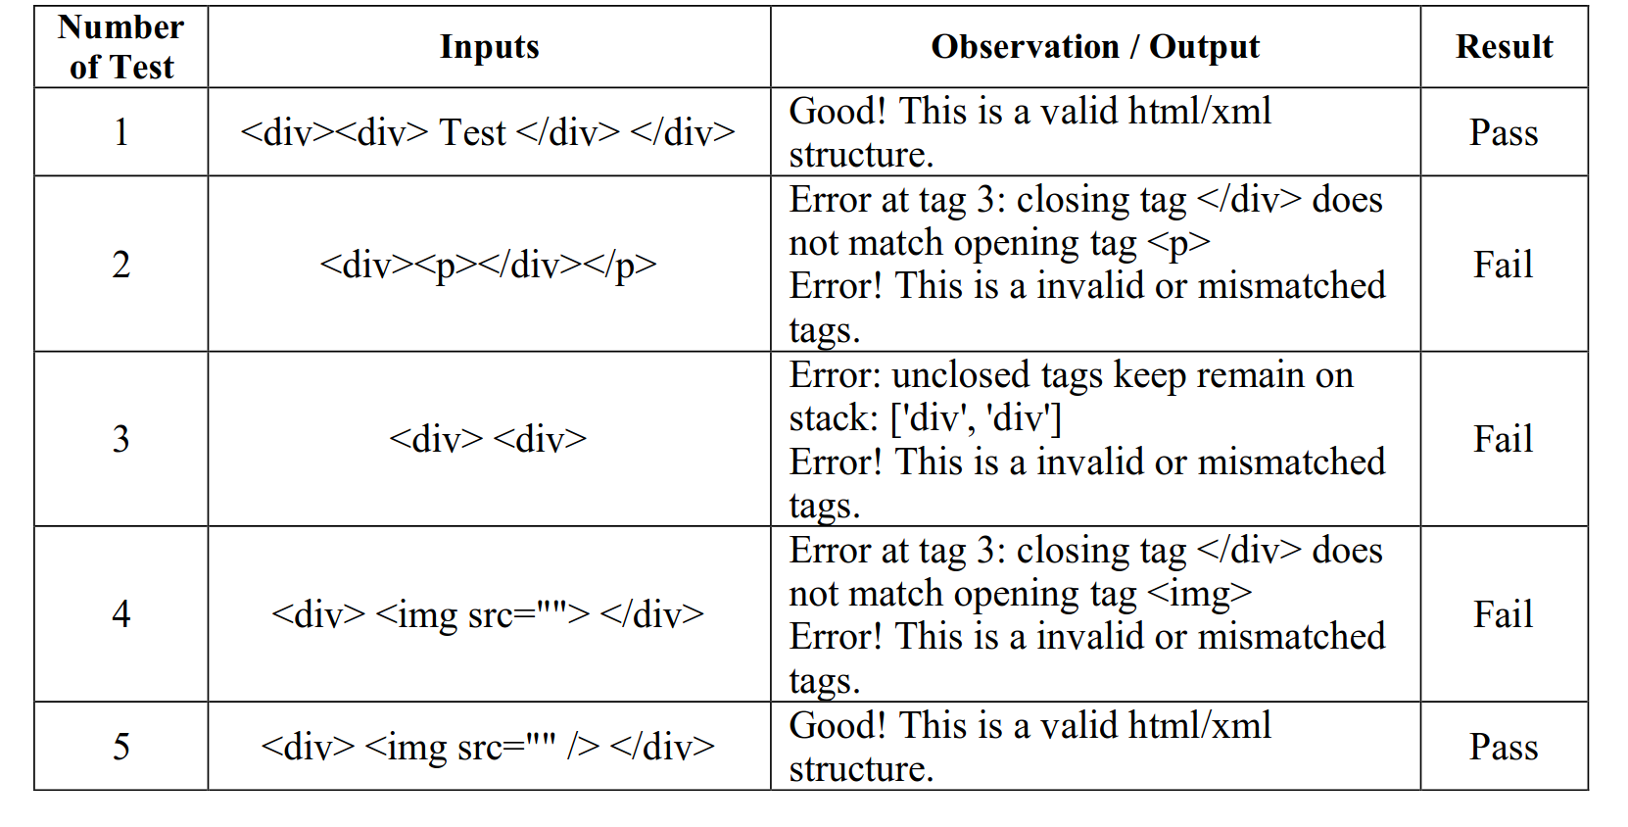
Test Cases

Slide 15
Future Enhancements
Stack visualization during execution
GUI or web-based interface
CFG parsing and deeper HTML grammar support

Slide 16
Conclusion
Demonstrates PDA in real-world format parsing
Applies TOC to a practical and useful tool
Bridges theory and implementation

Slide 17

Want to contribute !
Project link:
https://github.com/devnabin/TocFinalProject

Slide 18
Thank you.

