Slide 1

Bhaktapur Multiple Campus
Affiliated to TU
Department of computer Science and information Technology
Dudhpati, Bhaktapur
A project on
Job Station
A Job Recommendation System
Presented by:
1. Nabin Bhandari[20246/075]
2. Chetan Budhathoki[20232/075]
2. Bimal Shrestha[20227/075]
Date: 2080/02/01

Slide 2
Table of Content
Introduction
Problem statement
Objective
Scope and Limitation
Requirement Analysis
Process Model:
Dataflow Diagram
Flow Chart
ER Diagram
Implementation tool
Testing
Conclusion
Future Remediation

Slide 3
We all need jobs. It’s even better when somebody recommends jobs for us, so why not job station?

Slide 4
It is a platform where job seeker can seek, find and apply for jobs, at the same time job employer can post jobs.
Introduction

Slide 5
Countinue..
Easy procedure for both job seeker and employer.
Job seeker can search for jobs manually. Also, the system itself suggests the relevant jobs to the user.
The recommendation algorithm implemented here matches the employers requirements and job seekers qualifications, skills and experiences.
Admin monitors the user activity.

Slide 6
Purpose of the project
To build digital platform for both job seekers and employer to manage jobs, job application.

Slide 7
Problem statement
Loss of time in searching for the jobs and going to companies physically.
Companies have difficult time managing employee recruiting system and finding good employees.
It is not possible for the every job seeker to view the newspaper looking for jobs daily.

Slide 8
Some other problems related to employment are :
People are not getting the job according to their qualification, experience etc.
The problem of nepotism.
Problem regarding the placement of the right person in the right place.

Slide 9
OBJECTIVE
To recommend the job to job Seekers.
Reduce traditional way of job searching.
To improve job search efficiency.
To increase user engagement.
Enhance job matching accuracy.

Slide 10
Scope
To provide members with job information, online application for jobs.
Job seekers can apply for jobs and search jobs as per his/her requirement.
Maintain job seeker and employer records.
Provide customized job postings.
Maintain job posting details.
Maintain the job applications lists.

Slide 11
Limitation
Data Scalability
Cold start Problems
Limited data
Inability to handle context.

Slide 12
Requirement Analysis
It is the process of analyzing, gathering, refining and documenting system requirements.
This requirements determine what the system should do.
The requirements are categorized into two types: Functional Requirements and Non Functional Requirements

Slide 13
Functional requirement:
Our developed system has following functional requirements:
User Registration.
Job Search
Employer Registration and Job Posting
Job Matching
Apply Jobs
Feedback and Evaluation
Admin control

Slide 14
Job Seekers Module • Registration / Login • Apply for Job • Forgot Password • Search for Job vacancies • Update Profile • Logout • Send Feedback • View applied jobs

Slide 15
Employers Module
Registration
Login
View Job applications
Create and view job post
Update profile
Logout
Feedback System

Slide 16
Non functional requirement
The non-functional requirements of the job recommendation system are as below:
Usability
Performance
Scalability
Reliability
Security
Compatibility
Maintainability
Responsive

Slide 17
Technical Feasibility
To develop this portal, we have used different technology such as:
Front-end Design and User Interface: HTML,CSS, BootStrap.
Server: XAMPP
Back-end: PHP
Database: MYSQL

Slide 18
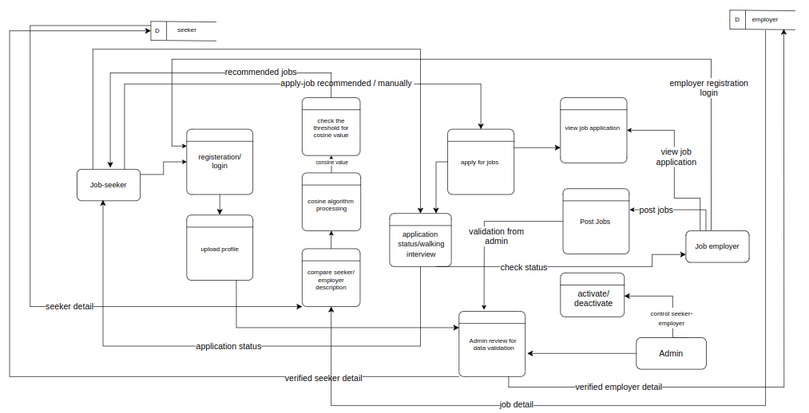
Process Modeling using DFD 2-Level DFD diagram
Figure: 2-Level DFD diagram

Slide 19
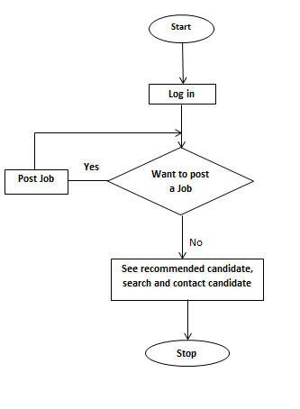
Flow Chart of Employer:
See job applicant

Slide 20
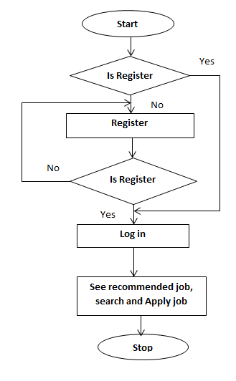
Flow chart of job seekers:

Slide 21
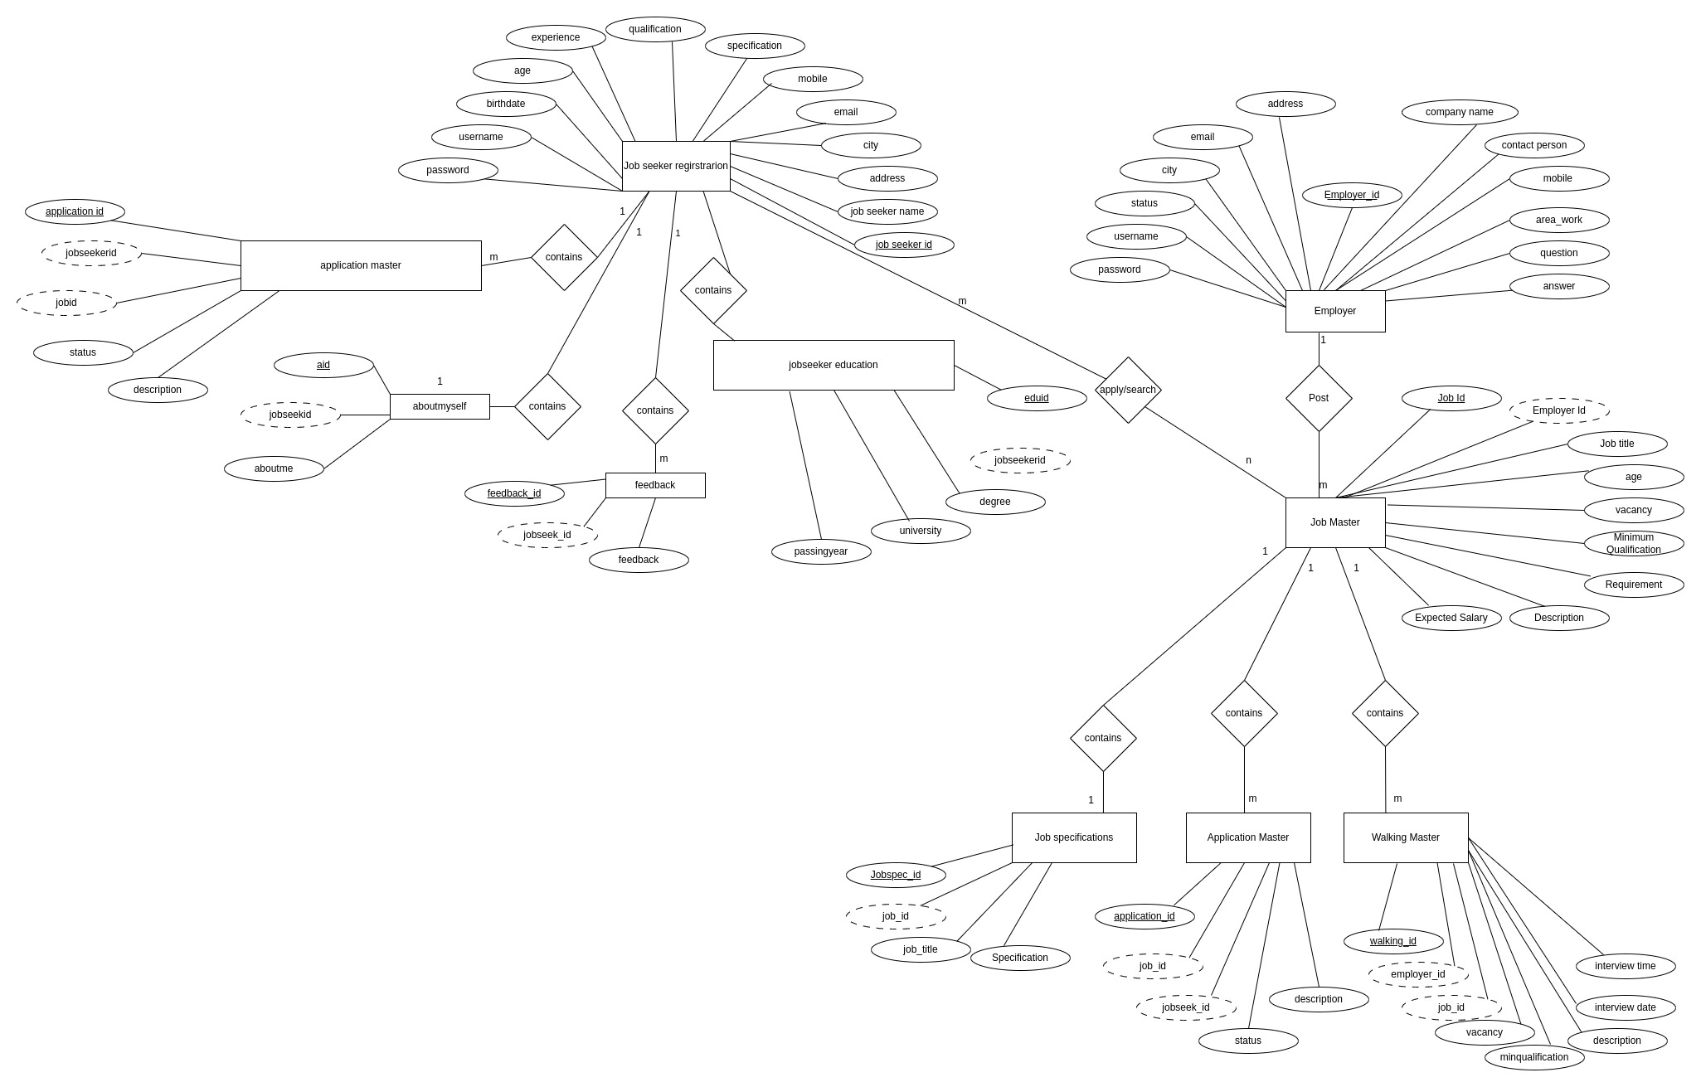
ER Diagram:

Slide 22
Content-Based Filtering
Content based filtering is a recommendation system that suggests new items they have already interacted in the past.
Content-based filtering can be helpful when there is not a lot of user data available or users have unique or niche preferences that are not captured by other recommendation methods. However, one challenge is that it may not capture the full complexity of user preferences.

Slide 23

Cosine Similarity Algorithm
Steps to find the cosine similarities
Convert words to vector
Find the cosine angle between the vectors by using the formula as below.
Find the items having the cosine values greater than defined in algorithm.

Slide 24
Testing
Unit testing: each and every components of software are tested.
Integration testing: integrated logically and tested as a group.
System testing: validates the complete and fully integrated software
Text Cases | Preconditions | Step to be executed | Expected Results | Actual Results | Pass/Fail
Log in for Job seeker | The job seeker account should be logged In | Email: nabin@gmail.com Pass: nabin Click logged In | The job seeker must be successfully logged in the System | Job seeker is successfully Logged In. | Pass

Slide 25
Future Improvement
The system can be enhanced for the future by:
Developing mobile apps for the system.
Making the recommendation job on the bases of the current location of the users.
Provides a convenient and efficient platform for job seekers and employers to interact with each other.
The interactive AI chatbot brings an additional touch to the user experience.

Slide 26
Conclusion
Provides a convenient and efficient platform for job seekers and employers to interact with each other
As a result, the system can recommend the job to the job seekers which will reduce the time of searching jobs. Job recommendation web-based application is developed through the use of the PHP. Through the use of web application Job provider can post the job and people can apply for the job according to the qualification and experience.

Slide 27

Seeking For A Desired Job...☹ Don’t worry! Come And Visit Our Site… Thank You !!! Bsc.CSIT 7th semester

