Slide 1
Final Year Project Presentation “Book Recommendation System”
Project Partners Supervised By
Abhiral Dhakal(10133/073) Nabin Ghimire
Milan Haynju(10151/073)
Paras Dulal(10155/073)
Shyam Shrestha(10162/073)

Slide 2
Background
“Book Recommendation System” is a web application developed using python as a backend tool and html, CSS and JavaScript as a front end tool.
Uses the content based filtering approach to recommend the book by matching the book with the user interest.
User can either read or buy books of their choice, they can rate the book as well.
The system keeps track of the book purchased and rated by the user in the database.
The recommendation algorithm implemented here matches the user data with the book data and recommends the book based on his/her interest.

Slide 3
Problem Statement
Loss of time in searching for the good website from where we can read , buy books of our own interest.
User have to search manually the book but instead our system recommends the book.

Slide 4
Objectives
To provide platform to view the books online.
To purchase books online.
To recommend a book to a user/buyer.

Slide 5
Future Scope
Making Book buddies on the basis of similar Book interests.
Recommendations based on the user ratings and user profile.
Creating chat rooms to discuss about upcoming or newly published books.

Slide 6
How the system works?
Gets the currently rated book and the user information(user id) and matches the book in the book database and recommends the book to the user.

Slide 7
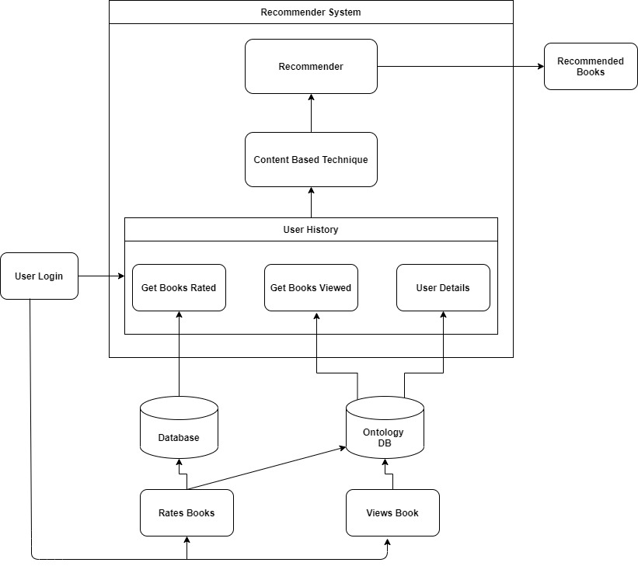
Working Mechanism of the System

Slide 8
Content-Based Filtering
Cognitive filtering, recommends items based on a comparison between the content of the items and a user profile
The vector space model and latent semantic indexing are two methods that use the terms to represent documents as vectors in a multidimensional space.
A learning algorithm has to be chosen that is able to learn the user profile based on seen items and can make recommendations based on this user profile.

Slide 9

Cosine Similarity Algorithm
Steps to find the cosine similarities
Convert words to vector
Find the cosine angle between the vectors by using the formula as below.

Slide 10
Contd..
Find the items having the cosine values greater than defined in algorithm.

Slide 11
Tools Used
Front end Tools
Html
CSS
JavaScript
Back end Tools
Python
Laravel
MySQL

Slide 12
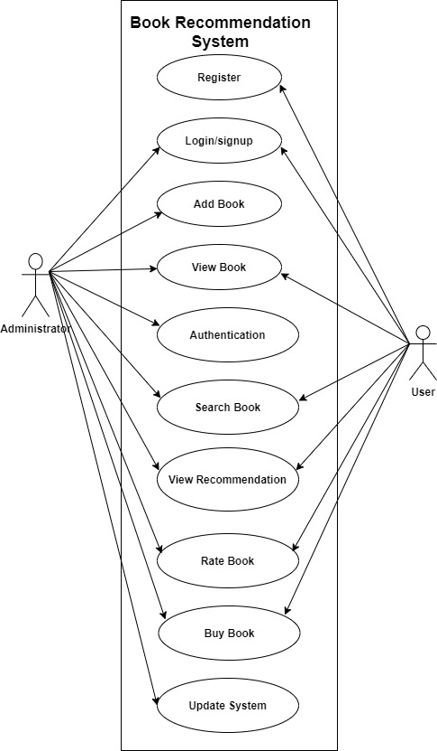
System Design
Figure: Use Case Diagram

Slide 13
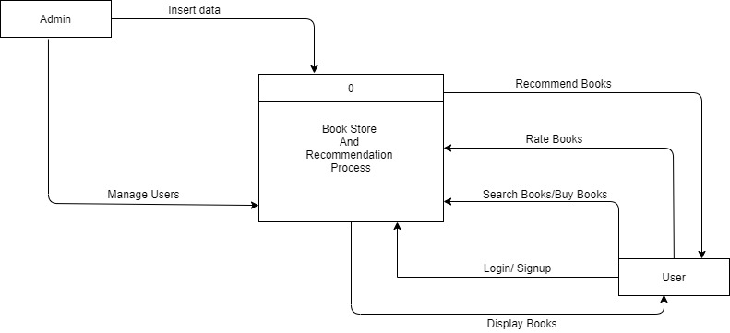
System Architecture
Figure:0-Level DFD

