Slide 1
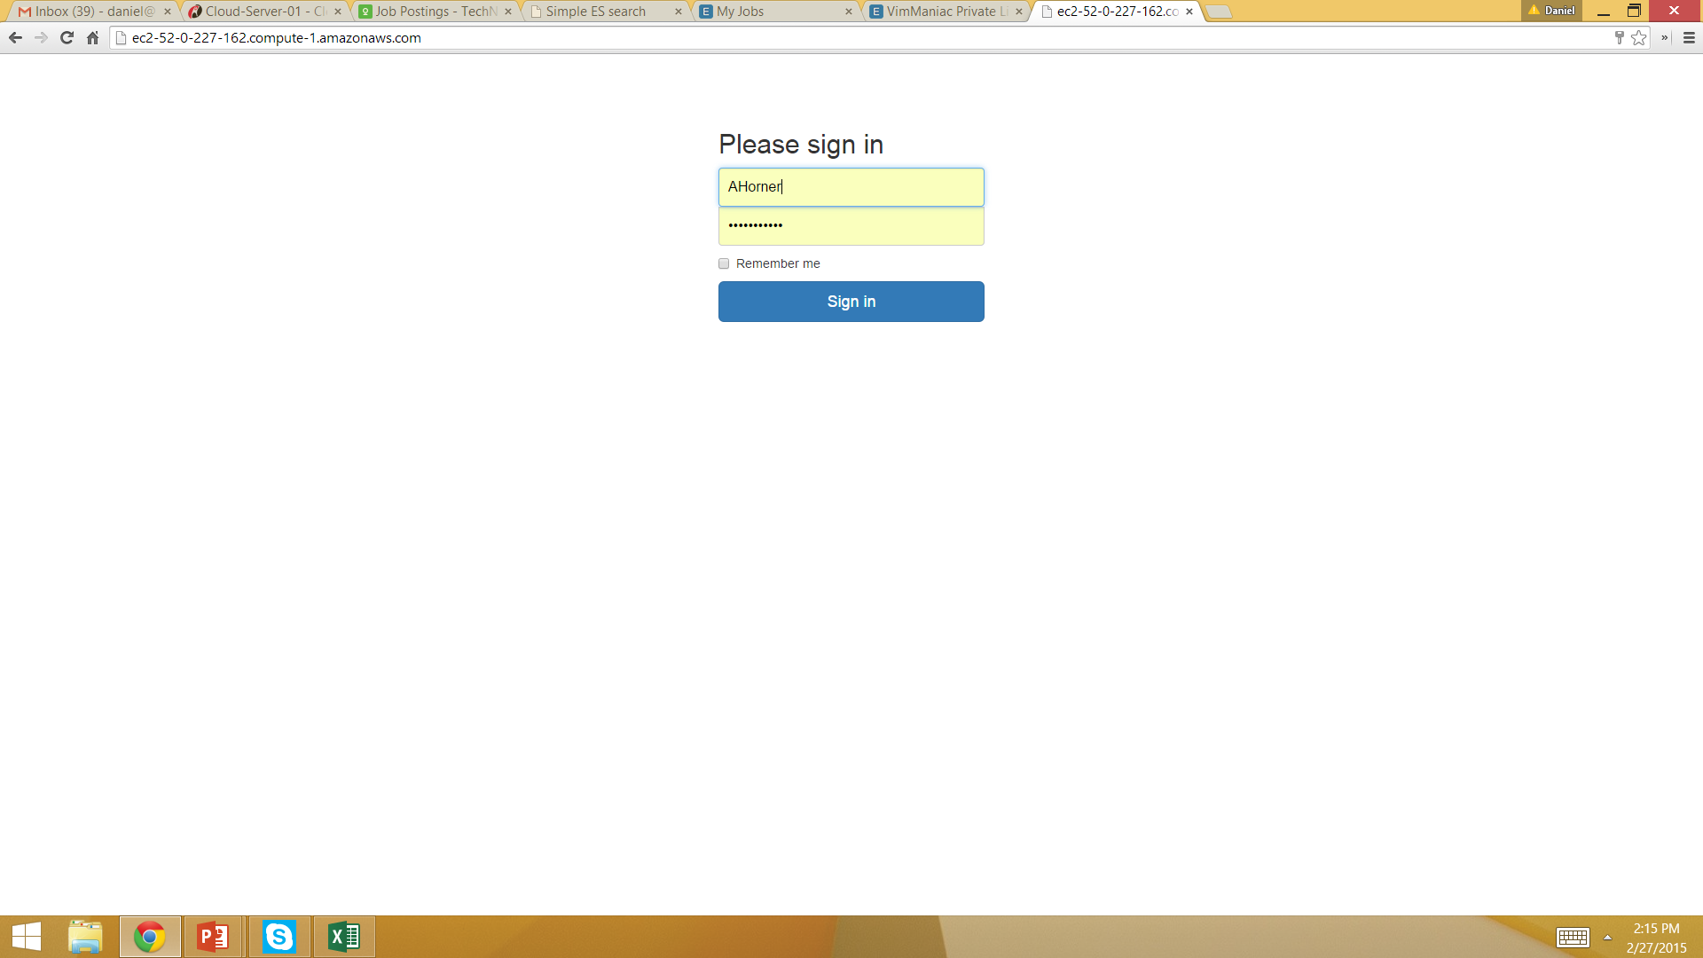
This is the login
This color means it exists
And is using Razor backend scripting backend

Slide 2
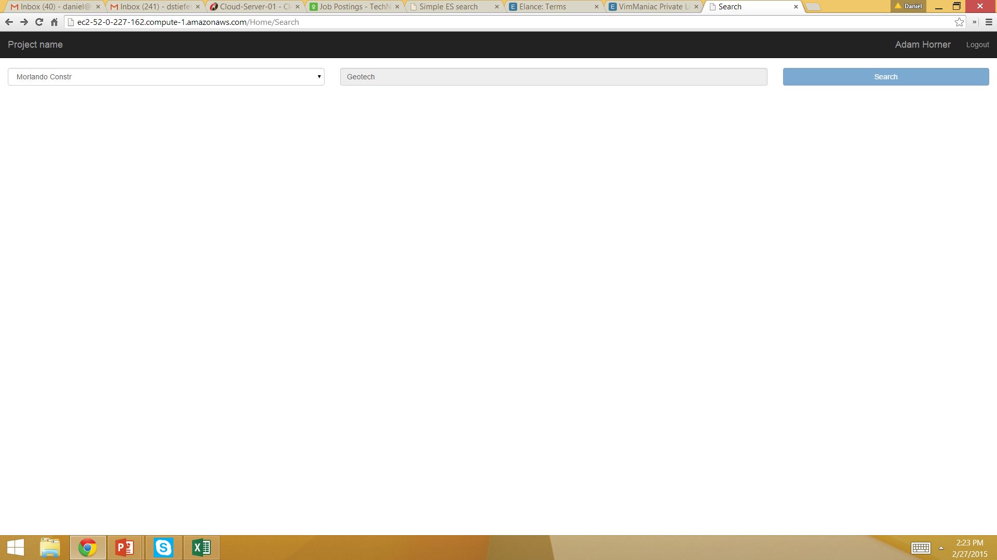
This is the initial page as is
See next slide for changes

Slide 3
search
Need to make button smaller
This color means it needs to be done

Slide 4
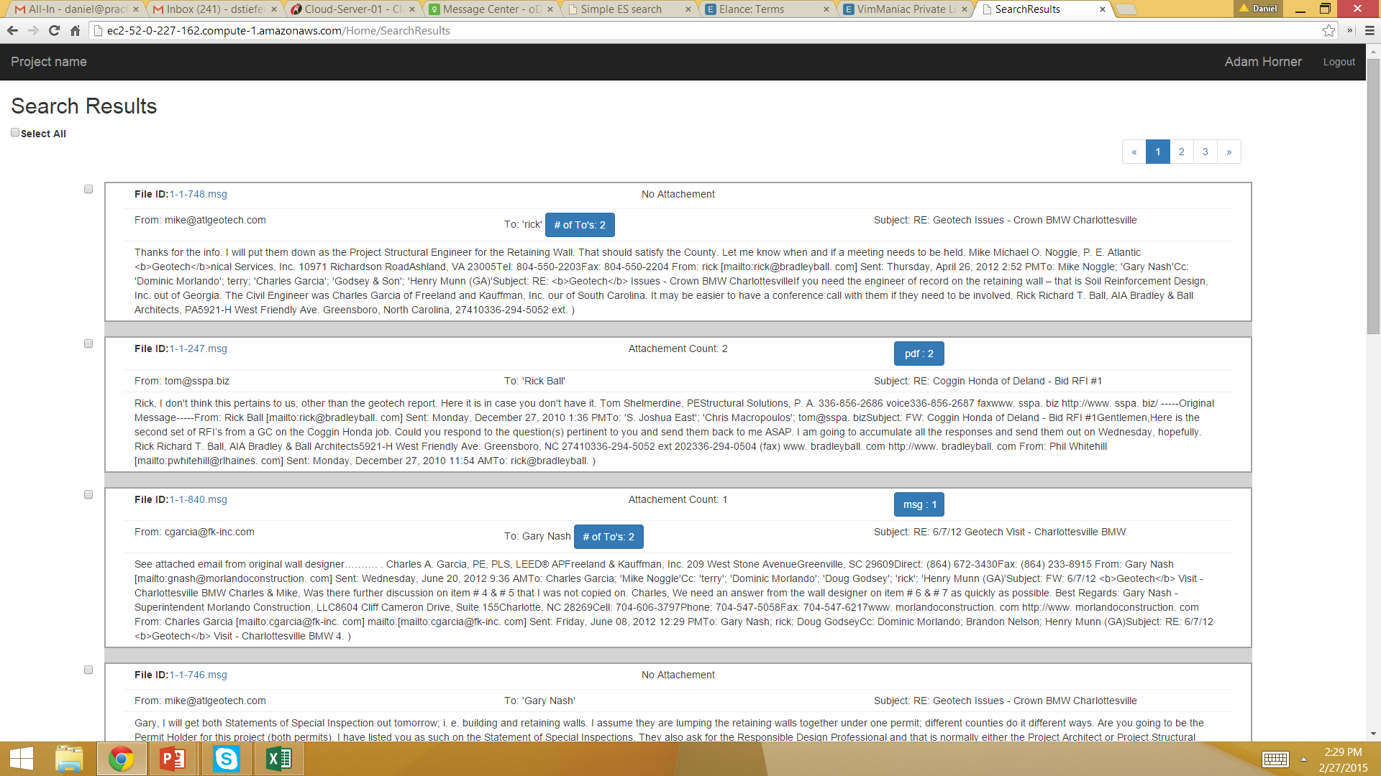
This is the existing search result page

Slide 5
1
search
total
records
with attachment
view
1,500
1,500
2
With
pdf
With
docx
3
1,500
1,500
With
xlsxs
With
jpg
1,500
1,500
See Next slide for notes

Slide 6
search
view
1
I want to keep the search bar on top when the search results come back
2
I want to create a section to the left that will stay constant even when they scroll down – this information will come for the server in JSON format
3
This section needs to improve how we are displaying the data – for example we currently are not ‘tabbing’ where we see /t or creating a new line where we se \n or having a return carriage where we see \r – things like that

Slide 7
Next item

Slide 8
search
total
records
with attachment
view
1,500
1,500
With
pdf
With
docx
1,500
1,500
Ok from this page the end user can select either all of the emails /documents or select just 1 or anything in-between (see green circles)
Once they make their selection they should hit the ‘view’ button
With
xlsxs
With
jpg
1,500
1,500

Slide 9
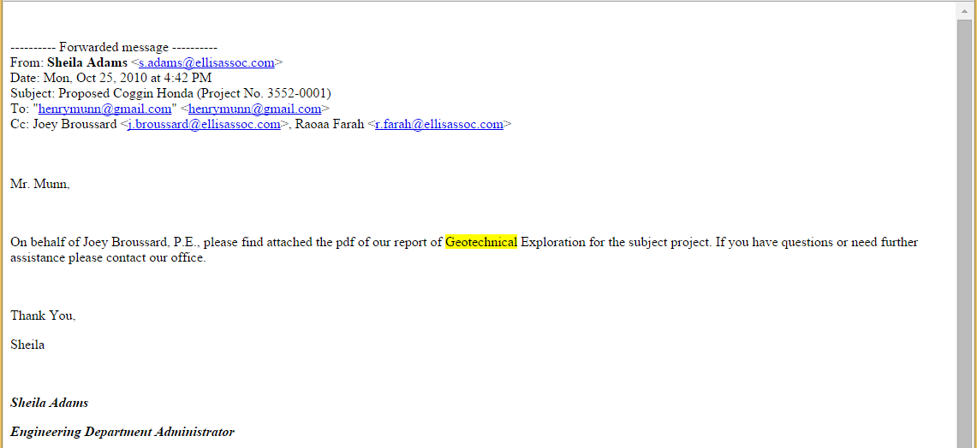
search
2
3
4
7
5
6
1 of 8
print
Privileged
Favorite
8
Attachment 1.pdf
Attachment 2.jpg
Attachment 3.docx
Attachment 4.xlxs
10
1
9
See next slide for notes

Slide 10
search
1
This is a new div that will hold the emails that the end user will select. It will have a header section and then a body section
2
This is a back button so they can go back to the search page where they selected their emails
3
This just lets them know out of the emails they selected what # in the array is it
4
This is a print option so they can print the email
5
Privileged – this is like a ‘tag’ and the backend folks will give you a REST end pint where to post some JSON info
6
Privileged – this is like a ‘tag’ and the backend folks will give you a REST end pint where to post some JSON info
7
Arrow keys so they can scroll through the documents they selected within the container that has been created
8
Scroll bar – for longer emails it’s ok to have a scroll bar within the div
9
The words that will be searched will be highlighted – so the backend-end developers will most likely put some kind of tag/class and you will set up in the css to highlight and bold
10
The attachments are on Azure blob storage – the location of the files is in the JSON doc from the back-end. You will need to make these links so end-user can download – but we need to set up so that the key to azure storage is not exposed

Slide 11

1
search
view

Slide 12
1
Account Info
Payment
Plans & Payment

Slide 13
1
search
search
See next slide for when you press the gear button
1
This is the advanced search button – when press it should trigger an accordion type of widget

Slide 14
tag type:
3
attachment type:
2
privileged
favorite
ocr pdf
jpg
xlsx
docx
1
search
search
Also the accordion should be a partial view
Here there are two sections tag type and attachment type and in both sections you should be able to multi-select – so there are two groups of controls
3
2
When you press the gear button – it should be like a standard jquery accrodian look…so you should see the space open up
1
This is the advanced search button – when press it should trigger an accordion type of widget and there should be a tool tip that says advanced search

