Slide 1
Introduction to Corona SDK

Slide 2
What is Corona?
2D Game Engine for Mobile development
Developers code in Lua
Multi-platform from a single codebase (iOS, Android, Windows, Nook, Kindle, Ouya)

Slide 3
Our Experience with Corona
Working with Corona for about 1.5 years
Launching asynchronous multiplayer game named Words & Cards for iOS

Slide 4
Pros
Multi-platform dev from single codebase
Solid simulator for testing, supports all devices
Various APIs and 3rd party tools available through Corona, all integrated with Lua (Box2D, FB, GC, OpenAL, Flurry, etc)

Slide 5
Cons
Most APIs & 3rd Party tools are black-boxes
No Native integration (ObjC, Java) without Enterprise license – Only Lua
Only supports Mobile – not a good choice if you plan on porting to Web/FB/Console
No conventional way to handle OOP in Lua/Corona, requires research & experimentation

Slide 6
Community
Fairly active dev community on Corona forums
Corona staff also active in forums
Typically have to rely on Corona staff to help with more complicated issues

Slide 7
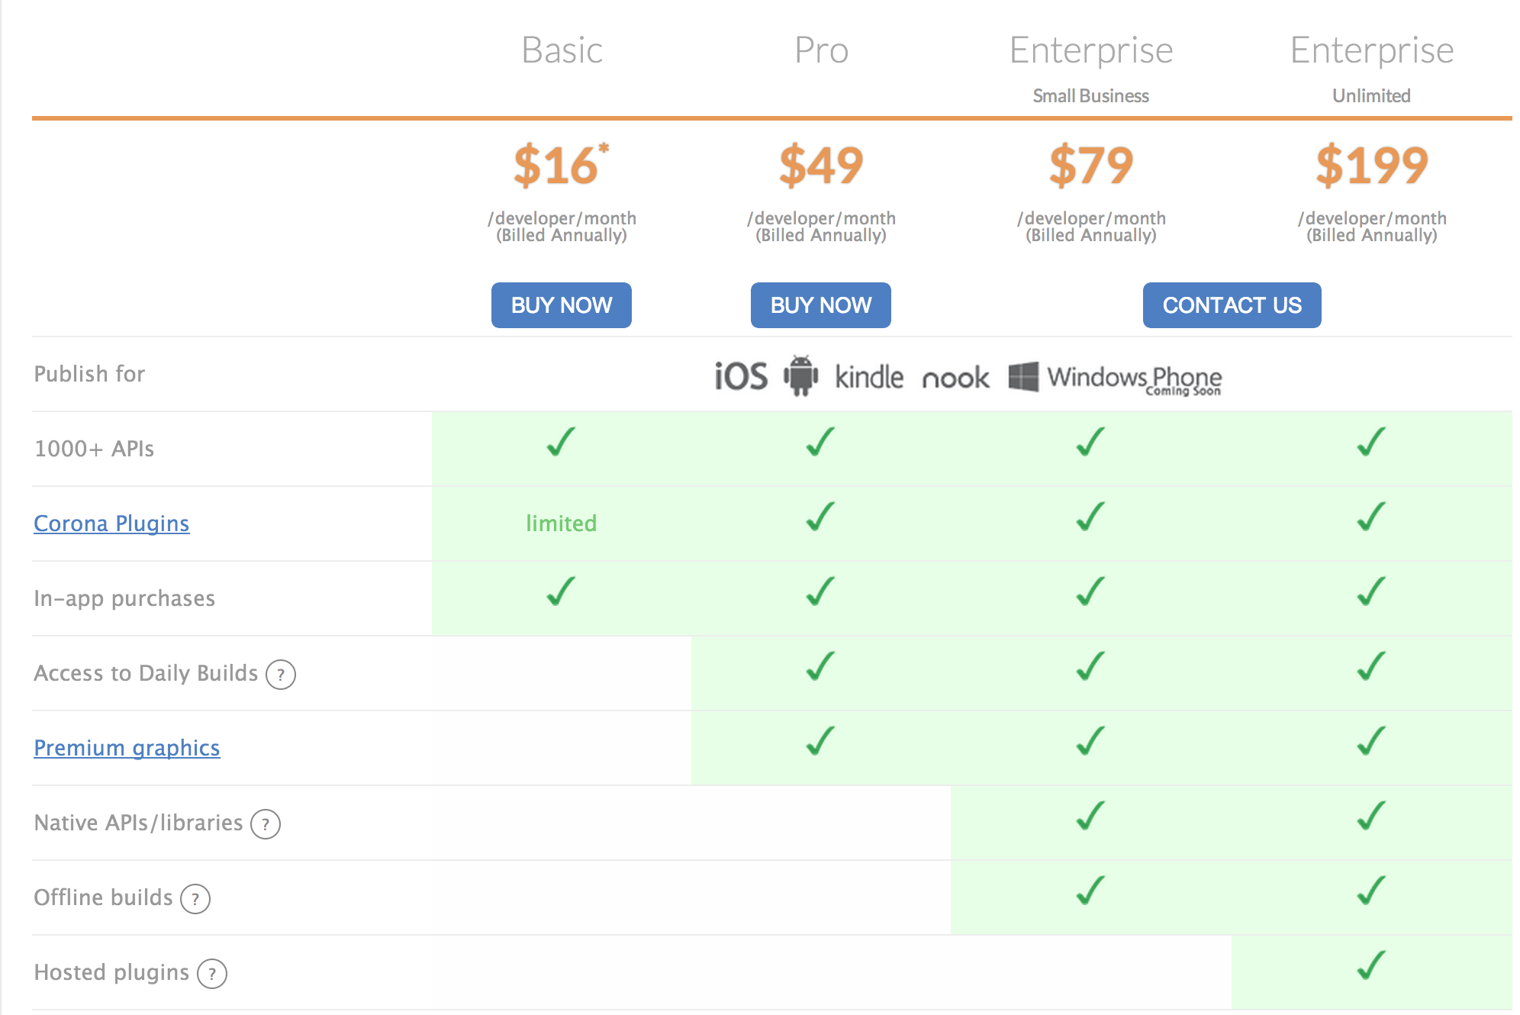
Pricing

Slide 8
Tutorial time!

Slide 9
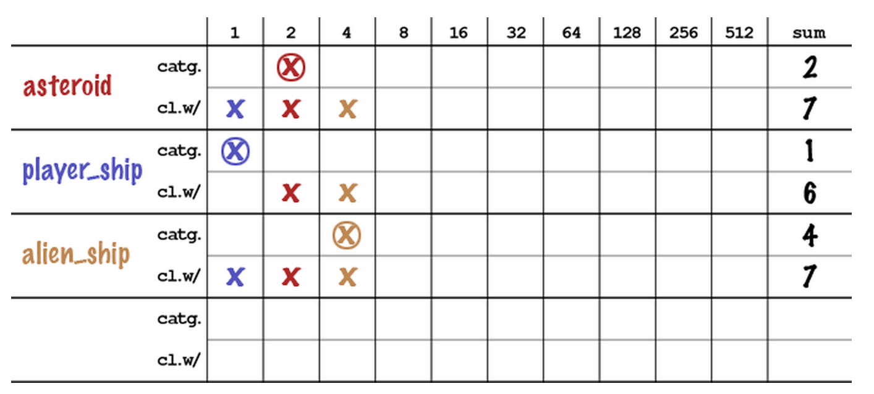
Physics: Collision Detection

Slide 10
Questions?
My Contact:
Justin Sheets
justin@th.ru.st

