Slide 1
It’s a Cloud Party – BYOD (Bring Your Own Data)
Jack Coleman, Architect
February 24, 2014 DevNexus
Notes:
2/24, 5:30-6:45 PM, Room: Room 102
HOOK: It’s a Cloud Party!
Message Objective:
By using jclouds and the HPCC Systems platform, you will be able to quickly and easily solve big data problems with several public cloud providers.
Slotted for 75 minutes – 15 minutes of slides, 30 minutes for the demonstrations, leave the rest of the time for questions (feel free to ask questions during the presentation)
Get you to the cocktail reception early!
Giveaways, Kidle Fire, HPCC training (fill out forms, must be present to win), Starbucks gift cards (trivia questions)

Slide 2

About the Presenter
Jack Coleman
Architect
HPCC Systems Ambassador
Risk Solutions
jack.coleman@lexisnexis.com
678.694.2730 Direct
678.488.1528 Mobile
1000 Alderman Drive
Alpharetta, GA 30005
hpccsystems.com

Slide 3
About the Presenter
Java Python
C Lisp
Go Haskell
ECL C++
C#
JavaScript
Notes:
Enjoy coding in a wide variety of programming languages

Slide 4


LexisNexis Risk Solutions
LexisNexis® Risk Solutions is a leader in providing essential information to help customers across industry and government assess, predict and manage risk.
100% of all U.S. P&C insurance carriers
100% of the top 50 U.S. banks
90% of the Fortune 500 companies
70% of local governments
80% of U.S. Federal agencies
HPCC Systems – open source initiative
HPCC – High Performance Computing Cluster
Big Data Platform
Notes:
Insurance companies use our services to help asses risk and streamline processes
Governments use us to safeguard citizens and reduce financial losses
In 2011, Risk Solutions launched an open-source initiative called HPCC Systems to broaden usage, tap the innovation of the development community and to more fully compete in the “big data” market.
We have been using the HPCC big data platform for over 13 years to run our business ($1.4B)
Reed-Elsivier ($4B) – Science Direct ($1B) – switched to HPCC for recommendation engine

Slide 5
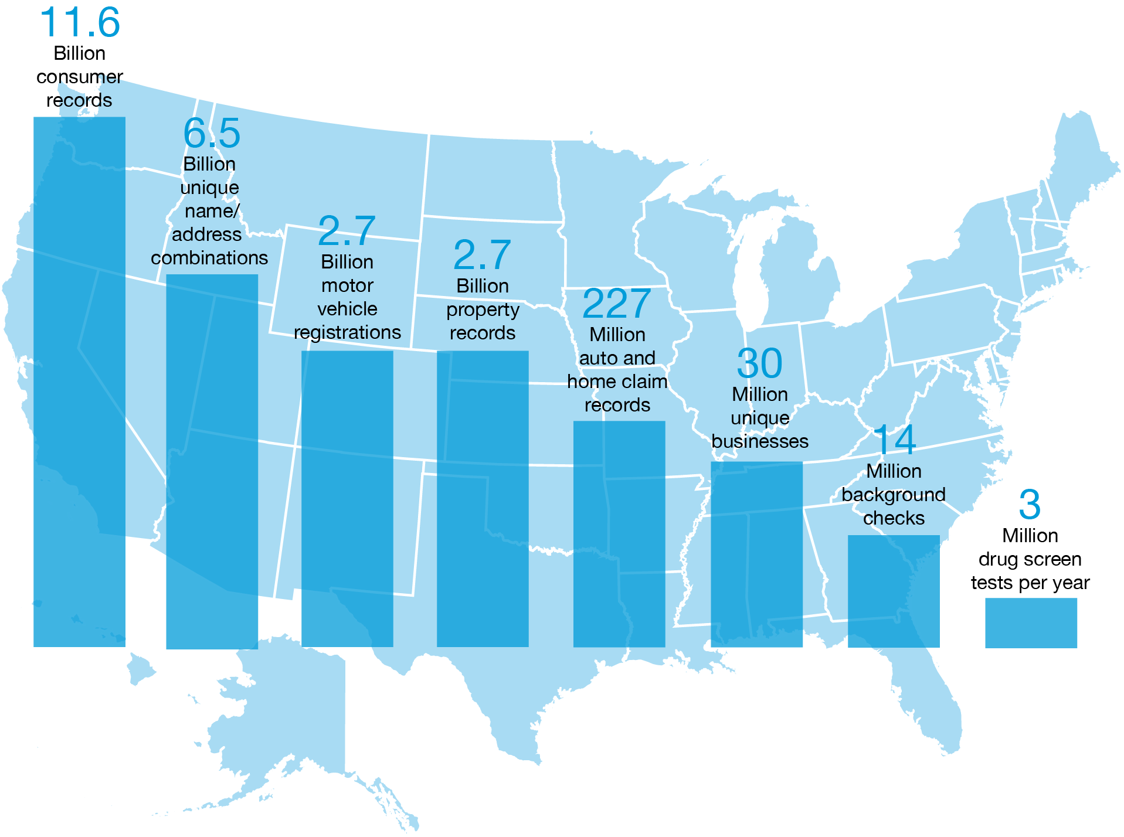
LexisNexis Risk Solutions is Big Data
Notes:
11.6 billion consumer records
• 6.5 billion unique Name & Address Combinations and 30+ years of Address History
• 2.7 billion motor vehicle registrations
• 2.7 billion property records
• 302 million unique businesses
• 227 million auto and home claim records; 99% of all U.S. auto claims
• 12 million background checks and 3 million drug screen tests per year

Slide 6
It’s a Cloud Party – BYOD (Bring Your Own Data)
Agenda:
Apache jclouds
HPCC Systems Big Data Platform
Provision HPCC clusters and demo use cases
Notes:
Apache jcouds – what it is and the pros and cons I’ve found using it
HPCC components and comparison with Hadoop
Live Demo

Slide 7
Apache jclouds
Notes:
Trivia Question #1:
Leading analyst firm Gartner defines Big Data from three aspects, all starting with the letter V. Which of these are not a part of their consideration of big data?
Value, Volume, Velocity, Variety
Answer: Value

Slide 8
Apache jclouds
Cloud Interfaces, Simplified
Apache jclouds is an open source library that helps you get started in the cloud and utilizes your Java development skills.
The jclouds API gives you the freedom to use portable abstractions or cloud-specific features.
ComputeService and BlobStore are the most mature.
jclouds supports over 30 cloud providers and cloud software stacks including Amazon Web Services, OpenStack, and Rackspace.
Notes:
Supports over 30 cloud providers
Has support for Closure
Simple intuative APIs
Built primarily by the European Java community
Contributed to Apache in April 2013 as an incubator project, graduated unanimously in October 2013

Slide 9

Why should I use jclouds?
Programming against cloud environments can be challenging, and jclouds focuses on the following areas so you can get started in the cloud sooner.
Simple Interface
Runtime Portability
Deals with Web Complexity
Unit Testability
Performance
Location
Quality
Notes:
Web Complexity
Get started without dealing with REST-like APIs or WebServices. Instead of creating new object types, jclouds reuses concepts like maps so that the programming model is familiar.
All of the cloud providers have different REST APIs with different subtleties

Slide 10
API
Compute Service
Used for managing compute nodes in the cloud (Virtual Machines)
Node Sets
SSH Keys and Credential Persistence
Predicate Matching
Blobstore
Used for storing and retrieving data stored in the cloud
Container namespace
Globally addressable
Notes:
Compute Service, key abstractions - hardware, operating system, template, image, location, options
Blobstore Service, key abstractions – container, folder, blob (Amazon S3 buckets)
Predicate matching “with group” “not terminated”, match image type, match OS names

Slide 11

Pros and Cons
Pros
Powerful abstractions
Easily manage clusters of nodes
Portable
Open source
Cons
Limited and unorganized documentation
Many jar files
No PaaS
New and still evolving
Notes:
Pros
Simple + high level
Run single commands on a set of nodes
Cons
Almost 100 jars needed
RDS and ELB are works in progress
I have had to upgrade versions three times, each one was a good amount of work

Slide 12
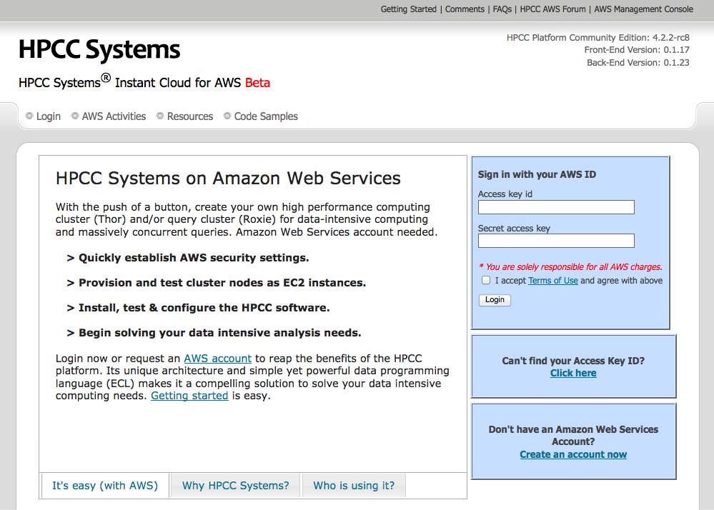
HPCC Systems Instant Cloud – Web Portal
Notes:
Our jclouds application for provisioning HPCC Clusters in the cloud
Launch the AWS demo

Slide 13
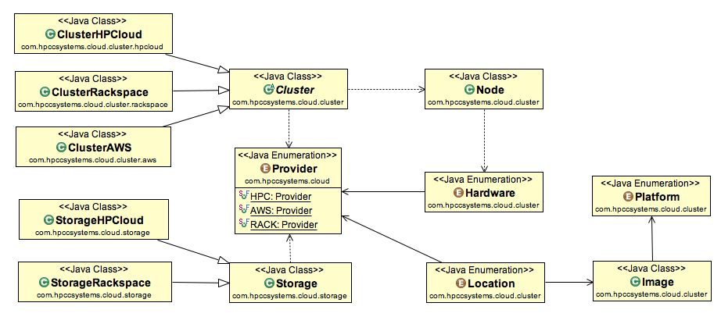
HPCC Systems Instant Cloud - Class Diagram
Notes:
Provider, Cluster, Storage, Node, Hardware, Location, Image, Platform
Provider specific versions of Cluster and Storage

Slide 14
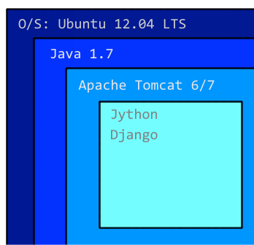
HPCC Systems Instant Cloud - Implementation
Portal Application
Linux O/S
Java / Tomcat backend
Python / Jython frontend
Django Web Framework
Launching a Cluster
Creates server instance(s)
Creates security group
Creates SSH keys
Node health check
Node configuration
Copies data from container(s)
Notes:
The reason for Python / Django is historical. The first portal was all Python / Django.
Jython is no longer supported for newest version of Django, need to port UI to something else
Wanted to re-use as much code as possible.
Use AWS Boto libraries for Python, not easily extendable to other cloud providers

Slide 15



HPCC Systems Instant Cloud – Providers
Notes:
Rackspace – issues with startup times
Future enhancements will be to add block storage to all providers
HP will be migrated to Havana in March before going live
Rackspace must push custom IP tables script
No ability to use SSH keys to setup images, password only
Other differences - usernames

Slide 16
HPCC Systems Big Data Platform
Notes:
Trivia Question #2:
In the past, computing was envisioned to be provided as a commodity utility like electricity.
Which year was this idea first published in a book?
Answer:
1966, Douglas Parkhill, The Challenge of the Computer Utility.

Slide 17
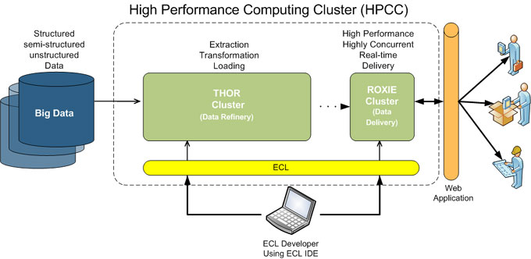
HPCC Systems Big Data Platform
High-Level HPCC Architecture
Image placeholder
Notes:
Thor, Roxie, ECL, ECL Eclipse Plugin, ESP (Enterprise Services Platform)
NoSQL, schema-free, clustered database
No single point of failure (no NameNode or JobTracker)

Slide 18

Thor
Thor (the Data Refinery Cluster) is responsible for consuming vast amounts of data, transforming, linking and indexing that data.
Single-threaded
Distributed parallel processing
Distributed file system
Powerful parallel processing programming language (ECL)
Optimized for Extraction, Transformation, Loading, Sorting, Indexing and Linking
Scales from 1-1000s of nodes
Notes:
Thor functions as a distributed file system with parallel processing power spread across the nodes.
DFU – Distributed file system (record oriented)
Data cleansing and hygiene
ETL processing of raw data
Record linking and entity resolution

Slide 19
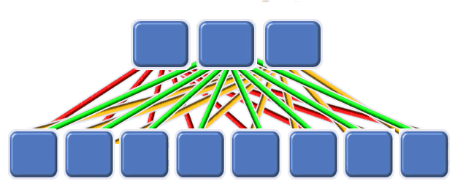
Roxie
Roxie (the Query Cluster) provides separate high-performance online query processing and data warehouse capabilities.
Multi-threaded
Distributed parallel processing
Distributed file system
Powerful parallel processing programming language (ECL)
Optimized for concurrent query processing
Scales from 1-1000s of nodes
Notes:
Rapid Online XML Inquiry Engine
Web Services interface
Thousands of simultaneous users and queries

Slide 20
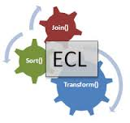
ECL
ECL (Enterprise Control Language) is the powerful programming language that is ideally suited for the manipulation of Big Data.
Transparent and implicitly parallel programming language
Non-procedural and dataflow oriented
Modular, reusable, extensible syntax
Combines data representation and algorithm implementation
Easily extend using C++ libraries
ECL is compiled into optimized C++
Notes:
One language for both Thor and Roxie development
Bad ECL code gets optimized to good C++ code

Slide 21
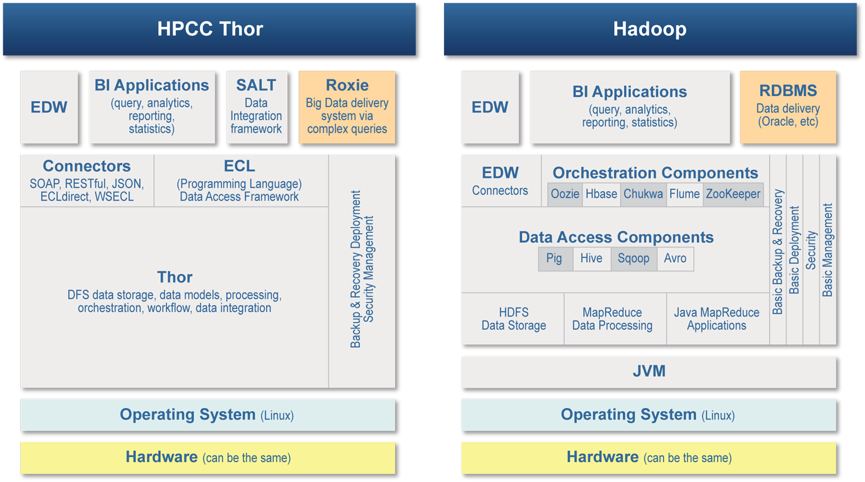
Comparison Between HPCC Systems and Hadoop
Image placeholder
Notes:
Thor and ECL replace most of the components.
Fewer components to learn, fewer components to install and configure.

Slide 22
Comparison Between HPCC Systems and Hadoop
Both HPCC Systems and Hadoop are based on a distributed shared-nothing architecture
HDFS is block oriented, while HPCC DFS is record oriented (supporting fixed length, variable length field delimited, and XML records)
Thor replaces Hadoop Java/MR, Chukwa, Flume, Avro, Sqoop, Oozie, etc.
The ECL language replaces Java/MR, PIG, Hive, etc.
Cassandra and other key/value data delivery stores are closer but have limitations inherent to the key/value model
Image placeholder
Notes:
There is no Hadoop equivalent of Roxie

Slide 23
Provision HPCC clusters and demo use cases
Notes:
Trivia Question #3:
What was the inspiration for the name "Swing” (bonus, what was the codename before Swing)?
Georges Saab coined it, because Swing dancing was big at the time in San Fransisco (1999) KFC was the codename before (copyright issues)
The Java mascot is "Duke”. Duke Ellington wrote the song "It Don't Mean A Thing (If it Ain't Got That Swing)"

Slide 24

Demonstration
Scenario
Start an HPCC cluster in AWS
Show ECL watch, run simple inline example
Start an HPCC cluster in Rackspace
Spray container data to cluster and run query
Start an HPCC cluster in HP Cloud
Streaming data example
Setup HPCC target in Eclipse (ECL Plugin)
Basic Machine learning example

Slide 25
It’s a Cloud Party - BYOD
Questions?
Comments?
Jack Coleman
jack.coleman@lexisnexis.com
678.694.2730 Direct
678.488.1528 Mobile
@hpccsystems
Copyright © 2014 LexisNexis. All rights reserved.
Notes:
Drawing for Kindle File and Training

