Slide 1
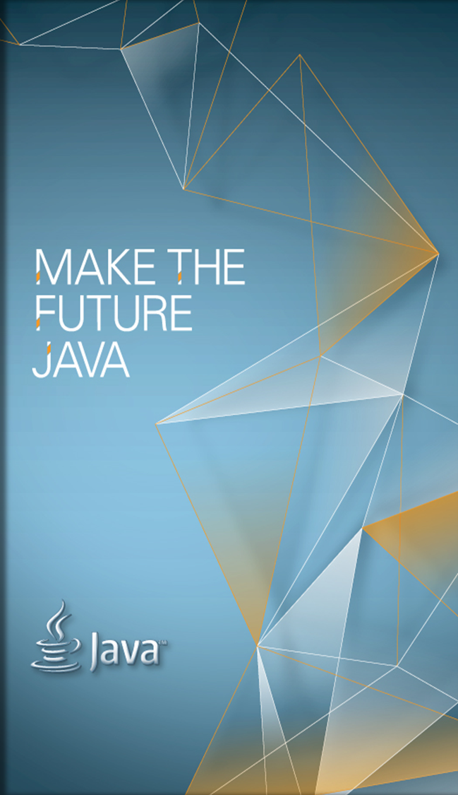
Down-to-Earth Microservices with Java EE
Reza Rahman
Java EE Evangelist
Reza.Rahman@Oracle.com
@reza_rahman

Slide 2
The following is intended to outline our general product direction. It is intended for information purposes only, and may not be incorporated into any contract.
It is not a commitment to deliver any material, code, or functionality, and should not be relied upon in making purchasing decisions. The development, release, and timing of any features or functionality described for Oracle’s products remains at the sole discretion of Oracle.

Slide 3
Agenda
What are microservices?
Are microservices for you?
Microservices and Java EE

Slide 4
Microservices: What’s in a Name?
“Microservices” incredibly vague
  Big hurdle to practical adoption by average Joe developer
  Terrible naming including the abominable “monolith”
  Already hijacked and overloaded by commercial interests
Simple concept with a long history
  UNIX, CORBA, Jini, RMI, EJB 1/2, COM/DCOM, OSGi, SOAP/ESB
  A very intellectually honest name might have been “Son of SOA”
Decomposing larger systems into smaller independently deployable parts
  Purists distance themselves from SOAP, ESB
  Purists embrace mostly REST and messaging
  Purists take for granted testing, DevOps, continuous delivery
  Purists focus on (ridiculously) fine grained services

Slide 5

What’s the Big Deal?
As systems grow, they become harder to maintain without modularity
  Ideal size for “monolithic” team is somewhere around 10-12 engineers
Business and system needs sometimes make decomposition lines obvious
Distributed systems can force better modularity
Easier to scale – supposedly
New dawn of polyglot programming – supposedly
DDD Bounded Context

Slide 6
Hype vs Reality
Long well-understood downsides of distributed systems
  Significantly more complex administration, deployment and monitoring
  Significantly harder testing, debugging, diagnostics, reliability, consistency
  Code duplication, the challenges of finding module boundaries
  Higher skill and automation requirements for development and operations
  “Distributed big ball of mud”
  “Fallacies of distributed computing”
The Bottom Line:
  Majority of systems just fine as “monoliths”
  Majority of systems needing microservices would be considered “hybrids” by purists
  Few practical enterprise systems can or need to achieve microservices nirvana

Slide 7
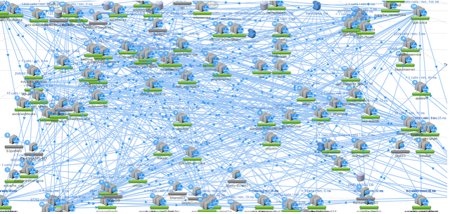
A Picture Says a Thousand Words…
For most ordinary “blue collar” IT organizations microservices nirvana is probably more like microservices hell.

Slide 8
Microservices and Java EE
JAX-RS
JMS
WebSocket
JSF
JSON
Bean
Validation
JAXB
CDI
EJB 3
JPA
JTA
JCA
Administration
Resources
High
Availability
Security
Monitoring

Slide 9

Java EE + Microservices Demo
https://github.com/smillidge/CargoTracker-J12015

Slide 10
Microservices Buzzword Bingo
Fat jars, “containerless”, microframeworks
  WildFly Swarm, Payara Micro/Embedded GlassFish, KumuluzEE, TomEE Embedded
Docker
Cloud, IaaS, PaaS
Eureka, RxJava, Hystrix, NetFlixOSS
Notes:
Java EE 8 is already in full swing. Many key JSRs including the Java EE 8 platform JSR were launched in the JavaOne 2014 time frame. Those expert groups are now fully active.
A second smaller batch of key JSRs including Java EE Security, Java EE Management and JSON-P 1.1 were launched more recently and are now solidifying their progress.
Many other JSRs like minor releases of WebSocket, Java EE Concurrency Utilities and JPA are yet to come.
There is still plenty of opportunities to participate and help shape Java EE 8!

Slide 11
Summary
Microservices newest incarnation of ideas with a long history, the last major incarnation being SOA.
Microservices are a valuable architectural technique, but not necessarily for everyone, not necessary always and not necessarily all-at-once.
Java EE is a capable platform for pragmatic microservices more relevant to ordinary IT organizations, “monoliths” and everything in between.
The Java EE ecosystem is already stepping in to support even the niche of microservices nirvana.

Slide 12
Resources
“Monolith” First by Martin Fowler
  http://martinfowler.com/bliki/MonolithFirst.html
Microservices is SOA, for those who know what SOA is
  http://service-architecture.blogspot.com/2014/03/microservices-is-soa-for-those-who-know.html
Java EE Tutorials
  http://docs.oracle.com/javaee/7/tutorial/doc/home.htm
Digging Deeper
  http://docs.oracle.com/javaee/7/firstcup/doc/home.htm
  https://glassfish.java.net/hol/
  http://cargotracker.java.net
The Aquarium
  http://blogs.oracle.com/theaquarium

