Slide 1
Visualization of Functional Dependencies in a Web Environment
____________________________
Nikolay Georgiev
Umeå University
Department of Computing Science
SE-901 87 Umeå
Sweden

Slide 2
Overview
____________________________
Theoretical Background
Motivation
Live Demo
Implementation
Conclusions

Slide 3
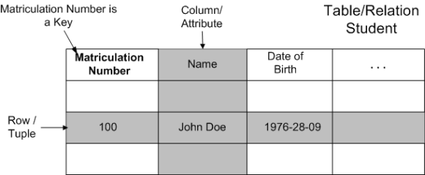
Theoretical Background
____________________________
Relational Data Model
Data are represented in tables/relations
The columns in the relation identify the attributes
A row/tuple contains all the data of a single instance of the table
Each row must have a unique identification or key based on the data

Slide 4
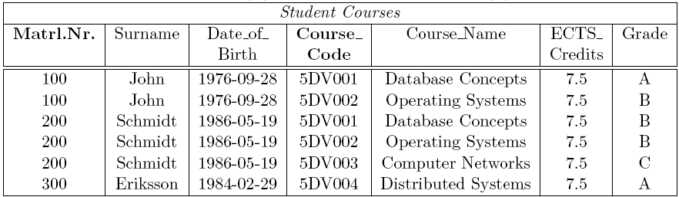
Example of a Bad Relation
____________________________
Why is this a bad relation?
A lot of redundant data
To insert a new course one have to insert a student as well
Deleting the student Eriksson also deletes the course Distributed Systems

Slide 5
Relational-Database Normalization
____________________________
Normalization - process of efficiently organizing the data in a database
Normalization involves decomposing a relation into several new relations
New relations have to be combined/joined to yield the same information
Formal notations called normal forms (NF) ensure low storage and update cost
NF - based on functional dependencies (FD)*
FD - semantic relationship between attributes
Attribute B is functionally dependant on A (A → B)
if the value of A determines the value of B
Example: Matriculation_Number → Name is satisfied
but: Name → Matriculation_Number is not satisfied
____________________________
* only true for 2NF, 3NF, BCNF

Slide 6
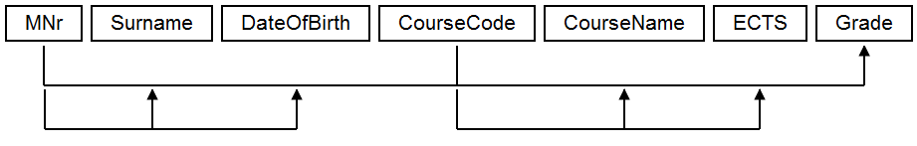
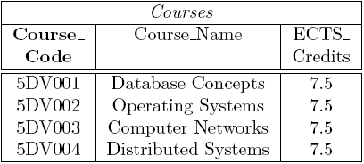
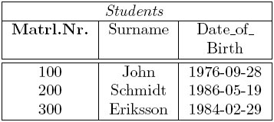
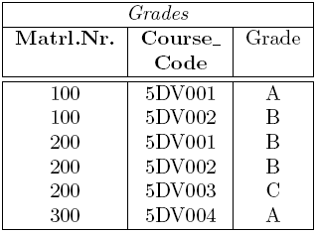
Example of a Normalized Relation
____________________________
Only storing related data in a table
Use the FDs and the different NF guidelines
Ensure no information is lost (lossless-join)‏
Ensure all FDs are present in the decomposition (dependency preservation)‏

Slide 7
Motivation for LDBN 1.0
____________________________
Normalization is a topic in most introductory courses
Subject considered purely theoretical, not well received by students
Develop a tool which allows students to experiment with the subject and test themselves in practice
Tool requirements:
Fast and easy to use
Test any proposed decomposition
Test lossless join
Test dependency preservation
Provide sample solutions/decompositions

Slide 8
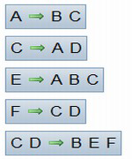
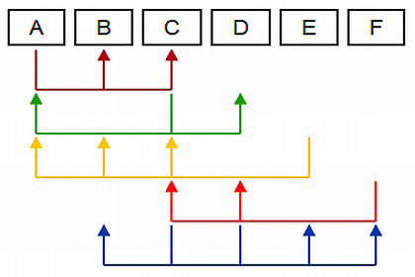
Motivation for LDBN 1.1
____________________________
Improving the usability of the system by:
adding new features - visualization of FDs
improving the existing features by:
dividing users into groups (instructional users vs. students)
Implementing new methods for saving/loading assignments
more power for users to edit/remove their content

Slide 9
Live Demo
____________________________

Slide 10
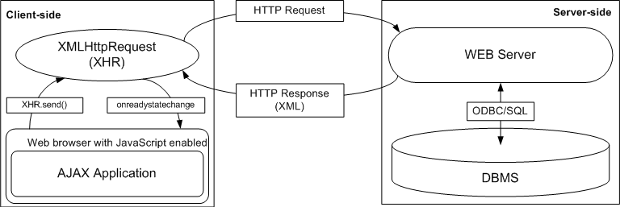
Implementation - Platform
____________________________
AJAX
Advantages
retrieve data from the server asynchronously in the background
No plug-ins required
Disadvantages
Not a standard...

Slide 11
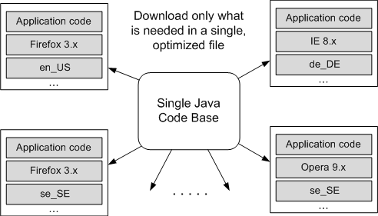
Implementation - Platform(2)‏
____________________________
GWT
Write AJAX applications in Java
Support only one codebase
Java-to-JS compiler
Browser independent code
JRE emulation/UI library/DOM API/...
Use of a debugger

Slide 12
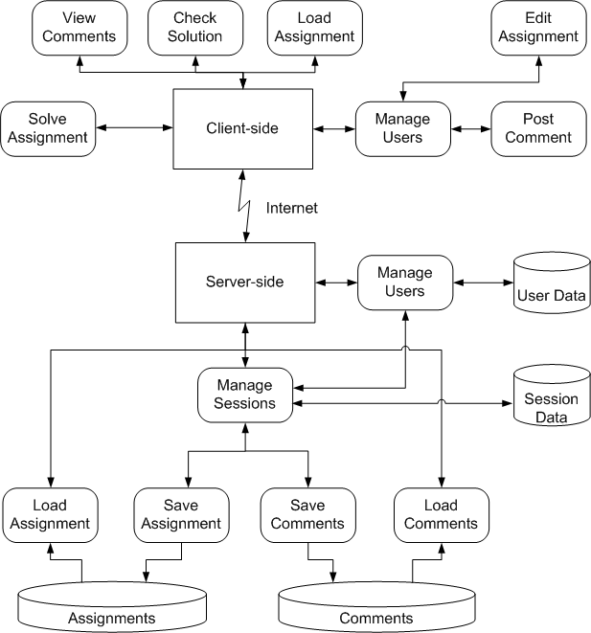
Implementation - System Architecture
____________________________
LDBN 1.0
Decentralized architecture
Client side - tutoring functions
Server side - data storage
Key functions
Check Solution
Algorithms for testing
Solve Assignment
Decomposition algorithms

Slide 13
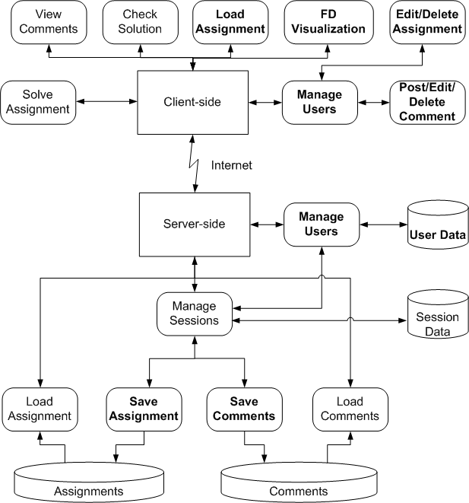
Implementation - System Architecture(2)
____________________________
LDBN 1.1
Most of the changes in the client
Few changes to the server
New key functions for this project:
FD Visualisation
Different user groups
Regular users (students)
Instructional users
Superusers
Load Assignment (Filters)
More control over content:
Edit/Delete Assignments and Comments

Slide 14
Conclusions
____________________________
Fulfilment of the Design Goals
Improve usability by introducing new tools – Visualization of FDs
Fast and easy to use UI ( Drag and Drop)‏
Giving more control to lecturers over the system.
New assignment management.
Limitations and Future Work
More types of visualization of FDs
Print support
Evaluation of the environment in a class room

Slide 15
Questions?
____________________________

