Slide 1
A Web-Based Environment for
Learning Normalization of
Relational Database Schemata
____________________________
  Nikolay Georgiev
  Umeå University
  Department of Computing Science
  SE-901 87 Umeå
  Sweden

Slide 2
Overview
____________________________
  Theoretical Background
  Motivation
  Live Demo
  Implementation
  Conclusions

Slide 3
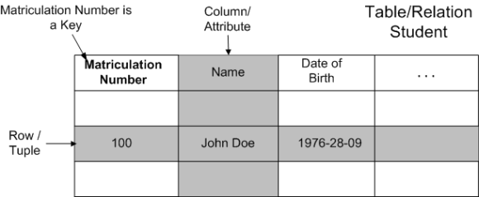
Theoretical Background
____________________________
Relational Data Model
  Data are represented in tables/relations
  The columns in the relation identify the attributes
  A row/tuple contains all the data of a single instance of the table
  Each row must have a unique identification or key based on the data

Slide 4
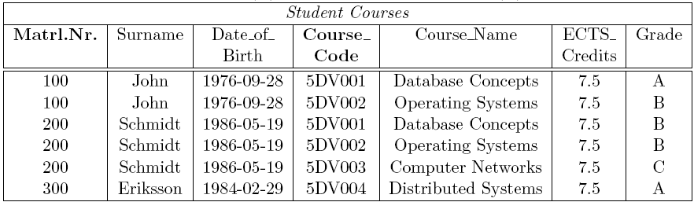
Example of a Bad Relation
____________________________
Why is this a bad relation?
  A lot of redundant data
  To insert a new course one have to insert a student as well
  Deleting the student Eriksson also deletes the course Distributed Systems

Slide 5
Relational-Database Normalization
____________________________
  Normalization - process of efficiently organizing the data in a database
  Normalization involves decomposing a relation into several new relations
  New relations have to be combined/joined to yield the same information
  Formal notations called normal forms (NF) ensure low storage and update cost
  NF - based on functional dependencies (FD)*
  FD - semantic relationship between attributes
  Attribute B is functionally dependant on A (A → B)
  if the value of A determines the value of B
  Example: Matriculation_Number → Name is satisfied
  but: Name → Matriculation_Number is not satisfied
____________________________
    * only true for 2NF, 3NF, BCNF

Slide 6
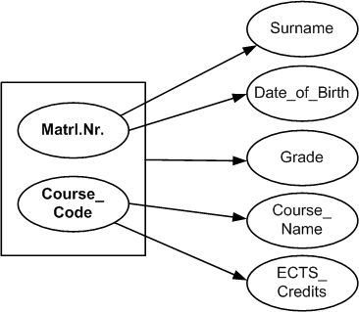
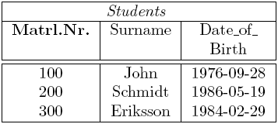
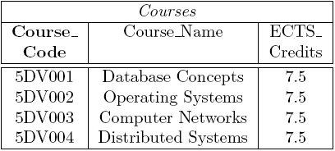
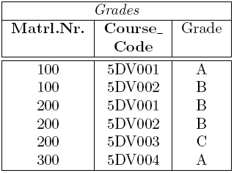
Example of a Normalized Relation
____________________________
  Only storing related data in a table
  Use the FDs and the different NF guidelines
  Ensure no information is lost (lossless-join)‏
  Ensure all FDs are present in the
  decomposition (dependency preservation)‏

Slide 7
Motivation
____________________________
  Normalization is a topic in most introductory courses
  Subject considered purely theoretical, not well received by students
  Develop a tool which allows students to experiment with the subject and test themselves in practice
  Tool requirements:
    Fast and easy to use
    Test any proposed decomposition
    Test lossless join
    Test dependency preservation
    Provide sample solutions/decompositions

Slide 8
Live Demo
____________________________

Slide 9
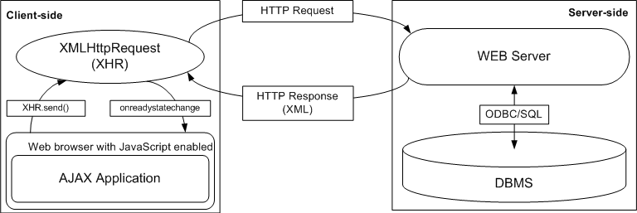
Implementation – Platform
____________________________
AJAX
  Advantages
    retrieve data from the server asynchronously in the background
    No plug-ins required
  Disadvantages
    Not a standard...

Slide 10
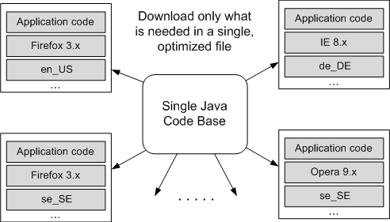
Implementation – Platform(2)‏
____________________________
GWT
  Write AJAX applications in Java
  Support only one codebase
  Java-to-JS compiler
  Browser independent code
  JRE emulation/UI library/DOM API/...
  Use of a debugger

Slide 11
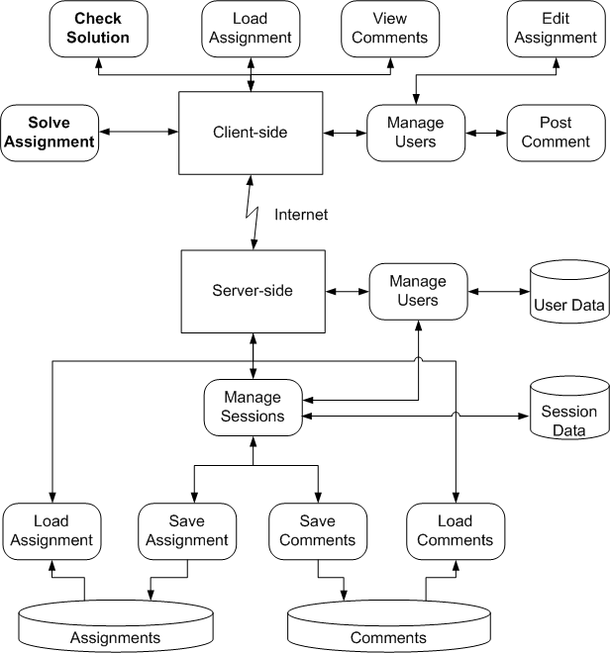
Implementation – System Architecture
____________________________
Decentralized architecture
Client side - tutoring functions
Server side - data storage
Key functions
    Check Solution
      Algorithms for testing
    Solve Assignment
      Decomposition algorithms

Slide 12
Conclusions
____________________________
Fulfilment of the Design Goals
  Evaluate any decompositions and provide sample ones
  Fast and easy to use UI ( Drag and Drop)‏
  Performance
    Advanced algorithms and fast data structures
    Decentralized system architecture
    Optimization tools – Java-to-JS compiler
Limitations and Future Work
  Support of more normal forms (4NF)‏
  Visualization of FDs
  Evaluation of the environment in a class room

Slide 13
Questions?
____________________________

