Slide 1
From vibe coding to agentic engineering
1
Spec
2
Verifier
3
Environment
Spec, verifier, environment: the Karpathy method, and the skills and CLAUDE.md rules that enforce it
agile-team · house-rules · unattended · six-hats · chezmoi-managed CLAUDE.md
Notes:
A talk for engineers who already use Claude Code and want higher-quality output. Three layers from the video and Karpathy's Sequoia Ascent 2026 talk, each mapped onto skills and CLAUDE.md rules that enforce it in code.

Slide 2
Floor and ceiling
“
Vibe coding raises the floor. It lets almost anyone create software by describing what they want. Agentic engineering raises the ceiling. It is the professional discipline of coordinating fallible agents while preserving correctness, security, taste, and maintainability.
Andrej Karpathy, Sequoia Ascent 2026
Vibe coding
Agentic engineering
Describe, accept, repeat. One long chat is the memory.
The model grades its own work.
Rules live in prompts; the model may ignore them.
Good enough for a prototype. Nobody can say why it works.
Design specs, supervise plans, inspect diffs, write tests.
Create evaluation loops; a second, opposed agent checks the first.
Manage permissions, isolate worktrees, preserve quality.
Rules live in hooks and gates the model cannot skip.
The right-hand list is Karpathy's own list of what the agentic engineer does. Every item has a slide below.
Notes:
Karpathy's list: design specs, supervise plans, inspect diffs, write tests, create evaluation loops, manage permissions, isolate worktrees, preserve quality. agile-team does each item in code.

Slide 3
Why the human stays in the loop: jaggedness
“
How is it possible that a state-of-the-art model can refactor a 100,000-line codebase or find zero-day vulnerabilities, yet tells me to walk to the car wash? That's jaggedness. To the extent models remain jagged, it means you need to be in the loop.
Andrej Karpathy, Sequoia Ascent 2026
Spec
What exactly are we building?
1
Verifier
How do we know it is right?
2
What the example shows
Models spike where the labs trained them on verifiable tasks, and stay rough elsewhere.
The model lacked one piece of context (you need the car at the car wash) and nothing checked it.
The method is three ways of giving the model that context and checking that it used it.
Environment
What does every session start from?
3
Notes:
The car wash: 50 m away, should I drive or walk? Every frontier model says walk. Karpathy's word is jaggedness. The three layers are the response.

Slide 4
Three layers: blueprint, quality check, workshop
“
Think of this layer as a workshop. The spec is a blueprint pinned to the wall. The verifier is the quality check station by the door. And then the environment is the workshop itself.
Narrator of the video
1
Spec
2
Verifier
3
Environment
Uncover the goal: have the agent interview you.
Be agile, not waterfall: tight scope, clear checkpoint, review, repeat.
Be precise; make the agent verify key decisions explicitly.
Set the evaluation criteria up front.
A second model as the critic.
Pull external signal: tests, CI, the deployed system.
A proper CLAUDE.md, injected first.
A knowledge base the agent can navigate.
Custom skills for anything repeated.
Guardrails enforced at the tool level.
In code: PO interview, stories with ACs, requirement traceability gate
In code: opposed roles on different models, runner-owned gates, green CI on the pushed commit
In code: chezmoi-deployed CLAUDE.md, the repo as knowledge base, pinned skills, hooks
Notes:
One slide the rest of the deck expands. Each layer has steps; each step has a mechanism in agile-team, house-rules or CLAUDE.md that enforces it.

Slide 5
The spec: deliver your understanding in a form the agent can use
LAYER 1
“I actually don't even like the plan mode. Obviously it's very useful, but I think there's something more general here where you have to work with your agent to design a spec that is very detailed.”
Andrej Karpathy
Notes:
Plan mode is the floor. A spec is a detailed document you design together with the agent. Analogy: an architect who just agrees with you builds the wrong house beautifully.

Slide 6
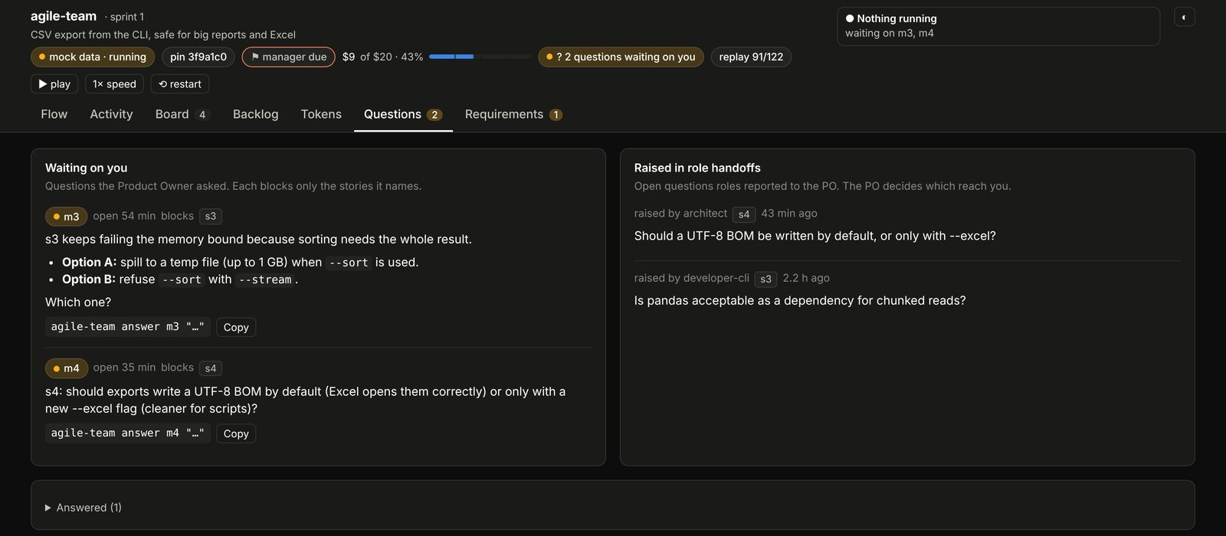
Step 1: uncover the goal, by being interviewed
LAYER 1 · STEP 1
The idea
A task is not a goal. “Create the end-of-month report” is a task; the goal is the conclusion the report must support.
Tell the agent: interview me to identify the goal.
In agile-team
The Product Owner's first instruction is the interview: ask few, sharp questions until goal, scope, users and acceptance criteria are clear.
Before that, the liaison sizes the task and asks whether a team is needed at all. “Do not decide alone.”
Questions tab: the team stops to ask rather than guess. A question blocks only the stories it names.
Notes:
The Questions tab shows the PO asking the human to choose between two options for a memory bound. Questions raised inside the team reach the human only through the PO.

Slide 7
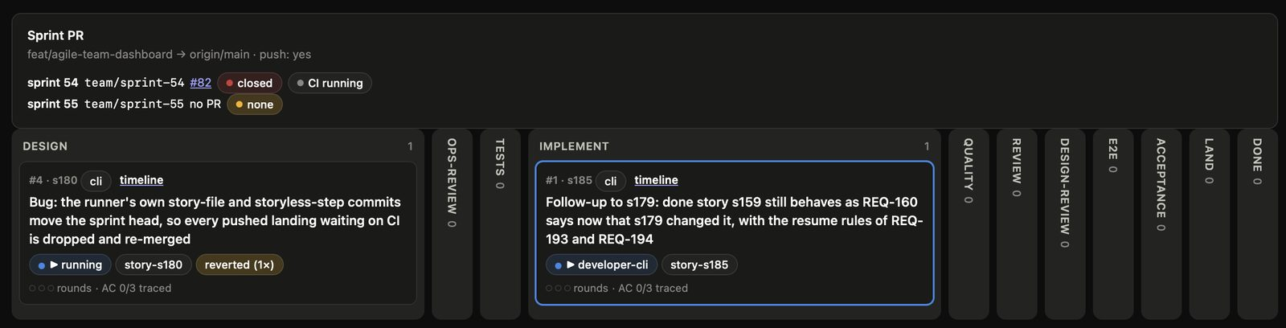
Step 2: be agile, not waterfall
LAYER 1 · STEP 2
“
People are extremely susceptible to using AI agents in a waterfall manner because they want to give them everything to do at once. The better move is agile specking. You want to have a tight scope, a clear checkpoint. You want to review the output, adjust it, and then repeat.
Narrator of the video
In agile-team: the task becomes stories, each with its own acceptance criteria, branch and worktree. Stories run in sprints and land one at a time. DESIGN → OPS-REVIEW → TESTS → IMPLEMENT → QUALITY → REVIEW → DESIGN-REVIEW → E2E → ACCEPTANCE → LAND → DONE.
Live Board from a real run: the sprint branch and its PR on top, then one column per gate. Each story moves one column at a time.
Notes:
Small stories, one checkpoint per column: the agile step made visible. The PO sets the order; you can reorder it from the dashboard.

Slide 8
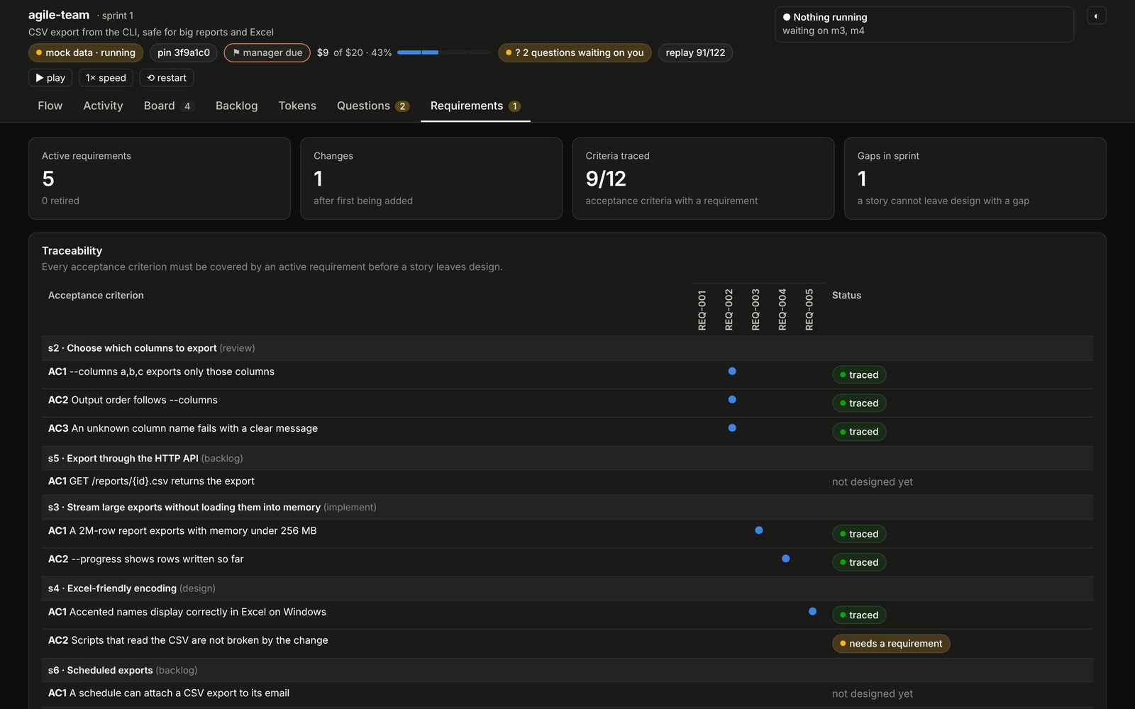
Step 3: be precise, and use your brain
LAYER 1 · STEP 3
“
The more precise you are, the less AI has to assume. And every assumption that AI makes is a chance for it to drift from the final product you actually want.
Narrator of the video
In agile-team
An assumption becomes a question, and the question reaches you instead of being guessed.
The design gate refuses to let a story leave design until every acceptance criterion is covered by a requirement file.
Critical thinking stays with you: a story created with --approved-by human records your sign-off as a git trailer.
Requirements tab: s4/AC2 “needs a requirement”, so s4 cannot leave design yet.
Notes:
Precision is checked by code, not asked for in a prompt. The human signs the story off; the trailer makes that auditable.

Slide 9
The verifier: the only lever you have
LAYER 2
“We're not building animals, we are summoning ghosts.” Yelling at a ghost does nothing. Checking it does.
“Really, the only lever you have, which most people don't even think to use, is the verification lever.”
Karpathy's framing; the narrator's conclusion
Notes:
Ghosts, not animals: statistical simulation circuits with no motivation. The robot librarian confidently makes things up when the book is missing. The posture is suspicion plus checking.

Slide 10
Why the lever works: automate what you can verify
LAYER 2
“
Traditional software automates what you can specify. LLMs and reinforcement learning automate what you can verify. If a task has an automatic reward or success signal, models can practice it.
Andrej Karpathy, Sequoia Ascent 2026
“
If Claude has a feedback loop, it will two to 3x quality of the final result.
Boris Cherny, creator of Claude Code, as quoted in the video
A
Building inspector
B
Four-eyes in a bank
C
In agile-team
The electrician never signs off their own wiring. An inspector does, against the code, with no reason to pass it.
Whoever makes a payment cannot approve it. Author and approver are different people by rule, not by habit.
Every gate is a feedback loop the model cannot skip. Authors and critics are separate roles, on different models, and the runner runs the checks itself.
Notes:
Coding gives the model feedback: tests pass or fail, programs run or crash, diffs can be inspected. The whole case for agile-team in one line: every gate is a feedback loop.

Slide 11
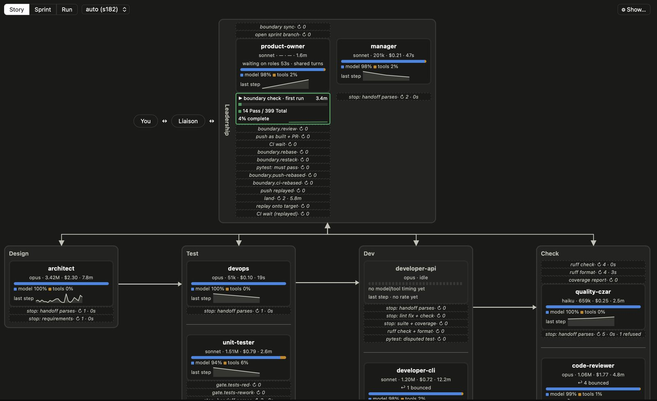
Authors and critics are different boxes
LAYER 2 · STRUCTURE
What to see
Roles run on different models: architect, devops and code-reviewer on opus; developer-cli and unit-tester on sonnet; quality-czar on haiku or a local model.
Dashed rows are the runner's own gates, not the roles': tests-red, ruff, coverage, pytest must pass, CI wait.
The counters are the confrontation: code-reviewer bounced the work 4 times; a handoff was refused.
Leadership's boundary check runs the suite itself instead of taking a role's word.
Live Story view of a real story on this repo: Leadership, Design, Test, Dev, Check.
Notes:
This is Layer 2's structure made visible. The point is that no role grades itself and no role can skip the runner's gate.

Slide 12
Steps 1 and 2: criteria up front, then an opposed critic
LAYER 2 · STEPS 1–2
“
Before Claude touches a single thing, define what good looks like with precision. A vague way to evaluate an output is ‘make this report look good’. A precise way: the report must have three sections, each ends with a recommendation.
Narrator of the video
In agile-team: every story has acceptance criteria before design starts. Then ops-review, a step that cannot be configured away, has DevOps say for each criterion how it will be checked automatically, before any test is written.
Critic | How it is set against the author
Unit-tester | Writes the tests before the code. The developer cannot edit them, only dispute one; the architect rules.
Code reviewer | “Catch bugs before the customer does.” Runs on opus; developers default to sonnet.
Customer proxy | Cannot see the source and must not try. Judges the product as a black box against the acceptance criteria.
Architect | Reviews the code against its own design in a second pass (design-review).
Manager | Takes over when the same setback repeats. At the round cap only the Manager can act.
Notes:
Karpathy goes further: a council of LLM judges, and ten Codex agents trying to break the deployed site. The critics here are roles, each on its own model, each with a reason to say no.

Slide 13
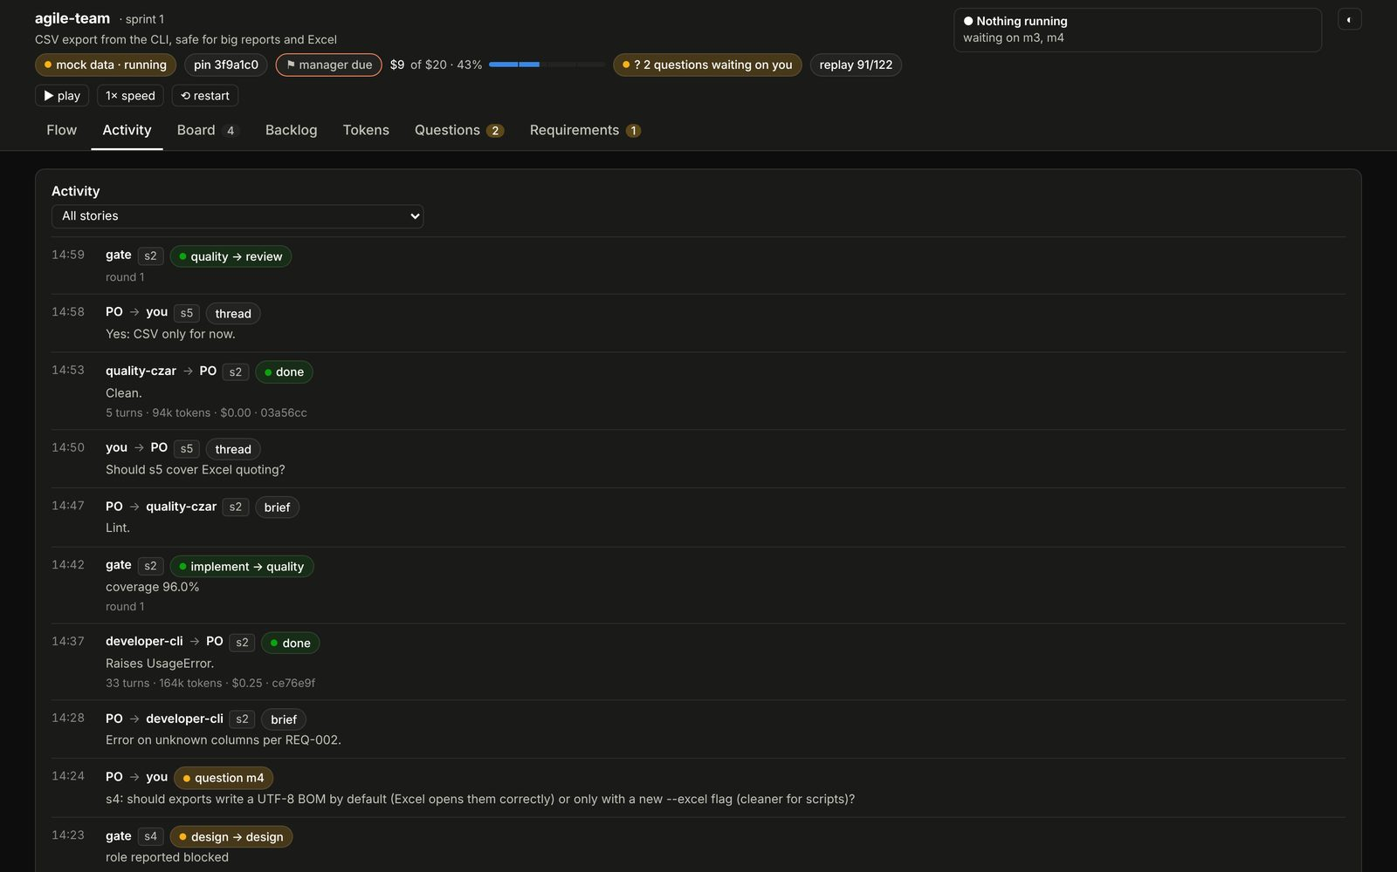
Step 3: pull external signal, never take the agent's word
LAYER 2 · STEP 3
In agile-team, the runner checks
It runs the test suite and coverage itself. A role that tries to run the full suite is refused.
A story lands only with green CI on the exact commit the runner pushed, read from GitHub by the runner.
A web acceptance environment is started and must answer before the customer proxy begins.
A mock or spec you hand the team is committed with its SHA-256; acceptance fails if anyone changed it.
Real case: a gate fix quietly removed an earlier bug fix to make three tests pass. The reviewer caught it. The customer proxy then failed an AC for lack of evidence until a real-git test was added.
Activity tab: gates (implement → quality at 96% coverage; quality → review) are the runner's, not the roles'.
Notes:
The deployment example from the video: connect the session to the system where it is deployed so it can verify. Here the equivalent is the runner reading CI from GitHub and starting the acceptance environment.

Slide 14
Red, green, refactor, each beat by a different role
LAYER 2 · TDD
1
Red
2
Green
3
Refactor
A test that fails because the behaviour is not there yet.
The unit-tester writes tests from the design before any code. New tests are red until implemented.
The least code that makes it pass.
The implement gate passes only when the suite passes and coverage meets the bar.
Clean up, with the tests as the safety net.
Quality and review steps send the story back to implement until lint, house-rules and the reviewer are satisfied; tests must stay green.
Known gap
Red is not enforced: the tests step has no gate, because a new test may already pass. A test that was never red proves less.
Notes:
The pipeline runs the three beats in order, each by a different role. Say the gap out loud: honesty about what is enforced is part of the method.

Slide 15
Agents in worktrees, humans in the checkout
LAYER 2 · GIT FLOW
1
Validator commits red
The unit-tester commits failing tests. Broken is allowed here.
Separate spaces
Agents work in git worktrees, never in the human's working tree.
Each story has its own branch and worktree; the main checkout moves only by landings.
2
Coder commits green
The developer commits the least code that makes them pass.
3
Review fixes as fixup! / amend!
Each code-review round adds a fixup! or amend! commit; nothing is rewritten yet.
Discrete checkpoints
4
Human reviews the branch
You read the full, unsquashed history: what was red, what fixed it, what review changed.
The human sees whole steps, not keystrokes: a red test commit, a green commit, review fixes.
Nothing reaches mainline until the human has reviewed and the history is squashed clean.
5
Autosquash, then land
git rebase -i --autosquash folds the fixups; a clean series lands on mainline. No merge commits.
The worktree-and-autosquash rule is a pending change to the chezmoi-managed CLAUDE.md; agile-team already runs each story in its own worktree.
Notes:
Red commits are legitimate in the agent's space. The human reviews the whole branch, then fixup! and amend! commits are autosquashed before the series lands on mainline. House rule: no merge commits; rebase before merging; Conventional Commits with scopes.

Slide 16
The environment: the workshop, the same on every machine
LAYER 3
“In Software 3.0, the context window becomes the main lever. The LLM is an interpreter over that context.”
Andrej Karpathy, Sequoia Ascent 2026. A ghost has no memory; the workshop has to be the memory, and the chat log is not it.
Notes:
Analogy: a hospital shift handover. Nurses change every 12 hours and nobody relies on what the last nurse remembers. The chart, protocols and drug cabinet are in the same place every shift. An agent changes shift every session.

Slide 17
Step 1: a proper CLAUDE.md, in git, deployed everywhere
LAYER 3 · STEP 1
“
Make this your environment. It's your world and AI is living in it. It should not feel like the other way around.
Narrator of the video
File | Holds | Reaches
~/.claude/CLAUDE.md, deployed by chezmoi from devnu11/home | chezmoi guard (never write to ~ unasked), git rules, code style, confidence tags, precedence | Every session on every machine
claude-skills/.claude/CLAUDE.md | How skills are built: process lives in code, coverage ≥ 95%, docs move with behaviour | Sessions in that repo, and every agile-team role
.team/CLAUDE.md | The team charter | Every agile-team role
What the global file asks for
Git: Conventional Commits with scopes; commit early and often; use commit --fixup, then amend to give it a useful message.
Code: SOLID and KISS; functions under 8 lines and at most 2 parameters; no boolean parameters; verb names; no code in the global scope.
Facts: tag every claim fact, certain, possible or guessing.
Notes:
Three layers of CLAUDE.md, each in git. The repo one is what the team reads; the home one never reaches the team, so the team's rules are what is committed.

Slide 18
Step 2: a knowledge base the agent can navigate
LAYER 3 · STEP 2
“
An agent incrementally compiles raw sources into a persistent Markdown wiki: summaries, entity pages, concept pages, contradictions, cross-links, logs, and evolving synthesis.
Andrej Karpathy on his LLM Wiki, Sequoia Ascent 2026
185
story files
222
requirements
In agile-team, the repo is the knowledge base
Story files, requirements (REQ-NNN.md), ADRs, reviews and acceptance reports sit in fixed folders.
Every role commit carries the role and its summary, so git log is the activity record.
A changed or retired requirement carries its reason as a git trailer; stories that trace it go back to design.
94
ADRs
Counts are agile-team's own history in the claude-skills repo: the skill built with itself.
Notes:
Your data is your moat. The point of fixed folders and trailers is that the next session finds things where the last one left them.

Slide 19
Step 3: custom skills for anything you do repeatedly
LAYER 3 · STEP 3
“
If you plan on doing something repeatedly, create a custom skill for that. Think of this like a handbook to complete a specific task. The best way to find a leak in a hose is to run water through it.
Narrator of the video
Skill | Use it when | What it enforces
agile-team | A multi-story feature; “give this to the team” | Roles, gates, worktrees, CI-on-pushed-commit, budget ceiling
house-rules | Any Python edit; runs as a PostToolUse hook | Function length, parameter count, no booleans, verb names, a baseline that only shrinks
unattended | Overnight or expensive runs | Deadline, hard stop, resume count, cost cap, idle notices
six-hats | A decision with trade-offs | One hat at a time; Yellow before Black; at least three options
routed-group-chat | Talking to several roles at once | @-routing, a decision log that is never summarised
render-markdown | Reading or printing a document | A PDF that checks itself before it counts as done
Installed on every machine by chezmoi through a git submodule pinned to a commit. agile-team builds its own runner on a pinned copy and re-pins after each green sprint.
Notes:
Run water through it: agile-team is developed by agile-team, on a pinned copy of itself, so every leak shows up in the skill's own history.

Slide 20
Step 4: rules the agent cannot bypass
LAYER 3 · STEP 4
“
You could have a rule in CLAUDE.md that says don't touch anything in this folder. That might get you 80% of the way there, but it's essentially a request, not a rule. So instead, you add a pre-tool-use hook. It's enforced at the tool level, not the prompt level.
Narrator of the video
“
A prompt states the rule and the code checks it. A rule that exists only in a prompt is a wish.
claude-skills/.claude/CLAUDE.md
✓
Always do
?
Ask first
✕
Never do
house-rules runs as a PostToolUse hook on every file Claude writes.
agile-team's Stop hook makes a role fix its lint and checks before it can finish.
chezmoi-guard.sh, a PreToolUse hook: any chezmoi apply that would write to ~ asks you, or is denied in auto mode.
agile-team asks once before its first push; only your answer cancels a story.
The role guard refuses a write outside a role's files: the PO cannot edit a story, a developer cannot edit a test.
No push ever replaces a branch's history. A budget ceiling halts the run.
Notes:
The video's three buckets, each with the hook or gate that enforces it. Depending on the cost of getting something wrong, pick the bucket.

Slide 21
The one thing: keep the understanding
“
You can outsource your thinking, but you can't outsource your understanding.
A line Karpathy quotes and keeps coming back to
Karpathy's pattern | Layer | PDCA | In agile-team
Define the context | 1 Spec, 3 Environment | Plan | Interview, story, ACs, design, requirements, ops-review
Define the tools | 3 Environment | Plan | Skills, CLAUDE.md, the repo as knowledge base
Define the feedback loop | 2 Verifier | Check | Gates, review, design-review, e2e, acceptance, CI
Define the guardrails | 3 Environment | Act | Hooks, role guard, budget ceiling
Let agents work | The pipeline | Do | Red tests, then green code, in worktrees
Preserve human understanding | This slide | Act | Questions relayed word for word; cancelling is yours alone; every decision written down
Notes:
The loop is Deming's Plan-Do-Check-Act and each story goes round it. The result is recorded in the repo, which is where the next Plan starts.

Slide 22
Where it is still loose
1
Spec ownership
2
Who writes the verifier
3
Rules that are still requests
A story can be queued with --approved-by none, with no human sign-off. Layer 1 says the human owns the spec.
Tests and acceptance evidence come from models. Gates check that evidence exists and passes, not that it is the right evidence. Opposed roles narrow the gap; they do not close it.
Confidence tags have no checker. “Interview me”, “be agile” and “verify key decisions” live only in agile-team's role files, so a plain session does not get them.
Every gap is a candidate for the next hook or gate. That is how the environment compounds.
Notes:
Say what is not enforced. The method is only honest if the gaps are on the slide too.

Slide 23
Start tomorrow
1
Put CLAUDE.md in git
Deploy it with chezmoi so every machine and every session starts from the same rules.
2
Add the hooks
house-rules as a PostToolUse hook; a PreToolUse guard for anything that must ask first.
3
Spec before code
Have the agent interview you. Split the work into stories with acceptance criteria.
4
Separate author and critic
Tests written before the code by a different role; a reviewer on a different model.
5
Work in worktrees
Agents on branches and worktrees; you review the whole history; autosquash before mainline.
6
Hand big work to the team
agile-team for multi-story features; unattended for overnight runs; six-hats for the decisions.
Notes:
Six moves, in the order that pays back fastest. The first two take an afternoon.

Slide 24
Sources
Source | Used for
“The Karpathy method” explainer video (youtu.be/7zZy1QTvokM), with interview clips of Andrej Karpathy | The three layers, their steps, the narrator's quotes, the workshop and robot-librarian analogies
Andrej Karpathy, Sequoia Ascent 2026 fireside chat: summary and edited transcript (karpathy.bearblog.dev/sequoia-ascent-2026) | Floor and ceiling, jaggedness, automate what you can verify, Software 3.0, LLM Wiki, the agentic engineer's list
devnu11/claude-skills: agile-team, house-rules, unattended, six-hats, routed-group-chat, render-markdown; docs/spec-driven-method | Every claim about what the skills enforce; the dashboard screenshots
devnu11/home: private_dot_claude/CLAUDE.md, hooks/chezmoi-guard.sh, the exact_skills submodule | The global CLAUDE.md rules, the guard hook, how skills are deployed
Notes:
Quotes from the video are word for word from its transcript, names corrected. Quotes from the Sequoia post are from the text Karpathy published.

