Slide 1
A Retro-Style Game Development Using Processing
Simplified doom project proposal
By Arnav Mehta, Teny Zhang
March 24, 2025

Slide 2
Introduction and background of the project
Project Overview
March 24, 2025

Slide 3
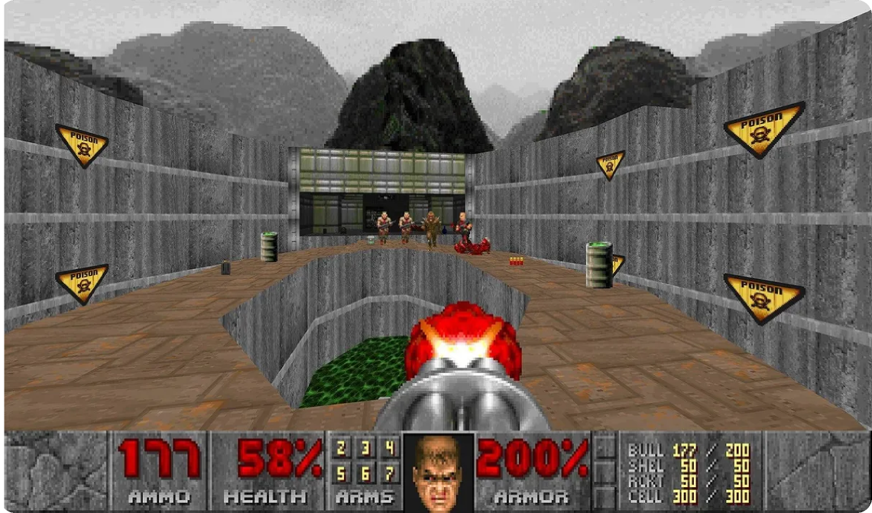
Project Theme
Creating a simplified version of Doom using Processing.
Focus on rendering 3D visuals and basic game mechanics.
Aim to develop a retro-style game with engaging gameplay.
Explore player movement, enemy interactions, and shooting system.

Slide 4
IMPORTANT INSIGHT
Doom is an iconic first-person shooter game from the 1990s.
Significant role in the history of game development.
Project helps understand fundamentals of 3D visual effects.
Background and Significance
March 24, 2025

Slide 5
Design Approaches
March 24, 2025

Slide 6

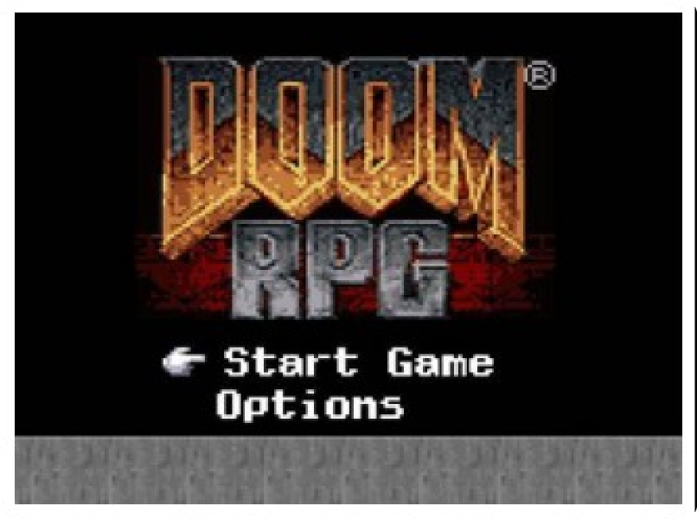
Start interface with simple functions like start and exit.
Displays player's health, armor, weapons, ammo, and score.
Design 1 Approach
March 24, 2025

Slide 7

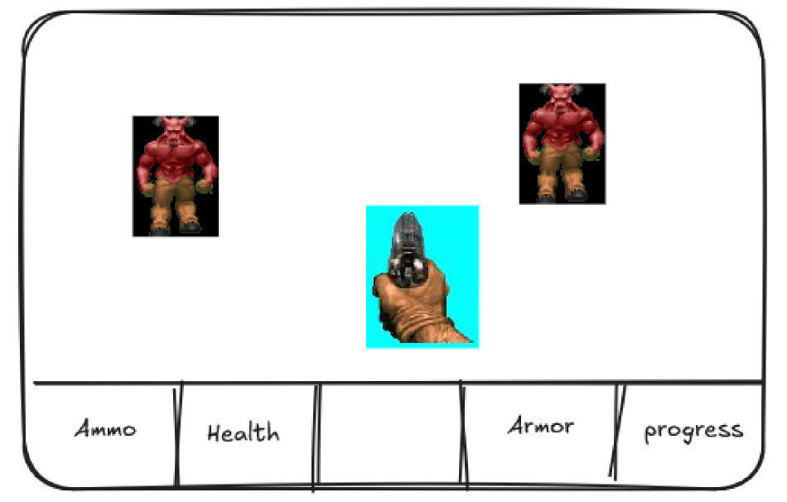
Real-time action as the gun is fired using mouse click.
Player's movement and rotation controlled through keyboard input.
Design 1 Approach
March 24, 2025

Slide 8
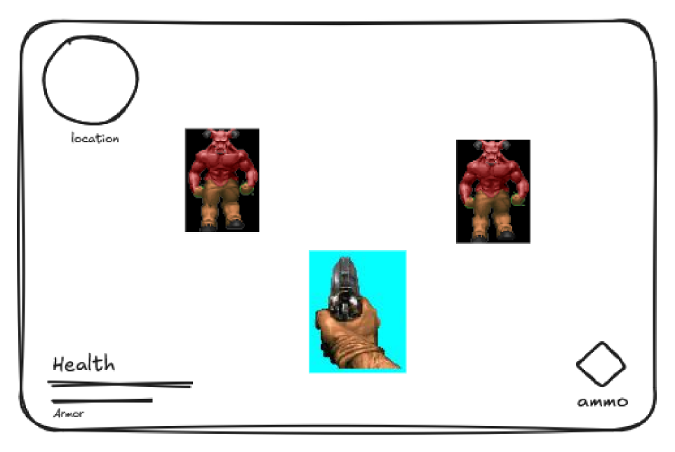
Design 2 Approach
Start interface with simple functions like start and exit.
Displays player's health, armor, weapons, ammo, and score.
Real-time action as the gun is fired using mouse click.
Player's movement and rotation controlled through keyboard input.

Slide 9
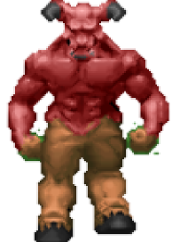

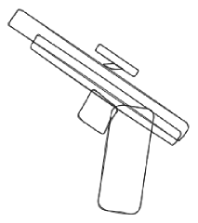
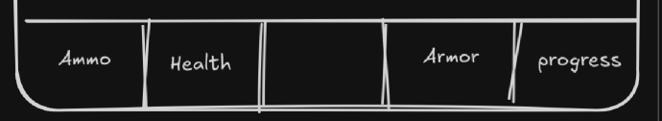
Common Features
Both designs include a start interface.
Display essential player stats: health, armor, weapons, ammo, and score.
Real-time shooting action with mouse click.
Keyboard controls for player movement and rotation.
Enemy
Gun
HUD

Slide 10
Open floor for questions and discussions
Questions?
March 24, 2025

Slide 11
admin@retrogames.cz, M. (n.d.). Doom (DOS) - online game. RetroGames.cz. https://www.retrogames.cz/play_414-DOS.php
Doom + doom II on steam. Welcome to Steam. (n.d.). https://store.steampowered.com/agecheck/app/2280/
REFERENCE
TEAM NAME
TODAY’S DATE

